Slide 1

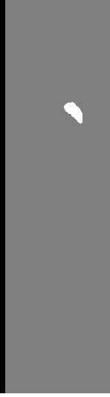

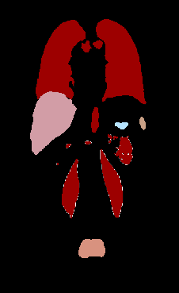
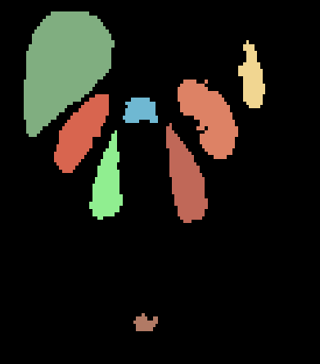
Separated segmentations in /Segmentations
1 label per file
Original size
Combined segmentations in /Combined_segmentations
Contains all labels
Original size
Output of PrepareData
Contains only 8 labels
Size: (120,120,120)
/Labels
Original Size
All labels
All patients
/Volume
Original Size
FilterPatientsByLabel
Remove patients without required labels
/Segmentations
Manual search
Segmentation
Original Size
Required labels
Most patients
GetCorrespiondingVolumes
Select volumes needed
/mrt1
CombineSegmentations
Volumes
Original Size
Most patients
Global data flowchart
/Combined_segmentations
NormalizePixDimensions
NormalizePixDimensions
Manual selection
Segmentations
Pixel dimension:(1,1,1)
Window size: full
Volumes
Pixel dimension:(1,1,1)
Window size: full
/torso
/full_body
ExtractKeypoints
Extract keypoints from all images
PrepareDataForVnetInput
/Volumes
GetCropsize
From reference patient get minimum window size (+10%) to include all desired segmentations
Window Size W
3D sift keypoints
Pixel dimension:(1,1,1)
Window size: full
/vnet_input
PrepareDataForVnetInput flowchart
CalculateScalingMatrix
To go from size W to (120,120,120)
Scaling Matrix
S
FilterKeypoints
Filter keypoints from reference patients to only keep keypoints on desired organs
TransformLabelImage
Transform all images except ref image using T
TransformVolumeImage
Transform all images except ref image using T
Reference Keypoints
Labels
Pixel dimension:(1,1,1)
Window translated and rotated
Volumes
Pixel dimension:(1,1,1)
Window translated and rotated
calculateTransformationMatrix
Using featMatchMultiple calculate a transformation matrix T between the reference keypoints and keypoints from other images
ExtractAndScaleWindow
Extract window W and scale it using S
ExtractAndScaleWindow
Extract window W and scale it using S
Transformation matrices T
Segmentations
Window size: (120,120,120)
Labels:[0,38,120,3087…]
Volumes
Window size: (120,120,120)
StandardizeLabels
Segmentations
Window size: (120,120,120)
Labels:[0,1,2,3…]

