Slide 1
Recorder Hero!
6.111 Final Project
Paul Hemberger, Andres Romero

Slide 2

Source:
http://www.hightech-edge.com/guitar-hero-3-legends-of-rock-xbox-games/1468/

Slide 3

Source: http://www.vgcats.com/comics/?strip_id=230

Slide 4
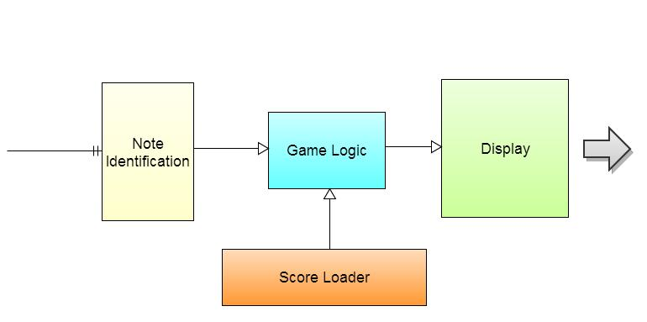
Technical Overview
Note Identification
Game State Machine
Video
Musical Score

Slide 5
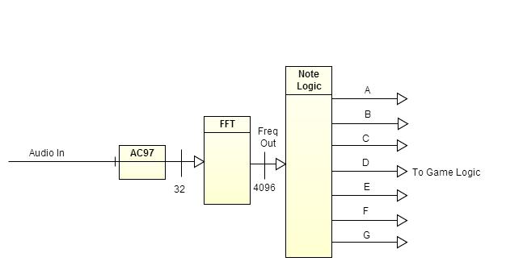
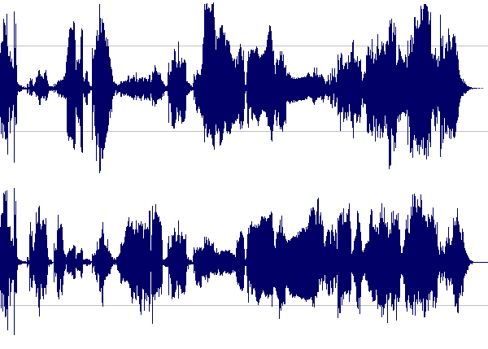
Note Identification
{ A, B, C, D, E, F, G }
Source: http://www.marinbezhanov.com/img/waveform_eggs.gif

Slide 6
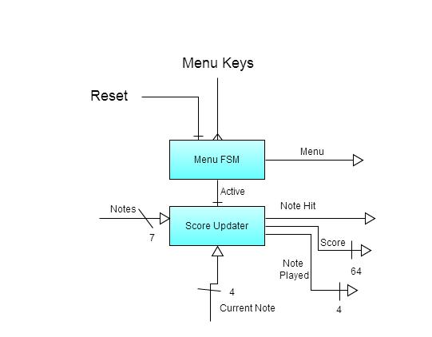
Game State Machine

Slide 7
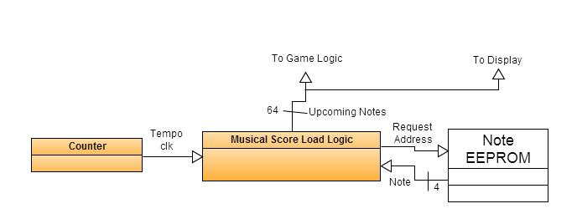
(Musical) Score Loader
♫♬♬♩
64’h39952155…

Slide 8
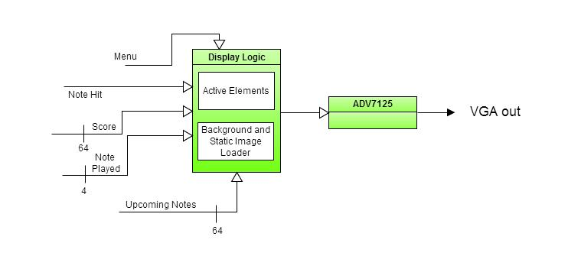
Display

Slide 9
SCORE: 54013
PITCH: C
C
B
A
G
F
E
D
C

Slide 10
Timeline
Week | Paul Hemberger | Andres Romero
11/12 | Game Display | FFT
11/19 | Score Loading | Full Note Identification
11/26 | Menu Display | Game Logic
12/3 | Polish & Integration

