Slide 1
Control/Learning Architectures For Use in Robots Operating in Unstructured Environments
October 2, 2000
Patrick McDowell
S.S. Iyengar
Marlin Gendron
Brian Bourgeois
John Sample

Slide 2
Introduction
The work presented in this paper originated from the LSU Robo-Tiger project.
The idea was conceived by Dr. S.S. Iyengar and Dr. Lynn Jelinski late in the fall semester of 1999.
The goal was to build a robotic tiger that would provide a research platform for mobile robots in unstructured environments, and catch the imagination of the students and faculty.
We present some of the issues and results from the small prototype phase of the project.

Slide 3
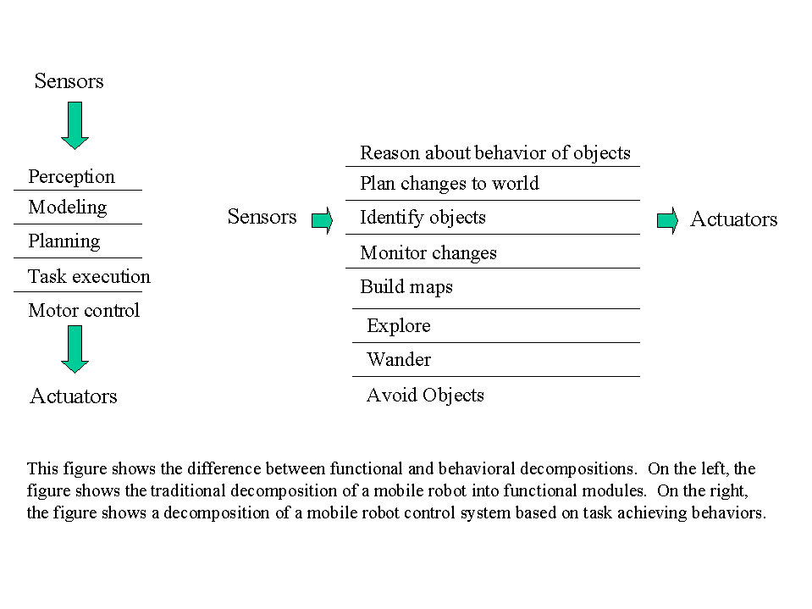
Data/Control flow in Subsumption vs. Classical AI

Slide 4
Learning Using Subsumption
Learning under the Subsumption Architecture is primarily a matter of conflict resolution among the various behaviors, that is, deciding which behaviors should be active at any particular instance in time.
  Behavior conflicts were resolved by the developers at compile time [Brooks, 1986] or by using a description of the desired behavior selection [Rosenschein & Kaebling, 1986]. In both cases, the behavior hierarchy is static.
  Maes [1990] describes an algorithm which allows a behavior based robot to learn based on positive and negative feedback, thus eliminating the need for the programmer to solve the problem ahead of time.

Slide 5
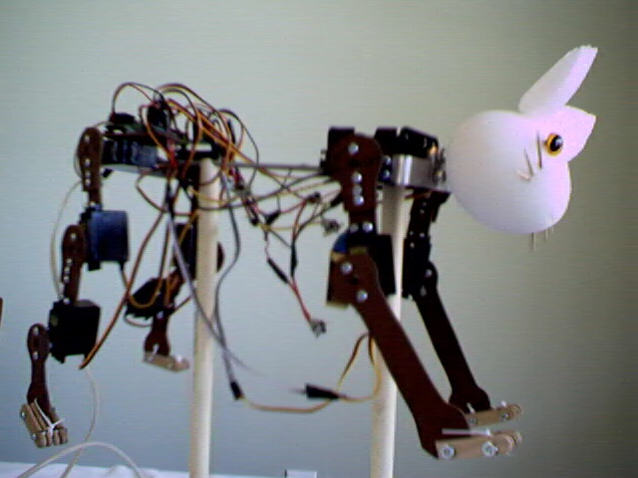
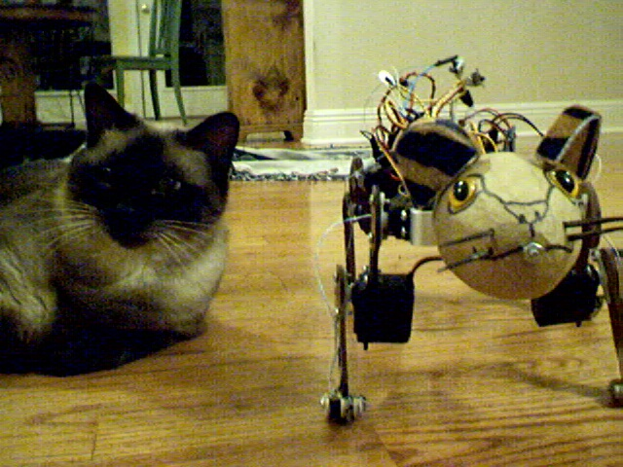
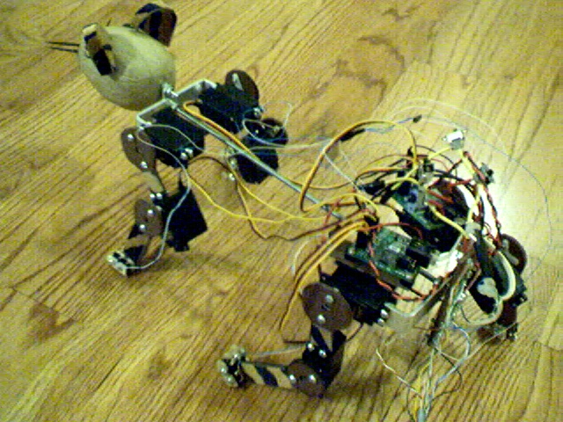
In Figure 1, notice that the body proportions of
Mickey are similar to that of a cat. Figure 2
shows that Stubby is cat size, but in Figure 3 it’s
simplified joint structure is apparent.
Figure 1. Mickey on the test stand.
Figure 2. Mitzy on left, Stubby on the right.
Figure 3. Top view of Stubby.

Slide 6
Hardware and Software (Cont.)
3 layers of software.
  Gait level.
  Command generation level.
  Device level.

Slide 7
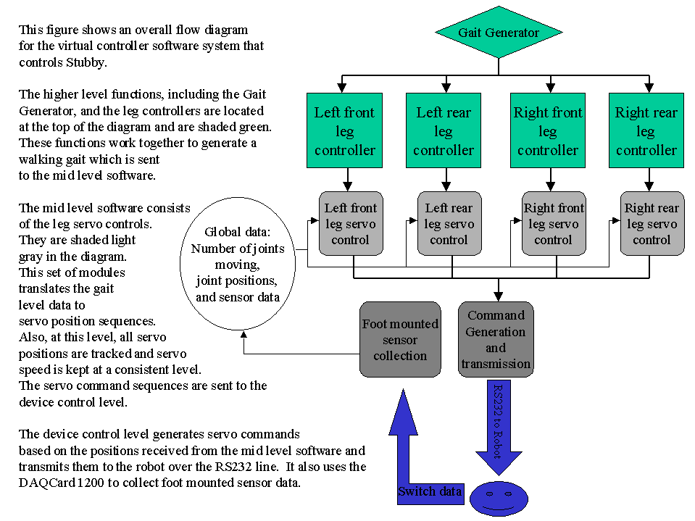
Hardware and Software (cont.)
System Overview

Slide 8
Gait level control algorithm development.
Movie Frame method.
  The first and most basic is the Movie Frame method.
  A series of “snapshots” of the joint positions during walking are created.
  Paradox. In order to take the snapshots, the robot first has to walk.
  By observing cats and using a servo control program the frames were estimated and recorded. Then they were played back into the robot in a loop.
  The typical number of frames for the loop was 8 frames.
  Results? Less than stellar. At few staggering steps forward, but proved that the robot could physically do it.

Slide 9
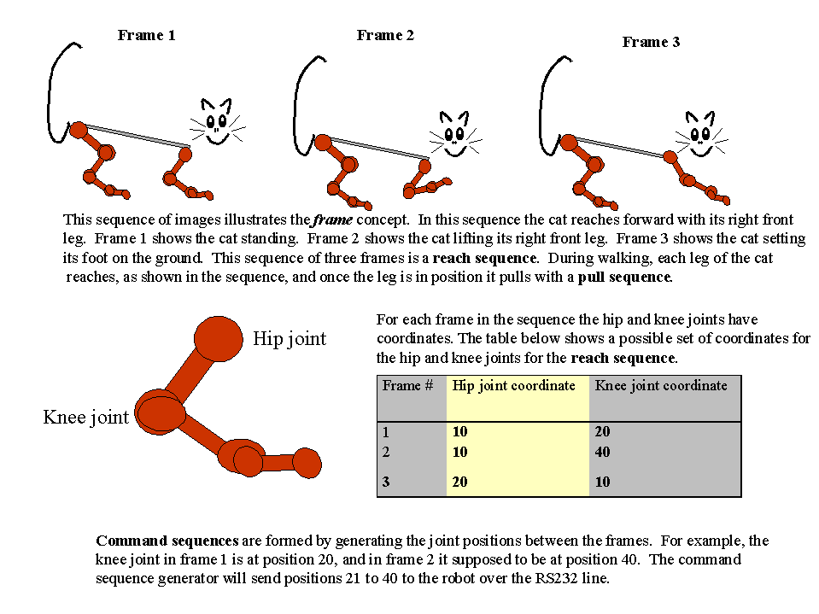
Movie Frame Method

Slide 10
Genetic Algorithm Method
Used to refine the best Movie Frame walking sequence.
Since the robot is a mechanical entity, the population size and number of generations were kept low by genetic algorithm standards.
A typical population size would be 5, and during run, 50 generations would be the outer limit.
The fitness function was distance walked by the robot in 16 steps, measured by a yardstick.
Each frame was a chromosome, crossover and mutation were implemented, as was sexual reproduction.

Slide 11
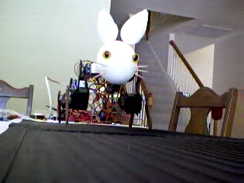
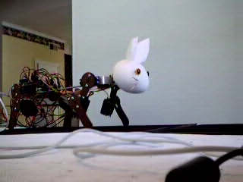
Walking Ugly
Figure 1. Stubby goes for a walk while
the genetic algorithm is being run.
Figure 2. Stubby struggles forward during
a testing session.

Slide 12
Virtual Controller Method
Given a stable robot and acceptable leg reach and leg pull movements, the walking problem boils down to one of timing.
That is, for the robot to walk, each leg has to reach and pull at the appropriate time.
This idea is fundamentally different from the frame approach in that each leg has its own state, rather than the whole robot has its state.
  A virtual controller per leg, implemented in LabView, is controlled by a gait generator.
  Each virtual controller has a “reach” and “pull” subsection.
  The controllers run asynchronously, each one sending its leg position commands to the robot over a common RS 232 line.

Slide 13
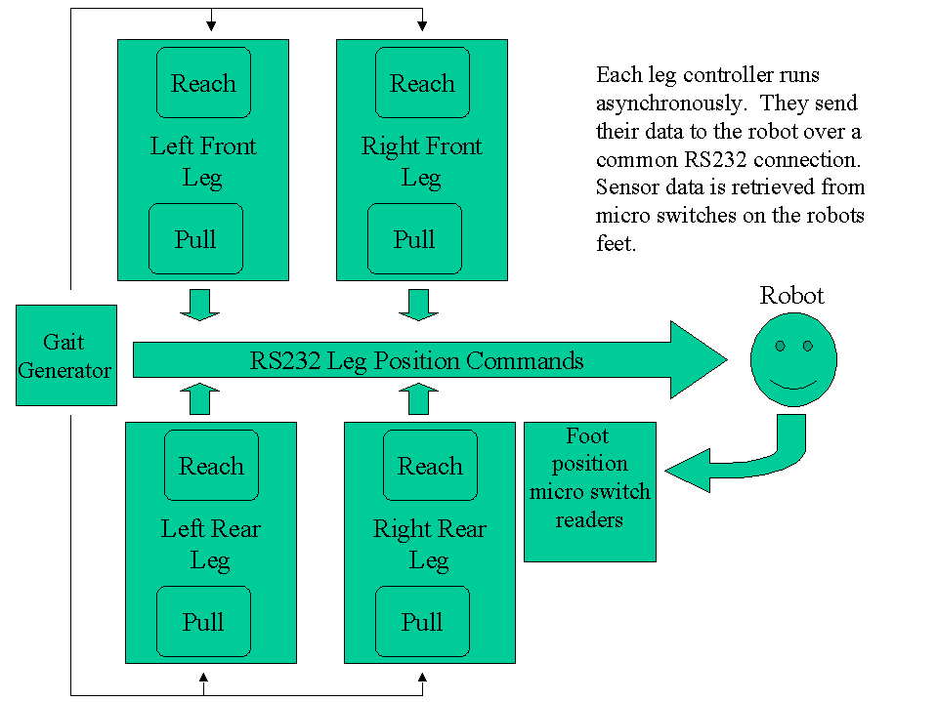
Virtual Controller Method (Cont.)
Figure 1. This figure shows a block diagram of the virtual controller system used to control Stubby. Since it is an
asynchronous system, each of the processes (represented by the square boxes) is running independent of the others.
The gait generator signals when the leg processes start. The leg processes signal the gait generator when they complete.
The sensor reading process makes current micro switch data available to any processes in which it is required.
It is implemented in LabView.

Slide 14
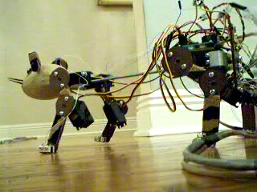
Virtual Controller Method (Cont.)
  Results? Much smoother and more efficient.
  Surface dependent. A slippery surface, like a wood floor, helps mask errors.
  Timing between steps, and the timing between the frames that the steps (movie frames) are made of influence gait effectiveness.
  MIT’s virtual biped gaits tested. Trotting and galloping successful.
Figure 1. One of the first successful walks.

Slide 15
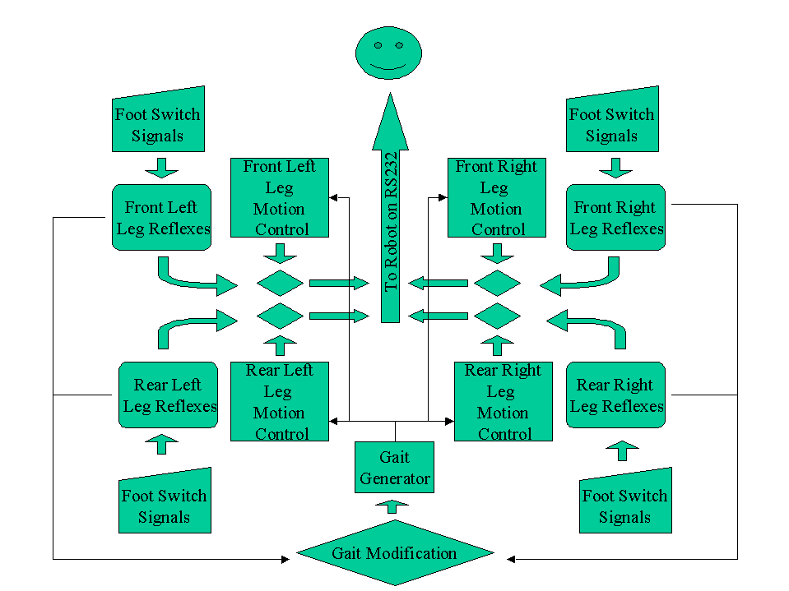
Continuing Development
    Figure 9. This diagram shows the interaction of the reflexive actions and the leg motion controls. Reflexive
    actions will take priority over the leg motion controls. Initially, Gait adjustment will be implemented at the
    Gait Generator Level, as shown, but will later be at the leg motion control level.

Slide 16
Summary
Mobile robotics is an interesting and challenging discipline.
The LSU robotic tiger project has provided a platform from which to research, explore and integrate the various technologies that will be used in creating truly useful machines that will be able to operate autonomously in unstructured environments.
The work that we have done so far has benefited from work done by many researchers, notably those at MIT and McGill University.
The work we planned for the near term will focus on improving performance by adding reflexive behaviors, gait optimization, and situational memories based on reflexive action driven associative memories.

Slide 17
Outline
Background - Schools doing similar work, discussion some of their ideas and results.
  MIT’s AI Lab and Subsumption Architecture.
  Learning under Subsumpiton.
  MIT’s Leg Lab and the “virtual biped”.
  McGill University and their four legged small robots.
Hardware and Software Design the third prototype, “Stubby”.
  Basic electrical and mechanical design of Stubby.
  Differences between Stubby and robots from MIT and McGill.

Slide 18
Outline (Cont.)
System Overview
Gait level control algorithm development
  Movie Frame method
  Genetic Algorithm method
  Virtual Controller method
Continuing Development
  Reflexive actions.
  Gait adjustment based on reflexive actions.
  Gait recall using associative memory.
Summary

Slide 19
Background
MIT’s AI Lab and Dr. Rodney Brooks have developed a mobile robot control paradigm called Subsumption Architecture.
  It can be described as a hierarchical, asynchronous, distributed system whose components produce behaviors. The combination of the behaviors produce functionality.
  Sensor input and actuator actions are closely coupled.
  The behavioral components are set up in hierarchy of layers, in which higher behaviors can inhibit or subsume lower behaviors, thus the name Subsumption Architecture.

Slide 20
Background (Cont.)
  This technique was used to program “Genghis” a six legged robot. It was able to learn the tripod gait, using swing forward behaviors for each leg, negative feedback when it fell, and positive feedback when it moved forward.
  This is not a trivial task, neither the negative nor the positive feedback is associated with any single behavior, but with the coordinating of the behaviors in a distributed system.

Slide 21
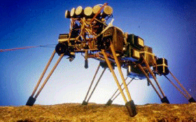
  Figure 2. Front view of the MIT AI Lab’s Genghis robot.
  It is a six-legged walking robot with two degrees of freedom per leg.

Slide 22
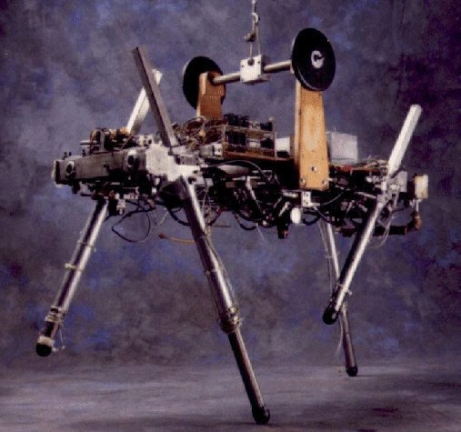
Background (Cont.)
MIT’s Leg Lab has developed several hopping, walking, and running robots.
  The Leg Lab has been able to generalize multi-leg walking from a “virtual biped” system.
  The Quadraped (1984 - 1987) demonstrated that two legged running algorithms could be generalized to allow four legged running.

Slide 23
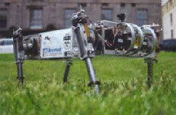
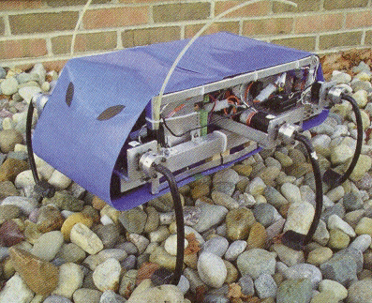
Background (Cont.)
McGill University built a series of small four and six legged robots with emphasis on simplicity of design and naturalness of operation.
  Radio Control components and off the shelf components used.
  Designs based on the belief that walking and biological is carried by simple and natural principles embedded in complex biological systems.
  Scout II and Rhex, both capable machines.

Slide 24
The Leg Lab has been able to generalize multi-leg walking
into a “virtual biped” system. That is groups of legs are
collected together and carry out the function of the right leg
or left leg of a biped. In Figure 1, the robot has all four
feet in contact with the ground, it is standing. The trotting gait,
see Figure 2., for a four-legged robot pairs the front left leg
with the rear right and the front right with the rear left. For
galloping, see Figure 3., the front legs are a pair and the
rear legs are the other pair. Figure 4., shows pacing, the
left side legs are paired and the right side legs are paired.
Figure 1. Standing
Figure 3. Galloping
Figure 2. Trotting
Figure 4. Pacing

Slide 25
Hardware and Software Design of the third prototype Stubby
First prototype one was unpowered, it was used for developing construction and material knowledge.
Second prototype, “Mickey” was proportioned like a house cat, but was underpowered and statically and dynamically unstable.
Stubby is about the size and weight of a house cat but its limbs are shorter and are the in the front and back. This decreases the torque demand on the motors, and increases stability, and reduces control complexity, but looks less like a cat.

Slide 26
Hardware and Software(Cont.)
The major difference between our prototypes and those of McGill and MIT is the joint structure. Our joints fold in a single plane, theirs usually are telescoping, (Quadraped, Scout II) or pantograph (Genghis).
  The other methods are effective, but Stubby was trying to emulate a cat, or a tiger.
Standard RC servos are used for locomotion. They are controlled by two Scott Edwards Electronics, Inc., Mini SSC II boards linked to the serial port of a laptop computer. Inputs from the foot sensors are collected by a National Instruments DAQCard-1200 card.

Slide 27
Hardware and Software (Cont.)
Originally the control software was written in C.
Recent revisions have used National Instruments LabView.
  Provides simple GUI support.
  Easy device interfacing for sending servo commands.
  Easy device interfacing for collecting data from foot mounted micro-switches.
  Multi-threading is natural for LabView.

Slide 28
Hardware and Software (Cont.)
Input: popSize: int; Population size
NumGens: int; Number of generations
Sequence: array of frames; A frame sequence from the Movie Frame method.
MuFact: float; The mutation factor.
Output: newSeq array of frame; Genetically improved set of frames.
Sequence of commands to RS232 port
Function Grow(popSize, NumGens, Sequence, MuFact, newSeq)
{
Population = CreatePopulation(Sequence, MuFact)
For (1 to NumGens) {
For ( Each member of Population) {
Move Robot to starting position.
Execute walking sequence
Measure and record distance traveled.
} /* End For. */
Rank Population based on distanced traveled.
Select two highest ranked members of Population (Mom, Pop).
Store Mom and Pop on Disk in case of restart.
BreedPopulation(Mom, Pop, MuFact)
} /* End For. */
}/* End Grow */

Slide 29
Hardware and Software (Cont.)
    Resutlts? Crude but worked. Nearly doubled walking distance in 16 steps after about 200 generations.
    Although the distance improved, the ranking function did not force any smoothness, Stubby walked but walked ugly.
    Several more generations would be needed to get good smooth walking.

Slide 30
Continuing Development
Reflexive actions.
  Toe stubbing is one of the largest problems for Stubby. A “dodge the floor” behavior would alleviate backward pushes created by toe stubbing.
  A “Find the floor” behavior would increase leg thrust efficiency.
  Prototype foot with micro-switches to detect stubbing or foot down conditions has been built.
Gait adjustment
  Reflexive actions are the result of gait errors. When reflexive actions become frequent, a gait altering behavior should optimize the gait until frequency of the reflexive actions decreases.

Slide 31
Continuing Development (Cont.)
Gait recall
  Consider the following example.
    A person is walking blindfolded through a parking lot and then into a field of thick tall grass. Upon the transition, the person would naturally start picking up their feet a little higher. The first few steps may be a surprise, but after that it would become routine and they would not be surprised again, until the walking surface changed again.

Slide 32
Continuing Development (Cont.)
Gait Recall
  Transition between surfaces should cause a somewhat distinct reflex generation pattern.
  Reflex pattern is used as a key to associative memory holding the appropriate gait.
  After new gait is being used reflexive action should drop off; if not the gait optimization process will begin using the new gait as starting point.

Slide 33
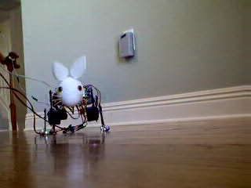
Walking with sensor equipped feet.
Figure 1. Stubby goes for a walk, weight of control cord
slows down the robot towards the end.

