Slide 1
ONLINE SHOES STORE
Web Application
Web Application Development Project (MERN Stack)
Pham Minh Thuc — ITITWE23033
Nguyen Huynh Dang Khoa — ITITWE22152
Vietnam National University HCMC — International University
Notes:
Speaker A (Minh Thuc):
Good morning/afternoon everyone. We are Minh Thuc and Dang Khoa. Today we will present our Online Shoes Store web application.
Speaker B (Dang Khoa):
After the overview, we will demonstrate key user flows and the admin management features.

Slide 2
Agenda
Project overview & objectives
Technology stack & system architecture
Requirement analysis (Use Case Diagram)
Database design (ERD)
Implementation highlights (User & Admin modules)
Testing + demo scenario
Conclusion & future improvements
Notes:
Speaker A (Minh Thuc):
I will start with the overview, tech stack, architecture, and design diagrams.
Speaker B (Dang Khoa):
Then I will cover implementation highlights, demo plan, and conclude with future work.

Slide 3
Add to Cart
Project Overview
An e-commerce web app for buying shoes online.
Two main user groups
  Customers: browse, add to cart, checkout, track orders
  Admins: manage users, products, and orders
Core goals
  Usable shopping flow
  Secure authentication & role-based access
  Maintainable full-stack structure
Browse ProductsBrowser
(React)
Add to Cart
(Node + Express)
Checkout
(MongoDB) Checkout
Track Orders
(images)
Notes:
Speaker A (Minh Thuc):
This project provides a complete online shopping experience: account creation, product browsing, cart management, checkout, and order history.
Speaker B (Dang Khoa):
On the right is the high-level architecture: React client calls Express APIs, data is stored in MongoDB, and product images are stored in Cloudinary.

Slide 4
Technology Stack & Key Libraries
MERN Stack
  MongoDB for data storage (users, products, carts, orders)
  Express.js + Node.js for RESTful APIs
  React.js for UI and routing
Supporting tools
  Tailwind CSS for responsive styling
  Cloudinary for product image hosting
  JWT for authentication and authorization
Notes:
Speaker A (Minh Thuc):
We used the MERN stack. MongoDB stores the main collections, Express and Node expose RESTful endpoints, and React renders the UI as a single-page application.
Speaker B (Dang Khoa):
For UI we used Tailwind. For images we used Cloudinary. For security, we used JWT tokens and protected routes for admin-only pages.

Slide 5
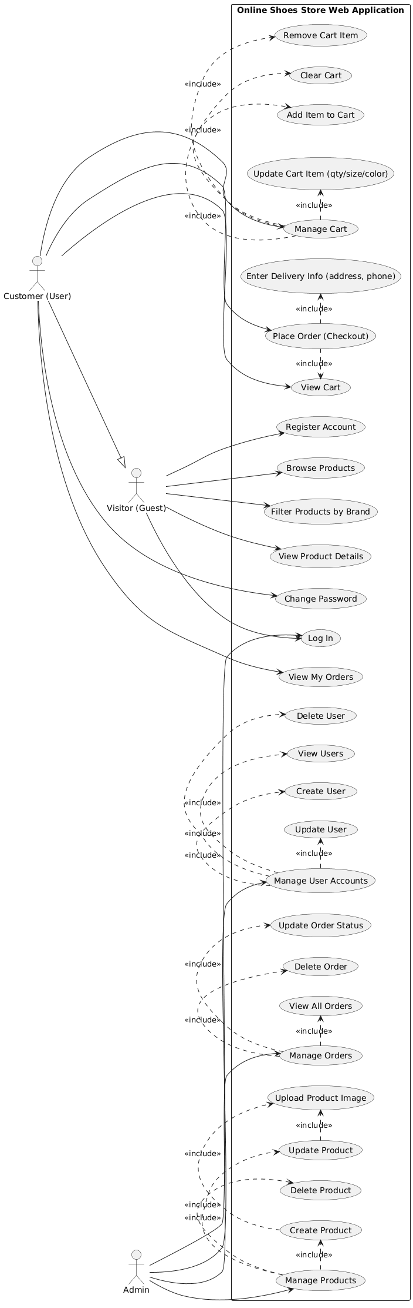
Requirement Analysis: Use Case Diagram
Actors and major system functions
Figure: Use Case Diagram of the Online Shoes Store Web Application
Notes:
Speaker A (Minh Thuc):
This diagram shows three actors: Visitor (Guest), Customer (logged-in user), and Admin. Guests can browse products, filter by brand, view details, register, and log in. Customers can additionally manage the cart, checkout, view their orders, and change password. Admins manage users, products, and orders.
Speaker B (Dang Khoa):
Notice the <<include>> relationships: 'Manage Cart' includes add/update/remove/clear; and 'Place Order' includes viewing the cart and entering delivery info. Admin management is also decomposed into create/update/delete sub-actions.

Slide 6
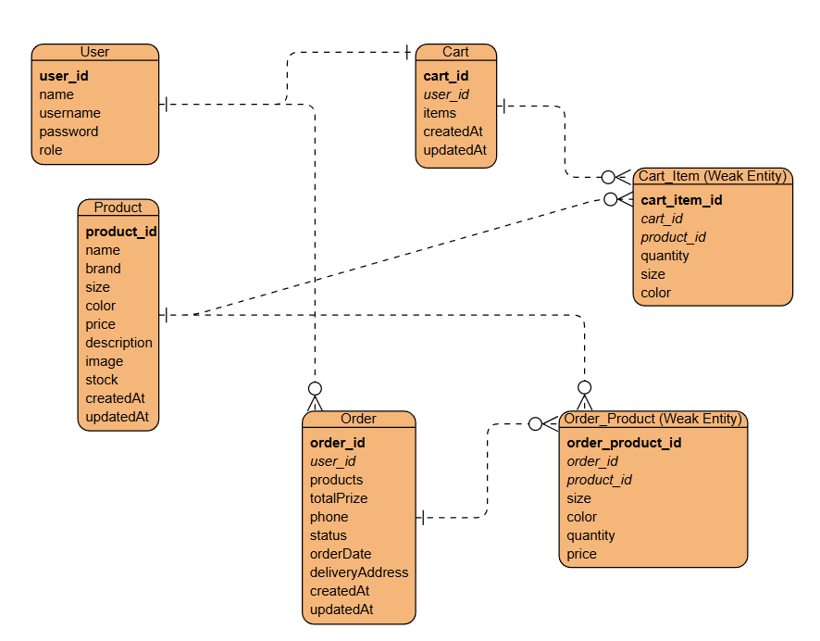
Database Design: ERD
Main entities and relationships
Figure: ERD / Data model (User, Product, Cart, Order and their line-item entities)
Notes:
Speaker A (Minh Thuc):
Our database focuses on four core collections: User, Product, Cart, and Order. Cart and Order each have line-item structures to store multiple products with options like size and color.
Speaker B (Dang Khoa):
This design separates master data (User, Product) from transaction data (Cart/Order). It supports many items per cart/order while keeping queries straightforward.

Slide 7
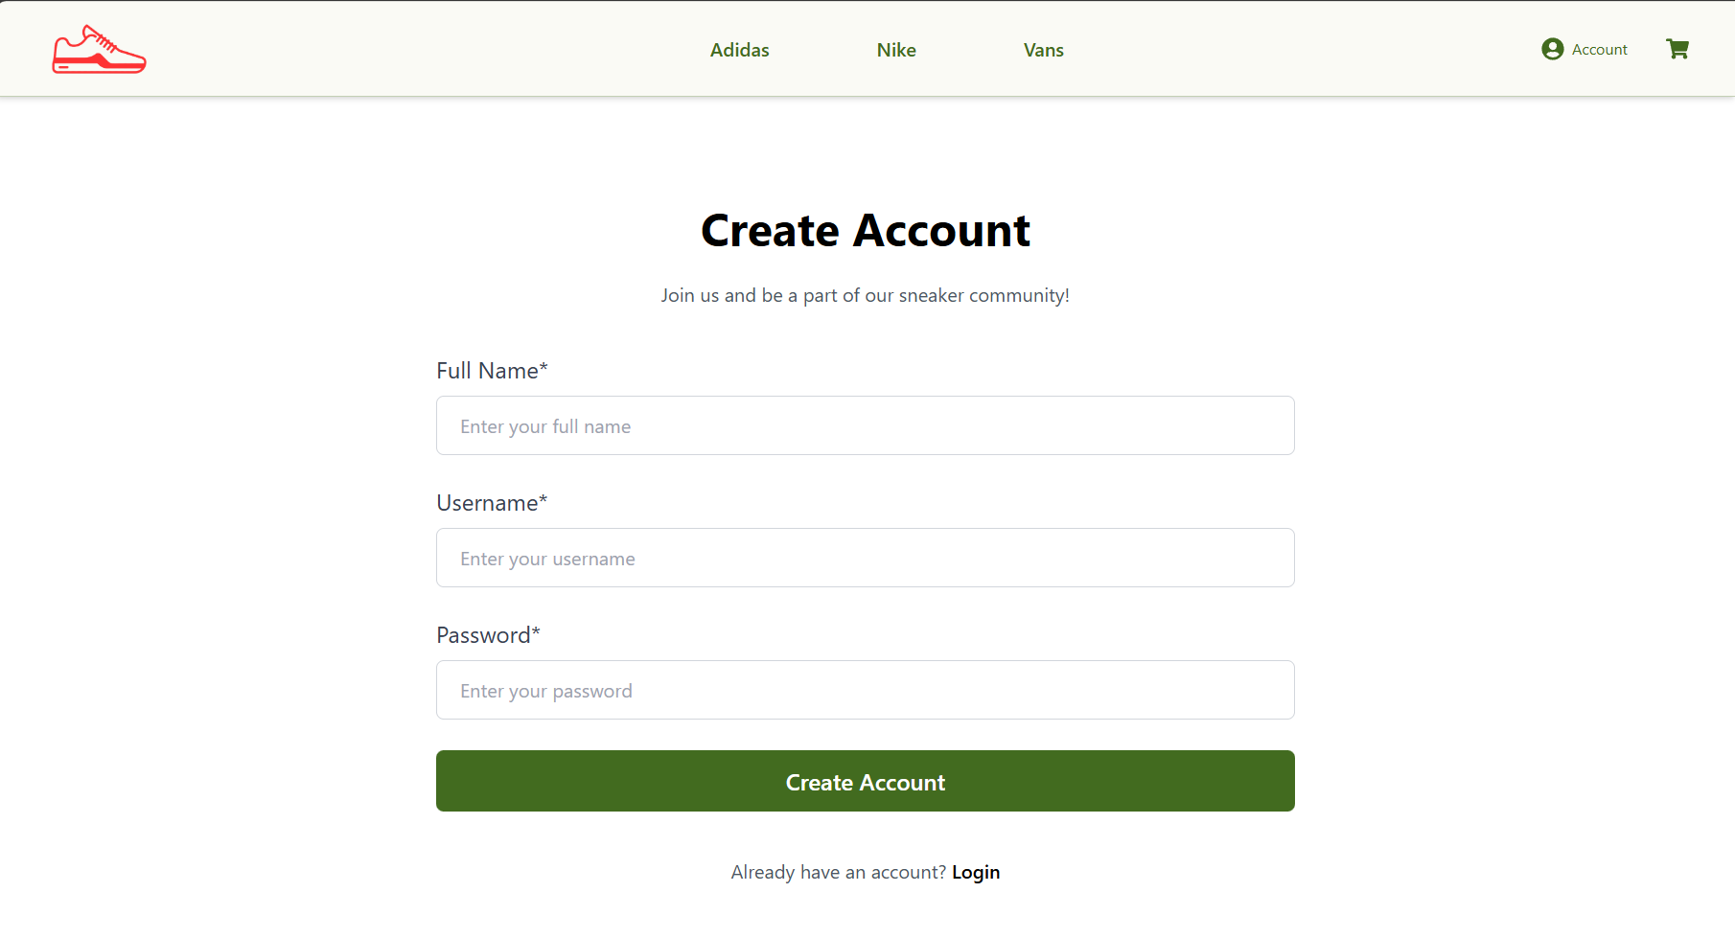
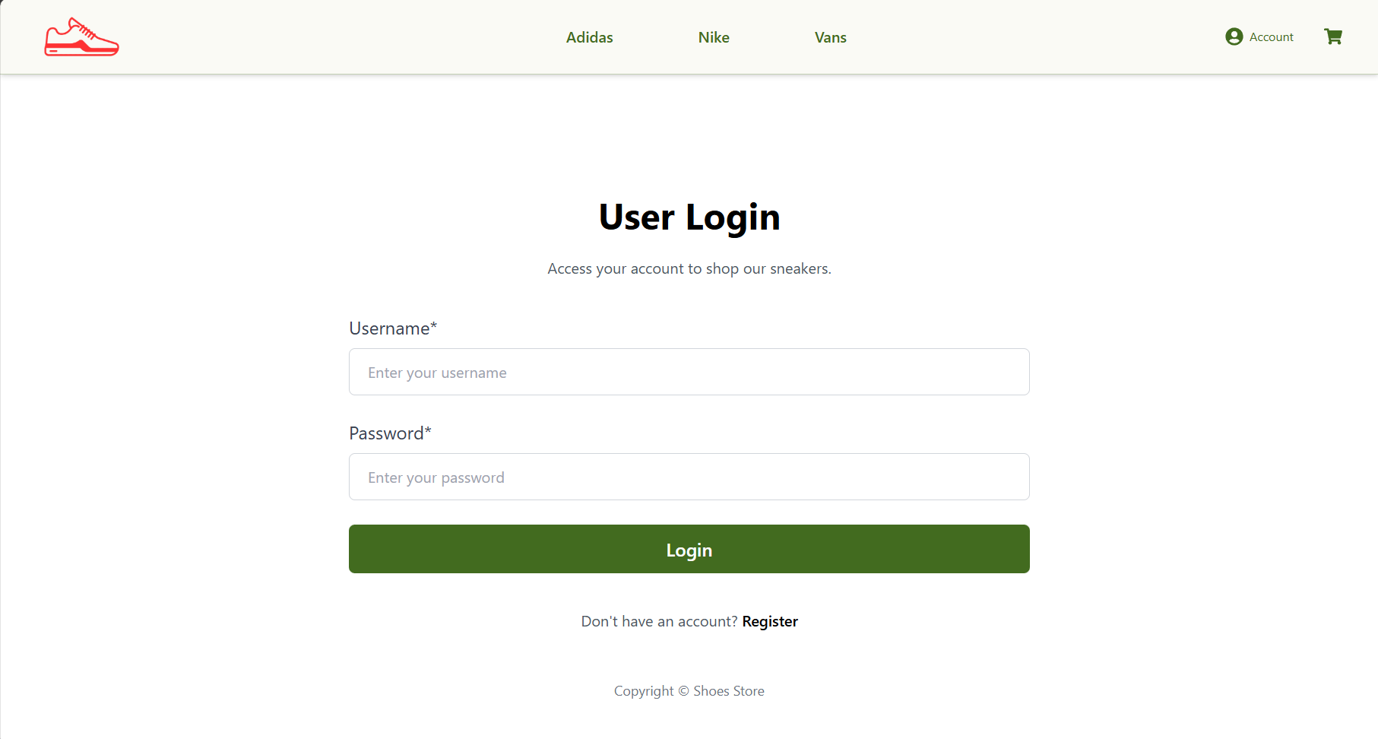
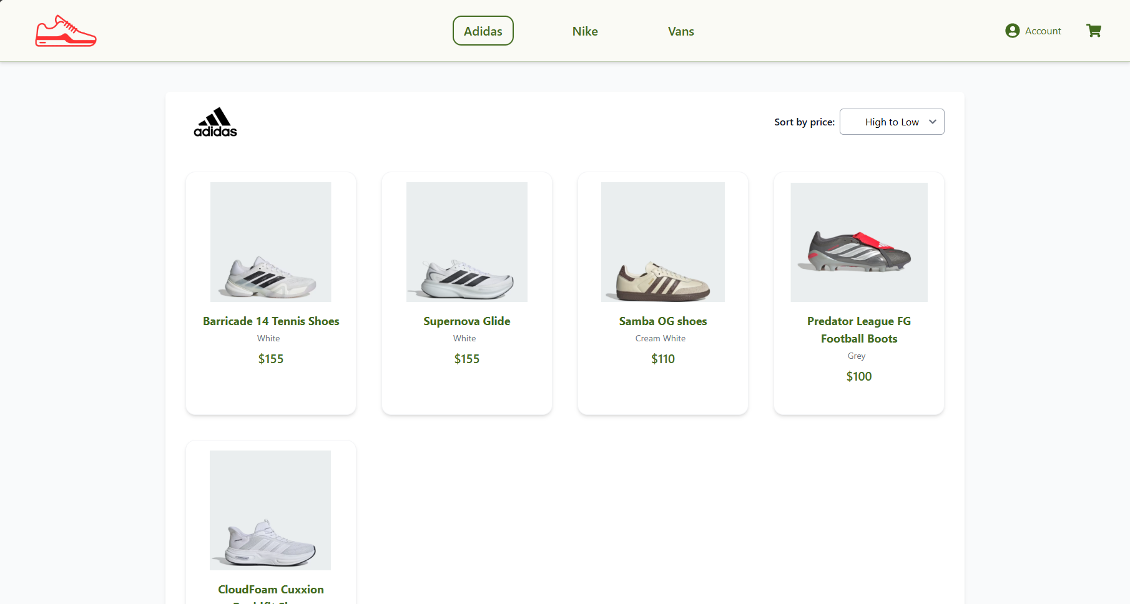
User Module: Authentication & Browsing
Register a new account and log in securely (JWT).
Browse products by brand (Adidas / Nike / Vans).
View detailed product information before buying.
Register / Login / Brand browsing (screenshots)
Notes:
Speaker A (Minh Thuc):
On the left are the main user functions: authentication and product browsing. After registration, the user logs in and receives a JWT token for secured requests.
Speaker B (Dang Khoa):
On the right are screenshots: register page, login page, and a brand page showing filtered products.

Slide 8
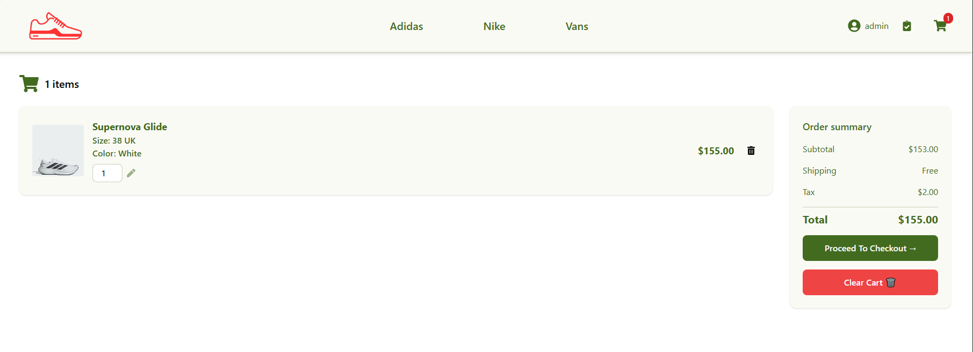
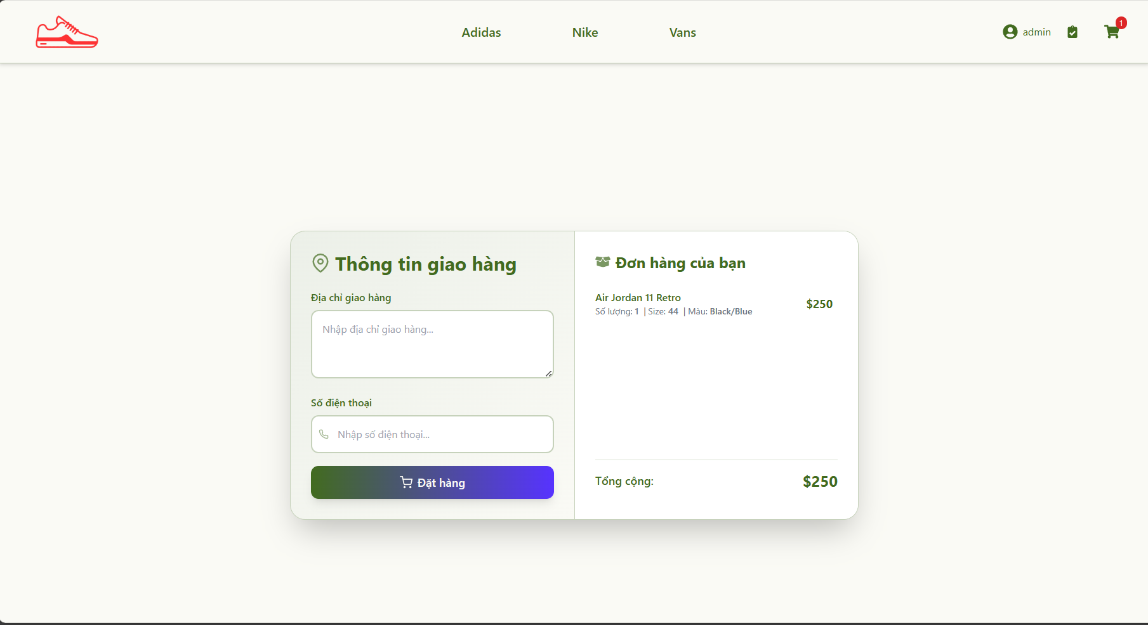
User Module: Cart & Checkout
Cart management
  Add item from product details
  Update quantity and options (size/color)
  Remove item or clear cart
Checkout
  Enter delivery address & phone
  Create an order and redirect to My Orders
Notes:
Speaker A (Minh Thuc):
This slide focuses on the shopping flow: users can manage the cart and then proceed to checkout.
Speaker B (Dang Khoa):
The cart supports updating quantity and product options. The checkout form collects delivery information and creates an order in the database.

Slide 9
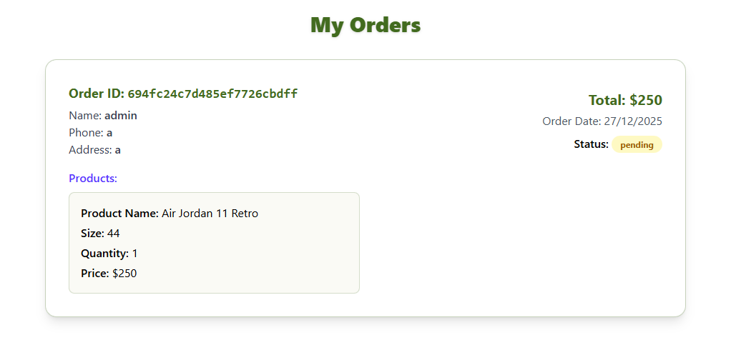
User Module: Order Tracking
After placing an order, the system saves order details and item list.
Users can view their order history in 'My Orders'.
Each order shows total price, date, items, and current status (e.g., pending).
Notes:
Speaker A (Minh Thuc):
After checkout, the user is redirected to My Orders. This page calls the backend to retrieve orders by user ID.
Speaker B (Dang Khoa):
The status field supports basic order tracking and can be updated by the admin.

Slide 10
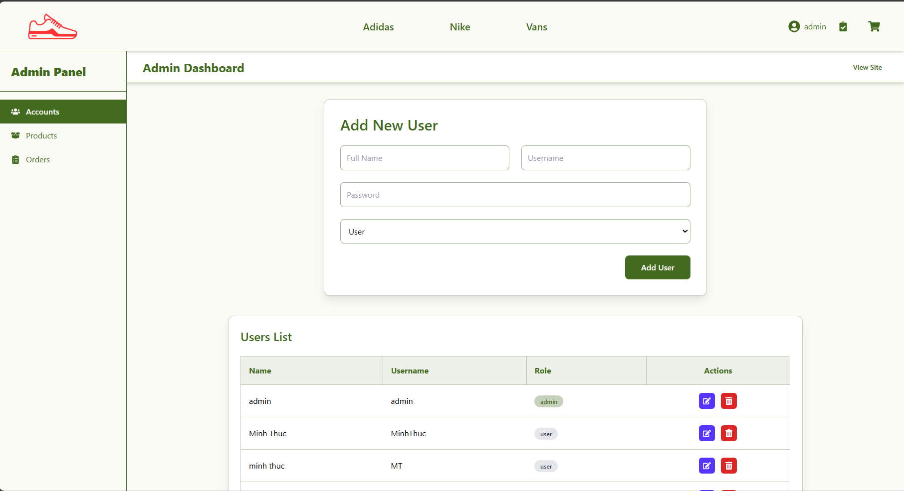
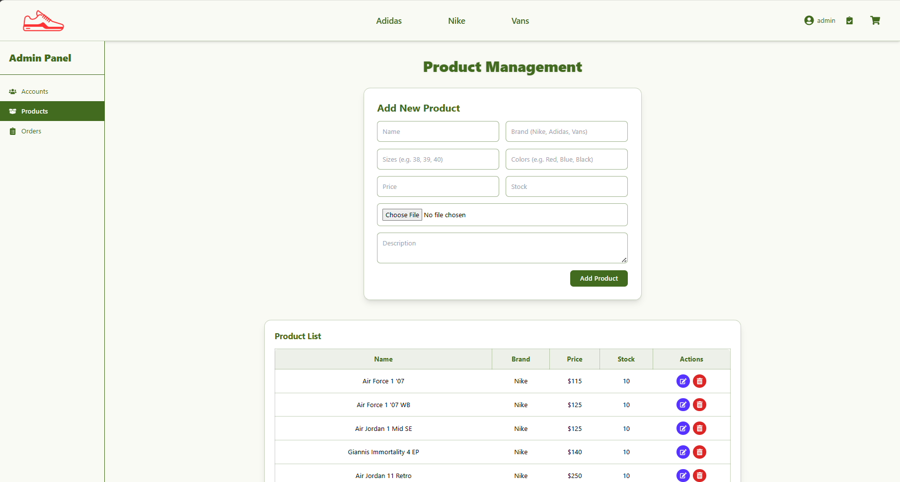
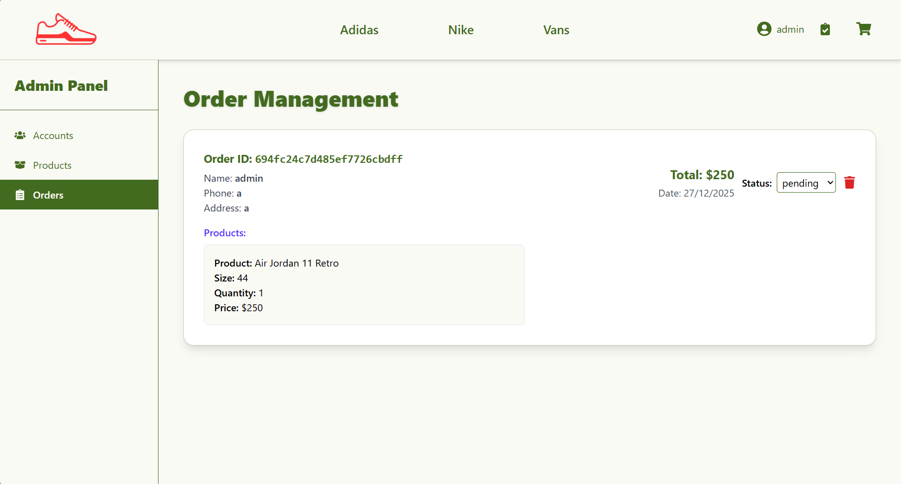
Admin Module: Management Dashboard
Role-based access to system administration
Admin capabilities
  Manage user accounts (create/update/delete, set roles)
  Manage products (CRUD + upload image to Cloudinary)
  Manage orders (view all, update status, delete)
Admin pages are protected by authentication + role checks.
Notes:
Speaker A (Minh Thuc):
Admins have a dedicated dashboard. They can manage accounts, products, and orders. Product management also supports image upload.
Speaker B (Dang Khoa):
All admin routes are protected: the backend verifies the JWT token, and the frontend uses role-based private routes to restrict access.

Slide 11
Implementation Highlights
End-to-end flow: UI → API → Controller → Database
Frontend (React)
  Pages & components (Register, Login, Cart, OrderForm, Admin pages)
  API layer (authApi / productApi / cartApi / orderApi)
Backend (Express)
  Routes: authRoutes, productRoutes, cartRoutes, orderRoutes
  Controllers validate input and perform CRUD with Mongoose models
Security
  JWT token expires (e.g., 1 hour) and is stored client-side
  Middleware for authenticateUser and admin authorization
Notes:
Speaker A (Minh Thuc):
We separated concerns using an API layer on the frontend and routes/controllers on the backend. Each UI action maps to an API request.
Speaker B (Dang Khoa):
For example: Add to cart triggers a PUT request to /api/cart/:userId, handled by cartRoute and cartController, and updates the cart in MongoDB. Security is enforced by JWT authentication middleware and admin role checks.

Slide 12
Testing & Demo Scenario
Demo flow (Customer)
  Register → Login
  Browse by brand → open product details
  Add to cart → update qty/size/color
  Checkout → create order → view My Orders
Demo flow (Admin)
  Login as admin
  Add a product (with image upload) / edit / delete
  View all orders and update order status
Testing: manual UI tests + API verification (Postman) for main endpoints.
Notes:
Speaker A (Minh Thuc):
In the live demo we will first show the customer journey end-to-end. Then we will switch to the admin account and show management features.
Speaker B (Dang Khoa):
We tested each core use case manually on the UI and verified key API endpoints with tools like Postman.

Slide 13
Challenges & Future Improvements
Challenges
  Designing a clean NoSQL structure for carts and orders
  Implementing authentication + role-based authorization
  Integrating third-party image hosting (Cloudinary)
Future improvements
  Integrate online payment (VNPay/Stripe)
  Search, sorting, and advanced filtering
  Analytics dashboard (sales, popular products)
  Email notifications for order updates
Notes:
Speaker A (Minh Thuc):
The main difficulties were NoSQL design for line items, secure authentication/authorization, and Cloudinary integration.
Speaker B (Dang Khoa):
With more time, we want to add online payment, stronger search/filtering, admin analytics, and notifications.

Slide 14
Conclusion & Q&A
We delivered a functional full-stack e-commerce application using the MERN stack.
The system supports complete user shopping flow and an admin management dashboard.
Thank you for listening — we are happy to answer your questions.
Q & A
Notes:
Speaker A (Minh Thuc):
Summarize the value and close the presentation.
Speaker B (Dang Khoa):
Invite questions and be ready to open the demo if requested.

