Slide 1

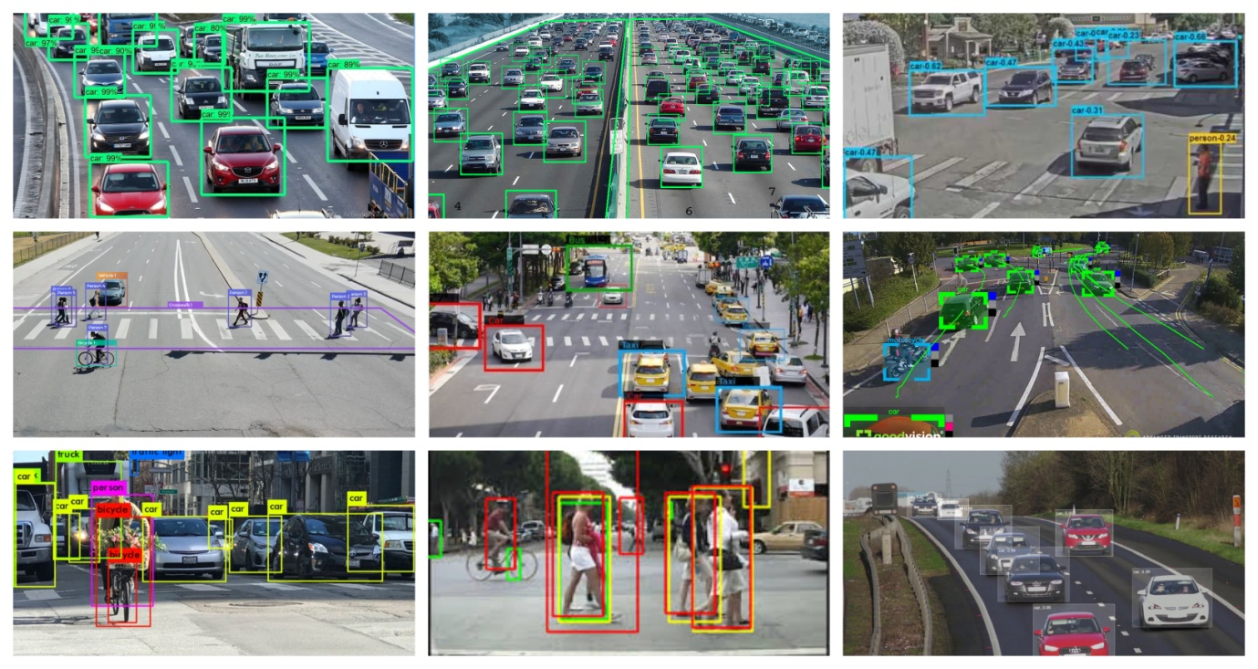
SMART TRAFFIC MONITORING AND MANAGEMENT SYSTEM
Project Mentor :
Assistant Professor
Student Name | Roll Number
Rohan Karmakar | 34900319031
Rajbir Banerjee | 34900319046
Snehasish Pradhan | 34900319049
Rahla Kisku | 34900319047
Preety Kumari Jha | 34901319035

Slide 2
Objective
Providing congestion free traffic
Prioritizing moderate traffic conditions by analyzing real time traffic situations
Offer safe and punctual public transportation
Remote observation of various busy road junction points
Less human intervention and optimized traffic signaling decisions

Slide 3
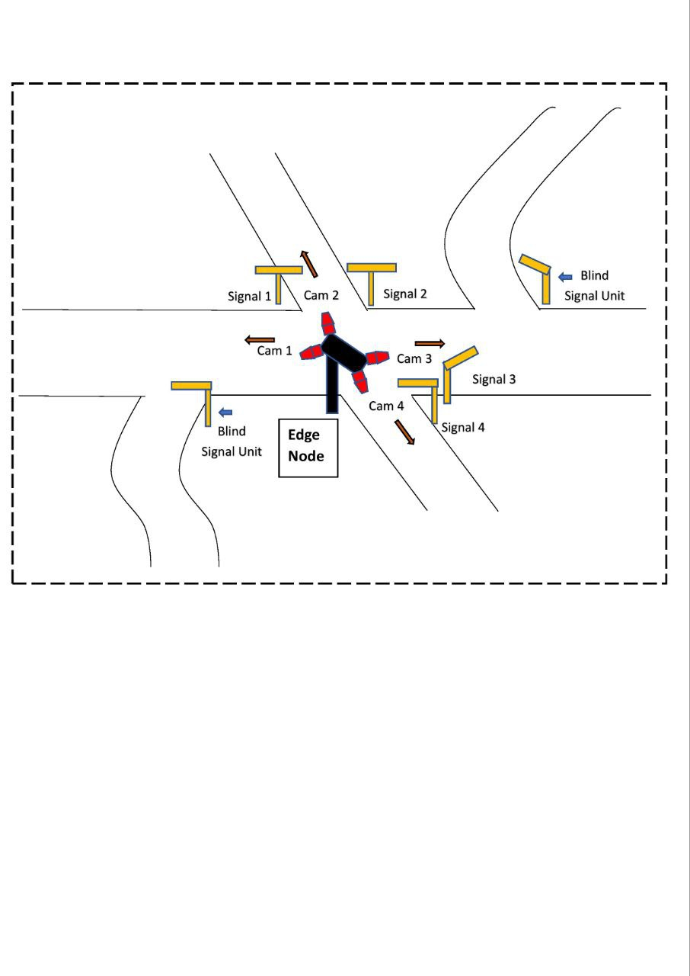
Brief Description

Slide 4
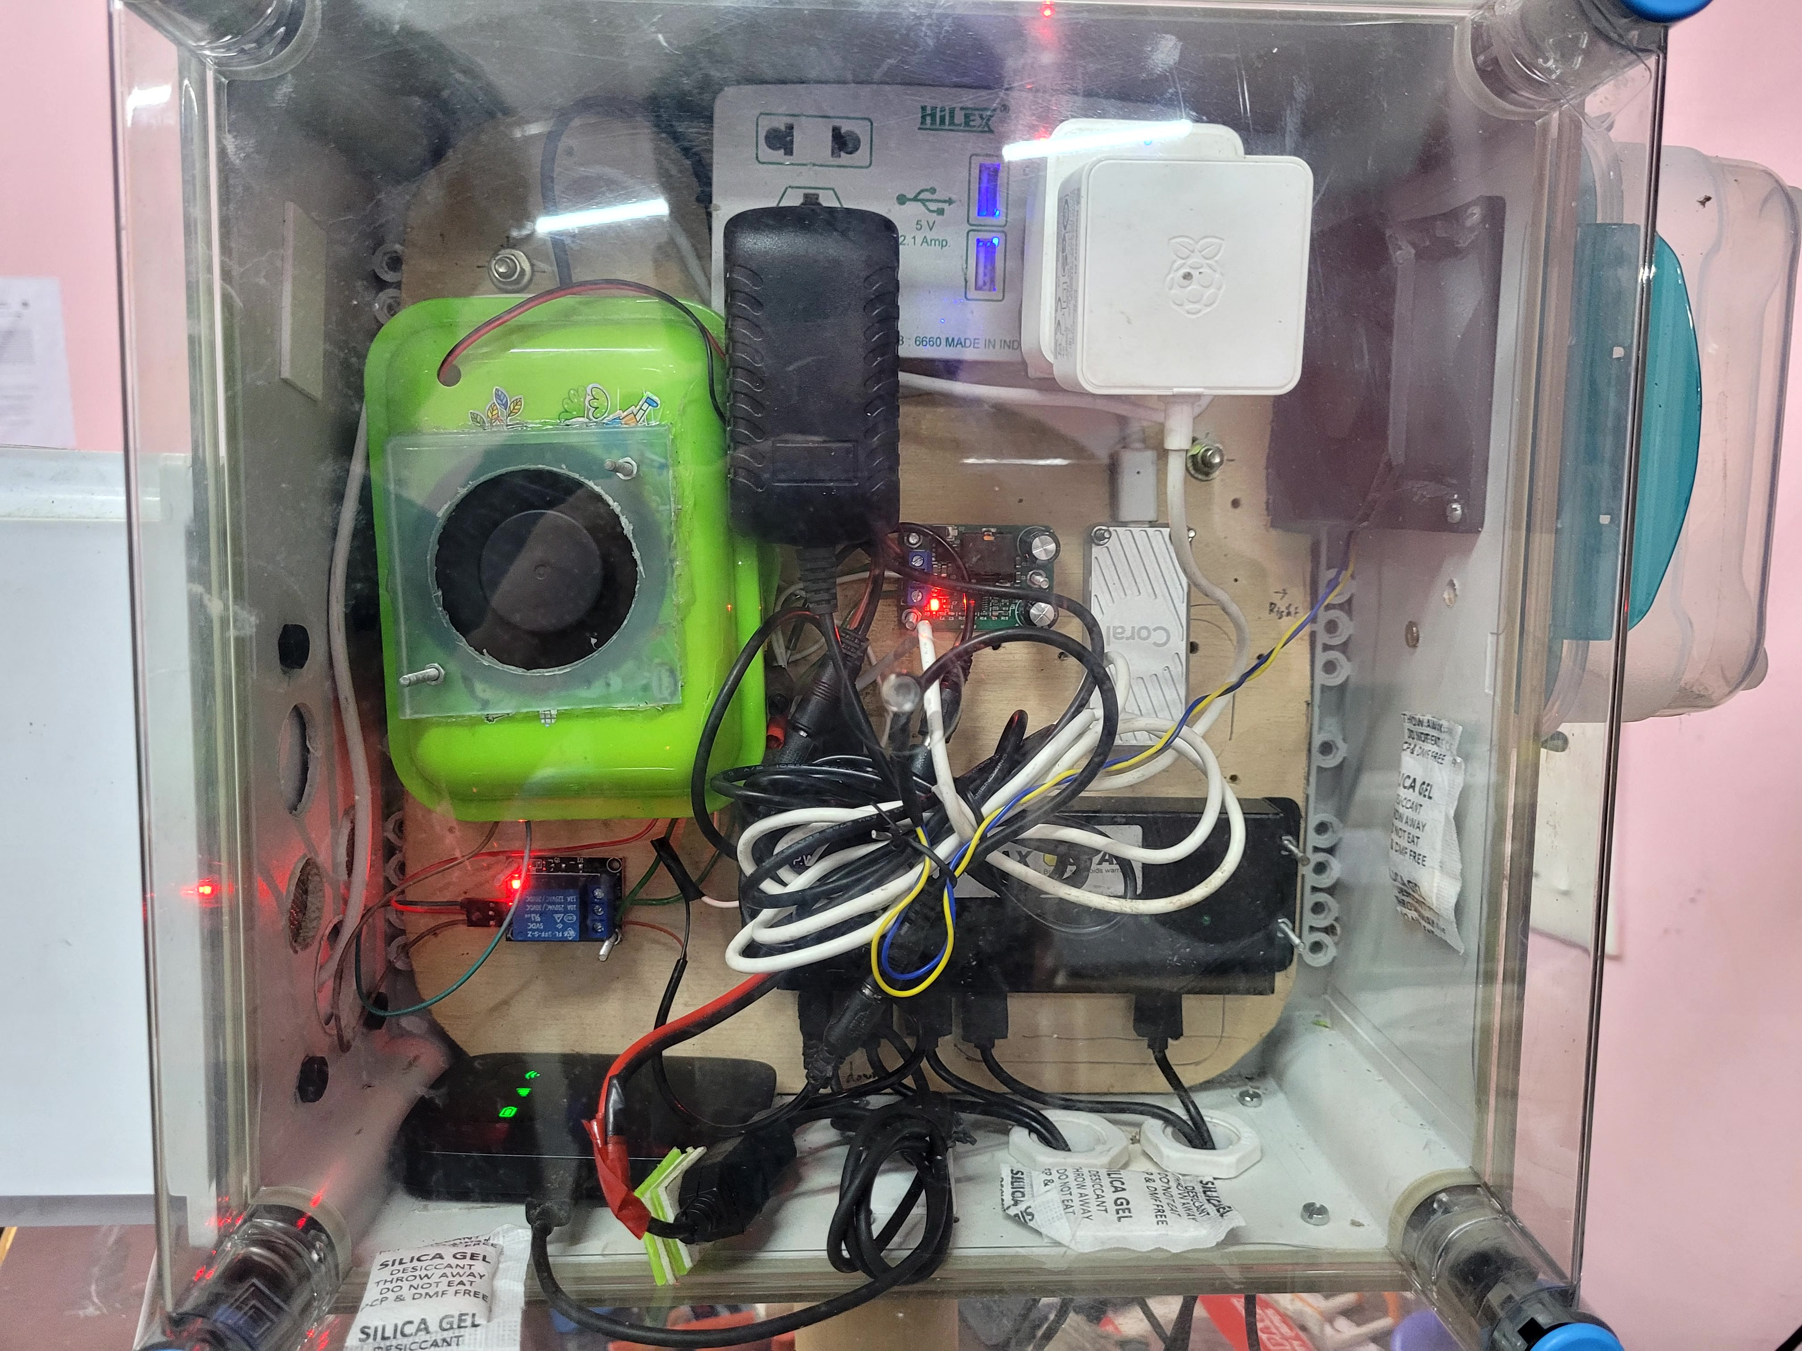
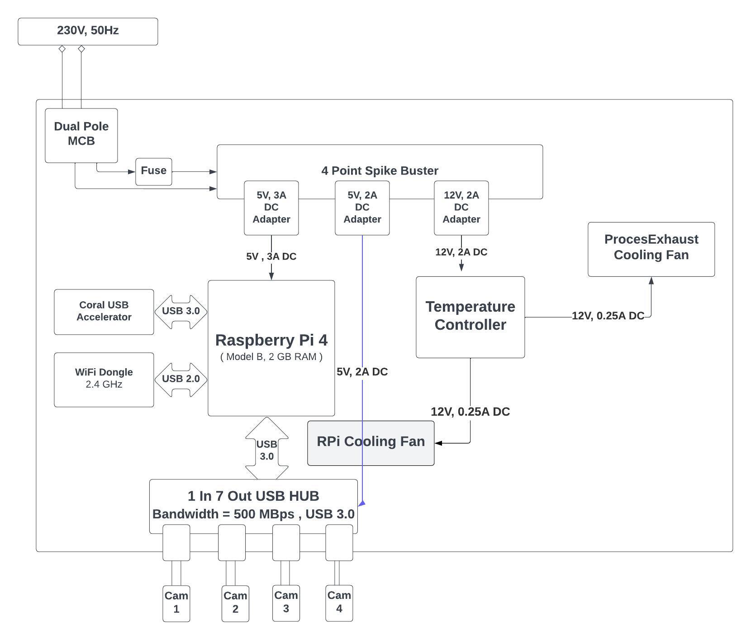
Hardware Description

Slide 5
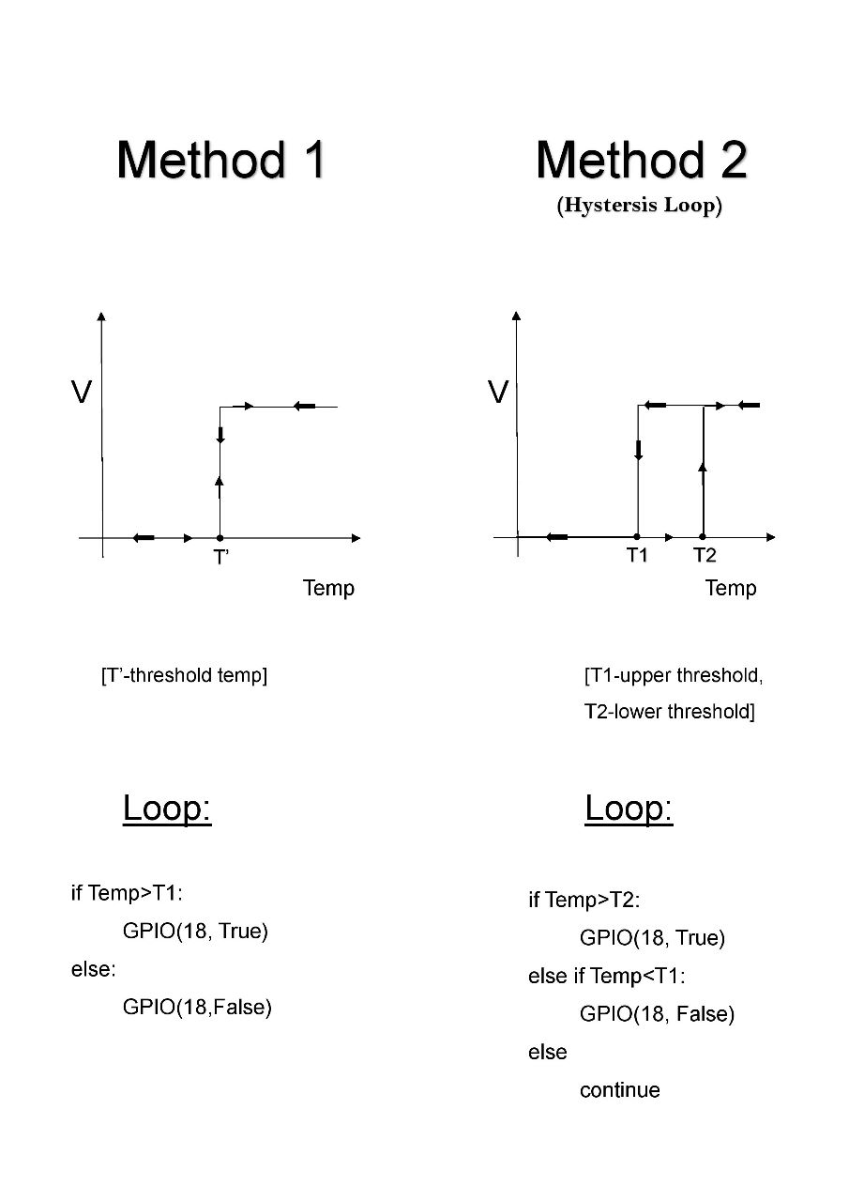
Forced Convectional CPU Cooling

Slide 6
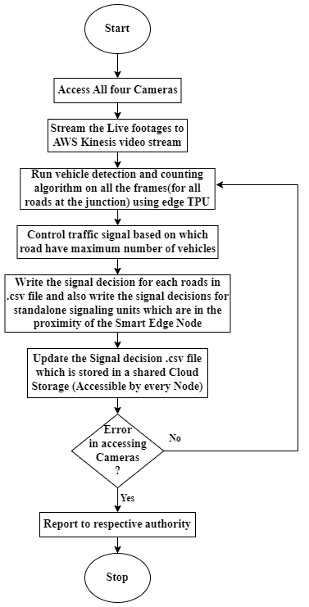
Flowchart of the Smart Edge Node Operations

Slide 7
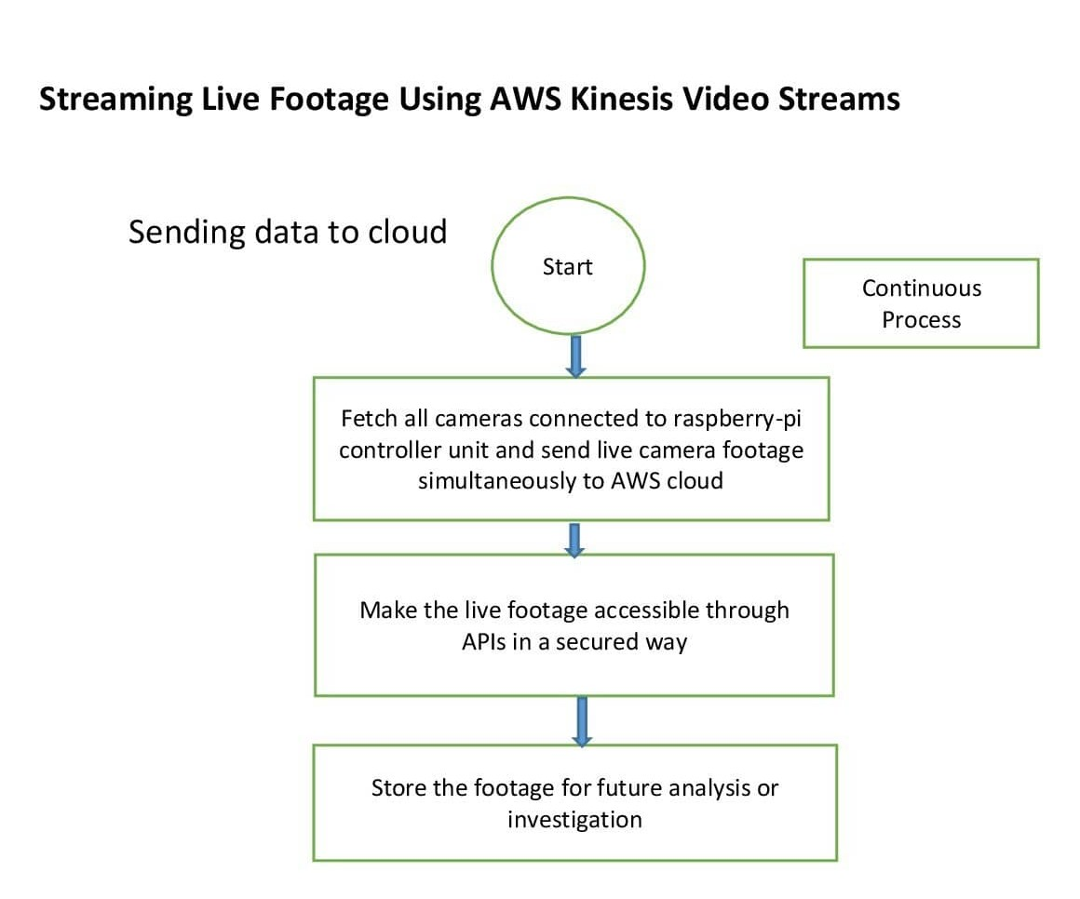
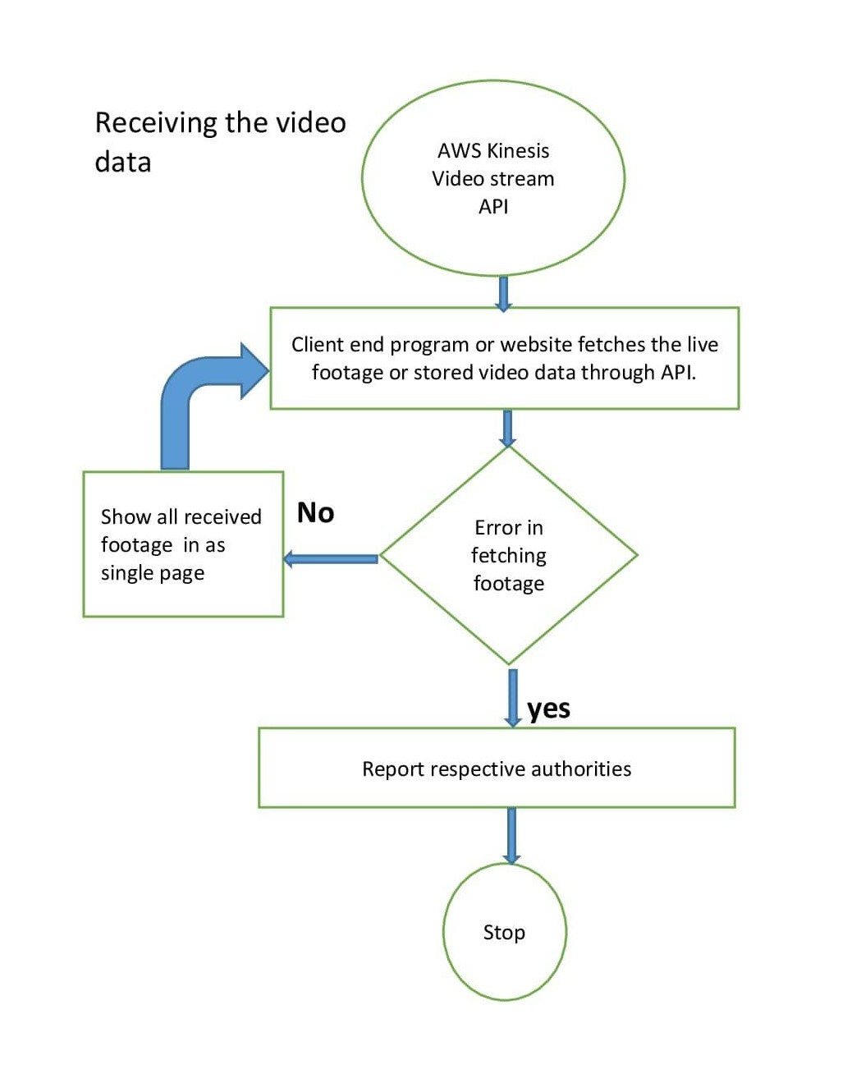
Flowchart of Traffic Camera Streaming

Slide 8
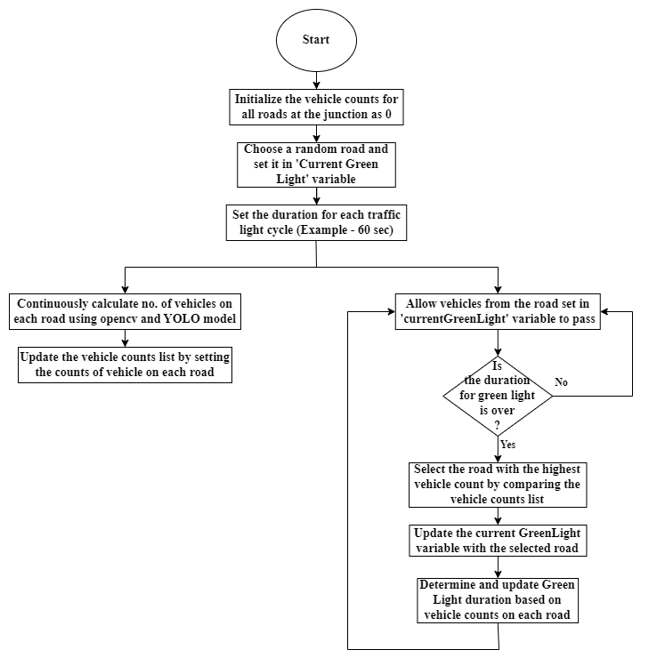
Flowchart of Traffic Signaling and Virtual Demonstration

Slide 9
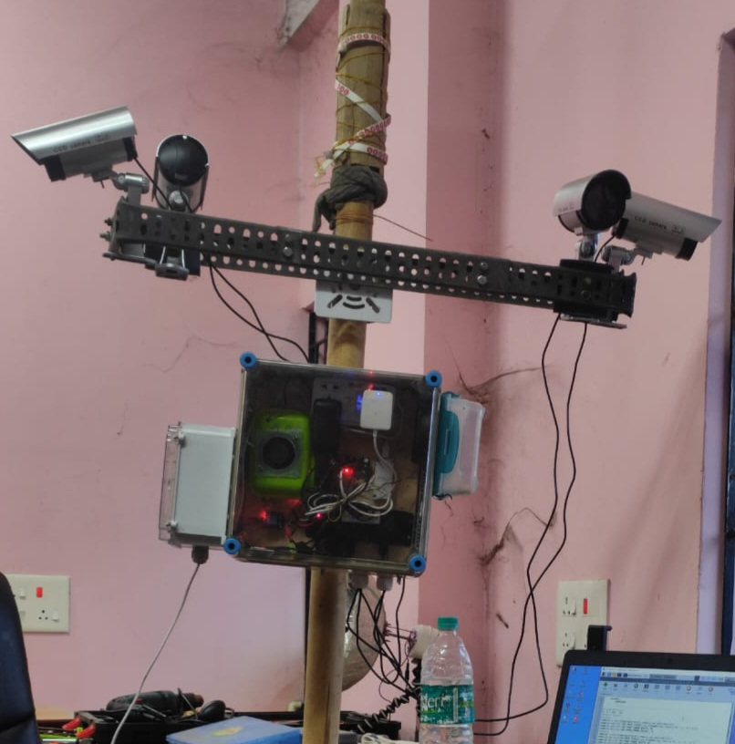
Live Object Detections in Edge Node

Slide 10
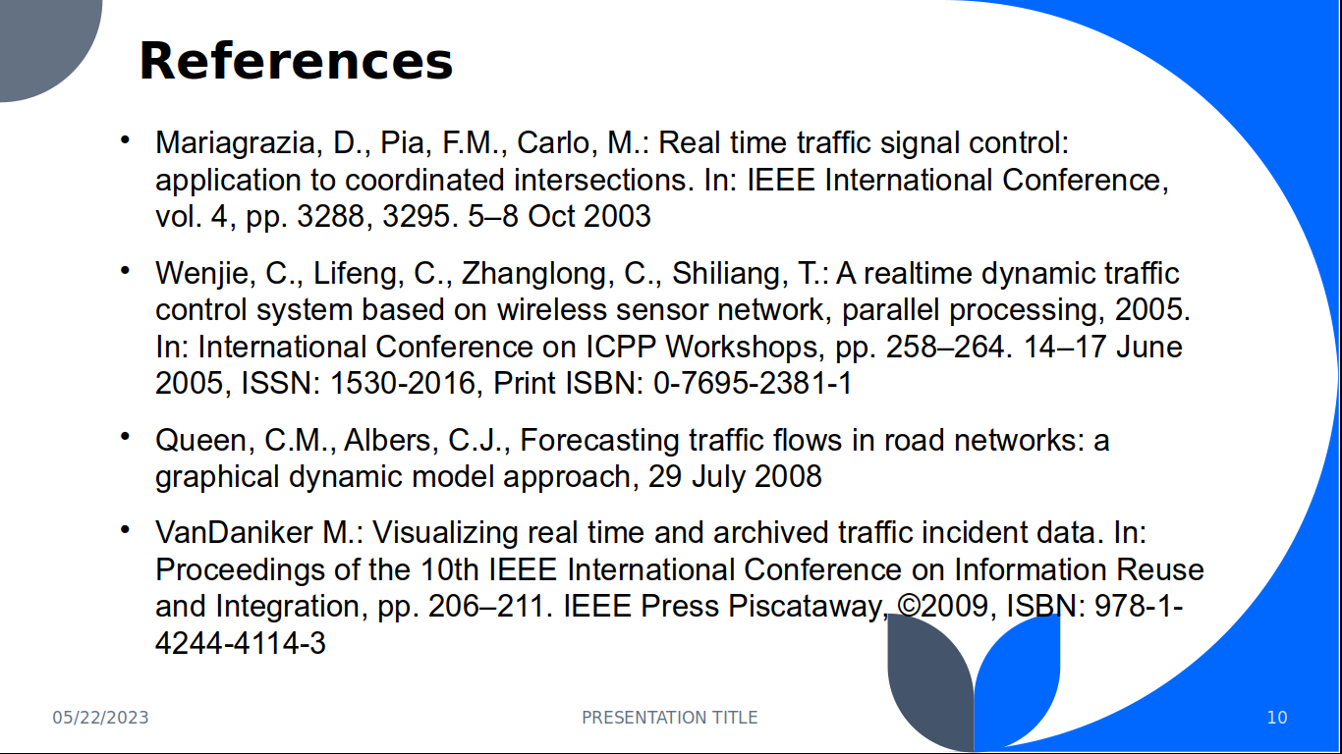
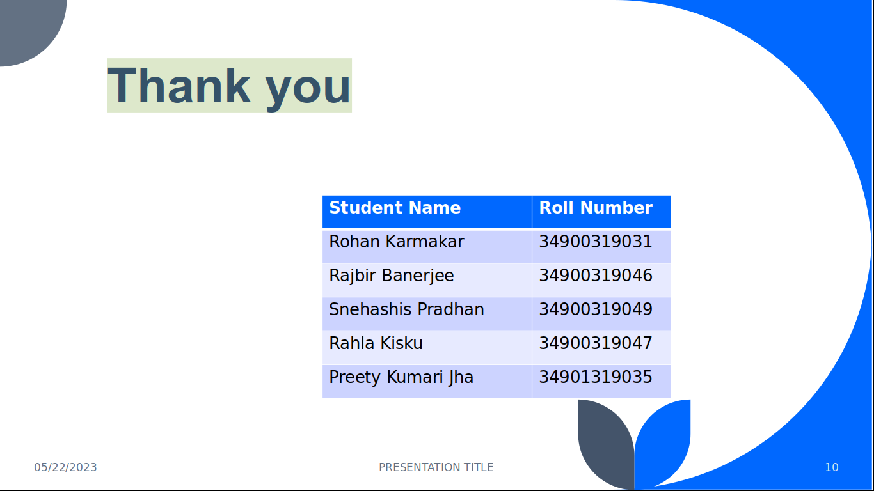
Future Works
Field testing of smart signal units as well as stand alone signal units.
Traffic violation detection and reporting
Server end design and implementation
Development of mobile apps for remote access, remote surveillance, real-time traffic update
Hybrid System depending on high traffic zone priorities

