Slide 1

Core Java

Slide 2
Java SE/EE/ME
Java SE: SE stands for Standard Edition.
It is the core Java programming platform.
It contains all of the libraries and APIs that any aspiring Java programmer should learn.
Java EE - EE stands for Enterprise Edition
It is used when your application demands a very large-scale, distributed system.
It is built on top of Java SE, it provides libraries for database access, remote method invocation, messaging, web services, XML processing, and defines standard APIs for Enterprise JavaBeans, servlets, portlets, Java Server Pages, etc.
Java ME - ME stands for Micro Edition.
It is used for developing applications for mobile devices and embedded systems like set-top boxes.
It provides a subset of the functionality of Java SE, but also introduces libraries specific to mobile devices.

Slide 3
JAVA SE TimeLine
1.0
(Jan 1996)
1.1
1.2
1.3
1.4
1.5
1.6
1.7
11
9
1.8
10
12
13
14
15
16
17
18
(Mar 22 2022)
Red Color Indicate LTS(Long Term Support) Version.

Slide 4
1.1
Reflection, JDBC, RMI, Java Swing
1.2
Java Util Collection
1.3
Java Naming and Directory Interface
1.5
For each Loop, Generics

Slide 5
1.6
JDBC 4
1.8
Lambda Expression, Stream API, Default Methods, Date & Time API
9
JShell Support , Modules
11
Garbage Collector Update
17
Sealed Class
https://ondro.inginea.eu/index.php/new-features-in-java-versions-since-java-8/

Slide 6
Tools Required to Develop Java Code
JDK
JRE
JVM

Slide 7
Features of Java
Simple
Object- Oriented
Secured
Platform Independent
Robust
Portable
Architecture Neutral
Dynamic
Interpreted
High Performance
Multi Threaded
Distributed

Slide 8
Program Component
Keywords
Identifiers
Tokens
Operators

Slide 9
Review Question
Which of the following is not a legal identifier?
(a) a2z
(b) ödipus
(c) 52pickup
(d) _class
(e) ca$h

Slide 10
Review Question
Which of the following do not denote a primitive data value in Java?
(a) "t"
(b) 'k'
(c) 50.5F
(d) "hello"
(e) False

Slide 11
OOPS Characteristics
Class
Object
Encapsulation
Abstraction
Inheritance
Polymorphism

Slide 12
Review Question
What is the correct ordering for the import, class and package declarations when found in a single file?
A. package, import, class
B. class, import, package
C. import, package, class
D. package, class, import

Slide 13
Review Question
What will be the result of compiling the following code:
public class Test {
public static void main (String args []) {
int age;
age = age + 1;
System.out.println(“The age is “ + age);
}}
A. Compiles and runs with no output
B. Compiles and runs printing out The age is 1
C. Compiles but generates a runtime error
D. Does not compile
E. Compiles but generates a compile time error

Slide 14
Review Question
Which statement about objects is true?
An object is what classes are instantiated from.
An object is an instance of a class.
An object is a blueprint for creating concrete realization of abstractions.
An object is a reference.
An object is a variable.

Slide 15
Review Question ( Object)
Given that Thing is a class, how many objects and how many reference variables are
created by the following code?
Thing item, stuff;
item = new Thing();
Thing entity = new Thing();
(a) One object is created.
(b) Two objects are created.
(c) Three objects are created.
(d) One reference variable is created.
(e) Two reference variables are created.
(f) Three reference variables are created.

Slide 16
Review Question
How do objects communicate in Java?
(a) They communicate by modifying each other’s fields.
(b) They communicate by modifying the static variables of each other’s classes.
(c) They communicate by calling each other’s instance methods.
(d) They communicate by calling static methods of each other’s classes.

Slide 17
Solution:
public class Test {
public static void main(String[] args) {
for(int i = 0; true; i++) {
System.out.println("Hello");
break;
}
}
}
Output:Hello
What is the o/p of following program?
public class Test {
public static void main(String[] args) {
for(int i = 0; 1; i++) {
System.out.println("Hello");
break;
}
}
}
Output: Compile time Error

Slide 18
Technique to Object Creation
Using new keyword
Using new instance
Using clone() method
Using newInstance() method of Constructor class

Slide 19
Java.Lang Package
Java.String
Java.StringBuffer
Java.StringBuilder

Slide 20
Control Structure
If
If else
Nested if
Else if ladder
switch
Implement Define Pattern
1
3
* 6
Looping
for
While
Do while

Slide 21
Components of Class
Variables
Methods
Constructor

Slide 22
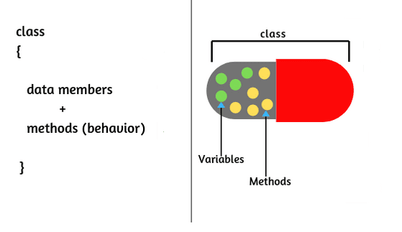
Encapsulation

Slide 23

Reflection
Used to modify the behaviour of methods, classes , interfaces at runtime

Slide 24
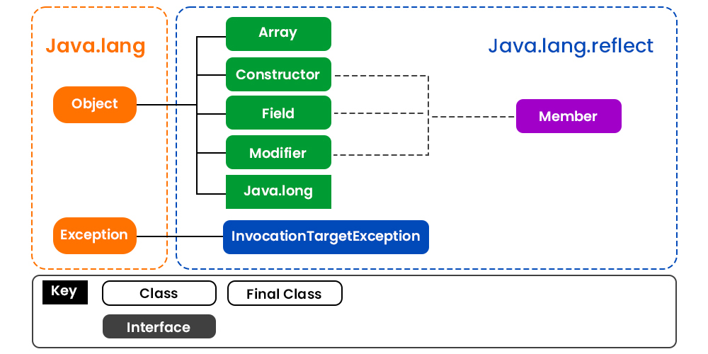
Reflection gives us information about the class to which an object belongs and also the methods of that class that can be executed by using the object.
Through reflection, we can invoke methods at runtime irrespective of the access specifier used with them.
Check Example

Slide 25
Important observations Drawn From Reflection API
Extensibility Features: An application may make use of external, user-defined classes by creating instances of extensibility objects using their fully-qualified names.
Debugging and testing tools: Debuggers use the property of reflection to examine private members of classes.
Performance Overhead: Reflective operations have slower performance than their non-reflective counterparts, and should be avoided in sections of code that are called frequently in performance-sensitive applications.
Exposure of Internals: Reflective code breaks abstractions and therefore may change behaviour with upgrades of the platform.

Slide 26
Review Question ( Constructor)
(a) (1)
(b) (2)
(c) (3)
(d) (4)
(e) (5)
Which is the first line of a constructor declaration in the following code?
public class Counter { // (1)
int current, step;
public Counter(int startValue, int stepValue) { // (2)
setCurrent(startValue);
setStep(stepValue); }
public int getCurrent() { return current; } // (3)
public void setCurrent(int value) { current = value; } // (4)
public void setStep(int stepValue) { step = stepValue; } // (5)
}

Slide 27
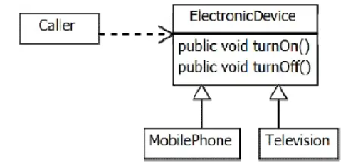
Modelling Business Problems with Classes
Inheritance (or subclassing) is an essential feature of the Java programming language. Inheritance provides code reuse through:
Method inheritance: Subclasses avoid code duplication by inheriting method implementations.
Generalization: Code that is designed to rely on the most generic type possible is easier to maintain.

Slide 28
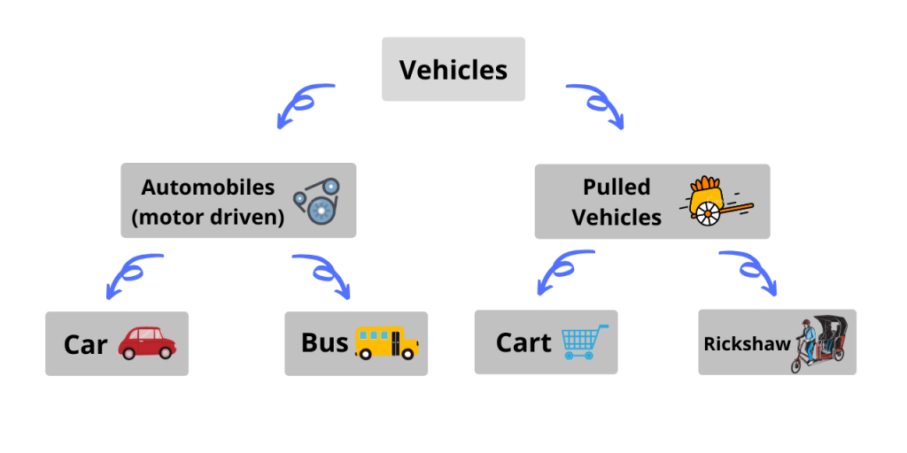
Inheritance
Method Overloading

Slide 29
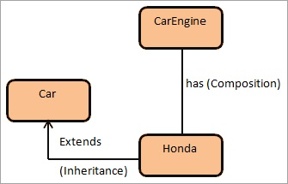
Composition
Has-a Relationship between objects
Implemented using instance variables
Code Reuse
Hide visibility to client access

Slide 30
Important Keywords
Static
This
Super
Final
Abstract

Slide 31
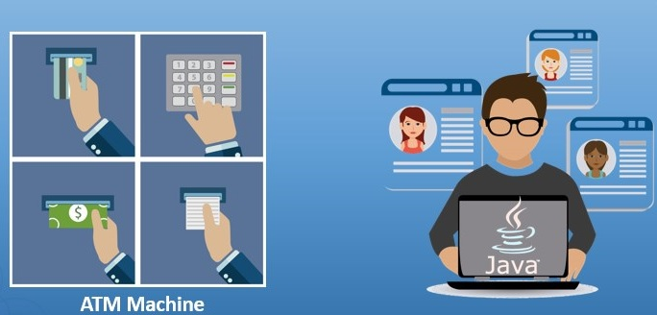
Interface

Slide 32
Review Questions
interface Foo { int bar(); }
public class Sprite {
public int fubar( Foo foo ) { return foo.bar(); }
public void testFoo() {
fubar(
//insert code here 15 ); } }
Which code, inserted at line 15, allows the class Sprite to compile?
A. Foo { public int bar() { return 1; }
B. new Foo { public int bar() { return 1; }
C. new Foo() { public int bar() { return 1; }
D. new class Foo { public int bar() { return 1; }

Slide 33
Virtual Function
The behaviour of a virtual function can be overridden with the inheriting class function with the same name.
Virtual function in Java is expected to be defined in the derived class.
Every non-static method in Java is by default a virtual method.
Java does not have a virtual keyword like C++, but we can define them and use them for concepts like run-time polymorphism.
Achieve this Concepts using
Method Overriding
Interface Implementation

Slide 34
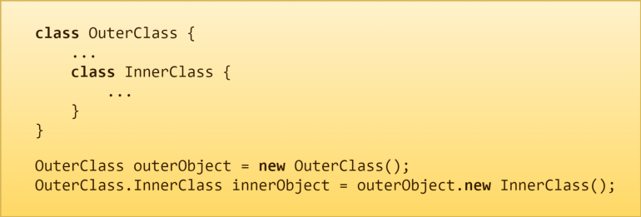
Inner Class

Slide 35
Immutable Class
Immutable objects are instances whose state doesn’t change after it has been initialized.
Benefits of Immutable Class in Java
Immutable class is good for caching purposes because you don’t have to worry about the value changes.
immutable class is that it is inherently thread-safe, so you don’t have to worry about thread safety in case of multi-threaded environment.
How to Create an immutable class in Java?
Declare the class as final so it can’t be extended
Make all fields private so that direct access is not allowed
Don’t provide setter methods for variables.
Make all mutable fields final so that its value can be assigned only once
Perform cloning of objects in the getter methods to return a copy rather than returning the actual object reference.

Slide 36
Java Annotation
Marker Annotations
@TestAnnotation()
Single value Annotations
@TestAnnotation(“testing”);
Full Annotations
@TestAnnotation(owner= ”Rahul”, value= ”Class DataFlair”)
Type Annotations
@Target
Repeating Annotation
@Repeatable

Slide 37
Predefine Annotation
@Override
@Deprecated
@SuppressWarnings
@Target
@Documented
@Inherited

Slide 38
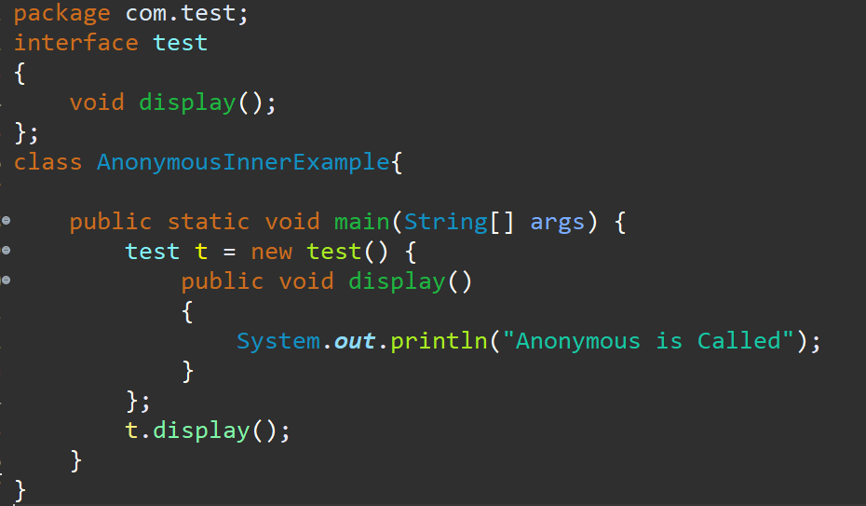
Anonymous inner classes
It is an inner class without a name and for which only a single object is created.
An anonymous inner class can be useful when making an instance of an object with certain “extras” such as overriding methods of a class or interface, without having to actually subclass a class.
Class (may be abstract or concrete)
Interface

Slide 39
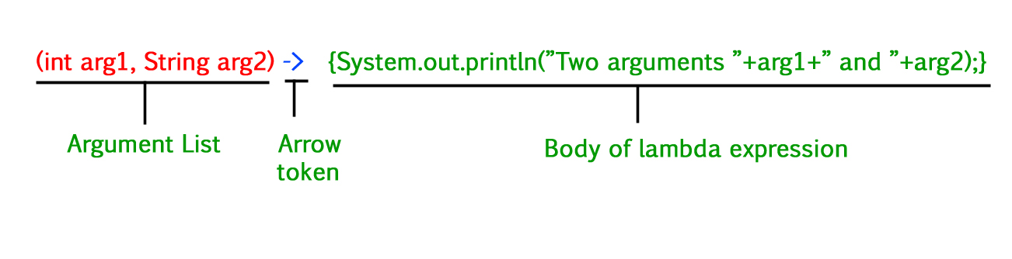
Lambda Expression

Slide 40
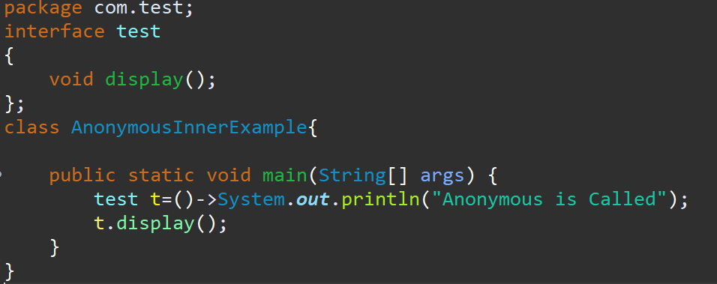
Conversion Anonymous Class in Lambda

Slide 41
Practical Task ( Deadline : 30 minutes)
A typical mobile number in India is “+91-AA-BBB-CCCCC”. Where the first two digits (AA)
indicate a mobile system operator, the next three (BBB) denote the mobile switching code
(MSC) while the remaining five digits (CCCCC) are unique to the subscriber. Write an
application that takes a mobile number as an input from a user in above mentioned format
and display code for mobile system operator, mobile switching code and last 5 digits which
are unique to subscriber.
Ex. For an input +91-94-999-65789, output should be :
Mobile system operator code is 94
MSC is 999
Unique code is 65789

Slide 42
Practical Task
Design a class named Cylinder containing following attributes and behavior.
One double data field named radius. The default value is 1.
One double data field named height. The default value is 1.
A no-argument constructor that creates a default Cylinder.
A Single argument constructor that creates a Cylinder with the specified radius.
Two argument constructor that creates a Cylinder with the specified radius and
height.
A method named getArea() that returns area of the Cylinder.
Create a class TestCylinder and test and display result

Slide 43
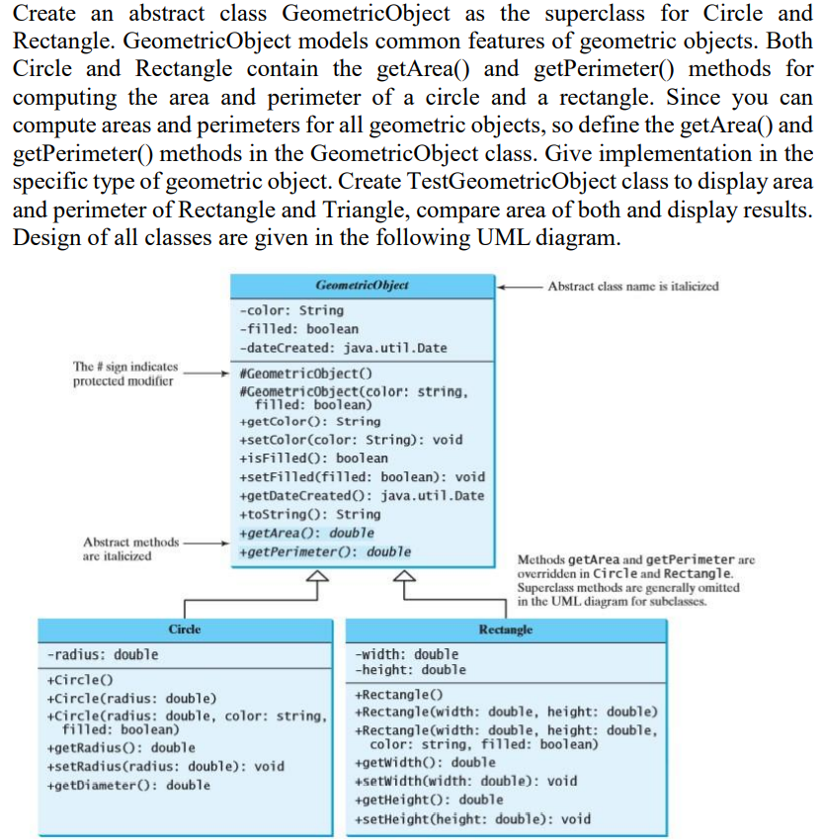
Practical Task

Slide 44
Collection Framework

Slide 45
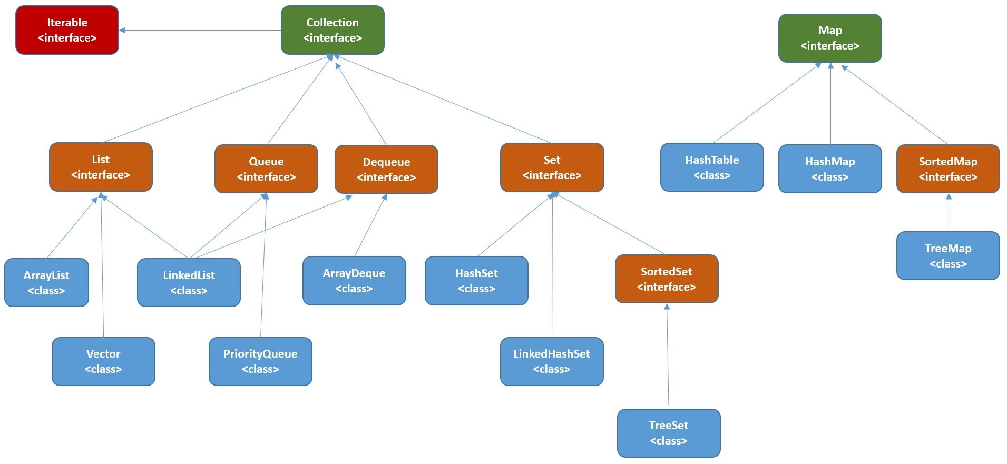
Collection

Slide 46
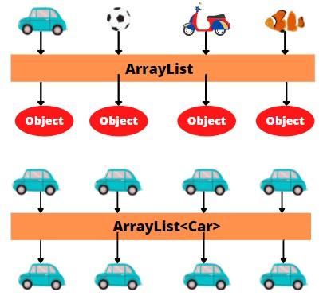
Generics
Introduced in JDK 1.5
Compile Time Type Checking
Avoid ClassCastException

Slide 47
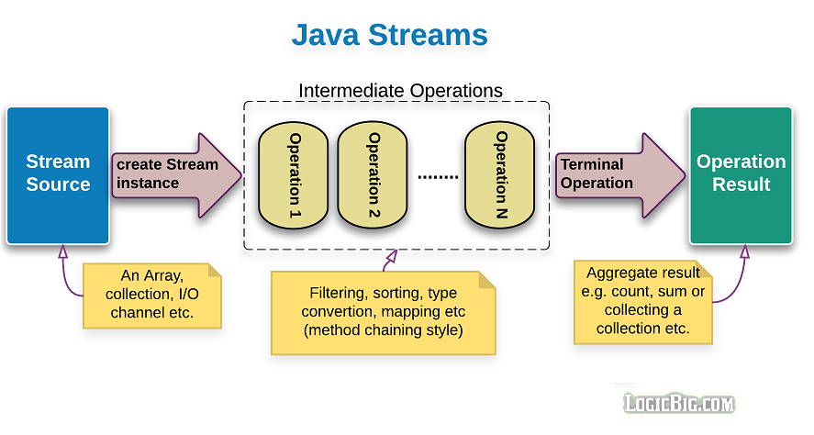
Streams

Slide 48
Multi Threading

Slide 49
Objective
Objects provide a way to divide a program into independent sections. Often, you also need to turn a program into separate, independently running subtasks.
Each of these independent subtasks is called a thread.
A piece of code that run in concurrent with other threads.
Thread is a statically ordered sequence of instructions.

Slide 50
Motivation
Resource utilization Programs sometimes have to wait for external operations such as input or output, and while waiting can do no useful work. It is more efficient to use that wait time to let another program run.
Fairness Multiple users and programs may have equal claims on the machine's resources. It is preferable to let them share the computer via finer-grained time slicing than to let one program run to completion and then start another.
Convenience Program with multiple tasks.

Slide 51
Process
A process is a self-contained running program with its own address space.
A multitasking operating system is capable of running more than one process (program) at a time.
A thread is a single sequential flow of control within a process.
A single process can thus have multiple concurrently executing threads
So threads are lightweight processes.

Slide 52
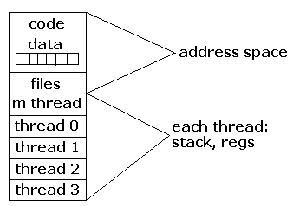
Process

Slide 53
Java Thread Memory Model
Memory that can be shared between threads is called shared memory or heap memory. All instance fields, static fields and array elements are stored in heap memory.
Local variables, method parameters and catched exception parameters are never shared between threads and stored in local stack and registers.

Slide 54
Threads compared with Processes
Processes are typically independent, while threads exist as subsets of a process
Processes carry considerable state information, whereas multiple threads within a process share state as well as memory and other resources
Processes have separate address spaces, whereas threads share their address space
Processes interact only through system-provided inter-process communication mechanisms.
Context switching between threads in the same process is typically faster than context switching between processes.

Slide 55
Java Threads & Synchronization
Introduction
Exploring Threads
Sharing Resources
Inter-Thread Communication
Deadlock
Advanced Issues
Assignment

Slide 56
Exploring Threads
Thread Life Cycle
Thread Creation
Priority
Joining
Yielding
Sleeping
Interrupting
Daemon Thread

Slide 57
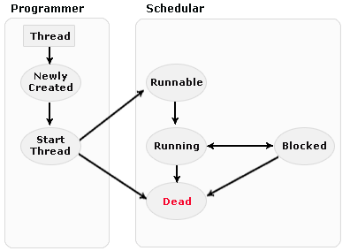
Thread Life Cycle
New state: The thread is considered not alive.
Runnable (Ready-to-run) state: A thread start its life. On this state a thread is waiting for a turn on the processor.
Running state: the thread is
currently executing
Dead state: its run() method completes.
Blocked: is waiting the resources that are hold by another thread.

Slide 58
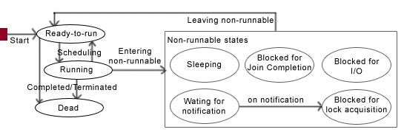
Life circle of multiple-threads

Slide 59
Thread Creation
Two ways:
Extending the java.lang.Thread Class
Implementing the java.lang.Runnable Interface
Which to choose:
If you extend the Thread Class, that means that subclass cannot extend any other Class, but if you implement Runnable interface then you can do this.
And the class implementing the Runnable interface can avoid the full overhead of Thread class which can be excessive.
Else use Thread

Slide 60
Priority
The priority of a thread tells the scheduler how important this thread is.
The thread scheduler can use the thread priorities to determine the execution schedule of threads.
Priorities are integer values
Thread.MIN_PRIORITY: 1
Thread.MAX_PRIORITY: 10
Thread.NORM_PRIORITY: 5

Slide 61
Joining
One thread may call join( ) on another thread to wait for the second thread to complete before proceeding.

Slide 62
Yielding
Causes the currently executing thread to pause and allow other threads to execute.
This hint (and it is a hint—there’s no guarantee your implementation will listen to it) takes the form of the yield() method.
In general, yield() is useful only in rare situations and you can’t rely on it to do any serious tuning of your application

Slide 63
Sleeping
Causes the currently executing thread to pause for a given number of milliseconds.
When you call sleep( ), it must be placed inside a try block because it’s possible for sleep( ) to be interrupted before it times out.
It just stops the execution of the thread for a while.
There is no guaranty that thread will resume the execution after the given number of milliseconds.
Not to use in real-time application.

Slide 64
Interrupting
Interruption is a mechanism whereby a thread that is waiting (or sleeping) can be made to prematurely stop waiting.
In general, InterruptedException is thrown when another thread interrupts the thread calling the blocking method. The other thread interrupts the blocking/sleeping thread by calling interrupt() on it.

Slide 65
Daemon Thread
A “daemon” thread is one that is supposed to provide a general service in the background as long as the program is running.
Thus, when all of the non-daemon threads complete, the program is terminated. Conversely, if there are any non daemon threads still running, the program doesn’t terminate.

Slide 66
Java Threads & Synchronization
Introduction
Exploring Threads
Sharing Resources
Inter-Thread Communication
Deadlock
Advanced Issues
Assignment

Slide 67
Sharing Resources
Improperly accessing resources
Colliding over resources
Resolving shared resource conflict
Semaphore
Mutex (Mutual Exclusion)
Synchronization
Atomic Operations
Volatile Variable
Critical sections

Slide 68
Improperly accessing resources
Consider the example where one task generates only even numbers.
Scenario 1: Single Threaded Program
Scenario 2: Multi Threaded Program
Problem is not that the object goes through a state that violates invariance, but that methods can be called by threads while the object is in that intermediate unstable state.

Slide 69
Colliding over resources
If one thread tries to read the data and other thread tries to update the same data, it leads to inconsistent state.
A race condition occurs when the order of execution of two or more threads may affect some variable or outcome in the program.
Race conditions can be considered harmless provided end result is correct. Otherwise needs to be handled.

Slide 70
Resolving shared resource conflict
Solution: Serialize access to shared resources
Semaphore: Semaphore is an object containing a value and two operations and used for communication between threads.
Java has built-in support to prevent collisions over resources in the form of the synchronized keyword.
It works much like the Semaphore.

Slide 71
Resolving shared resource conflict…
Mutex: A mechanism in which a piece of code is running at a time by means of a lock (also called Monitor or Lock).
Locks in Java are reentrant. Reentrancy means that locks are acquired on a per-thread basis rather than per-invocation basis.
Synchronization: When one object pass a message to another object then both objects are in synchronized state. Synchronization needs if multiple objects passes the message to specific object.
Atomic Operation: An atomic operation is one that cannot be interrupted by the thread scheduler.
Volatile Variable: Every time the variable is used it must be read from main memory. Similarly, every time the variable is written, the value must be stored in main memory.

Slide 72
Synchronization (Cont…)
Only methods (or blocks) can be synchronized, Classes and variable cannot be synchronized.
If two threads wants to execute a synchronized method in a class, and both threads are using the same instance of the class to invoke the method then only one thread can execute the method at a time.
If you need to synchronize one method in a class, synchronize all of them, but this is not necessary.
You can synchronize a block of code rather than a method.
Constructors cannot be synchronized. Code inside the constructors can be synchronized.
Rule zero of concurrent programming: never make any assumptions.

Slide 73
Critical Sections
Piece of code that must be executed by one thread at a time
Must have solution that guarantees:
Mutual exclusion (correctness)
Absence of deadlock/unnecessary delay (no hang up)
Randomly entry (fairness)
This is also called a synchronized block.

Slide 74
Java Threads & Synchronization
Introduction
Exploring Threads
Sharing Resources
Inter-Thread Communication
Deadlock
Advanced Issues
Assignment

Slide 75
Inter-Thread Communication
When multiple threads are running inside an application, most of them will need to communicate with each other in some form.
Threads can communicate each other using wait() and notify()/notifyAll() methods without any race condition.
Wait-and-notify must be used in conjunction with the synchronized lock to prevent a race condition.
Methods wait(), notify() and notifyAll() are part of the base class Object and not part of Thread, as is sleep(). Why???

Slide 76
Inter-Thread Communication (Cont…)
sleep() does not release the lock when it is called but method wait() does release the lock.
The only place you can call wait( ), notify( ) or notifyAll( ) is within a synchronized method.
Restaurant Example: The waitperson must wait for the chef to prepare a meal. When the chef has a meal ready, the chef notifies the waitperson, who then gets the meal and goes back to waiting.
The chef represents the producer, and the waitperson represents the consumer.

Slide 77
Java Threads & Synchronization
Introduction
Exploring Threads
Sharing Resources
Inter-Thread Communication
Deadlock
Other Stuff
Assignment

Slide 78
Deadlock
In general, want to be careful about performing any operations that might take a long time while holding a lock.
It is possible for one thread to get stuck waiting for another thread, which in turn waits for another thread, etc., until the chain leads back to a thread waiting on the first one.

Slide 79
Deadlock (Cont…)
Example 1
Thread1() { Thread2() {
synchronized(a) { synchronized(b) {
synchronized(b) { synchronized(a) {
… …
} }
} }
} }
// Thread1 holds lock for a, waits for b
// Thread2 holds lock for b, waits for a

Slide 80
Deadlock (Cont…)
Example 2
void moveMoney (Account a, Account b, int amount) {
Synchronized (a) {
synchronized (b) {
a.debit (amount);
b.credit (amount);
}
}
}
Thread1() { moveMoney(a,b,10); }
// holds lock for a, waits for b
Thread2() { moveMoney(b,a,100); }
// holds lock for b, waits for a

Slide 81
FORK AND JOIN FRAMEWORK

Slide 82
Some History
Until recently, most computers only had 1 processing core
Multithreading was simulated on a single core
Not true concurrency
Serial approach to algorithms often sufficed

Slide 83
Multi-core
Concurrency and performance are tied together
Real concurrency – separate threads can execute on different cores at the same time
The JVM runtime controls scheduling

Slide 84
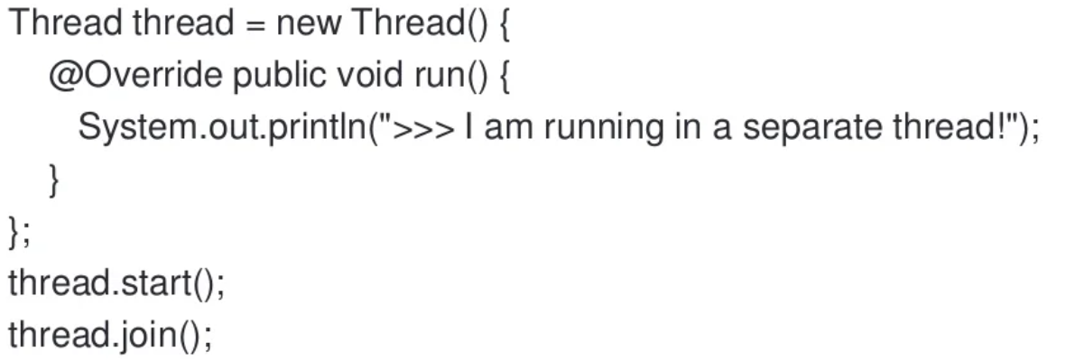
Palin old Thread

Slide 85
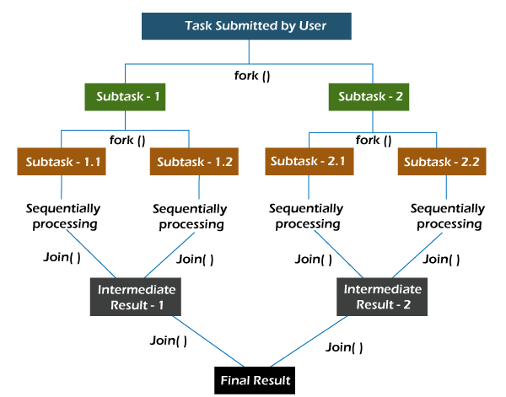
Fork and Join Framework
Some types of algorithms exist that require tasks to create subtasks and communicate with each other to complete.
Those are the “divide and conquer” algorithms, which are also referred to as “map and reduce,”

Slide 86
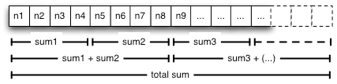
Fork and Join Framework (cont.)
Example: partial sums of an Array of Integers
Solving the problem above with executors is easy:
Divide the array into the number n of available physical processing units
Create Callable instances to compute each partial sum
Submit them to an executor managing a pool of n threads
Collect the result to compute the final sum.

Slide 87
Fork and Join Framework (cont.)
The core addition is a new ForkJoinPool executor that is dedicated to running instances implementing ForkJoinTask.
ForkJoinTask objects feature two specific methods:
fork(): allows a ForkJoinTask to be planned for asynchronous execution
join() method allows a ForkJoinTask to wait for the completion of another one.

Slide 88
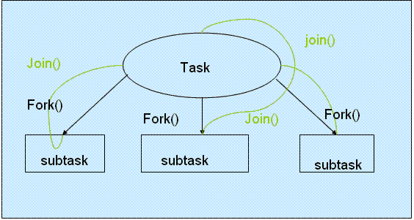
There are 2 types of ForkJoinTask:
RecursiveAction represent executions that do not yield a return value.
Instances RecursiveTask yields return values.
Demo

Slide 89
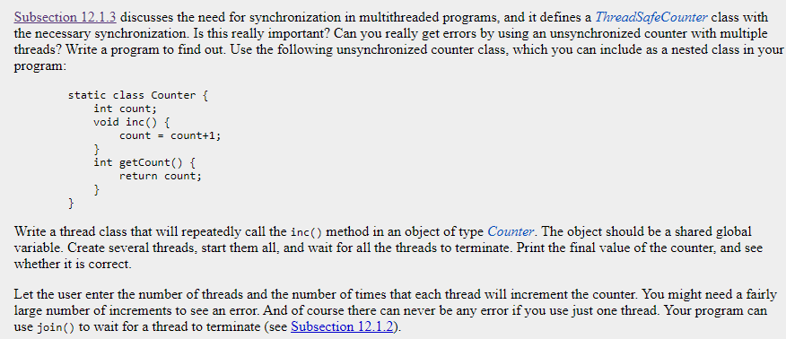
Assignment

Slide 90
Exception Handling

Slide 91
Exception Handling - Motivations
When a program runs into a runtime error, the program terminates abnormally. How can you handle the runtime error so that the program can continue to run or terminate gracefully? This is the subject we will introduce in this chapter.

Slide 92
Exception Types

Slide 93
System Errors
System errors are thrown by JVM and represented in the Error class. The Error class describes internal system errors. Such errors rarely occur. If one does, there is little you can do beyond notifying the user and trying to terminate the program gracefully.

Slide 94
Exceptions
Exception describes errors caused by your program and external circumstances. These errors can be caught and handled by your program.

Slide 95
Runtime Exceptions
RuntimeException is caused by programming errors, such as bad casting, accessing an out-of-bounds array, and numeric errors.

Slide 96
Checked Exceptions vs. Unchecked Exceptions
Runtime Exception, Error and their subclasses are known as unchecked exceptions. All other exceptions are known as checked exceptions, meaning that the compiler forces the programmer to check and deal with the exceptions.

Slide 97
Unchecked Exceptions
In most cases, unchecked exceptions reflect programming logic errors that are not recoverable. For example, a NullPointerException is thrown if you access an object through a reference variable before an object is assigned to it; an IndexOutOfBoundsException is thrown if you access an element in an array outside the bounds of the array. These are the logic errors that should be corrected in the program. Unchecked exceptions can occur anywhere in the program. To avoid cumbersome overuse of try-catch blocks, Java does not mandate you to write code to catch unchecked exceptions.

Slide 98
Unchecked Exceptions
Unchecked exception.

Slide 99
Declaring, Throwing, and Catching Exceptions

Slide 100
Declaring Exceptions
Every method must state the types of checked exceptions it might throw. This is known as declaring exceptions.
public void myMethod()
throws IOException
public void myMethod()
throws IOException, OtherException

Slide 101
Throwing Exceptions
When the program detects an error, the program can create an instance of an appropriate exception type and throw it. This is known as throwing an exception. Here is an example,
throw new TheException();
TheException ex = new TheException(); throw ex;

Slide 102
Throwing Exceptions Example
/** Set a new radius */
public void setRadius(double newRadius)
throws IllegalArgumentException {
if (newRadius >= 0)
radius = newRadius;
else
throw new IllegalArgumentException(
"Radius cannot be negative");
}

Slide 103
Catching Exceptions
try {
statements; // Statements that may throw exceptions
}
catch (Exception1 exVar1) {
handler for exception1;
}
catch (Exception2 exVar2) {
handler for exception2;
}
...
catch (ExceptionN exVar3) {
handler for exceptionN;
}

Slide 104
Catching Exceptions

Slide 105
Catch or Declare Checked Exceptions
Suppose p2 is defined as follows:

Slide 106
Catch or Declare Checked Exceptions
Java forces you to deal with checked exceptions. If a method declares a checked exception (i.e., an exception other than Error or RuntimeException), you must invoke it in a try-catch block or declare to throw the exception in the calling method. For example, suppose that method p1 invokes method p2 and p2 may throw a checked exception (e.g., IOException), you have to write the code as shown in (a) or (b).

Slide 107
Example: Declaring, Throwing, and Catching Exceptions
Objective: This example demonstrates declaring, throwing, and catching exceptions by modifying the setRadius method in the Circle class. The new setRadius method throws an exception if radius is negative.
227ETCE04
CircleWithException
TestCircleWithException

Slide 108
The finally Clause
try {
statements;
}
catch(TheException ex) {
handling ex;
}
finally {
finalStatements;
}

Slide 109
Defining Custom Exception Classes
Use the exception classes in the API whenever possible.
Define custom exception classes if the predefined classes are not sufficient.
Define custom exception classes by extending Exception or a subclass of Exception.

Slide 110
Custom Exception Class Example
the setRadius method throws an exception if the radius is negative. Suppose you wish to pass the radius to the handler, you have to create a custom exception class.
InvalidRadiusException
CircleWithRadiusException
TestCircleWithRadiusException

Slide 111
JUnit

Slide 112
What is Unit Testing?
A procedure to validate individual units of Source Code
Example: A procedure, method or class
Validating each individual piece reduces errors when integrating the pieces together later

Slide 113
Automated Unit Tests with JUnit
Junit is a simple, open source unit testing framework for Java
Allows you to write unit tests in Java using a simple interface
Automated testing enables running and rerunning tests very easily and quickly
Supported by www.junit.org

Slide 114
JUnit Example
public class Calc
{
static public int add (int a, int b)
{
return a + b;
}
}
import org.junit.Test
import static org.junit.Assert.*;
public class CalcTest
{
@Test
public void testAdd()
{
int result = Calc.add(2,3);
assertEquals( 5, result);
}
}

Slide 115
Basic Information
Test Suit
A collection of of test cases/classes executed together
Test Class
Named [classname]Test.java, where classname is the name of the class that is tested.
Test Method
A test method can contain one or more test cases.
Annotated with @Test to indicate them to Junit.
Has one or more assert statements or fail statements.
Test Case
A test case is usually a single run of a specific functionality.

Slide 116
Steps to perform unit tests (Junit)
Prepare (or setUp() ) environment conditions that must be met, according to the test plan. At this stage, define and set prefix values. E.g. instantiate objects, initialize fields, turn on logging, etc.
Execute the test case. This means, executing (exercising) the part of the code to be tested. For that we use some test inputs (test case values), according to the test plan.
Evaluate (or assert*()) the results, or side effects generated by the execution of the test case, against an expected value as defined in the test plan.
Clean up (or tearDown()) the test environment if needed so that further testing activities can be done, without being influenced by the previous test cases. We deal here with postfix values.

Slide 117
Step 1: Unit Testing with JUnit 4
Prepare (or setUp() ) the test environment:
- Annotate with @Before: Those methods are executed before each test case (test method).
@Before
public void setUp() {
s = new Sample();
}

Slide 118
Step 2&3: Unit Testing with JUnit 4
2. Execute the test case.
3. Evaluate the results (using assertion).
@Test
public void testAddition( ) {
int a=3 , b=6;
int expectedOutput = (a+b);
int res = s.Addition(a, b);
assertEquals(expectedOutput, res);
}

Slide 119
Step 4: Unit Testing with JUnit 4
4. Clean up (or tearDown()) the test environment is done in one or several methods that are run after execution of each test method.
A method has to be annotated with @After.
If you allocate external resources in a @Before method, you need to release them after the test runs.
@After
public void tearDown() {
s = null;
}

Slide 120
junit.framework.Assert
Provide static methods which can help comparing the expected result and actual result.
If any assert is violated, a failure will be recorded.
assertEquals (expected, actual) assertEquals (message, expected, actual)
assertSame (expected, actual) assertSame (message, expected, actual)
assertNotSame (unexpected, actual) assertNotSame (message, unexpected, actual)
assertFalse (condition) assertFalse (message, condition)
assertTrue (condition) assertTrue (message, condition)
assertNotNull (object) assertNotNull (message, object)
assertNull (object) assertNull (message, object)
fail () fail (message)

Slide 121
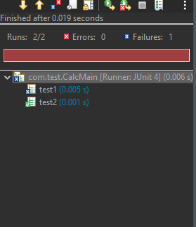
Test Execution

Slide 122
Status of a Test
A test is a single run of a test method.
Success
A test succeeds in time when No assert is violated; No fail statement is reached; No unexpected exception is thrown.
Failure
A test fails when an assert is violated or a fail statement is reached.
Error
An unexpected exception is thrown or timeout happens.

Slide 123
JDBC PROGRAMMING

Slide 124
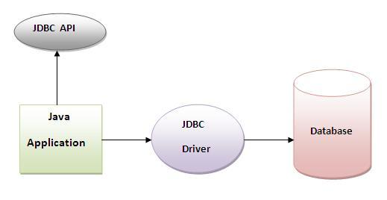
Java JDBC is a java API to connect and execute query with the database. JDBC API uses jdbc drivers to connect with the database.
Why use JDBC?
Before JDBC, ODBC API was the database API to connect and execute query with the database. But, ODBC API uses ODBC driver which is written in C language (i.e. platform dependent and unsecured). That is why Java has defined its own API (JDBC API) that uses JDBC drivers (written in Java language).

Slide 125
What is API?
API (Application programming interface) is a document that contains description of all the features of a product or software.
It represents classes and interfaces that software programs can follow to communicate with each other.
An API can be created for applications, libraries, operating systems, etc.

Slide 126
COMPONENTS OF JDBC
JDBC API
Methods & Interface for easy and effective Communication with database.
Provide two package Java.sql & Javax.sql.
JDBC Driver Manager
Load database-specific driver in an application to establish connection with the database.
JDBC Test Suite
Used to test the operations performed by JDBC drivers.
JDBC-ODBC Bridge
This bridge transfer JDBC methods calls to ODBC function calls.

Slide 127
Classes & Architecture of JDBC
DriverManager
Driver
Connection
Statement
PraparedStatement
CallableStatement
ResultSet
DatabaseMetaData
ResultSetMetaData
SqlData
Blob
Clob

Slide 128
Types of Drivers
JDBC-ODBC Bridge Driver
Native-API-Partly-Java Driver
JDBC-Net-All-Java Driver
Native-Protocol-All-Java Driver
Thick Driver
Thin Driver

Slide 129
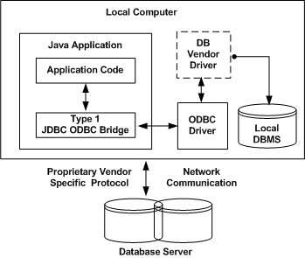
JDBC-ODBC bridge driver
The JDBC-ODBC bridge driver uses ODBC driver to connect to the database.
The JDBC-ODBC bridge driver
converts JDBC method calls
into the ODBC function calls.
Advantages:
easy to use.
can be easily connected to any database.
Disadvantages:
Performance slow because JDBC method call is converted into the ODBC function calls.
The ODBC driver needs to be installed on the client machine.

Slide 130
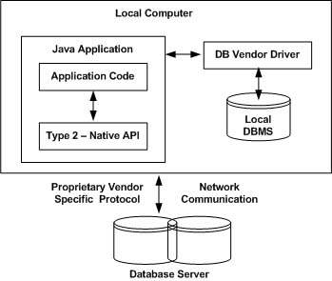
Native-API-Partly-Java Driver
In a Type 2 driver, JDBC API calls are converted into native C/C++ API calls, which are unique to the database.
These drivers are typically provided by the database vendors and used in the same manner as the JDBC-ODBC Bridge.
The vendor-specific driver must be installed on each client machine.
Advantage:
performance upgraded than JDBC-ODBC bridge driver.
Disadvantage:
The Native driver needs to be
installed on the each client machine.
The Vendor client library needs to be
installed on client machine.

Slide 131
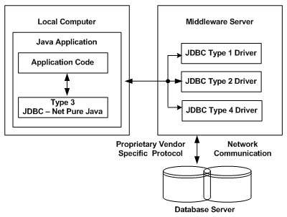
JDBC-Net-All-Java Driver
In a Type 3 driver, a three-tier approach is used to access databases.
The JDBC clients use standard network sockets to communicate with a middleware application server.
The socket information is then translated by the middleware application server into the call format required by the DBMS.
Forwarded to the database server.
Advantage:
No client side library is required because of Middleware
server that can perform many tasks like auditing,
load balancing, logging etc.
Disadvantages:
Network support is required on client machine.
Requires database-specific coding to be done
in the middle tier.
Maintenance of Network Protocol driver becomes
costly because it requires database-specific coding to be done
in the middle tier.

Slide 132
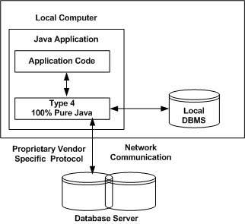
Native-Protocol-All-Java Driver{ Thin Driver}
In a Type 4 driver, a pure Java-based driver communicates directly with the vendor's database through socket connection.
This is the highest performance driver available for the database and is usually provided by the vendor itself.
This kind of driver is extremely flexible, you don't need to install special software on the client or server.
Advantage:
Better performance than all other drivers.
No software is required at client side or server side.
Disadvantage:
Drivers depends on the Database.

Slide 133
5 Steps to connect to the database in java
Register the driver class
Creating connection
Creating statement
Executing queries
Closing connection

Slide 134
Register the driver class
The forName() method of Class class is used to register the driver class.
This method is used to dynamically load the driver class.
Syntax of forName() method
public static void forName(String className)throws ClassNotFoundException
Example to register the OracleDriver class
Class.forName("oracle.jdbc.driver.OracleDriver");

Slide 135
Create the connection object
The getConnection() method of DriverManager class is used to establish connection with the database.
Syntax of getConnection() method
1) public static Connection getConnection(String url)throws SQLException
2) public static Connection getConnection(String url,String name,String password) throws SQLException
Example to establish connection with the Oracle database
Connection con=DriverManager.getConnection( "jdbc:oracle:thin:@localhost:1521:xe","system","password");

Slide 136
Create the Statement object
The createStatement() method of Connection interface is used to create statement.
The object of statement is responsible to execute queries with the database.
Syntax of createStatement() method
public Statement createStatement()throws SQLException
Example to create the statement object
Statement stmt=con.createStatement();

Slide 137
Execute the query
The executeQuery() method of Statement interface is used to execute queries to the database.
This method returns the object of ResultSet that can be used to get all the records of a table.
Syntax of executeQuery() method
public ResultSet executeQuery(String sql)throws SQLException
Example to execute query
ResultSet rs=stmt.executeQuery("select * from emp");
while(rs.next())
{
System.out.println(rs.getInt(1)+" "+rs.getString(2));
}

Slide 138
Close the connection object
The close() method of Connection interface is used to close the connection.
Syntax of close() method
public void close()throws SQLException
Example to close connection
con.close();

Slide 139
DriverManager class
The DriverManager class acts as an interface between user and drivers.
It keeps track of the drivers that are available and handles establishing a connection between a database and the appropriate driver.
The DriverManager class maintains a list of Driver classes that have registered themselves by calling the method DriverManager.registerDriver().

Slide 140
Methods of DriverManager class
Method | Description
public static void registerDriver(Driver driver): | is used to register the given driver with DriverManager.
public static void deregisterDriver(Driver driver): | is used to deregister the given driver (drop the driver from the list) with DriverManager.
public static Connection getConnection(String url): | is used to establish the connection with the specified url.
public static Connection getConnection(String url,String userName,String password): | is used to establish the connection with the specified url, username and password.

Slide 141
Connection interface
A Connection is the session between java application and database.
The Connection interface is a Collection of Statement, PreparedStatement, and DatabaseMetaData i.e. object of Connection can be used to get the object of Statement and DatabaseMetaData.
Methods | Description
public Statement createStatement() | creates a statement object that can be used to execute SQL queries.
public Statement createStatement(int resultSetType,int resultSetConcurrency) | Creates a Statement object that will generate ResultSet objects with the given type and concurrency.
public void setAutoCommit(boolean status) | is used to set the commit status.By default it is true.
public void commit() | saves the changes made since the previous commit/rollback permanent.
public void rollback() | Drops all changes made since the previous commit/rollback.
public void close() | closes the connection and Releases a JDBC resources immediately.

Slide 142
Statement interface
The Statement interface provides methods to execute queries with the database.
The statement interface is a factory of ResultSet i.e. it provides factory method to get the object of ResultSet.
Methods | Descriptions
public ResultSet executeQuery(String sql) | is used to execute SELECT query. It returns the object of ResultSet.
public int executeUpdate(String sql) | is used to execute specified query, it may be create, drop, insert, update, delete etc.
public boolean execute(String sql) | is used to execute queries that may return multiple results.
public int[] executeBatch() | is used to execute batch of commands.

Slide 143
ResultSet interface
The object of ResultSet maintains a cursor pointing to a row of a table.
Initially, cursor points to before the first row.

Slide 144
Methods of ResultSet
Methods | Description
public boolean next(): | is used to move the cursor to the one row next from the current position.
public boolean previous(): | is used to move the cursor to the one row previous from the current position.
public boolean first(): | is used to move the cursor to the first row in result set object.
public boolean last(): | is used to move the cursor to the last row in result set object.
public boolean absolute(int row): | is used to move the cursor to the specified row number in the ResultSet object.
public boolean relative(int row): | is used to move the cursor to the relative row number in the ResultSet object, it may be positive or negative.
public int getInt(int columnIndex): | is used to return the data of specified column index of the current row as int.
public int getInt(String columnName): | is used to return the data of specified column name of the current row as int.
public String getString(int columnIndex): | is used to return the data of specified column index of the current row as String.
public String getString(String columnName): | is used to return the data of specified column name of the current row as String.

Slide 145
PreparedStatement interface
The PreparedStatement interface is a sub interface of Statement.
It is used to execute parameterized query.
Syntax
String sql="insert into emp values(?,?,?)";
we are passing parameter (?) for the values.
Its value will be set by calling the setter methods of PreparedStatement.
Why use PreparedStatement?
Improves performance: The performance of the application will be faster if you use PreparedStatement interface because query is compiled only once.

Slide 146
How to get the instance of PreparedStatement?
The prepareStatement() method of Connection interface is used to return the object of PreparedStatement.
Syntax
public PreparedStatement prepareStatement(String query)throws SQLException{}
Example
PreparedStatement stmt=con.prepareStatement("insert into detail values(?,?)")

Slide 147
Methods of PreparedStatement interface
Method | Description
public void setInt(int paramIndex, int value) | sets the integer value to the given parameter index.
public void setString(int paramIndex, String value) | sets the String value to the given parameter index.
public void setFloat(int paramIndex, float value) | sets the float value to the given parameter index.
public void setDouble(int paramIndex, double value) | sets the double value to the given parameter index.
public int executeUpdate() | executes the query. It is used for create, drop, insert, update, delete etc.
public ResultSet executeQuery() | executes the select query. It returns an instance of ResultSet.

Slide 148
ResultSetMetaData Interface
The metadata means data about data i.e. we can get further information from the data.
If you have to get metadata of a table like total number of column, column name, column type etc.
ResultSetMetaData interface is useful because it provides methods to get metadata from the ResultSet object.
How to get the object of ResultSetMetaData:
The getMetaData() method of ResultSet interface returns the object of ResultSetMetaData.
Syntax
public ResultSetMetaData getMetaData()throws SQLException

Slide 149
Methods of ResultSetMetaData interface
Method | Description
public int getColumnCount()throws SQLException | it returns the total number of columns in the ResultSet object.
public String getColumnName(int index)throws SQLException | it returns the column name of the specified column index.
public String getColumnTypeName(int index)throws SQLException | it returns the column type name for the specified index.
public String getTableName(int index)throws SQLException | it returns the table name for the specified column index.

Slide 150
DatabaseMetaData interface
DatabaseMetaData interface provides methods to get meta data of a database such as database product name, database product version, driver name, name of total number of tables, name of total number of views etc.
How to get the object of DatabaseMetaData:
The getMetaData() method of Connection interface returns the object of DatabaseMetaData.
Syntax
public DatabaseMetaData getMetaData()throws SQLException
Example
DatabaseMetaData dbmb=con.getMetaData();

Slide 151
Methods of DatabaseMetaData interface
Methods | Description
public String getDriverName()throws SQLException | it returns the name of the JDBC driver.
public String getDriverVersion()throws SQLException | it returns the version number of the JDBC driver.
public String getUserName()throws SQLException | it returns the username of the database.
public String getDatabaseProductName()throws SQLException | it returns the product name of the database.
public String getDatabaseProductVersion()throws SQLException | it returns the product version of the database.
public ResultSet getTables(String catalog, String schemaPattern, String tableNamePattern, String[] types)throws SQLException | it returns the description of the tables of the specified catalog. The table type can be TABLE, VIEW, ALIAS, SYSTEM TABLE, SYNONYM etc.

Slide 152
CallableStatement Interface
CallableStatement interface is used to call the stored procedures and functions.
We can have business logic on the database by the use of stored procedures and functions that will make the performance better because these are precompiled.
Example
Suppose you need the get the age of the employee based on the date of birth, you may create a function that receives date as the input and returns age of the employee as the output.

Slide 153
What is the difference between stored procedures and functions?
Stored Procedure | Function
is used to perform business logic. | is used to perform calculation.
must not have the return type. | must have the return type.
may return 0 or more values. | may return only one values.
We can call functions from the procedure. | Procedure cannot be called from function.
Procedure supports input and output parameters. | Function supports only input parameter.
Exception handling using try/catch block can be used in stored procedures. | Exception handling using try/catch can't be used in user defined functions.

Slide 154
How to get the instance of CallableStatement?
The prepareCall() method of Connection interface returns the instance of CallableStatement.
Syntax
public CallableStatement prepareCall("{ call procedurename(?,?...?)}");
The example to get the instance of CallableStatement is given below:
CallableStatement stmt=con.prepareCall("{call myprocedure(?,?)}");

Slide 155
Transaction Management in JDBC
Atomicity means either all successful or none.
Consistency ensures bringing the database from one consistent state to another consistent state.
Isolation ensures that transaction is isolated from other transaction.
Durability means once a transaction has been committed, it will remain so, even in the event of errors, power loss etc.

Slide 156
Connection interface provides methods to manage transaction.
Method | Description
void setAutoCommit(boolean status) | It is true bydefault means each transaction is committed bydefault.
void commit() | commits the transaction.
void rollback() | cancels the transaction.

Slide 157
Thank You

