Slide 1
IBM University Engagement Project Submission
“Exploring the Power of Agentic AI with IBM Granite and LangFlow”

Slide 2
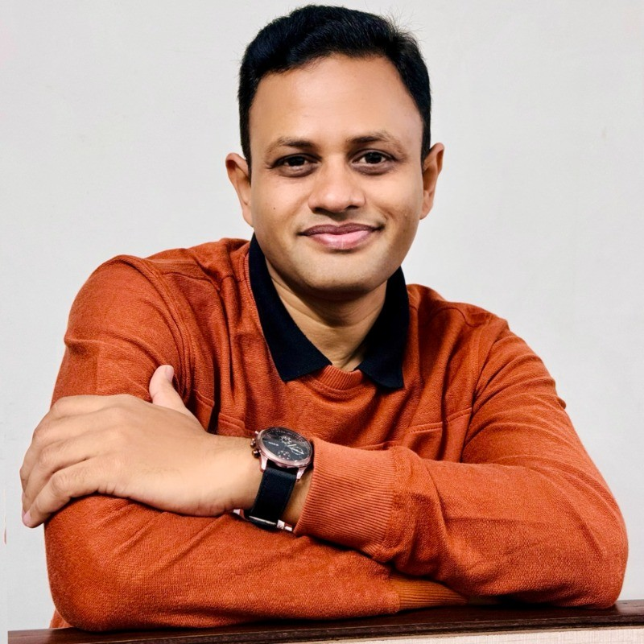
Project Tile – [Write your project title here]
Domain of Project – [ like Agriculture / Education / Healthcare / … ]
Student Name | Recent Passport Photo | Email ID | Mobile number [WhatsApp]
Ronak Patel |  | ronakrpatel.ce@charusat.ac.in | 9409330900

Slide 3
Problem Statement -
Problem Statement Research Agent
The Challenge
Researchers, students, and professionals often deal with scattered academic papers, technical articles, and experimental data spread across multiple platforms. Filtering relevant knowledge, summarizing insights, and keeping track of the latest developments is time-consuming and inefficient. The challenge is not just to collect references but to synthesize, analyze, and
generate actionable research insights in real time.
The Objective
Build an agentic AI application that acts as an intelligent research companion. The solution
should:
1. Fuse Academic Sources: Aggregate data from research papers, journals, preprints, and
knowledge repositories, then synthesize them into clear, concise literature reviews.
2. Enable Multimodal Research Input: Accept user queries, notes, charts, or even PDFs, and
convert them into structured insights, references, and summaries.
3. Create a Predictive & Agentic Layer: Highlight emerging trends, detect citation gaps, and
predict promising directions for future research in a given domain.
4. Visualize Research Insights: Provide an interactive dashboard with topic clusters, citation
maps, sentiment/trend analysis, and concise knowledge graphs.

Slide 4
Technology Used
Tech Stack (Mandatory)
Use any one of the following approaches:
LangFlow + IBM watsonx.ai + Granite Models
IBM Cloud Agentic Lab with IBM Granite Models
Replicate with LangChain + RAG + IBM Granite Models
I used LangFlow + IBM watsonx.ai + Granite Models

Slide 5
Proposed Solution -
Proposed Solution: Research Agent
The proposed solution is an AI-Powered Research Assistant Agent developed using LangFlow, IBM watsonx.ai, and IBM Granite Models to support researchers, academicians, and students throughout the research lifecycle. The system leverages Retrieval-Augmented Generation (RAG) to retrieve relevant information from research papers, journals, and academic databases, ensuring accurate and context-aware responses. It integrates multiple intelligent agents, including a Research Knowledge Agent for retrieving and summarizing scholarly content, a Literature Review Agent for identifying relevant studies and research gaps, a Research Advisory Agent for recommending methodologies and datasets, and a Document Analysis Agent for reviewing uploaded manuscripts and providing summaries and improvement suggestions. With an interactive dashboard for literature search, reference management, and progress tracking, the solution delivers an end-to-end intelligent research companion that enhances productivity, simplifies literature review, and supports informed research and publication decisions.

Slide 6
Langflow component Used -
1) Chat Input – Interface where users enter their research queries, keywords, paper titles, or upload research documents for analysis.
2) IBM watsonx AI Agent – Processes user queries using IBM Granite models to generate research insights, summarize literature, answer questions, and provide recommendations.
3) IBM Granite Model – Granite-4.0-8B-Instruct → Used for research paper summarization, literature review, question answering, and content generation.
4) Chat Output – Displays AI-generated responses such as research summaries, literature reviews, methodology suggestions, citation assistance, and research recommendations.
5) File Component – Stores and retrieves research papers, PDFs, datasets, and academic documents for Retrieval-Augmented Generation (RAG) and document analysis.
6) Astra DB / Vector Store (or Chroma DB if used) – Stores embeddings of research documents and enables semantic search for retrieving relevant information in the RAG pipeline.

Slide 7
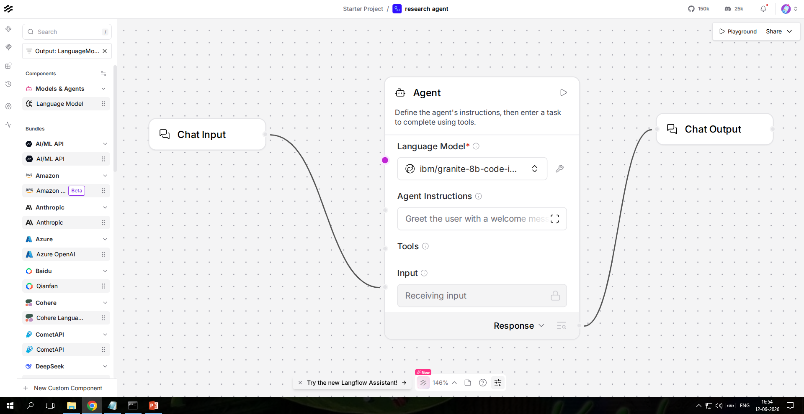
Langflow workflow -

Slide 8
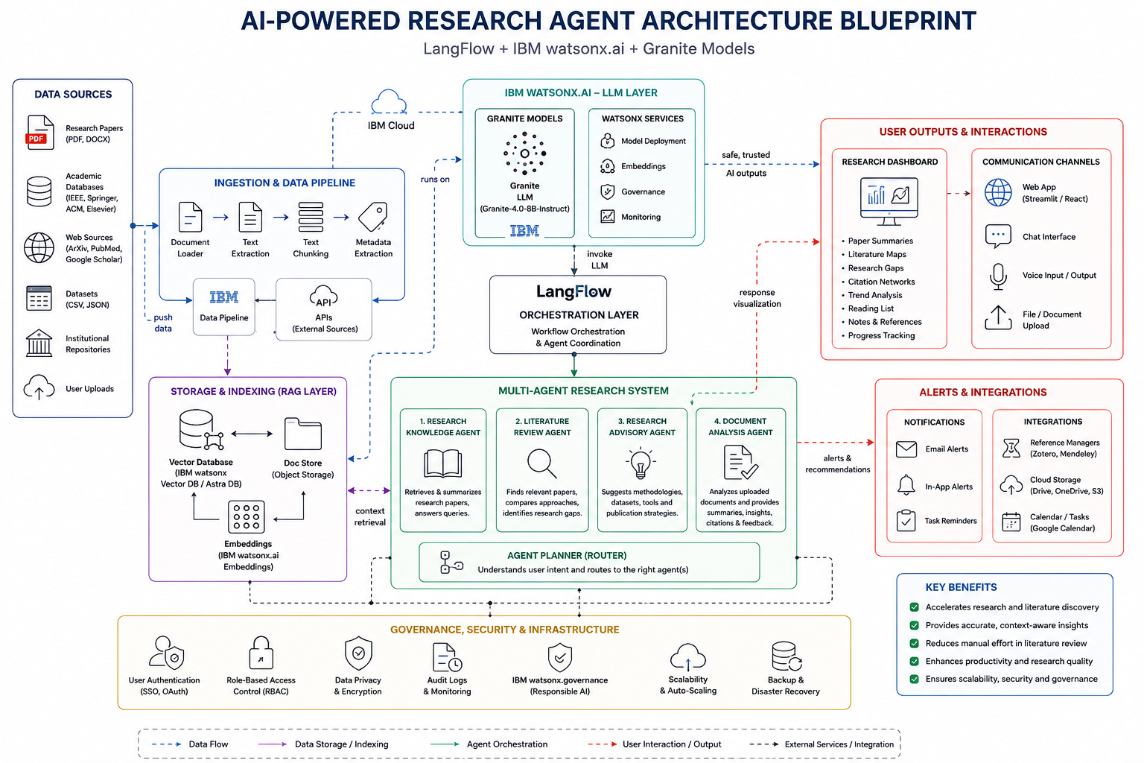
Architecture blueprint

Slide 9

Role of Agentic AI in the solution
Role of Agentic AI in Research Agent
Agentic AI enables the Research Agent to function as an intelligent, autonomous research companion rather than a simple search tool. Using IBM watsonx.ai and IBM Granite models, it coordinates multiple specialized agents to deliver synthesized, real-time academic insights. Each agent performs a specific role — such as aggregating research papers from arXiv and PubMed, detecting citation gaps, predicting emerging trends, and generating structured literature reviews — while working collaboratively. This multi-agent approach ensures comprehensive knowledge coverage and accurate, grounded results. Agentic AI also brings context awareness, understanding the user's research domain, expertise level, and specific objectives to generate tailored summaries and recommendations. It supports real-time adaptation, continuously updating its knowledge base as new papers are published and new queries are submitted. Additionally, agents communicate with each other — the Source Fusion Agent feeds retrieved papers to the Citation Gap Detector, which then informs the Trend Prediction Agent — enabling smarter decision-making and richer research outputs. Overall, Agentic AI makes the system proactive, domain-aware, and insight-driven, acting like a smart digital research assistant that helps researchers, students, and professionals stay ahead of the knowledge curve and accelerate their academic work.

Slide 10
Technology Used
Langflow platform -For designing and orchestrating multi-agent workflows visually
IBM Grainte model - for eg – ibm-granite-3-2-8b – For natural language understanding, reasoning, and personalization
IBM Cloud – It provides the infrastructure to build, deploy, and scale the Research Agent efficiently. IBM Cloud enables a reliable, secure, and scalable environment for deploying the Research Agent across academic and enterprise use cases.
RAG– RAG to fetch real academic papers first, then generate intelligent research summaries, making the Research Agent more trustworthy, grounded, and citation-accurate.
IBM Watsonx.ai - For model deployment, embeddings generation, vector store management, and AI governance ensuring transparent and auditable research outputs.
Vector Database For RAG-based academic paper retrieval, storing paper embeddings for fast semantic search across arXiv, PubMed, and Semantic Scholar sources.

Slide 11
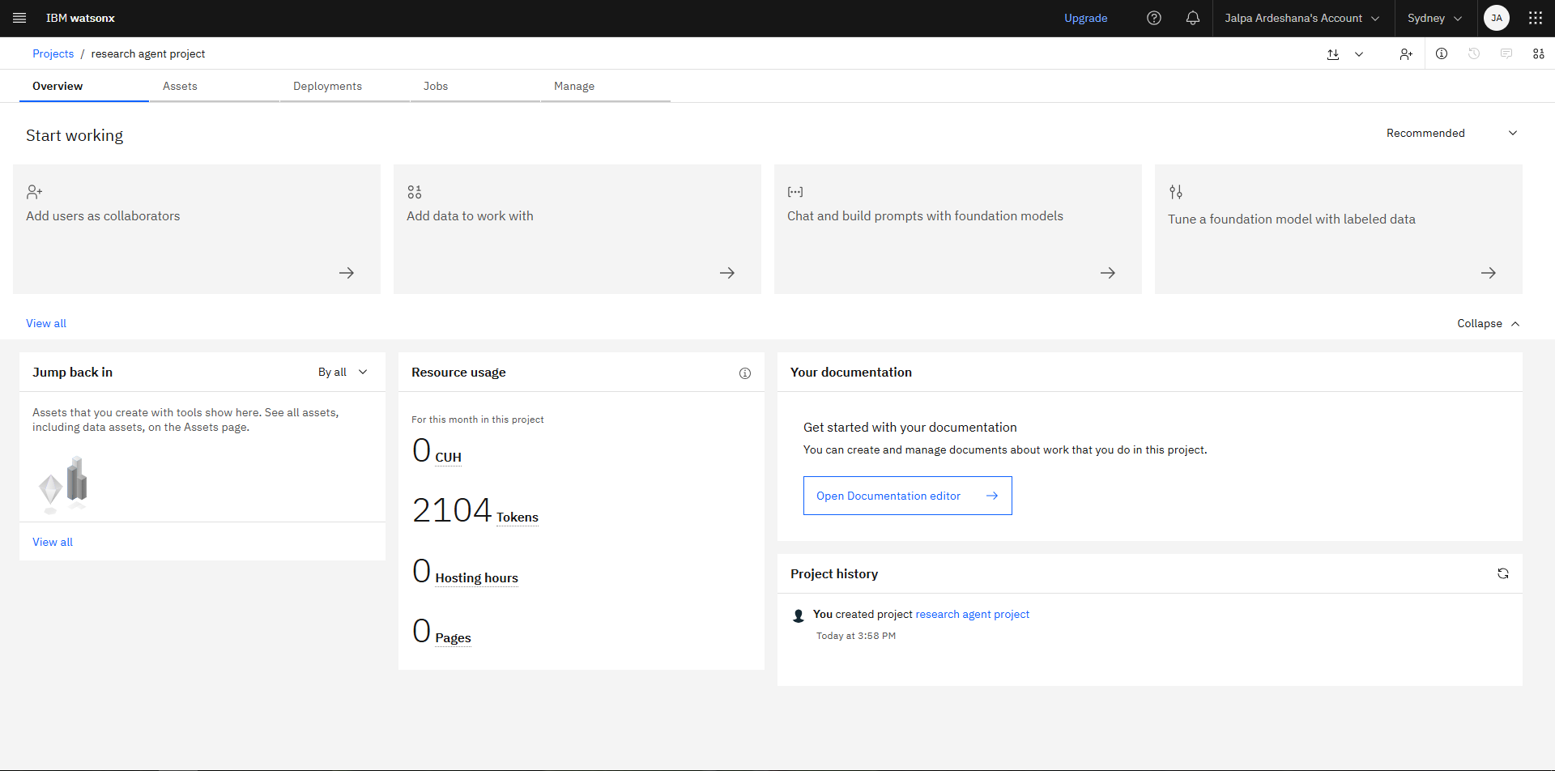
Token Usage
2104 token used.
·
·
·

Slide 12
Novelty and Uniqueness
Here's the Novelty and Uniqueness content for the Research Agent in the same format:The proposed Research Agent stands out by combining Agentic AI, RAG, and predictive intelligence into a single intelligent academic research companion.Multi-Agent Intelligence – Instead of a single search tool, multiple specialized agents collaborate to deliver accurate, synthesized, and context-aware research insights and literature reviews.RAG-Based Accuracy – Integrates real-time academic paper retrieval from arXiv, PubMed, and Semantic Scholar with AI generation, reducing hallucinations and ensuring trustworthy, citation-grounded outputs.Citation Gap Detection – Automatically identifies missing references and weak citation links in a research area, suggesting papers that strengthen and complete the academic argument.Predictive Trend Forecasting – Uses temporal citation velocity and topic momentum to predict emerging research directions, helping researchers stay ahead of the knowledge curve.Multi-Modal Research Input – Supports text queries, uploaded PDFs, chart images, and voice notes for flexible and seamless research workflows.Interactive Knowledge Visualization – Goes beyond text outputs to provide dynamic topic cluster maps, citation networks, and sentiment trend dashboards for deeper research insight.Scalable & Enterprise-Ready – Built on IBM watsonx.ai with IBM Granite models, ensuring reliable, auditable, and governed AI outputs suitable for academic institutions and enterprises.

Slide 13
Git Hub Link
· Please create public github repository (Enable Add README button while creating repository) with format –
Please test and Paste the working Github URL –https://github.com/pRonak86/IBM_FDP_BVM
Make sure you have Uploaded following three files into your github repository 1) app.json file , 2) yourproblemstatement.pdf file 3) your projectpresntation.pptx file
·
·
·

Slide 14
Future Scope
1. Collaborative Multi-User Research Workspace – The Research Agent can be extended to support real-time collaboration among multiple researchers, allowing teams to share agent sessions, co-annotate papers, and merge literature reviews simultaneously — similar to Google Docs but powered by Agentic AI for academic research.
2. Voice-Enabled Research Assistant & Multilingual Support – Enhancing the system with a voice-enabled interface and support for multiple languages such as Hindi, Spanish, and Mandarin will improve accessibility. Researchers can interact naturally in their preferred language, making the solution more inclusive and suitable for global academic communities.
3. Automated Research Paper Drafting – The agent can be extended to not just review but autonomously draft entire research paper sections — including introduction, literature review, and methodology — grounded in retrieved sources with proper citation formatting (APA, MLA, IEEE) generated automatically.
4. Integration with Reference Managers (Zotero / Mendeley) – Seamlessly syncing with popular reference management tools will allow the agent to auto-populate citation libraries, push newly discovered papers directly into researchers' existing workflows, and eliminate manual bibliography management entirely.
·
·
·

Slide 15


