Slide 1

Leaf Growth Modelling
Om Prakash and Pratyay Pande
Supervision under: Prof Sujin B Babu

Slide 2
Existing research on this field
In litreature, we had some currently existing models available to us to refer to.
For example, we tried to understand models like the AUSIM-Maize and the CERES-Maize, which were complicated as well as computationally expensive
Some models were beyond our understanding. These models take into account a lot of factors to evaluate the structure of the leaf, which often involve solving PDEs, requiring high computational resources and GPUs for calculation
In our model, we have tried to model the growth of the leaf using simple physics, which is much less computationally and resource inexpensive, and we found that we can get similar results with much less complicated calculations.

Slide 3
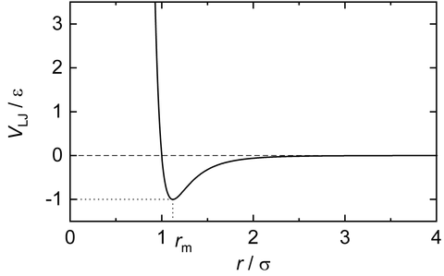

Aim: To simulate a cubical box containing fixed amount of spherical atoms under
Lennard-Jones Potential.
Week-1
As per the given figure, LJ potential is effective only within the range of [1,2].
So, in order to stay the particles subjected to LJ potential the interparticle distance must be within [1,2].
We assumed, the distance r/sigma, to vary from 1 to 2. Thus, the interparticle distance will decide the rate in a
compartment.

Slide 4
Layer 1
Layer 2…
Idea:
For compartment 1, we fix the cell division after layer 2 to take place when it has reached a distance of r/sigma = 1.2(just for analysis).
Similarly we can get a large set of r/sigma within [1,2] and different sets of growth too.
The figure below shows the idea used in the code.
Week-1
Direction of growth
Stem
r/sigma
r/sigma
Layer 1
Layer 2
Layer 3
Stem

Slide 5
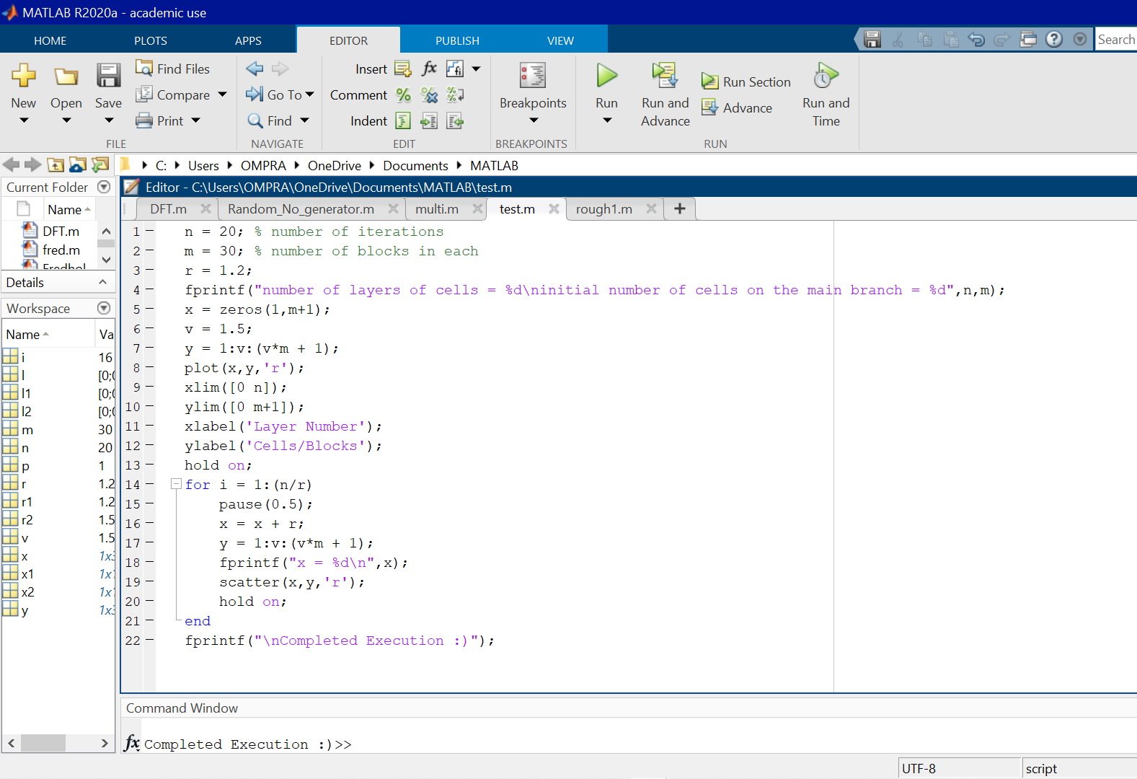
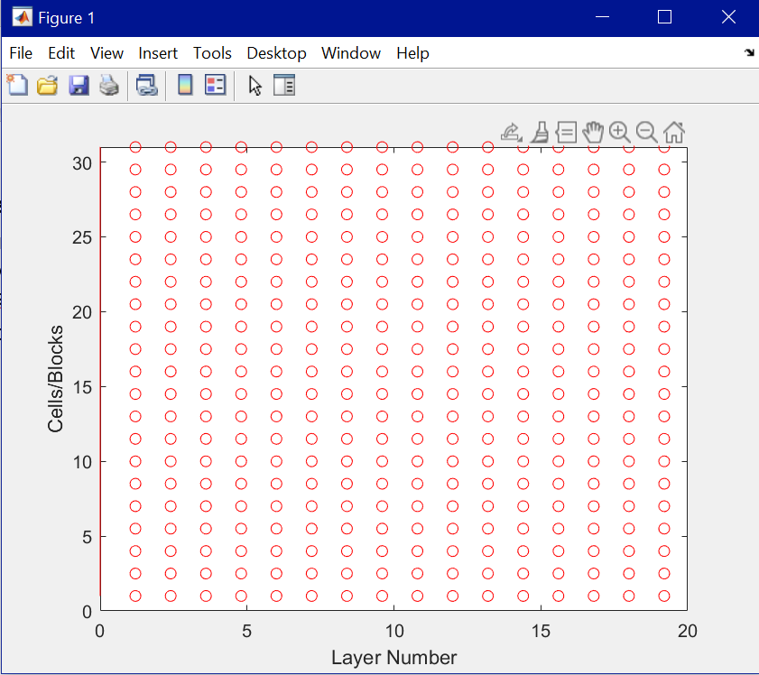
Idea Incorporation:
Successfully created a MATLAB program for one compartment to visualise the growth.
However, the code is crude yet.
Week-1
Program
Simulation output of Program

Slide 6
AIM: To write a program for a combination of compartments with their respective radius derived from a Gaussian distribution.
Idea:
If we limit the radii distance to be bounded in [1,2], we can get a Gaussian distribution of radii values between 1 and 2.
We can derive those values and use them respectively for different compartments.
The given fig. 1, shows the radius values.
2
Week-2
r6
r5
r7
r4
r8
r1
r2
r3
r4
r3
r9
r1
r2
r10
Comp. 1
Comp. 2
Comp. 3
Comp. 4
1
2
Fig. Particles with different radius encapsulated by a curve

Slide 7
Leaf Blade
Week-2
Direction of Growth
Microscopic view of the particles
of different compartments
Stem
Idea is that if we take a large no. of compartments with a perfectly organised respective rates. We can get a leaf like structure.

Slide 8
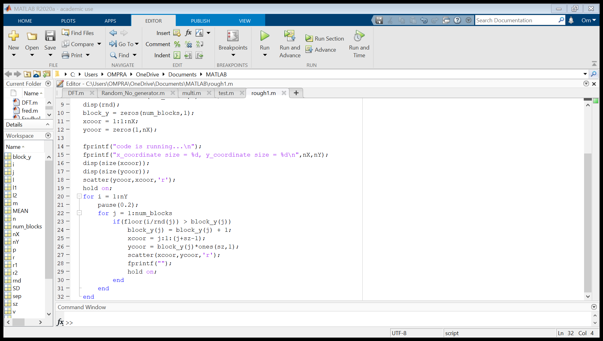
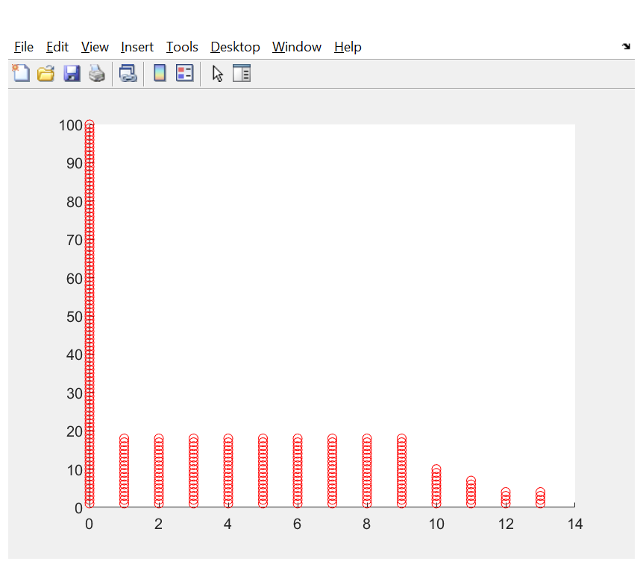
MATLAB PROGRAM AND WORKING OUTPUT:
Week-2
Output

Slide 9
Aim: Simulation of a cell fission in a linear direction with a given rate under Lenard – Jones potential.
Idea:
First we segmented the leaf structure into compartments and simulated the growth of leaf cells in accordance to Lenard-Jones potential.
Now we concentrate on the growth rate of a single leaf cell under in accordance to any potential (as of now we have taken Lenard-Jones Potential into account but it can be changed anytime with another potential function).
Week-3

Slide 10
Week-3
r/sigma
r/sigma

Slide 11
Implementation:
Consider we have n cells on a line (n>=1).
So, net potential in this configuration will be:
_{i=1} Σ^{n-1} _{j=1+1}Σ^{n} U_{ij} = _{i=1} Σ^{n-1} _{j=1+1}Σ^{n} LJ_{ij}
Calculation of roots for this Potential function.
By roots, we can find the value of the separation between the cells such that,
_{i=1} Σ^{n-1} _{j=1+1}Σ^{n} D(LJ_{ij})
Week-3

Slide 12
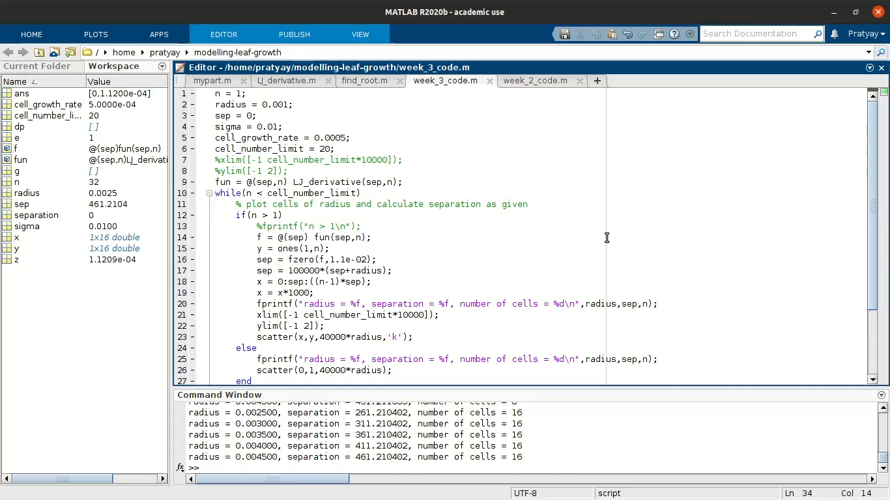
Program and Output
Week-3

Slide 13
FINAL IMPLEMENTATION OF THE IDEA AND RESULTS
Final

Slide 14
IDEA:
The initial idea is the same. We needed to work on the project to see if we can get a model that gives us the final state of growth of a leaf
Before the mid-sem presentation, our progress stands such:
Final
We had successfully compartmentalised the leaf, and had taken into account the Lennard-Jones Potential function between the cells of the leaf.
We initially demonstrated that it is possible to grow each compartment of the leaf given the growth rate of one cell with this model

Slide 15
Cells divide and each compartment grows as shown in the diagram
r/sigma
r/sigma
Expected final state of the cells:
Final
Leaf Blade
Stem

Slide 16
RESULTS:
The rate of growth of the leaf is varied according to various functions, and after the growth, we can get a good representation of the leaf.
Upon observation of the feasibility of the idea, we developed the code to implement this, and observed that it actually works.
We can say that it is possible to model the growth of a leaf using concepts of simple physics.
Final

Slide 17
DEVELOPING THE CODE:
Final

Slide 18
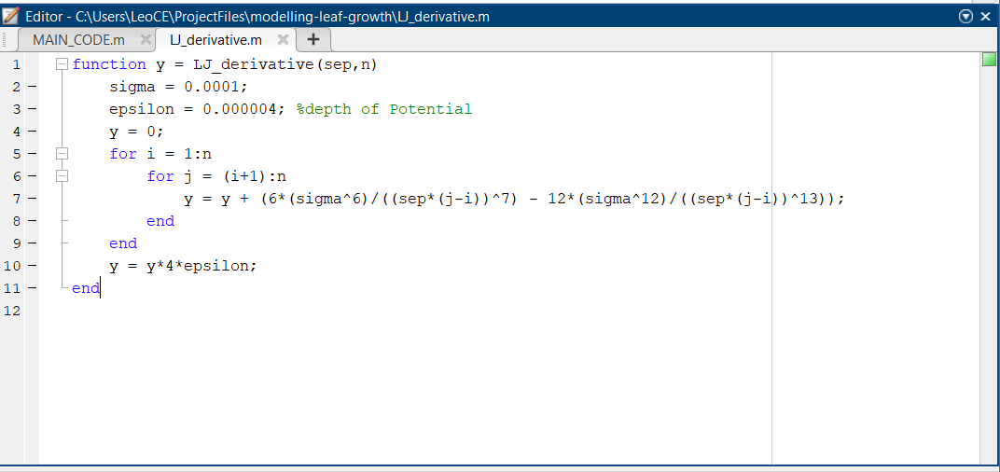
Calculation of optimum separation for minimum potential:
Final

Slide 19
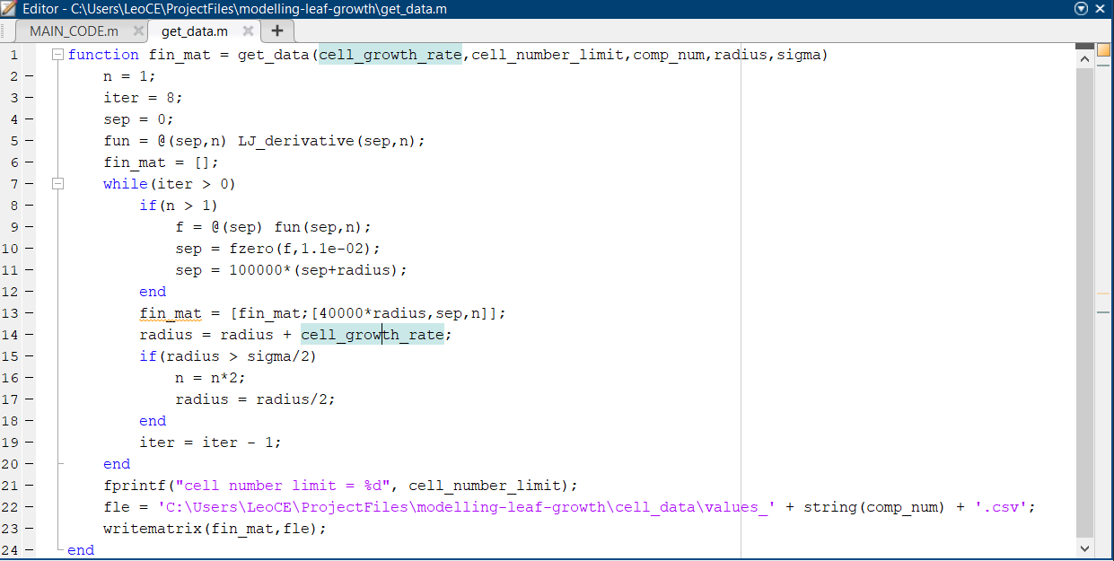
Calculation of the cell-growth data
Final

Slide 20
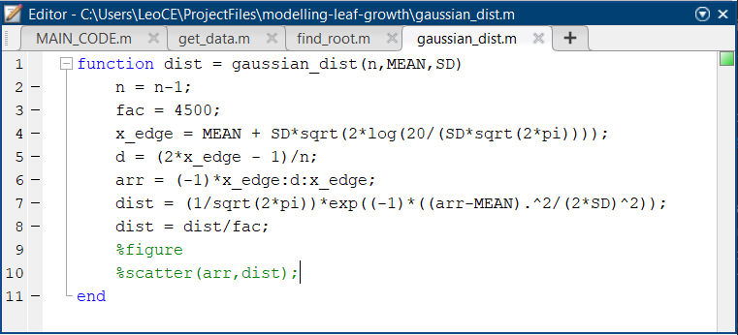
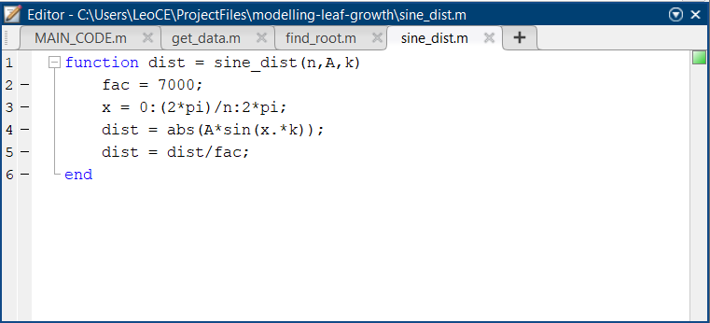
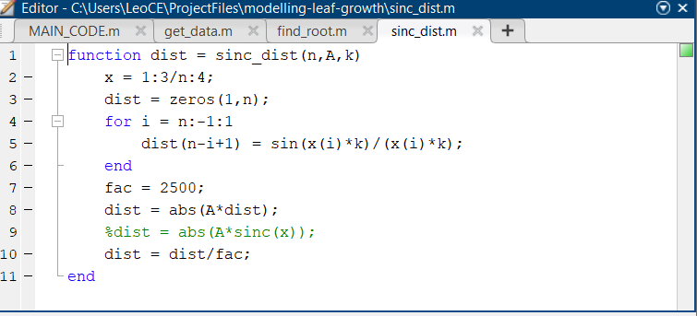
Calculation of rates of growth of the cells
Final
3 different ways of computing the rates of growth of the cells, thus resulting in 3 different types of leaves

Slide 21
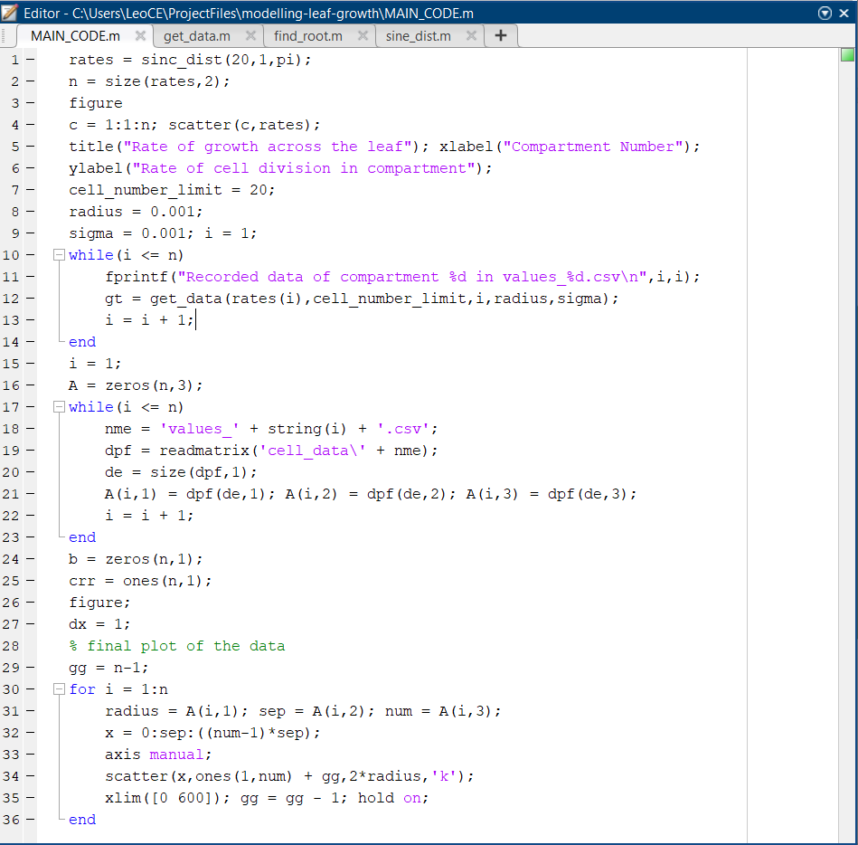
Main code to represent the data
Attached alongside is the main code from which the above functions are called respectively to get the desired outputs
Final

Slide 22
RESULTS:
(LEAVES OBTAINED)
Final

Slide 23
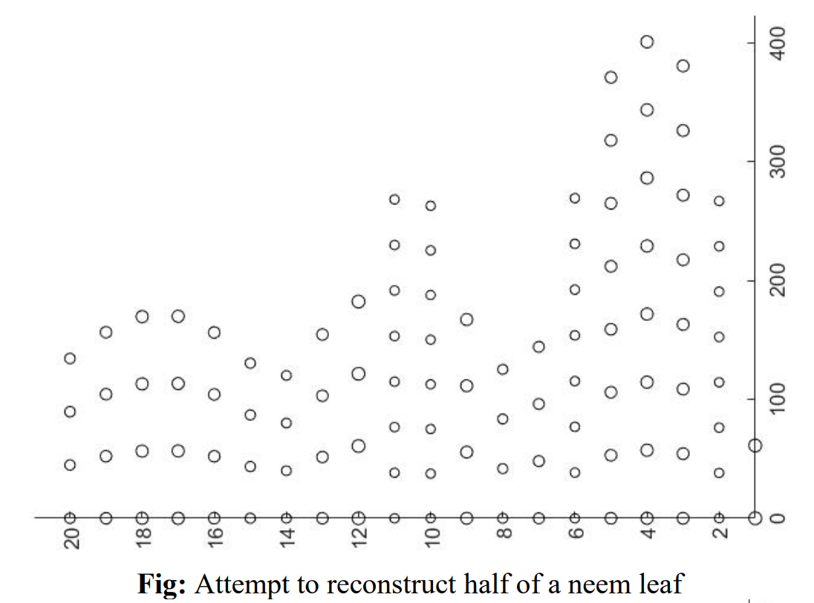
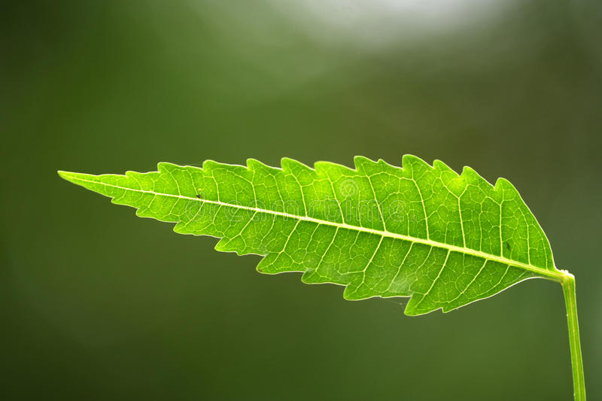
Neem leaf
Attached alongside is a representation of a neem leaf obtained by the model developed.
Final

Slide 24
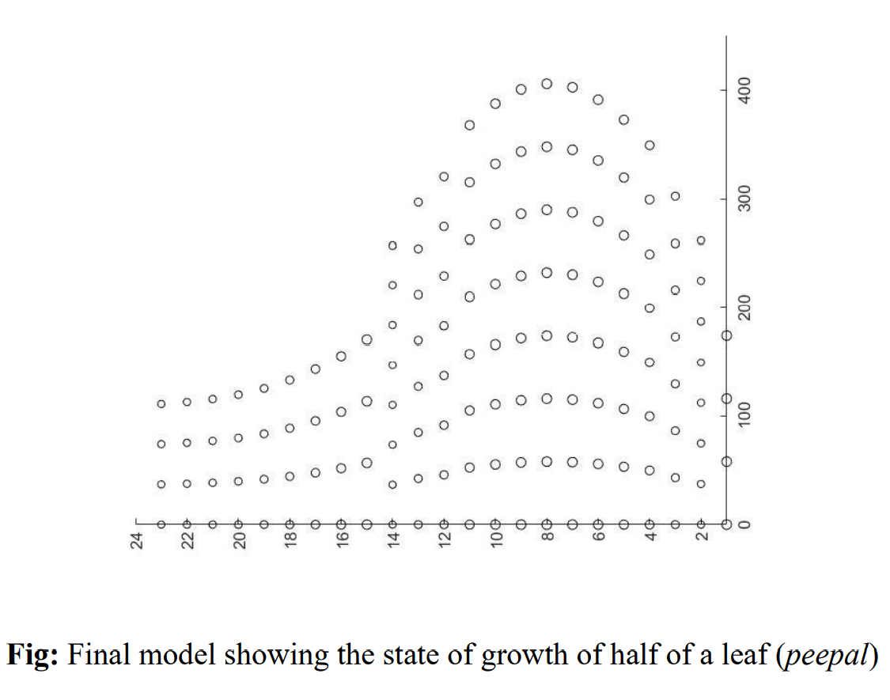
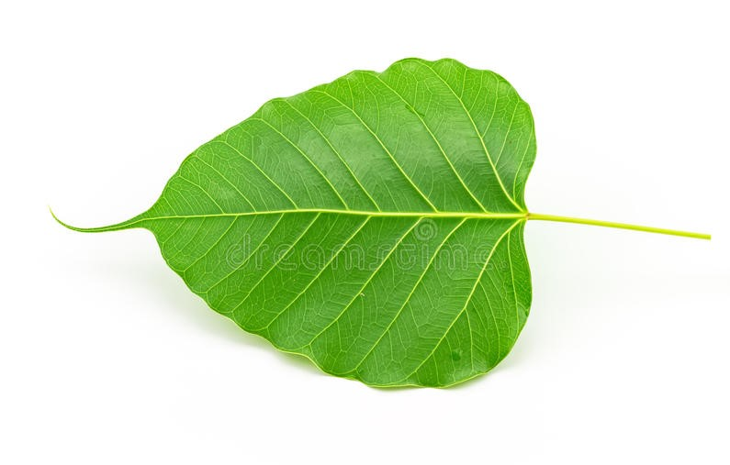
Peepal leaf
Attached alongside is a representation of a peepal leaf obtained by the model developed.
Final

