Slide 1

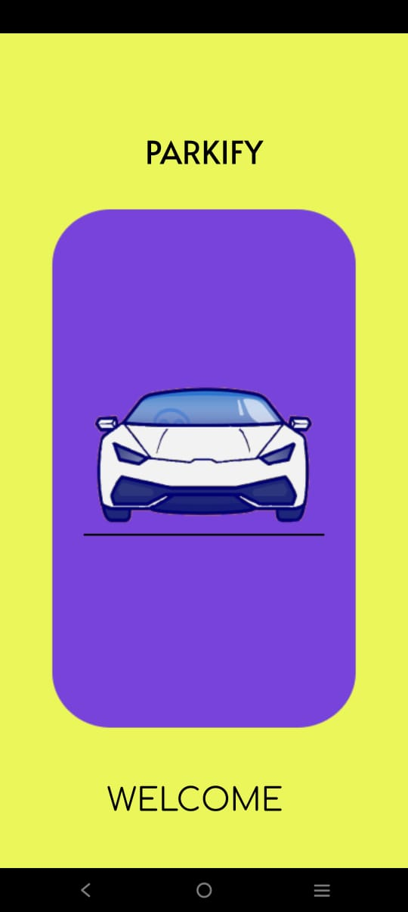






The Welcome screen is the first
screen of our app.
The user can click anywhere on the screen
to proceed.

Slide 2
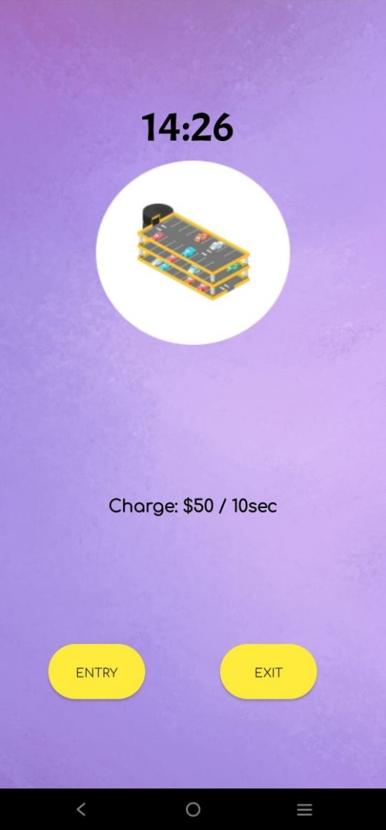


This screen will be present at both,
entrance and exit
User can select “ENTRY” and
proceed further.

Slide 3
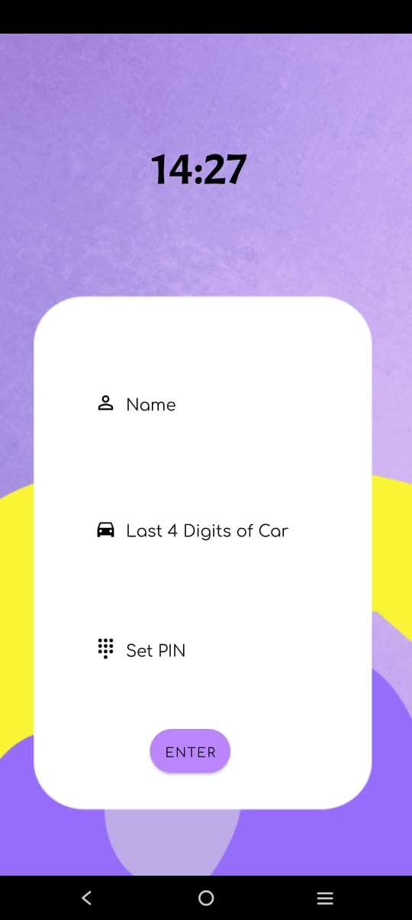
User enters the details
User cannot proceed further without
entering the complete details

Slide 4
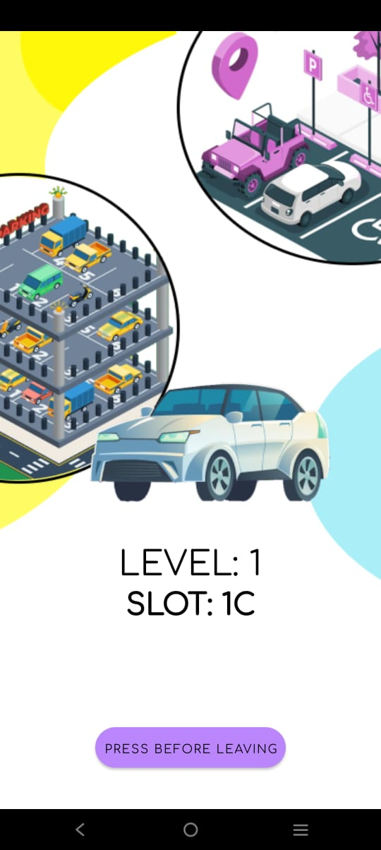
After entering valid details, user will get the nearest vacant slot code along with the level

Slide 5

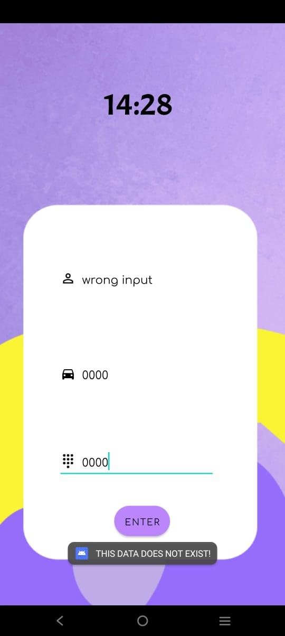
At exit, User can select “Exit” and enter their details to get the amount to be paid.
In case user enters invalid details, they will get the error message “THIS DATA DOES NOT EXIST!”

Slide 6
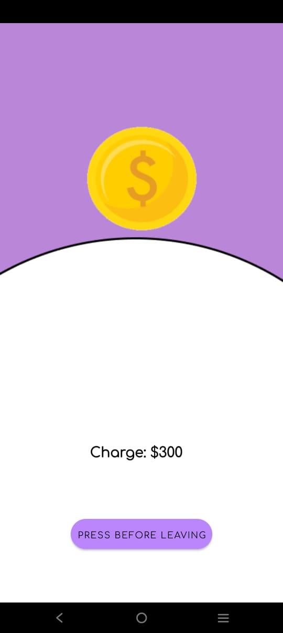
After entering valid details at exit screen user will get the charges to paid

Slide 7
Piyush Arya: p_arya@cs.iitr.ac.in Mob. No.- 9116916870 Enrollment No. – 21117074
Contribution - Basic Framework of the application, Database Management, Shared Preferences, Class Diagram.
Pranavdeep Singh: p_singh2@cs.iitr.ac.in Mob. No.- 8920582347 Enrollment No. – 21119036
Contribution – Basic Framework of the application, Page Linking, Database Management, Shared Preferences,
Use Case Diagram and Flowchart.
Priyansh Mawal: p_mawal@cs.iitr.ac.in Mob. No. – 6378146484 Enrollment No. - 21114076
Contribution – UI Design and Slides
Priyanshu Behera: p_behera@cs.iitr.ac.in Mob. No. – 9340371238 Enrollment No. - 21114077
Contribution – UI Design and Sequence Diagrams
Rajat Raj Singh: r_rsingh@cs.iitr.ac.in Mob. No. – 8218516522 Enrollment No. - 21114079
Contribution – Basic Framework of the application, Page Linking, Database Management, Shared Preferences,
Use Case Diagram and Flowchart.
Atharv Chhabra: a_chhabra@cs.iitr.ac.in Mob. No.- 6260888533 Enrollment No. - 21118025
Contribution - UI Design, Nearest Slot Algorithm, Project Report

