Slide 1




Estimation and Pricing with the Schwartz and Smith Two-Factor Model
This presentation explores the estimation and application of the Schwartz and Smith (2000) two-factor model for commodity futures and options pricing. We cover futures pricing theory, Monte Carlo simulation, Fourier-based option pricing, and Kalman filter estimation using crude oil data.
The model decomposes log-spot prices into short-term mean-reverting and long-term equilibrium components, enabling closed-form futures prices and option valuation. We validate the model through simulations, convergence studies, and calibration results.
by David Lag

Slide 2
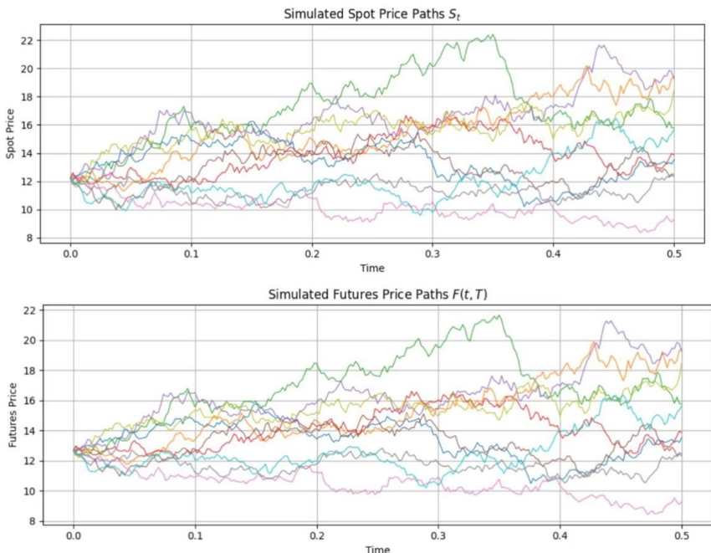
Futures Pricing and Option Valuation under the Two-Factor Model
Futures Pricing
Under the risk-neutral measure, futures prices equal the discounted expected spot price at maturity. The log-spot price splits into short-term (mean-reverting) and long-term (drifted Brownian motion) components.
The futures price has a closed-form expression involving the mean and variance of these components, capturing realistic price dynamics.
Option Valuation
European options on futures are priced using Black's formula, with volatility derived from the variance of the log-futures price. This variance accounts for both factors and their correlation.
The model yields explicit formulas for option prices,
enabling efficient valuation consistent with observed
market behavior

Slide 3
Economic Interpretation and Dynamics of Model Factors
Short-Term Component (ω_t)
Long-Term Component (ε_t)
Represents transient deviations and inventory effects, modeled as a mean-reverting Ornstein–Uhlenbeck process with speed of reversion κ.
Captures the persistent equilibrium log-price level, following a Brownian motion with drift under the risk-neutral measure.
Correlation and Dynamics
The two factors are correlated, with ω_t describing temporary shocks that decay exponentially, while ε_t accumulates permanent price shifts.

Slide 4


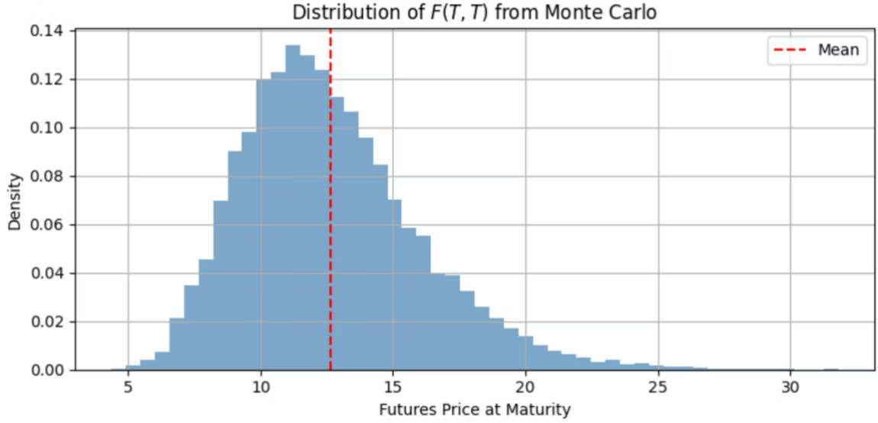


Monte Carlo Simulation for Futures and Option Pricing
Simulation Setup
Simulate M independent paths of the short- and long-term factors using Euler–Maruyama discretization on a time grid with N steps.
Price Computation
At each step, compute spot and futures prices from simulated factors. At maturity, estimate option prices as discounted averages of payoffs across paths.
Validation
Monte Carlo estimates converge to analytical prices from Black's formula as the number of paths increases, confirming numerical accuracy.

Slide 5

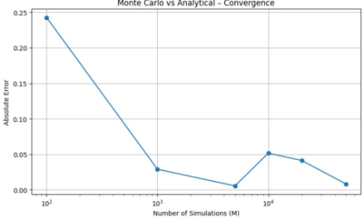
Convergence Study of Monte Carlo Estimates
Convergence Behavior
Numerical Stability
Practical Implication
Absolute pricing error between Monte Carlo and analytical prices decreases steadily as simulation paths increase, demonstrating statistical convergence.
Errors approach zero for large path counts, validating the robustness and efficiency of the simulation engine.
Reliable option pricing can be achieved with sufficiently many paths, balancing computational cost and accuracy.

Slide 6
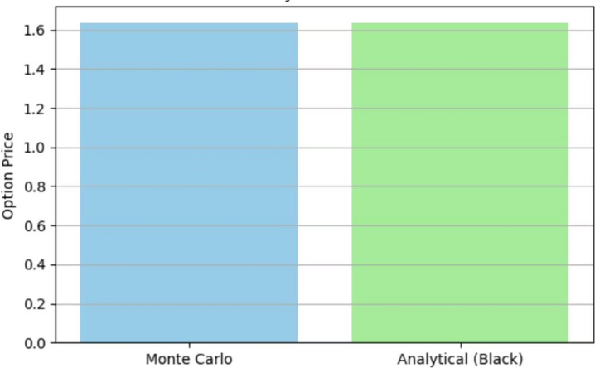
Direct Pricing Comparison: Monte Carlo vs Analytical
Pricing Table
Monte Carlo price: 1.6368 | Analytical Black price: 1.6338 | Absolute error: ~0.0029
Visual Comparison
The bar chart confirms close alignment between simulation and analytical methods, highlighting the precision of the Monte Carlo implementation.

Slide 7
Fourier-Based Option Pricing and Model Calibration
Characteristic Function Approach
Model Calibration
European call option prices are computed using the characteristic function of the log-spot price and Gauss–Legendre quadrature integration.
Parameters estimated via Kalman filter on crude oil futures data include mean reversion speed, volatilities, correlation, and risk-neutral drift.
This method yields fast, accurate pricing consistent with the two-factor model's Gaussian structure.
The full two-factor model outperforms nested models in log-likelihood, validating its superior fit to market data.
Integration bounds and node counts are chosen to balance speed and precision, with maximum pricing deviation below ¬0.001.
Pricing via Gauss3 Legendre Integration
European call option prices are computed using Bakshi and Madan's Fourier pricing framework, evaluating integrals with Gauss–Legendre quadrature for accuracy and efficiency.

Slide 8
Kalman Filter Implementation
State-Space Model
Filter Steps
The two-factor model is expressed in state-space form with transition and observation equations. The transition matrix captures mean reversion and drift, while measurement equations relate states to observed futures prices.
Prediction and update steps compute state estimates and covariances. Kalman gain adjusts estimates based on measurement errors, maximizing likelihood of observed data.

Slide 9



1.3784
Estimated Parameters and Model Comparison
Mean Reversion Rate (»)
28.94%
Short-Term Volatility (ÃÇ)
14.76%
Long-Term Volatility (Ã¿)
0.3000
Correlation (Ã)
The full two-factor model outperforms nested models in log-likelihood, demonstrating superior fit to crude oil futures data compared to GBM-only or OU-only specifications.

Slide 10
Estimates comparison
Parameter | Our Estimate | S&S (2000, Futures Data) Estimate
Short-term mean-reversion rate (κ) | 1.3784 | 1.49
Short-term volatility (σₓ) | 28.94% | 28.6%
Short-term risk premium (λₓ) | 5.67% | 15.7%
Equilibrium drift (μ_ξ) | –1.98% | –1.25%
Equilibrium volatility (σ_ξ) | 14.76% | 14.5%
Risk-neutral drift (μ*_ξ) | 0.89% | 1.15%
Correlation (ρ) | 0.3000 | 0.300
Measurement noise (σₑ) | 0.0363, 0.0100, 0.0100, 0.0100, 0.0100 | 0.042, 0.006, 0.003, 0.000, 0.004
Model | Log-Likelihood (Our Estimation) | Log-Likelihood (S&S, Futures Data)
GBM (long-term only) | 2835.40 | 3860
OU (short-term only) | 3206.31 | 4331
S&S (2-factor) | 3585.80 | 5140

Slide 11

Summary and Future Directions
Validated Two-Factor Model
The Schwartz and Smith model effectively captures commodity price dynamics with short- and long-term factors, enabling closed-form futures and option pricing.
Robust Numerical Methods
Monte Carlo simulations and Fourier-based pricing methods are accurate and efficient, confirmed by convergence studies and direct comparisons.
Kalman Filter Estimation
State-space representation and Kalman filtering provide reliable parameter estimates from market data, outperforming simpler models.
Future Work
Potential extensions include Bayesian estimation techniques and application to commodity options pricing with enhanced numerical methods.

