Slide 1
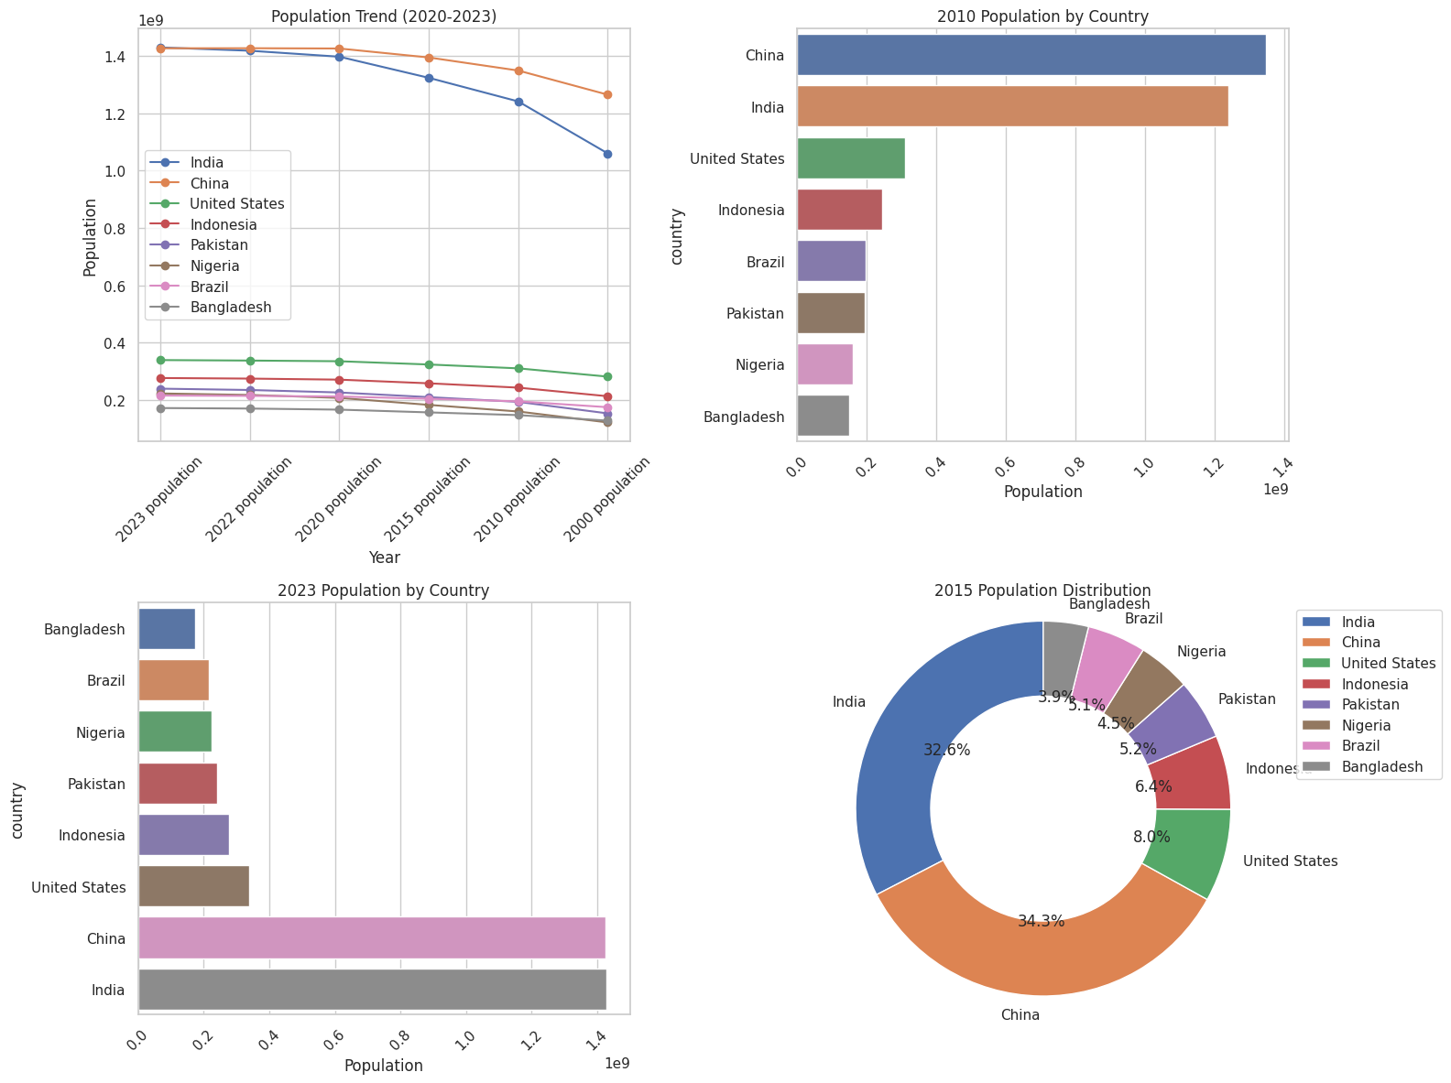
World population trends
The Dashboard is representing the world population scenarios .
The pie graph saying the population of countries in 2015.
The bar graph depicting the 2015 and 2023 and trend show how population grow year by year.
Student ID: 22092233

