Slide 1
BUGS in RTL
ASYNCRONOUS FIFO

Slide 2
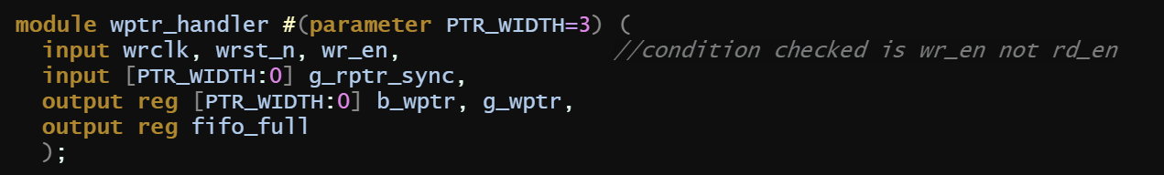
rd_en was taken as input instead of wr_en.

Slide 3
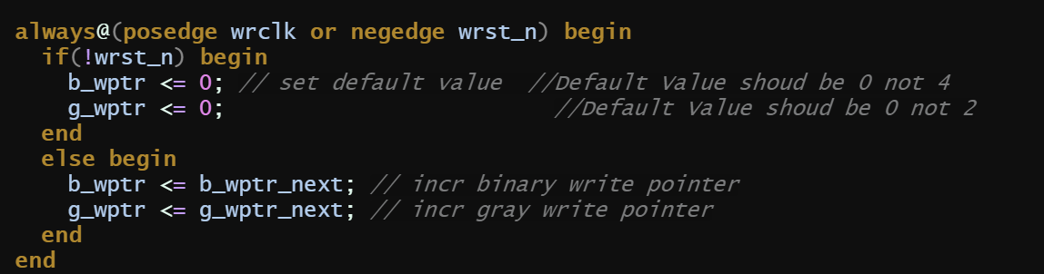
Default value of b_wptr and g_wptr should be zero, non-zero values were mentioned.

Slide 4
For checking full condition g_wptr_next should be checked not the b_wptr_next.

Slide 5
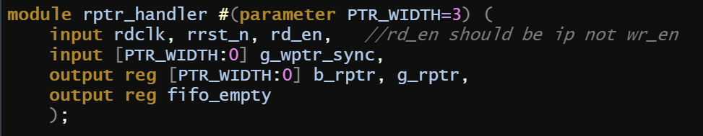
rd_en should be taken as input, wr_en was initially taken as input

Slide 6
rd_en should be checked not wr_en for generating b_rptr_next.

Slide 7
For checking empty conditions g_rptr_next should be compared, initially it was b_rptr_next mentioned

Slide 8
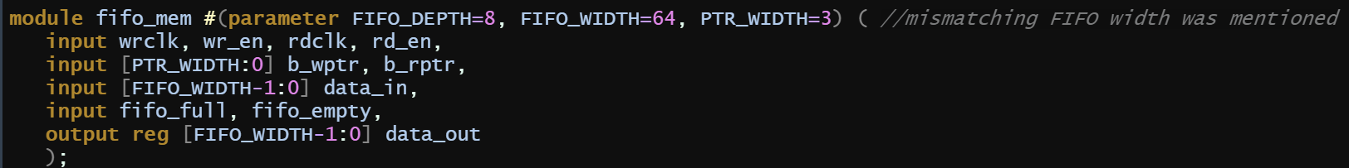
FIFO_WIDTH was given to be 8 initially which doesn’t match with other descriptions. FIFO_WIDTH should be uniform throughout

Slide 9
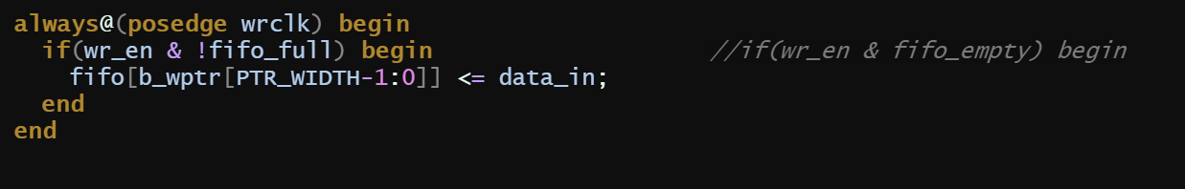
Conditioned checked initially was wr_en & fifo_empty but it should be wr_en & !fifo_full.

Slide 10
Comma was present instead of semicolon at the line end

Slide 11
Semicolon was missing at the end of line

Slide 12
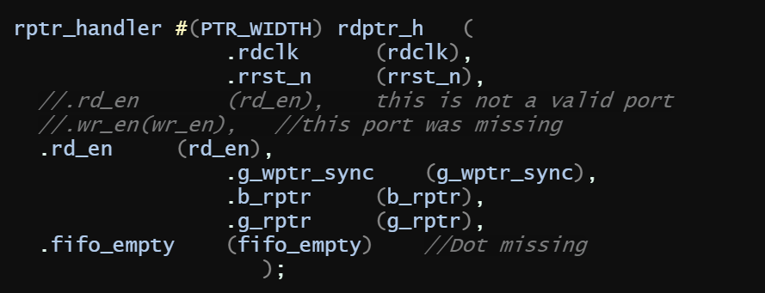
. (dot) was missing while connecting ports

Slide 13
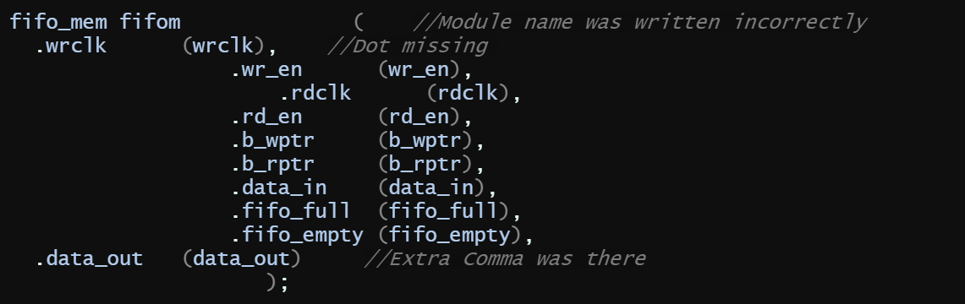
module name was written incorrectly while instantiating.
Dot was missing while connecting the wr_en port.
Extra comma was there at the end of data_out.

