Slide 1
Workshop on RDF & SPARQL
Building blocks of Graph Database

Slide 3
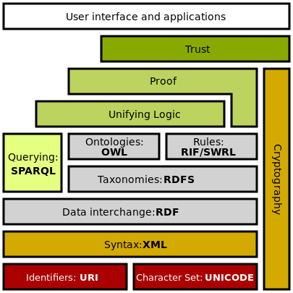
Semantic Web Stack
Notes:
The Semantic Web Stack is an illustration of the hierarchy of languages, where each layer exploits and uses capabilities of the layers below.
The Semantic Web is a collaborative movement led by the World Wide Web Consortium (W3C). The standard promotes common data formats on the World Wide Web.
Hypertext Web technologies
Internationalized Resource Identifier (IRI), generalization of URI, provides means for uniquely identifying semantic web resources.
Unicode serves to represent and manipulate text in many languages.
XML is a markup language that enables creation of documents composed of semi-structured data. Semantic web gives meaning (semantics) to semi-structured data.
Standardized Semantic Web technologies
Resource Description Framework (RDF) is a framework for creating statements in a form of so-called triples. It enables to represent information about resources in the form of graph
RDF Schema (RDFS) provides basic vocabulary for RDF. Using RDFS it is for example possible to create hierarchies of classes and properties.
Web Ontology Language (OWL) extends RDFS by adding more advanced constructs to describe semantics of RDF statements, such as for example cardinality, restrictions of values, or characteristics of properties such as transitivity.
SPARQL is a RDF query language - it can be used to query any RDF-based data (i.e., including statements involving RDFS and OWL). Querying language is necessary to retrieve information for semantic web applications.
RIF is a rule interchange format.

Slide 4
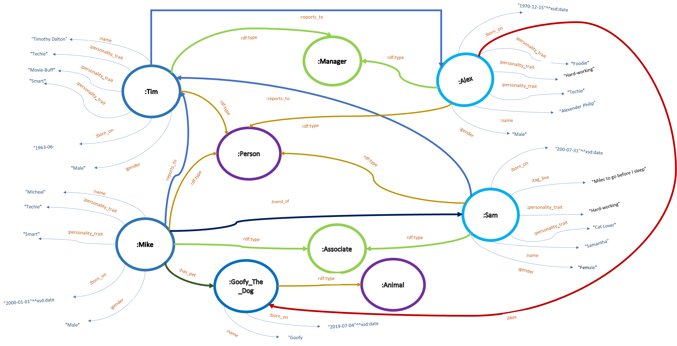
Notes:
What is an RDF graph: Simply it is data represented in the RDF data model.
It is a directed graph consisting of nodes with clearly labeled relationships with directionality.
Relationships are called edges.
Edges are connectors linking one node to another.
In RDF, each pair of connected nodes and their connecting edges are triples.
A triple is also called as a statement.
A triple consists of a subject (node), a predicate (edge) and an object (node).
All predicates are essentially binary relations.
Nodes cannot exist by themselves.
3 kinds of nodes:
1. Internationalized Resource Identifier ( IRI ) is a generalization of Uniform Resource Identifier.
Uniquely defining entities in a graph.
2. Literals -> plain data values like Strings, integer, Date values etc.
^^=> datatypes (XML schema Datatype -> XSD)
3. Blank nodes -> no persistent labels, best is to not use them.

