Slide 1
Learn & Play with SNOWFLAKe

Slide 2
Agenda

Slide 3
What will I learn?
A bit of history
Snowflake Architecture
Snowflake Key Features
Scaling-up and Scaling-out Compute Clusters
Loading Data
Protecting Data from failures using Time-Travel
Setting up multiple environments using Zero-Copy Cloning
Sharing Data without hassles of complicated ETL processes
Building a Data Pipeline for a continuous ELT process
Securing Data using Column Masking
Performance Considerations and Tips

Slide 4




Overview
Snowflake – Founded in 2012
Snowflake – Founders
Benoit Dageville
Thierry Cruanes
Marcin Zukowski
Snowflake – What’s in a name
Notes:
Prior to Snowflake:
Benoit and Thierry were architects at Oracle
Marcin co-founder of the Dutch start-up Vectorwise
Snowflakes are “born in the cloud” -> For a data warehouse built from the ground up for the cloud, that’s very important.
The founders love the snow
Each Snowflake is unique => Gave rise to the idea of having multiple warehouses of different sizes, all in one system.

Slide 5



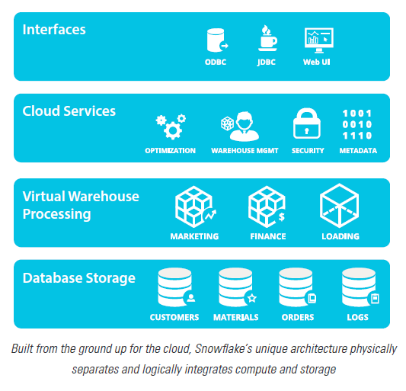
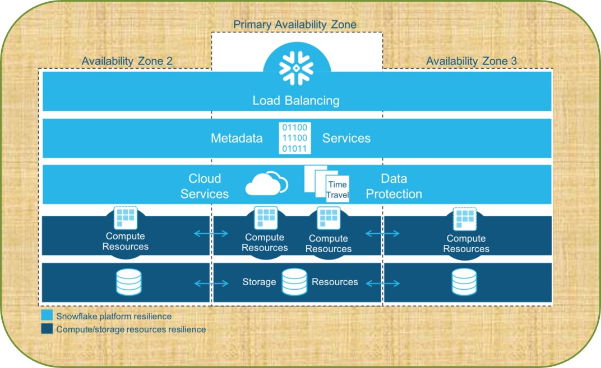
Overview
Pure Software-as-a-Service (SaaS) Experience
Relational
Semi-Structured
Elastic
Highly Available
Durable
Cost-efficient
Secure
Notes:
Pure Software as a Service –
No installation of hardware or software
No Upgrade / Patching responsibility
Relational – Provides support using SQL for storing data in relational tables and supports ACID properties for transaction management
Semi-Structured Data – Provides support for storing semi-structured data (in json, parquet, avro) from various sources alongside relational data
Elastic – Provides transparent scaling-in and scaling-up options for compute resources
Highly available – Storage and Cloud Services layer rely on high-availability attributes provided by the cloud providers (like AWS)
Durable – Storage and Cloud Services layer rely on durability attributes provided by the cloud providers (like AWS)
Cost – efficient – No upfront cost for setting up any hardware infrastructure. Pay-as-you-use construct.
Secure – Data is completely secure at rest and in-transit within Snowflake
Resilience – Snowflake tolerates individual and correlated node failures at all levels of the architecture.
Data Storage & Metadata Storage
The Data Storage layer of Snowflake today is S3, which is replicated across multiple data centers called “availability zones“ or AZs in Amazon terminology.
Matching S3's architecture, Snowflake metadata store is also distributed and replicated across multiple AZs.
Cloud Services Storage
The remaining services of the Cloud Services layer consist of stateless nodes in multiple AZs, with a load balancer distributing user requests between them.
It follows that a single node failure or even a full AZ failure causes no system-wide impact, possibly some failed queries for users currently connected to a failed node.
These users will be redirected to a different node for their next query.
Virtual Warehouses
VWs are not distributed across AZs. This choice is for performance reasons.
High network throughput is critical for distributed query execution, and network throughput is significantly higher within the same AZ.
If one of the worker nodes fails during query execution, the query fails but is transparently re-executed, either with the node immediately replaced, or with a temporarily reduced number of nodes.
To accelerate node replacement, Snowflake maintains a small pool of standby nodes.

Slide 6
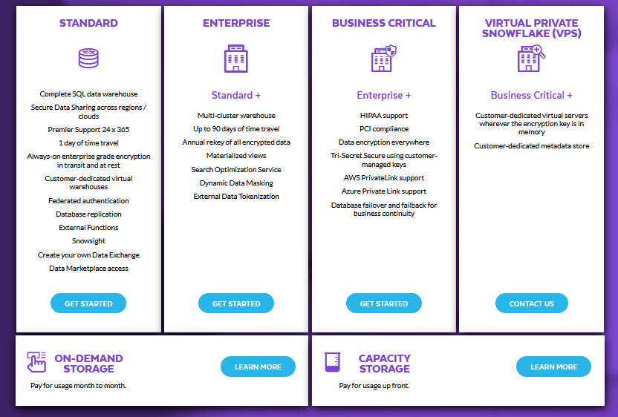
Purchase options
Notes:
Snowflake provides various purchasing options for customers.
Each option provides the basic features of Snowflake services topped-up with advanced features including various security options designed for the needs of large-scale enterprises and organizations.

Slide 7
Releases and patches
A weekly release cycle for new features, upgrades and bug fixes
Enterprise Edition accounts can designate few accounts as “early access accounts”
New releases follow a 3-stage release cycle
Stage 1 – Early access accounts can opt for upgrading and testing the features, 24 hours in-advance
Stage 2 – All Standard Edition accounts
Stage 3 – All Enterprise and higher edition accounts
Patch releases are applied on the same day
Notes:
Snowflake follows a weekly release cycle.

Slide 8
Demo with snowflake gui
Notes:
I will go over a small demo using the GUI and try to give an overview of all the actions that are possible via the GUI.

Slide 9
Key features

Slide 10
Features
Virtual Warehouses – Multi-clustering
Data Loading and Unloading
Support for semi-structured data
Continuous Data Protection
Continuous Data Pipelines
Table Clustering
Zero-copy Cloning
Data Sharing
Data Replication
Column Masking and Row Level Security

Slide 11
Architecture

Slide 12
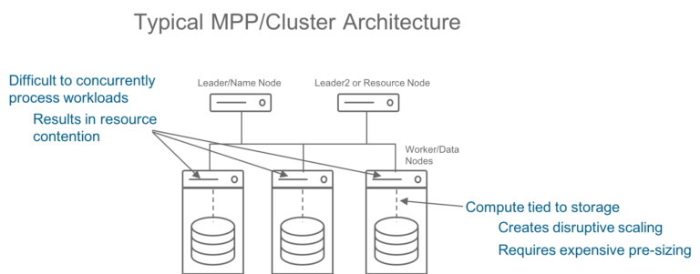
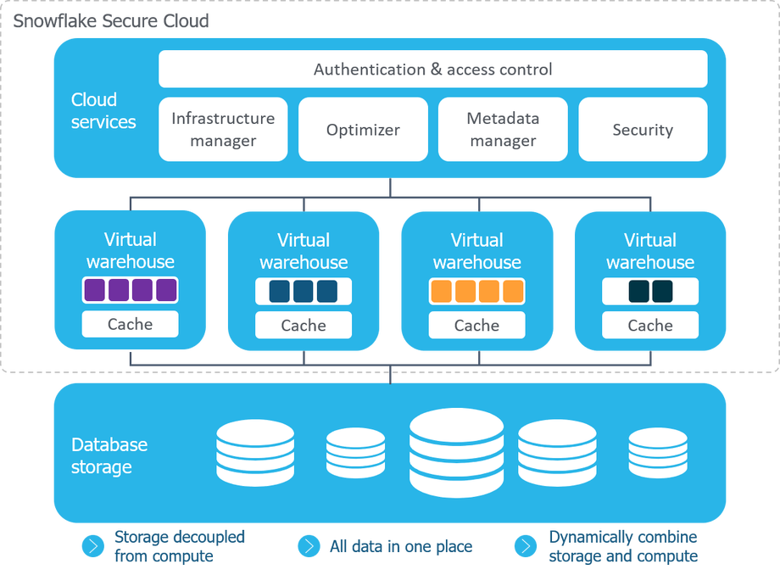
Multi-clustered Shared data-architecture
Hybrid of traditional shared-disk database architectures and shared-nothing database architectures.
Data Storage is independent from compute and uses the cloud persistent storage service (Amazon S3).
The virtual warehouse uses the shared-nothing architecture.
Data loading can be isolated from query performance
Cloud services is the brain of Snowflake. Supports:
Authentication
Warehouse Infrastructure mgmt.
Metadata Management
Role Based Access Control
Notes:
Let us talk about issues with existing multiple processor / cluster architecture
The compute and storage need to be pre-sized
The compute clusters cannot scale instantly
Resizing will lead to disruptive scaling
There will be resource contention for concurrent processes
There will be risk of over-provisioning and thus increase in cost
Hybrid of traditional shared-disk database architectures and shared-nothing database architectures.
Data Storage is independent from compute and uses the cloud persistent storage service (Amazon S3).
But similar to Shared-Disk architecture, all virtual warehouses have access to all data
The virtual warehouse uses the shared-nothing architecture.
Each virtual warehouse server / node has its own Memory, CPU and SSD disk which stores a portion of the data to be processed.
Each node uses its compute power to process the query on the data
Warehouses can scale independently of the data
Data loading can be isolated from query performance
Cloud services is the brain of Snowflake. It orchestrates activities across Snowflake.
Supports Authentication (the most common being Username and Password)
Warehouse Infrastructure mgmt.
This layer monitors query queuing and based on internal algorithm, scales out the multi-cluster warehouses to support high concurrency
Calculates and stores credit usage of the warehouses and updates the metadata
Metadata Management (using Key-value storage using FoundationDB)
Metadata managed separately from databases and compute
Holds metadata information about tables, roles and users
Role Based Access Control => Different from user-based access control seen in other products
Query parsing => Performs syntax and semantics check for each query submitted by user
Query optimization =>
Uses file pruning techniques
Builds and fetches data from the Result-Cache for same queries executed by users, to improve performance and reduce cost
Evaluates if queried information is present in metadata.
Saves cost by NOT spinning warehouses for executing certain metadata-only operations like
Most DDL operations except operations like CTAS
Cloning
Min / Max / Count queries

Slide 13
Compute

Slide 14
Compute – virtual warehouses
Compute is supported by cloud providers’ compute, example: Amazon EC2 and are called as Virtual Warehouses (VW)
VW come in T-shirt sizes (X-Small, Small, Medium…)
Each increment of size doubles the number of servers
X-Small = 1 server, Small = 2 servers ….
Each server has 8 threads to support parallel processing
Supports two scaling options:
Scale – up => increasing the size of warehouse for performance
Scale – out => adding more clusters of same size for concurrency support
VW can be created, destroyed, or resized at any point, on demand.
Creating or destroying a VW has no effect on the state of the database.

Slide 15
Database objects

Slide 16
Database Objects
Table
External Table
User
View
Role
Stored
Procedure
Warehouse
Sequence
Resource Monitor
Stage
Database
Schema
File Format
Pipe
Stream
Task
User Defined
Function

Slide 17
Tables

Slide 18
Tables
Named storage objects within snowflake
Data is stored in micro-partitions in the cloud platform’s immutable object storage (example Amazon S3)
Metadata pseudo column metadata$partition_name available for all tables
Tables support Snowflake’s Continuous Data Protection feature
Time-travel
Ability to access a table’s historical point-in-time data within the retention period defined for the table.
This amounts to storage costs determined by the size of table
Can be set to 0; no storage cost, but risk of completely losing the data
Fail-safe
Feature provided by snowflake for standard tables to recover data lost due to catastrophic failures.
This is performed ONLY by Snowflake support staff.
This is a mandatory feature enabled at the account level and cannot be disabled.
It is valid only for 7 days for a table, beyond which it is permanently dropped.
This amounts to storage costs determined by the size of table
Notes:
Time-travel is synonymous to Flashback feature in Oracle database

Slide 19
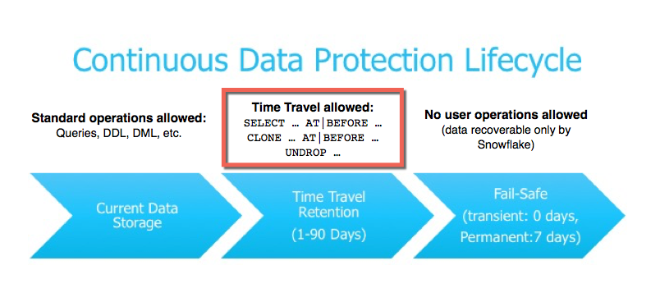
Continuous data protection – Time-Travel
Enables access historical data at any point in the past within a defined period
Restores data-related objects (database, schemas and tables) that may been dropped / deleted
Duplicates and backs-ups data from key points in the past
Enables analyzing data usage / changes over specified periods of time
Relies on the retention period of database / schema / tables
For Standard edition, maximum retention period allowed is 1 day
For Enterprise edition and above, maximum retention period allowed is 90 days
Default retention period for all accounts is set to 1 day
Parameter “data_retention_time_in_days” on table is used to control the retention period
Notes:
At / Before => Supports
Timestamp
SQL ID
Offset (mins / seconds / hours )

Slide 20
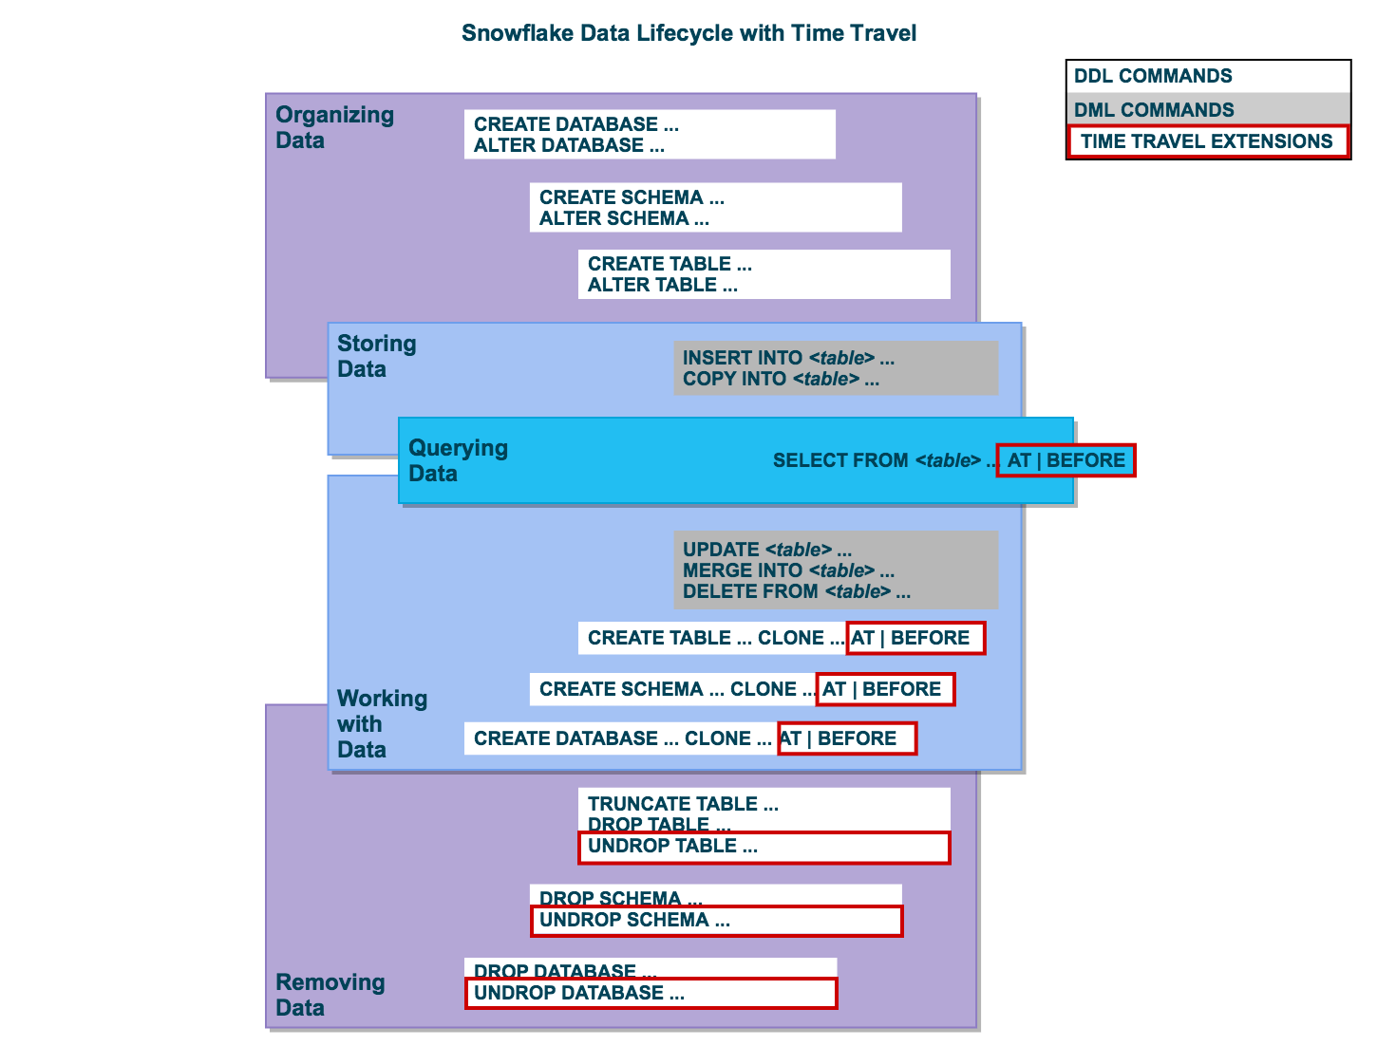
Continuous data protection – Life Cycle

Slide 21
Tables – micro-partitions
Data in tables is stored in micro-partitions
Contiguous units of storage
Size of each micro-partition is between 50 MB – 500 MB after compression
Groups of rows are mapped into individual micro-partitions
Organized in a columnar fashion.
Snowflake stores meta-data for each micro-partition
MIN and MAX values of each columns
Number of Distinct Values for each column
Enables extremely fast pruning of data for SELECT or DML operations
Updates to columns result in new micro-partitions
Old micro-partitions retained for Time-Travel operations
Notes:
Inserts and updates to data will result in new micro-partitions being provisioned to store the data.
The old micro-partitions (incase of delete and update) will continue to exist for the period of data retention defined on the table level to support Time Travel operation.

Slide 22
Tables - Types
Type | Objective | Edition | Time Travel (days) | Fail-safe (days) | Total Retention Period (days)
Standard | To persist data for the table’s life-time for long term storage, example: Fact and Dimension tables | Standard | 0 – 1 | 7 | Min – 7 Max – 8
 |  | Enterprise + Above | 0 – 90 | 7 | Min – 97 Max – 98
Temporary | To persist for a session, example: Short lived tables used during ELT / ETL processes | All | 0 – 1 | 0 | Min – 0 Max – 1
Transient | To persist data for the table’s life-time, example: Short lived tables where data can be recreated if dropped. | All | 0 – 1 | 0 | Min – 0 Max – 1
External | To access data directly from files stored on cloud-provider’s storage | Enterprise + Above | 0 | 0 | 0
Notes:
External tables can be synonymous with Amazon Athena which uses Glue catalog to read the metadata from S3 and users can execute SELECT queries against the files stored in Amazon S3.

Slide 23
activity

Slide 24
Tables – HANDS-on activity
Note: Ensure you have a database, a schema and warehouse selected in the GUI before starting this activity.
You will create one table each of the three types and describe them.
How do you find out which type it is?
You will then load data into each of the three tables using one worksheet of the GUI.
Open a new worksheet and use the same role and database and warehouse as the earlier worksheet.
Query each of the tables.
What do you expect and what do you get?
Which is the 4th type table you didn’t create here?

Slide 25
File Format

Slide 26
File formats
Named objects specified during loading and unloading operations
Supported file formats:
Delimited Files (CSV, TSV, custom)
JSON
AVRO
ORC
PARQUET
XML
File Format option can be provided
At Table Creation time
At Stage Creation time
During COPY’ing of data

Slide 27
stages

Slide 28
Stages
Specifies location where files are “staged” before loading / unloading
Types of stages
User Stages
Table Stages
Named Internal Stages
Named External Stages
Stages can contain “paths” as in directory path or “folders” as in prefixes in AWS S3 buckets.
FTP-like “put” and “get” commands to load and unload data respectively

Slide 29
Type | Representation | Features
User | @~ | One user stage for every user in the account Accessible only by the specific user Can load any types of files to be loaded into multiple tables Cannot be dropped or altered, though files can be deleted File-formats cannot be specified Will add to the storage cost
Table | @%<table> | One table stage for every table and name same as that of the table To stage files, list the files, query them on the stage, or drop them, user needs to have the OWNERSHIP privilege on table Can load any types of files to be loaded into a single table Cannot be dropped or altered, though files can be deleted Gets dropped once table is dropped File-formats cannot be specified Will add to the storage cost
Named Internal Stage | @<name> | Created within Snowflake’s storage Users with the appropriate privileges on the stage can load data into any table Owners of stage need to grant explicit privileges on stage for other users to access it File-formats can be specified during creation time Can be dropped explicitly Will add to the storage cost
Named External Stage | @<name> | References external blob storage objects (example Amazon S3) Requires roles / credentials associated with identify mgmt. user of the cloud provider to connect to external staged object (S3). File-formats can be specified during creation time Can be dropped explicitly Dropping an external stage does not delete the storage object (S3 bucket), but deletes all the files in the storage object (S3 bucket)

Slide 30
activity – loading & unloading

Slide 31
loading – HANDS-on activity

Slide 32
unloading – HANDS-on activity

Slide 33
Views

Slide 34
Views
An object (similar to a table) that is based on a result-set of a SQL statement
Used for combining, segregating and protecting data.
Help write clearer, more modular SQL code; hiding complex logic
Types:
Non-Materialized View
Materialized View
Sub-Types of views:
Recursive Views
ONLY for Non-Materialized Views
Secure Views
Supported for both Materialized and Non-Materialized Views

Slide 35
Type | Objective | Time-Travel Support | Cost
Non-Materialized | Default view type Named definition of a SQL Query Results are not-persisted (not materialized) Query results are obtained at run-time execution of the view View can be based on single or multiple tables and can contain any columns from the tables used in the query | Not supported | No storage cost Credits will be accumulated for the Compute utilization
Materialized | Results of the view are persisted. Any changes to the base table will be reflected in the view’s result-set. Generally used for enhancing performance of queries, for ex: Materializing the results of complex queries and accessing the MV directly Views cannot contain joins to multiple tables Cannot include ORDER BY, HAVING and GROUPING SETs, ROLLUPs and CUBEs Cannot include nesting of subqueries. | Not Supported | Storage cost for persisting the data Credits will be accumulated for the Compute utilization Credits will be accumulated for MV’s active maintenance (MV refresh)

Slide 36
Type | Objective | Time-Travel Support | Cost
Secure | Non-Materialized and Materialized views can be defined as Secure Views Used to improve data privacy Used for data sharing (only secure views and secure MVs can be shared using data-sharing) | Not supported | Non-Materialized No storage cost Credits will be accumulated for the Compute utilization Materialized Storage cost for persisting the data Credits will be accumulated for the Compute utilization Credits will be accumulated for MV’s active maintenance (MV refresh)
Recursive | Only on Non-Materialized views Generally used for hierarchical queries | Not supported | No storage cost Credits will be accumulated for the Compute utilization

Slide 37
activity

Slide 38
views – HANDS-on activity
Note: Ensure you have a database, a schema and warehouse selected in the GUI before starting this activity.
Create the dept and emp table using the statements provided.
Note that the emp table represents a SCD Type 2 dimension table, i.e., we pick up the latest record if the “last_update_dt” value is NULL
Create the views using the scripts.
What difference do you see in creating simple view v/s materialized view?
What difference do you see in creating recursive view v/s materialized view?
Will there be a performance difference in views accessing emp base table v/s views accessing materialized view? Why do you think so?
How do you differentiate between a non-materialized view v/s materialized view?
How different are secure views?
Why are they called secure views?

Slide 39
cloning

Slide 40
cloning
A point-in-time snapshot of data present in the source object
Objects can be cloned only within the account
Cloning a meta-data only operation
Cloning uses Snowflake’s Time-Travel feature
No new storage created at the time of cloning operations
Hence, referred to as “Zero-Copy Cloning”
Cloned objects are writable & independent of the source
Storage created for cloned objects ONLY when cloned objects are modified
Cloning a database will clone all the schemas in the database
Cloning a schema will clone all cloneable objects in that schema

Slide 41
cloning
Cloneable objects
Database
Schema
Tables (ONLY Permanent and Transient)
Views (?)
Stages ( ONLY EXTERNAL Stages and TABLE stages)
Pipes
Streams
Tasks
File Format
Sequence
Non-Cloneable objects
External Tables
Internal Stages
Materialized Views ( Independent MVs cannot be cloned)

Slide 42
Demo

Slide 43
Data sharing

Slide 44
sharing
Traditional Data Sharing | Snowflake Cloud Data Sharing
Data providers send data to consumers via “emails” or via FTP / elaborate ETL processes | Sharing involves no movement of data and no data duplication
Process is slow, cumbersome, and costly | Live read-only copies of data shared with consumers without any ETL processes
Only allows for moving limited amounts of shared data due to network or process restrictions | Any change to data at producer end is reflected immediately (at real-time) at the consumer end
Consumer needs to make storage available for the copies of data | There is no storage cost borne by the consumer
Multiple copies of data available across org. | Opens up opportunities to monetize data as products and services
Makes the data quickly stale | Eliminates data silos and develops a single source of truth for the data in an org.

Slide 45
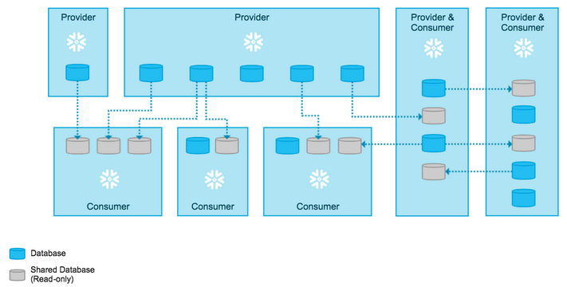
shares
Creating shares is a meta-data only operation
Sharable database objects
Tables
External tables
Secure views
Secure materialized views
Secure UDFs
Providers share data and Consumer import the data
Shares are created by
ACCOUNTADMIN role or
Role granted the CREATE SHARE global privilege
All database objects shared between accounts are read-only
Shares are consumed by
ACCOUNTADMIN role or
Roles granted
IMPORT SHARE global privilege
CREATE DATABASE privilege
Database created on Consumer side from the share is READ-ONLY
No DML statements con be issued on the databases created from the share.
Notes:
The privileges that grant access to the database(s) and the schema containing the objects to share.
The privileges that grant access to the specific objects in the database.
The consumer accounts with which the database and its objects are shared.
Shared databases have the following limitations for consumers:
Shared databases are read-only.
Users in a consumer account can ONLY view/query data
The following actions are not supported:
Creating a clone of a shared database or any schemas/tables in the database.
Time Travel for a shared database or any schemas/tables in the database.
Editing the comments for a shared database.
Shared databases and all the objects in the database cannot be forwarded

Slide 46
shares
Direct data sharing between accounts possible
If one or more accounts in same region and on same cloud provider
No complex configuration required
If one or more accounts in different regions or on different cloud providers
Database replication should be enabled between accounts. (Enterprise Edition + )
One share can contain object(s) from one database in an account
Required privileges on share by the providers
Usage privilege on database that needs to be shared
Usage privilege on schema(s) containing the objects that need to be shared
SELECT privilege on specific sharable objects in each shared schema
If shared object (secured view) references objects from other databases in the same account,
Grant the REFERENCE_USAGE privilege on each database referenced by the object
So, what is a SHARE?
The privileges that grant access to the database(s) and the schema containing the objects to share.
The privileges that grant access to the specific objects in the database.
The consumer accounts with which the database and its objects are shared.

Slide 47
Shares – responsibilities
 | Providers | Consumers
Objects Ownership | Own the dataset | Only own the databases created from the shares. No ownership of dataset
Cost | Storage cost borne by Providers alone | Compute costs for querying the data borne by Consumers
Shares – Account Types
 | Snowflake Account | Non-Snowflake Account
Definition | Providers and Consumers have Snowflake accounts | Providers have snowflake accounts. Consumers do not have snowflake accounts. These accounts are called “READER” accounts. READER accounts belong to the Providers who created them.
Cost | Storage cost borne by Providers alone Compute costs for querying the data by Consumers, borne by Consumers. | Storage cost borne by Providers alone Compute costs for querying the data by READER accounts, borne by Providers.

Slide 48
Difference between Data sharing & Cloning
Cloning | Data - Sharing
Point-in-time snapshot of data | Real-time
Cloning is only within the account | Sharing is across accounts
Cloned objects are writable | Shared objects are read-only
Source objects and Cloned objects have independent life-cycle | Shared objects belong to producers and valid till consumer has the viewing privileges on the shard objects
New changes to the source objects are NOT reflected in cloned objects | Any changes to data in shared objects are instantaneously available to consumers
Cloned objects can be further cloned | Shared objects cannot be cloned
Used in conjunction with Devops and agile software delivery | Used to eliminate the need to build redundant & complex data movement pipelines.

Slide 49
Demo

Slide 50
Continuous Data Pipelines
Automating many of the manual steps involved in transforming data
Optimizing continuous data loads
Common Use Case:
Loading “raw” data into “temporary” staging table
Transforming data using series of SQL stmts
Automating the above processes to execute frequently
Features of Data Pipelines
Continuous Data Loading
Snowpipe
Snowflake Connector for Kafka
3rd Party Data Integration Tools
Change Data Tracking
Snowflake Streams
Recurring Tasks
Snowflake Tasks

Slide 51
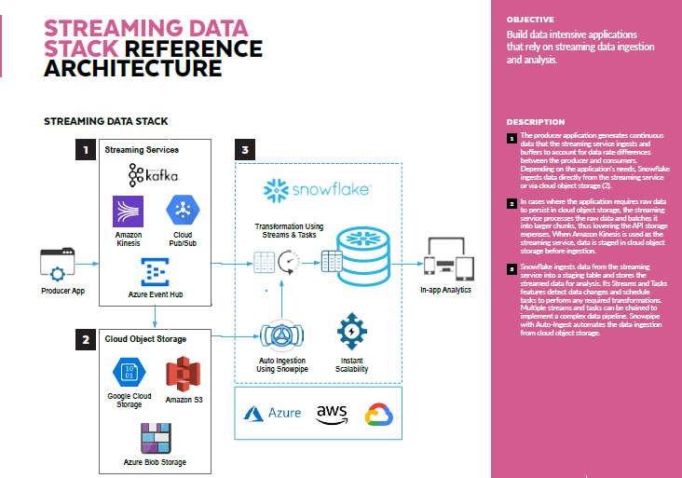
Continuous Data Pipelines – Use case

Slide 52
snowpipe
Snowflake’s serverless service
Loads data from files as soon as they are available in a stage
Both internal stage and external stage
The data is loaded according to the COPY statement defined in a referenced pipe
Various ways of invoking Snowpipe:
Using cloud messaging (example: Amazon SQS or Amazon SNS)
Continuously loads micro-batches of data from an external stage location (Amazon S3, Google Cloud Storage, or Microsoft Azure) into a staging table
Using Snowpipe REST endpoints

Slide 53
Difference between bulk loading and snowpipe
Topic | Bulk Data Load | Snowpipe
Authentication | Relies on various security options provided by client, such as username and password, public-private key pair with RSA encryption, SSO etc | ONLY FOR REST endpoints: Requires key-pair authentication with JWT using public-private key pair with RSA encryption
Compute | Requires user specified warehouse to execute the COPY statements | Uses Snowflake supplied compute resources (serverless compute)
Cost | Credits accumulated for the amount of time each warehouse is active | Credits accumulated according to the actual compute resources used within Snowflake warehouse while loading files. There is an additional overhead for maintaining the queue for files to be loaded.
Load History | Stored in metadata of target table for 64 days and is available on completion of the COPY statement | Stored in metadata of pipe for 14 days. Must be requested via a REST endpoint, SQL table function or account_usage view
Transactions | Loads are performed in single transaction. | Loads are combined or split into a single or multiple transactions based on the number and size of the rows in each data file.

Slide 54
Streams
A Stream object
Records delta of DML operations on a table
Allows querying and consuming a set of changes to a table, at row level, between two transactional points of time
Uses Snowflake’s Time-Travel feature to accomplish this
Maintains an offset from the point when the stream was last consumed by a DML statement
Allows querying of data by multiple statements within a single transaction
Is populated for DELETE, INSERT and UPDATE statements on the table
Has three metadata columns for identifying the type of DML operation
METADATA$ACTION : (INSERT / DELETE)
METADATA$ISUPDATE: : ( FALSE for Direct INSERT or UPDATE, TRUE for UPDATES)
METADATA$ROW_ID : Unique identifier for the record
Types of Streams
Standard => Captures all DML Operations
Append-Only => Captures only INSERT Operations
Insert- Only => Only on External Tables.

Slide 55
Tasks
A task object
Defines a recurring schedule for executing a SQL statement or a stored procedure
Can work in conjunction with Streams to a provide a convenient way to transform data
Can be chained with other task for successive execution to support a complex periodic processing
Root
Task1
Task 2
Uses user-defined compute resource to execute the SQL provided in its definition
Can check if there is data in the stream before it can start processing, thus saving cost
Supports only SYSTEM$STREAM_HAS_DATA condition currently
Task 1-1
Task 1-2
Task 2-1

Slide 56
Demo

Slide 57
Column Data Masking
Column-level security feature that uses masking policies to selectively mask data at query time
Apply a policy to multiple table / view columns across databases
This feature can prohibit privileged users with ACCOUNTADMIN or SECURITYADMIN roles from unnecessarily viewing data
Supports easy masking of data before sharing

Slide 58
Demo

Slide 59
Performance considerations

Slide 60
Table clustering
Clustering => Ordering and sorting of data in micro-partitions
Data is automatically clustered into micro-partitions to allow for faster retrieval of frequently requested data
Over time, due to DMLs on large tables, data might no longer cluster optimally on desired dimensions
Option 1:
Manually sort rows on key table columns and re-insert them into the table
Option 2:
Create a clustering key on one or more ( <= 3) table columns / expressions on the table to automatically allow Snowflake to sort the data in micro-partitions based on the key
Clustering keys are not intended for all tables
Size of table and query performance for the table should be the deciding factors for clustering the table
Tables in the multi-terabyte (TB) range will experience the most benefit from clustering if DML is performed regularly on these tables

Slide 61
Demo

Slide 62
Caching
Two types of caches available in Snowflake to improve performance and reduce costs
Data / Warehouse Cache:
Data cache is populated by copying Snowflake data partitions from remote cloud object storage into the warehouse node SSD and memory.
By leveraging this cache, “physical i/o” of getting data from the long-term storage, is avoided
Result Cache:
Query results are persisted in the cloud services layer for every executed query
This greatly improves performance and reduces credit usage as snowflake DOES NOT spin any warehouse to retrieve the data if the same query is executed again.
USE_CACHED_RESULT => Session Parameter to control use of result-cache

Slide 63
Caching – Limitations
Data / Warehouse cache gets reset if warehouses are
Suspended and Resumed
Resized
Result Cache gets reset after 24 hours if any of the following conditions are met
A query satisfying the semantics (privileges and roles) and syntax (same hash-value) is executed again within 24 hours, by virtue of which the life of the result-cache extends by 24 hours (max 31 days from the day the query was first issued).
Underlying data changes (either micro-partitions are marked for delete or new micro-partitions are created for updates or inserts)
Re-clustering process reorganizes data in new micro-partitions.
Query structure (syntax) changes (ex adding an alias or an extra where condition or changing the case of select stmt)
Configuration (parameters) used to generate the result-set changes
Query includes functions like CURRENT_TIME and CURRENT_TIMESTAMP, UUID_STRING.
Exception to above rule is CURRENT_DATE

Slide 64
Demo

Slide 65
Warehouse – Resizing
Problems with under-sizing:
Smaller the warehouse, less the no of servers, less the data cache
Could result in data spill-over to disk while reading data from storage or while processing an update statement
Results in slowness of queries and results in more credit usage
Solution
Increase the size of the warehouse or resize to a larger value => SCALE_UP
This increases the data cache size
Eliminates data spill-over and improves performance
Improves concurrency by reducing queuing of queries due to increase in memory

Slide 66
Warehouse – Multi-clustering
Problems with single cluster w/h with concurrent users executing queries :
Might result in other queries to be queued up
Delays query execution and hence results in performance degradation
Solution
Convert single cluster w/h to multi-cluster w/h => SCALE_OUT
Improves query wait-time and reduces queuing
Improves concurrency

Slide 67
Warehouse – Performance silver bullet
No silver bullet
Best Practices:
Have dedicated warehouses according to workloads
Examples
Single-cluster smaller w/h for COPY operation
Multi-cluster larger w/h for online queries
For multi-cluster warehouse, choose scaling-type => “auto-scaling” , to tackle unknown loads on the system
Start small and increase the size and number of clusters depending on the tables’ sizes and queries’ performances with regards to
data spill-over to disk
Query queuing numbers
Time to complete the queries
Data cache is reset every time a warehouse exits the active state.
If a particular warehouse runs regular queries on a large data set, then it might be advisable to keep the warehouse running or, at least, increasing the auto-suspend timer value.
The extra cost of a query that doesn’t leverage the data cache might outweigh the cost of keeping an idle warehouse running.

