Slide 1


2035
A year of growth, new opportunities, and resilience
Annual
Report
Metro Markets
Presented by: Fernandino Ortiz

Slide 2
Executive summary
Agenda
Financial performance
Looking ahead
Metro Markets

Slide 3



2035 marked a year of steady progress
for Metro Markets
Through a focus on customer service, operational efficiency, and community engagement, the business strengthened its position while adapting to changing market conditions.
Highlights:
Revenue increased year over year
Product selection expanded across key categories
Inventory management became more efficient
Community partnerships continued to grow
Executive summary
Metro Markets

Slide 4

What made this year successful
Stronger customer relationships
Operational improvements
Expanded
product range
Community engagement
Personalized service and loyalty initiatives encouraged repeat visits and strengthened customer trust.
Workflow enhancements reduced delays and improved inventory availability.
New product categories attracted more shoppers while increasing average purchase value.
Local partnerships and seasonal events increased brand awareness throughout the year.
Metro Markets

Slide 5
A quick snapshot of the year's most important metrics
Financial performance
Annual revenue
Customer retention
$7.48M
86%
14%
6% YoY
Gross profit margin
Average monthly orders
39.8%
2,340
2.4 pts
11%
Metro Markets

Slide 6
Revenue growth
Seasonal promotions and customer retention drove steady revenue growth.
Quarter | Store revenue | Online revenue | Key insight
Q1 (January-March) | $910,000 | $645,000 | Established steady revenue growth across both store and online channels
Q2 (April-June) | $1,470,000 | $825,000 | Revenue accelerated, supported by seasonal promotions and increased customer activity
Q3 (July-September) | $2,030,000 | $1,190,000 | Strong momentum continued, with both channels reaching their highest performance to date
Q4 (October-December) | $2,325,000 | $1,475,000 | Year-end sales drove the strongest quarterly revenue, closing the year on a high note
Metro Markets

Slide 7
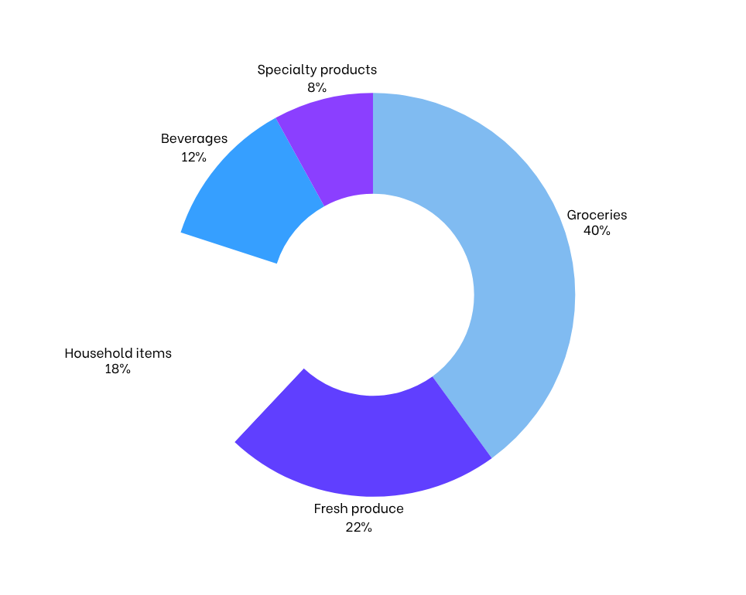
Strategic priorities
Core product categories continued driving sales while specialty offerings generated additional growth opportunities.
Metro Markets

Slide 8


Metro Markets gameplan heading into 2036
Looking ahead
As we look toward the year ahead, our focus remains on sustainable growth, operational excellence, and delivering even greater value to our customers.
Metro Markets

Slide 9




Strategic priorities
Grow customer loyalty
We'll enhance our loyalty program with more personalized rewards, exclusive promotions, and improved customer engagement initiatives.
Increase operational efficiency
We'll continue refining internal processes, adopting smarter inventory planning, and streamlining Metro Markets operations.
Expand product selection
Guided by customer feedback and purchasing trends, we'll introduce products that meet evolving needs.
Strengthen community presence
We'll deepen our involvement in local events, partnerships, and community initiatives to build stronger relationships and increase brand visibility.
Metro Markets

Slide 10



Thank you!
Questions? Reach out.
Email
Social media
Contact number
hello@reallygreatsite.com
@reallygreatsite
123-456-7890

Slide 11







































Resource Page
  Use these in your presentation. Delete or hide this page before presenting.
Fonts
Design Elements / Icons
This presentation template
uses the following free fonts:
TITLES:
Fran Ruhl Libre
BODY TEXT:
Be Vietnam
You can find these fonts online too.
Colors
#369FFF
#8B3FFF
#DFF0FF
#0F1A38

Slide 12

Credits
  This presentation template is free for everyone to use, thanks to the following:
  for this presentation template
Pexels, Pixabay, Sketchify
  for the photos, graphics, and elements
  Happy designing!

