Slide 1
Very Deep Convolutional Neural Network Based Image Classification Using Small Training Sample Size
Shuying Liu, Weihong Deng
Beijing University of Posts and Telecommunications, Beijing, China

Slide 2
Main motivation and idea of method in the paper
Very deep CNN can be used on small data
ImageNet datasets
Modified VGG-16
CIFAR-10 dataset
adding stronger regularizer and using Batch
Normalization
8.45% error rate

Slide 3
CIFAR-10
60k 32x32 colour images in 10 classes,
with 6k images per class.
There are 50k training, and 10k test images
Small for a very deep network.

Slide 4
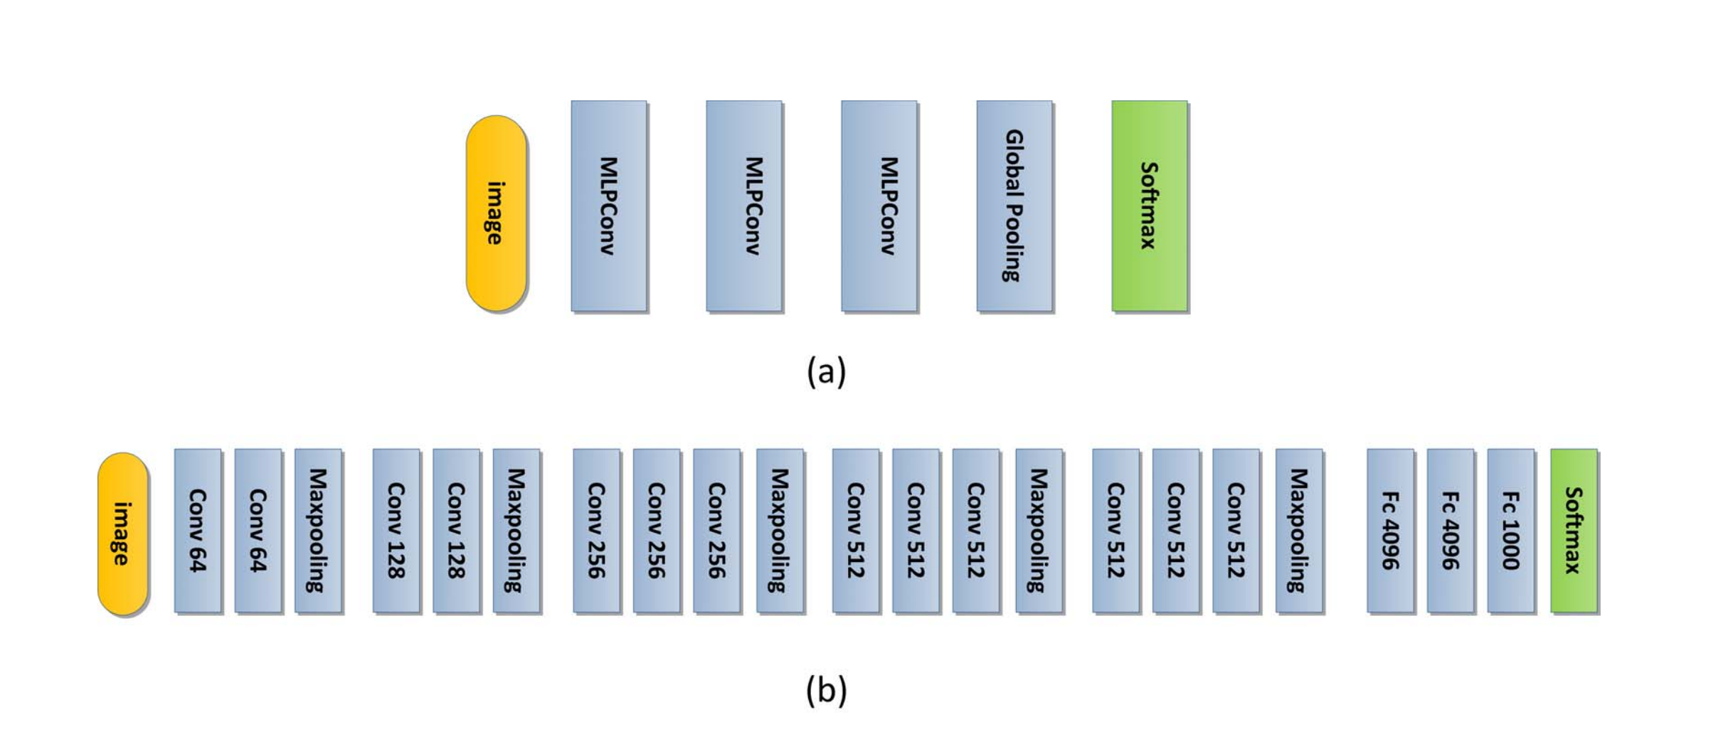
Architecture ( Modified VGG net)
Stride: 1
Kernel: 3x3
Pool: 2x2
ReLU Activataion

Slide 5
Batch normalization ( BN )
For very deep networks, small changes in the previous layers will amplify layer by layer and finally cause some problem.
Normalize every input layer. Converge faster, lower and less overfitting
Google didn’t release code so they made their own, same idea, formula have fun!

Slide 6
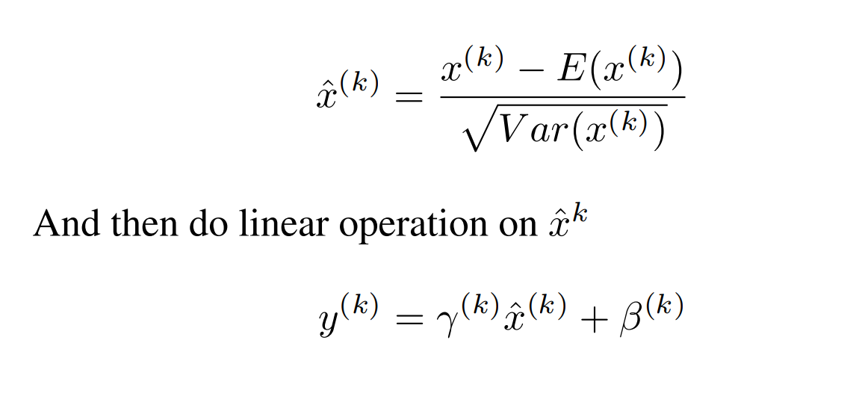
Batch normalization

Slide 7
Dropout
To counter Overfitting
On convolution and dense layers
From 0,3 % dropout to 0,5 in the dense layers
This and BN reduces loss from 20% to 8.45%.

Slide 8
Speed
They tried to make it go faster
Changed to layers of 3x3 convolution with one 5x5 concolution
Speed; From 19 hours, to 16.5 hours
Error from; 8,45 % to 11 %
Irrelevant since they just want to show that it works, independent of time, want high accuracy

Slide 9
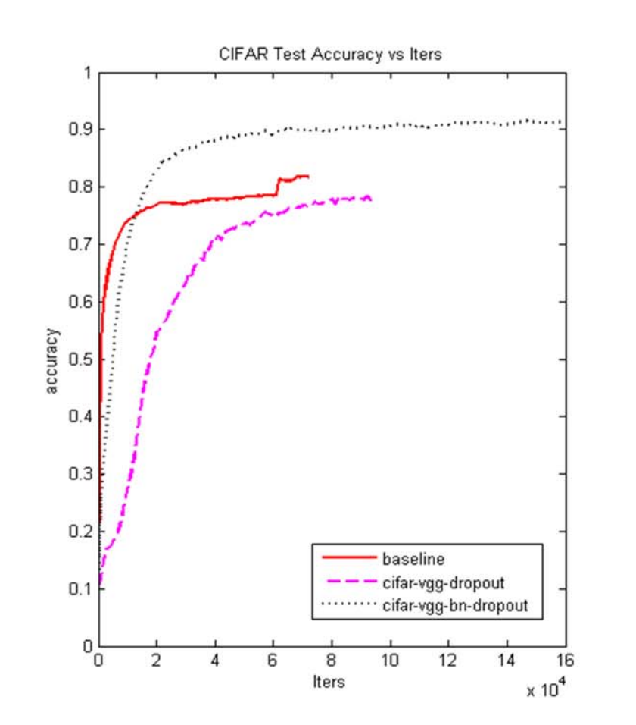
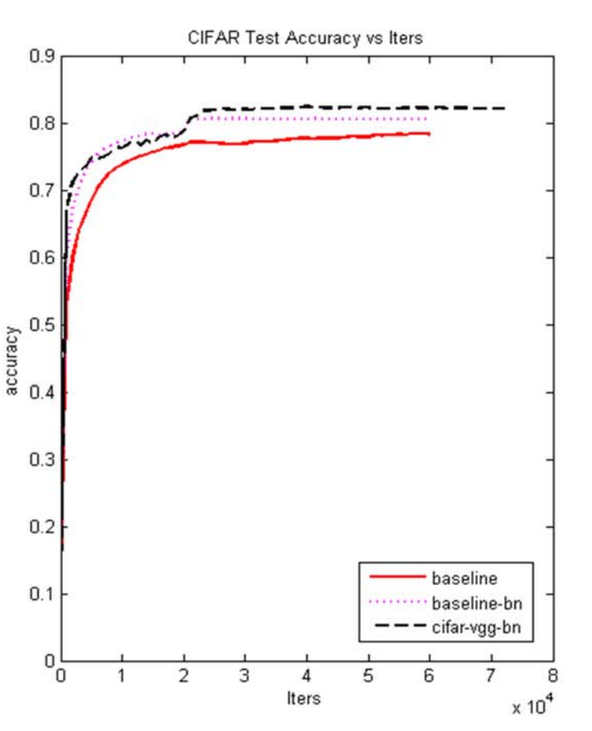
Results

Slide 10
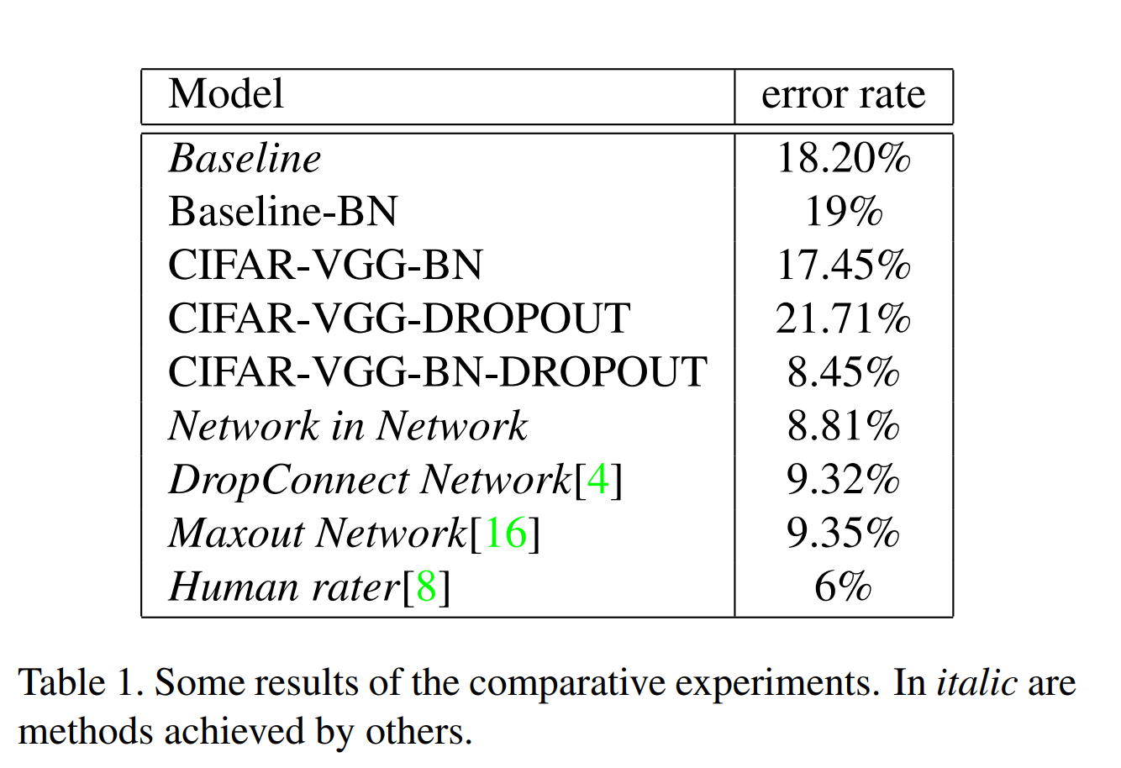
Training - Main results
Result shows that this VGG-based deep model is much more stronger than a 4-layer CNN even in the task of classifying CIFAR-10.
(The baseline )

Slide 11
Assessment of strengths and weaknesses
Managed to do what they tried to do
Didn’t save the world

