Slide 1

EPIM,EPMP & IMDM Solutions Using spring Boot

Slide 2
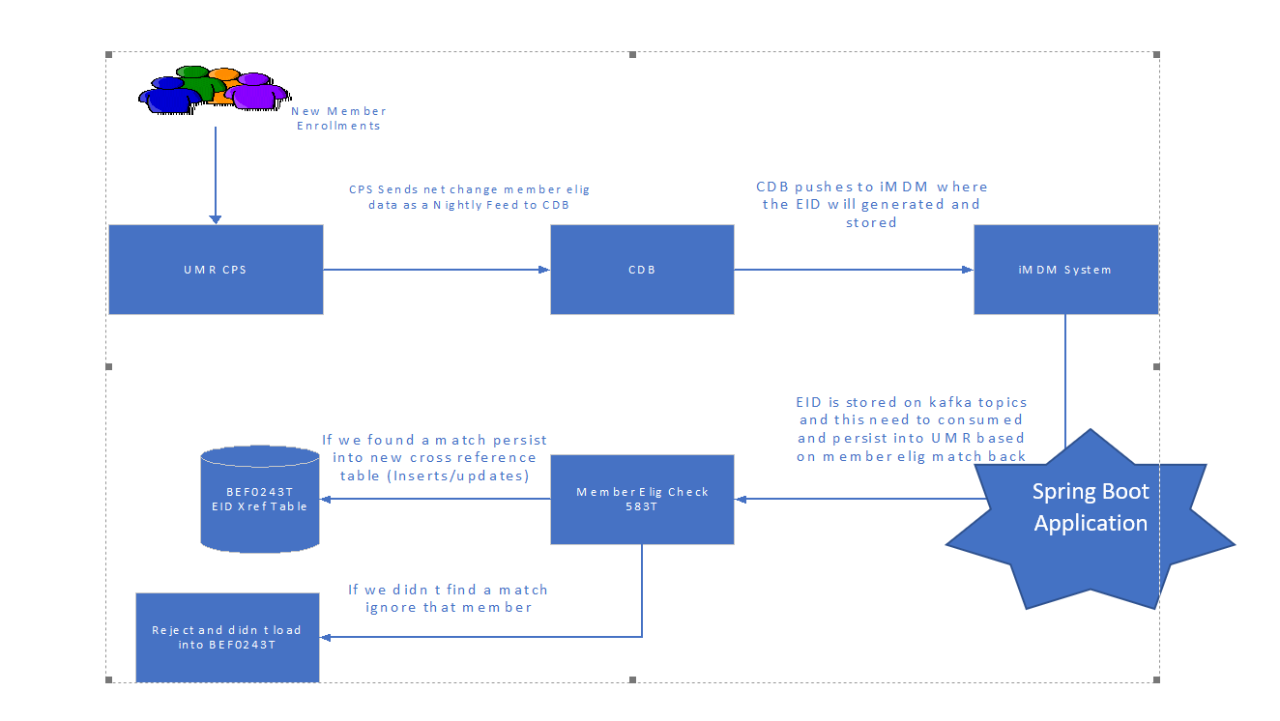
IMDM Architecture:

Slide 3
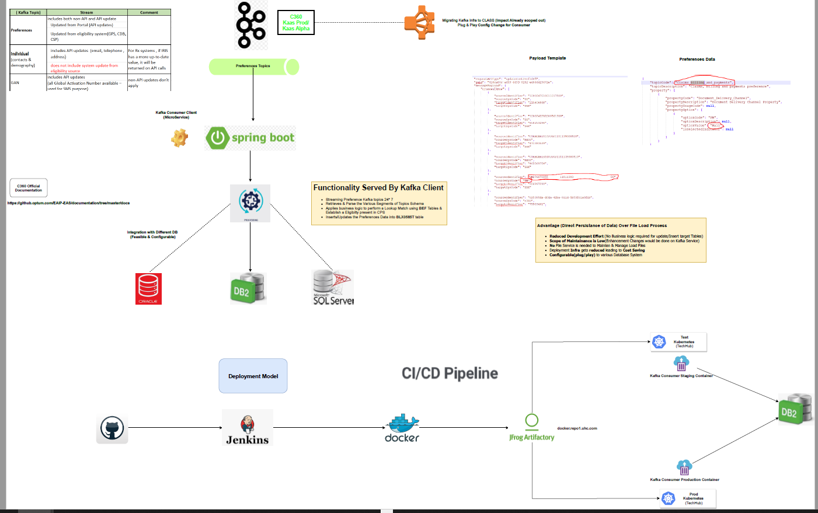
EPMP Preferences Architecure:

Slide 4
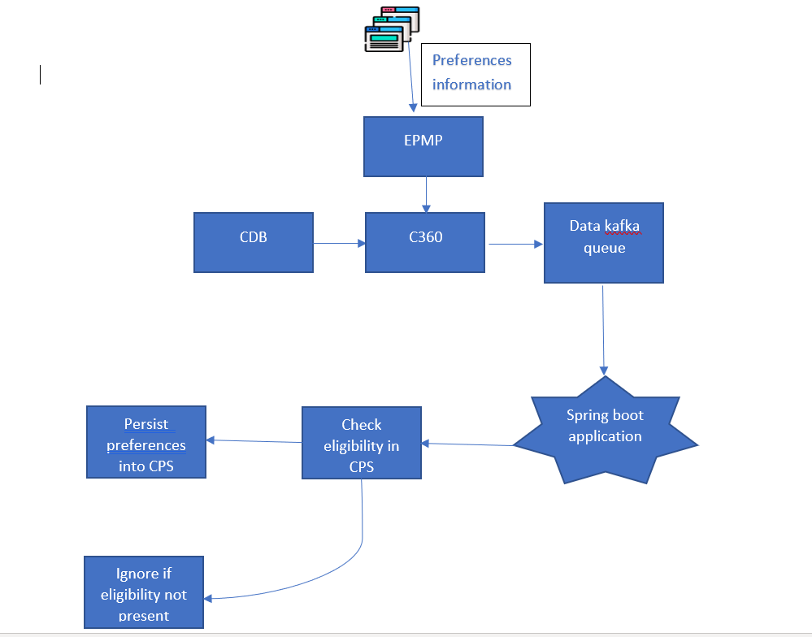
Preferences Block Diagram:

Slide 5
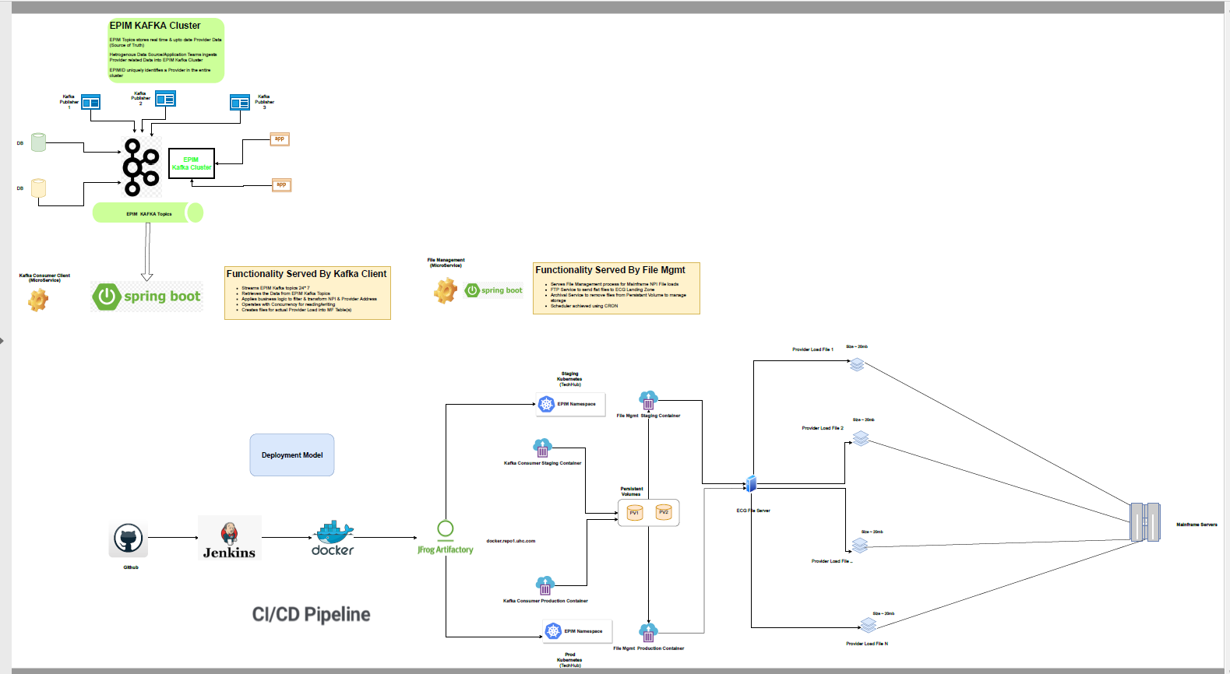
EPIM Architecture:

Slide 6
Technologies Used:
Spring boot
  Kafka Listener(Java)
  Tomcat
Docker
Kubernetes
Jenkins
JFrog antifactory
GIT
Prometheus
Grafana
Technologies Going to be use:
Sonar Qube
HP fortify scan

Slide 7
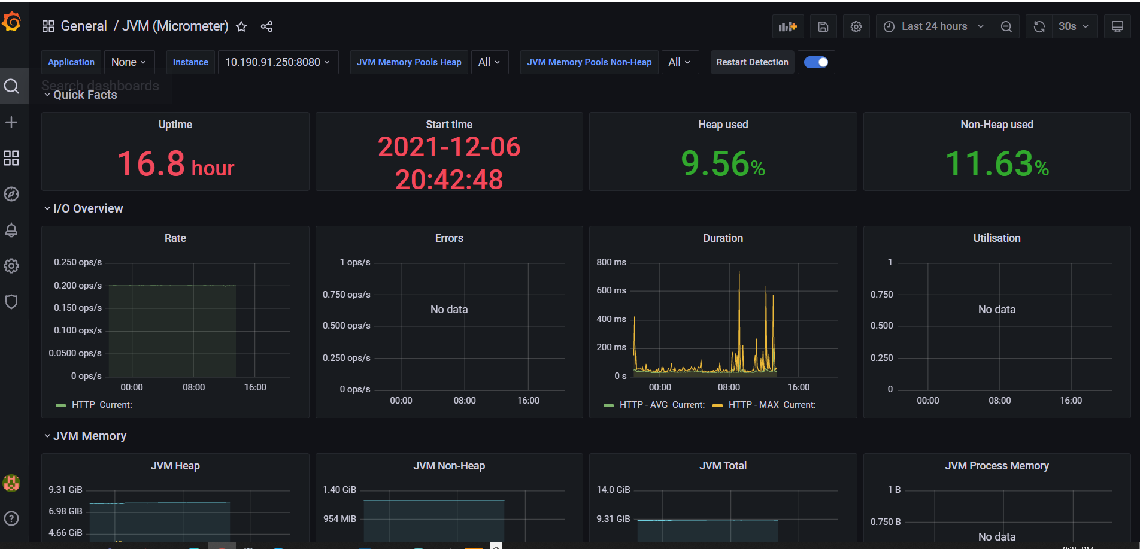
Grafana Dashboard:

