Slide 1
A&I Global Build-a-Thon
Conversational AI Bot
Pandavulu M
Madhusmitha M
Jithendra D
Vamshi v
Chiranjibi M

Slide 2
Idea Overview
Problem Addressed : At present user contact UMR portal through Contact us section for their queries. It requires human intervention to resolve user queries. Different type of users include members, providers, employers, producers, partners. Currently every query is going to customer support team and they are answering queries either through email or chat.
Potential Solution: Here we are going to develop a machine Learning(NLP) model which can answer automatically without human intervention. The NLP model will use historic users question data and provide suggestions.
The Benefits:
24/7 availability
Effective customer service
Instant response
Increased savings

Slide 3
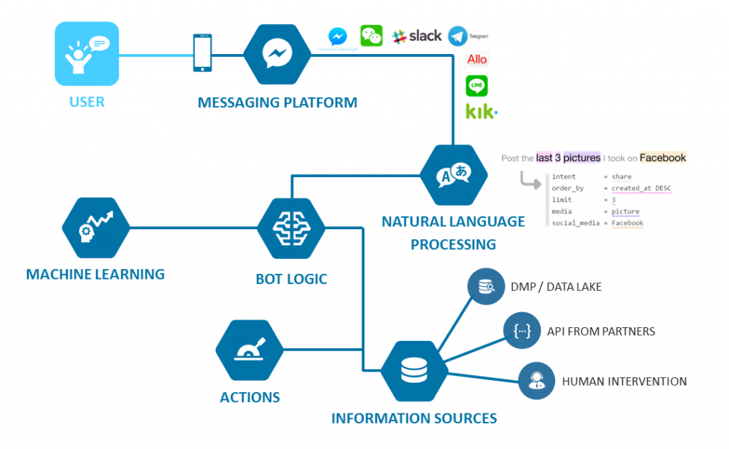
Architecture Diagram

Slide 4
User Story
This idea gets benefitted by business as we can reduce the human efforts involved in answering queries. And users waiting time as we are giving immediate reply to the user.
Business can use this idea as replacement of human efforts in the most of the cases. Especially contactUS in UMR portal. There currently Operations team getting mail and replying manually
We can use the Machine Learning model to answer users questions based on historic data.
Deep Learning, NLP, Flask, Python
We can reduce human efforts by replacing Machine Learning Model(Bot),

Slide 5
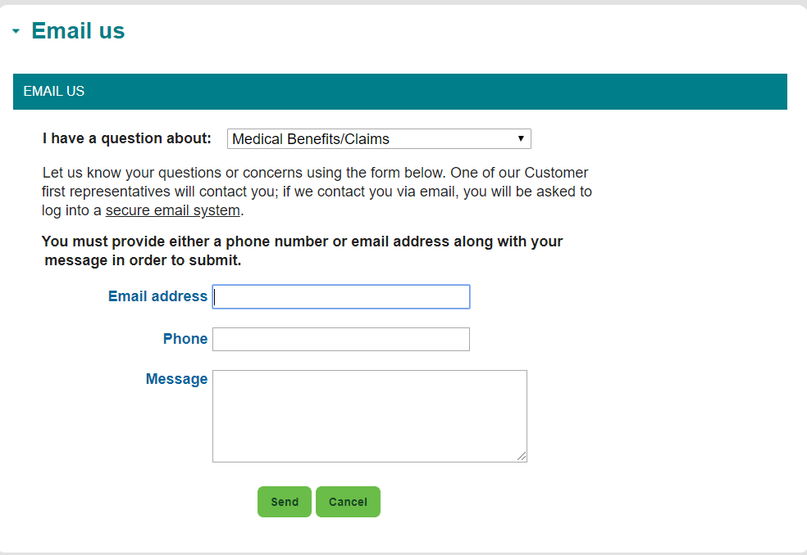
UMR usecase

Slide 6
The Five W’s
Who will:
This idea can be used by business as they no need to invest amount on employees to respond for user queries
Business
What is your idea (system, product, process, service, etc.) and what does it look like? What competition exists for this idea?
Idea is an automation reply for user queries. There is no competition as of today.
When do you think users will want it and when do you think it could be delivered?
It needs by business as cost cutting on employees for responding user queries. It can be delivered .
Where should it be delivered, (in the cloud, hosted, or premise-based for products) as face-to-face services, in the doctor’s office, etc.?
We can delivered as POC and can be delivered in cloud and hosted too
Why:
Is Optum well-positioned to deliver this solution? Yes
Would people want to pay for your solution? Yes
Would users want to use your solution? Yes

