Slide 1
Context-Mimosa Scenarios
2016-02-22-25
App:CommandFileSpinManager
Commands:csmCommands_context_mimosa_store_test1-2.json

Slide 2
Building a new context model
1) Creating a new workcoreplus:WorkOrder by context_mimosa:CreateWorkOrderTemplate()
Argument: woid=201 (workcoreplus:work_order_id)
Argument: segtag=‘SEG-101’ (combined:segment_tag)
Argument: agent_id=1 (mctxcore:cris_agent_id)
(start)-->| LOAD_KB(0) |-->| INF_MODEL(1) |-->| INFER(2) |-->| SELECT(3) |-->| USER_CHECK(4) |-->| LIST(5) |-->| USER_CHECK(4) |-->| CALL_TEMPLATE(6) |-->| SELECT(3) |-->(end)
=================CONSTRUCT TEMPLATE RESULTS===============
<rdf:RDF
xmlns:rdf="http://www.w3.org/1999/02/22-rdf-syntax-ns#"
xmlns:j.0="http://ssp4t5.net/mimosa/combined#"
xmlns:j.1="http://ssp4t5.net/mimosa/workcoreplus#" >
<rdf:Description rdf:about="http://ssp4t5.net/mimosa/workcoreplus#WorkOrder_202">
<j.0:targetAsset_id rdf:datatype="http://www.w3.org/2001/XMLSchema#integer">101</j.0:targetAsset_id>
<j.0:targetSegment_tag rdf:datatype="http://www.w3.org/2001/XMLSchema#string">SEG-101</j.0:targetSegment_tag>
<j.1:toAgent rdf:resource="http://ssp4t5.net/mimosa/combined#Agent_1"/>
<j.1:work_order_id rdf:datatype="http://www.w3.org/2001/XMLSchema#integer">202</j.1:work_order_id>
<rdf:type rdf:resource="http://ssp4t5.net/mimosa/workcoreplus#WorkOrder"/>
</rdf:Description>
</rdf:RDF>
==================================================
Notes:
CSM_RUNLOG1_...test1.txt
-------------------------------
URIs
http://ssp4t5.net/test/context_mimosa#CreateWorkOrderTemplate
http://ssp4t5.net/test/context_mimosa#CreateSituationContextTemplate
CreateWorkOrderTemplate:
=================CONSTRUCT TEMPLATE RESULTS===============
<rdf:RDF
xmlns:rdf="http://www.w3.org/1999/02/22-rdf-syntax-ns#"
xmlns:j.0="http://ssp4t5.net/mimosa/combined#"
xmlns:j.1="http://ssp4t5.net/mimosa/workcoreplus#" >
<rdf:Description rdf:about="http://ssp4t5.net/mimosa/workcoreplus#WorkOrder_202">
<j.0:targetAsset_id rdf:datatype="http://www.w3.org/2001/XMLSchema#integer">101</j.0:targetAsset_id>
<j.0:targetSegment_tag rdf:datatype="http://www.w3.org/2001/XMLSchema#string">SEG-101</j.0:targetSegment_tag>
<j.1:toAgent rdf:resource="http://ssp4t5.net/mimosa/combined#Agent_1"/>
<j.1:work_order_id rdf:datatype="http://www.w3.org/2001/XMLSchema#integer">202</j.1:work_order_id>
<rdf:type rdf:resource="http://ssp4t5.net/mimosa/workcoreplus#WorkOrder"/>
</rdf:Description>
</rdf:RDF>
==================================================

Slide 3
Building a new context model
2) Creating a new mctxcore:SituationContext by context_mimosa: CreateSituationContextTemplate()
Argument: workorderid=201 (workcoreplus:work_order_id)
(start)-->| LOAD_KB(0) |-->| INF_MODEL(1) |-->| INFER(2) |-->| CALL_TEMPLATE(6) |-->| DESCRIBE(7) |-->| USER_CHECK(4) |-->| CALL_TEMPLATE(8) |-->| DESCRIBE(9) |-->(end)
<rdf:Description rdf:about="http://ssp4t5.net/context/mctxcore#SituationContext_2016-02-24T11:14:41.222+02:00">
<j.0:hasElement rdf:resource="http://ssp4t5.net/context/mctxsimple#EMaintPerson_2016-02-24T11:14:41.222+02:00"/>
<j.0:hasElement rdf:resource="http://ssp4t5.net/context/mctxsimple#EMaintTarget_2016-02-24T11:14:41.222+02:00"/>
<j.0:hasElement rdf:resource="http://ssp4t5.net/context/mctxsimple#EMaintWork_2016-02-24T11:14:41.222+02:00"/>
<rdf:type rdf:resource="http://ssp4t5.net/context/mctxcore#SituationContext"/>
<rdf:Description rdf:about="http://ssp4t5.net/context/mctxsimple#EMaintWork_2016-02-24T11:14:41.222+02:00">
<j.0:cris_work_order_id rdf:datatype="http://www.w3.org/2001/XMLSchema#integer">201</j.0:cris_work_order_id>
<rdf:type rdf:resource="http://ssp4t5.net/context/mctxsimple#EMaintWork"/>
<rdf:Description rdf:about="http://ssp4t5.net/context/mctxsimple#EMaintTarget_2016-02-24T11:14:41.222+02:00">
<j.0:ref_tag_code rdf:datatype="http://www.w3.org/2001/XMLSchema#string">SEG-101</j.0:ref_tag_code>
<rdf:type rdf:resource="http://ssp4t5.net/context/mctxsimple#EMaintTarget"/>
<rdf:Description rdf:about="http://ssp4t5.net/context/mctxsimple#EMaintPerson_2016-02-24T11:14:41.222+02:00">
<j.0:cris_agent_id rdf:datatype="http://www.w3.org/2001/XMLSchema#integer">1</j.0:cris_agent_id>
<rdf:type rdf:resource="http://ssp4t5.net/context/mctxsimple#EMaintPerson"/>
Notes:
CSM_RUNLOG2_...test1.txt
-------------------------------
URIs
http://ssp4t5.net/test/context_mimosa#CreateWorkOrderTemplate
http://ssp4t5.net/test/context_mimosa#CreateSituationContextTemplate

Slide 4

Building a new context model
3) Running SPIN Constructors
(start)-->| LOAD_KB(0) |-->| INF_MODEL(1) |-->| INFER(2) |-->| CALL_TEMPLATE(6) |-->| CALL_TEMPLATE(8) |-->| DESCRIBE(9) |-->| SPIN_CONSTRUCTOR(10) |-->| WRITE(11) |-->| DESCRIBE(9) |-->(end)
<http://ssp4t5.net/context/mctxcore#SituationContext_2016-02-22T14:55:34.973+02:00>
a mctxcore:SituationContext ;
mctxcore:active true ;
mctxcore:created "2016-02-22T14:55:35.410+02:00"^^xsd:dateTime ;
mctxcore:hasElement <http://ssp4t5.net/context/mctxsimple#EWorkOrder_2016-02-22T14:55:34.973+02:00> , <http://ssp4t5.net/context/mctxsimple#EMaintTarget_2016-02-22T14:55:34.973+02:00> , <http://ssp4t5.net/context/mctxsimple#EMaintPerson_2016-02-22T14:55:34.973+02:00> .
<http://ssp4t5.net/context/mctxsimple#EWorkOrder_2016-02-22T14:55:34.973+02:00>
a <http://ssp4t5.net/context/mctxsimple#EMaintWork> ;
<http://ssp4t5.net/context/mctxcore#created>
"2016-02-22T14:55:35.224+02:00"^^<http://www.w3.org/2001/XMLSchema#dateTime> ;
<http://ssp4t5.net/context/mctxcore#hasWorkOrder>
<http://ssp4t5.net/mimosa/workcoreplus#WorkOrder_201> .
Notes:
CSM_RUNLOG3_...test1.txt
-------------------------------

Slide 5
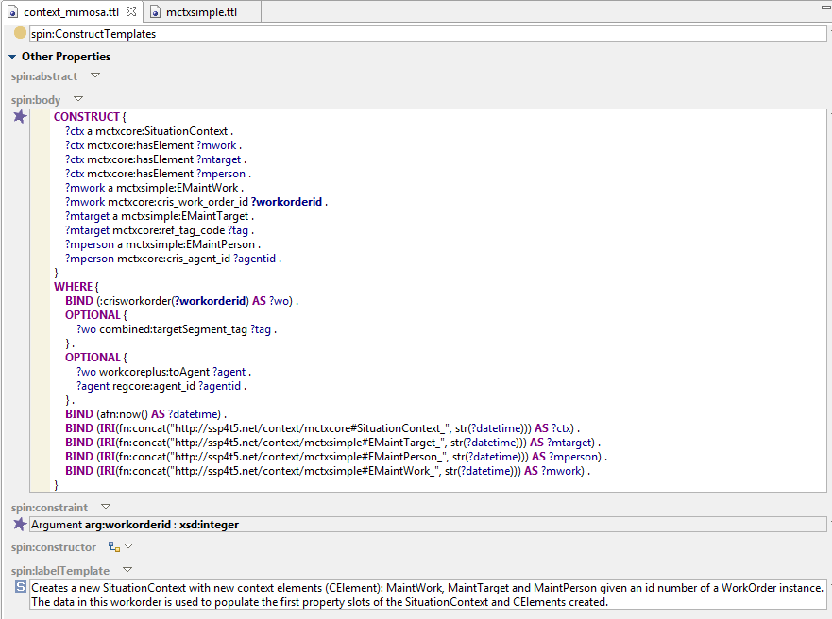
CreateSituationContextTemplate

Slide 6
Extending EMaintWork SPIN:Constructor
Extending the SPIN:Constructors to create new instances of other classes

Slide 7
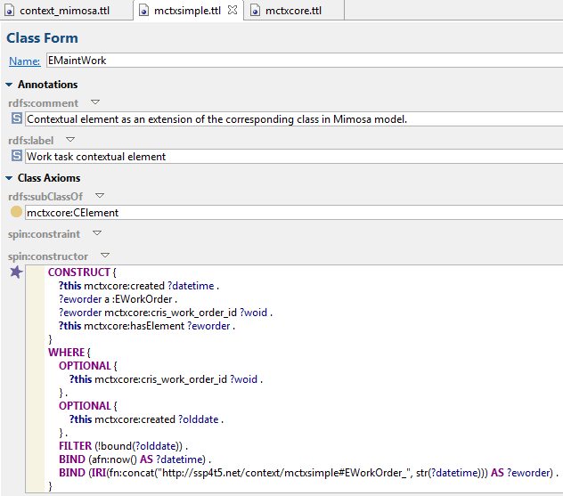
EMaintWork SPIN:Constructor extended
EMaintWork SPIN:CONSTRUCTOR:
CONSTRUCT {
?this mctxcore:created ?datetime .
?eworder a :EWorkOrder .
?eworder mctxcore:cris_work_order_id ?woid .
?this mctxcore:hasElement ?eworder .
}
WHERE {
OPTIONAL {
?this mctxcore:cris_work_order_id ?woid .
} .
OPTIONAL {
?this mctxcore:created ?olddate .
} .
FILTER (!bound(?olddate)) .
BIND (afn:now() AS ?datetime) .
BIND (IRI(fn:concat("http://ssp4t5.net/context/mctxsimple#EWorkOrder_", str(?datetime))) AS ?eworder) .
}
Notes:
EMaintWork CONSTRUCTOR:
CONSTRUCT {
?this mctxcore:created ?datetime .
?eworder a :EWorkOrder .
?eworder mctxcore:cris_work_order_id ?woid .
?this mctxcore:hasElement ?eworder .
}
WHERE {
OPTIONAL {
?this mctxcore:cris_work_order_id ?woid .
} .
OPTIONAL {
?this mctxcore:created ?olddate .
} .
FILTER (!bound(?olddate)) .
BIND (afn:now() AS ?datetime) .
BIND (IRI(fn:concat("http://ssp4t5.net/context/mctxsimple#EWorkOrder_", str(?datetime))) AS ?eworder) .
}

Slide 8
Building Context Model – Templates and Constructors (1)
sp:Arg
CALL_TEMPLATE
CreateWorkOrder Template (Args: )
Workcoreplus: WorkOrder
Mimosa
KB
sp:Arg
work_order_id = 201
CALL_TEMPLATE
CreateSituationContext Template (Arg: workorderid)
Situation Context
Context
KB
SPIN_CONSTRUCTORS
Situation Context
hasElement
hasElement
EMaintWork
EMaintTarget
EMaintPerson
SPIN_CONSTRUCTORS
EMaintWork
EMaintTarget
EMaintPerson
cris_work_order_id = 201
cris_work_order_id = 201
hasElement
EWorkOrder
EAsset
EPersonProfile
cris_work_order_id = 201
ESegment
Note: The sub-classes of mctxcore:CELement beginning with letter E are defined in mctxsimple: namespace.
Notes:
Note: The sub-classes of mctxcore:CELement beginning with letter E are defined in mctxsimple: namespace.

Slide 9
Building Context Model – Templates and Constructors (2)
SPIN_CONSTRUCTORS
Situation Context
Context
KB
hasElement
SPIN_CONSTRUCTORS
EMaintWork
EMaintTarget
EMaintPerson
cris_work_order_id = 201
ref_tag_code = SEG-101
cris_agent_id = 1
hasElement
SPIN_CONSTRUCTORS
EWorkOrder
EAsset
EPersonProfile
cris_work_order_id = 201
ref_tag_code = SEG-101
cris_agent_id = 1
ESegment
FOCUS NEXT
ref_tag_code = SEG-101
Isa-95:
EquipSegSpecification
pm:
MachineDocumentation
Isa-95:
Person Capability Property
ctxisa:
Maintenance
Experience
ISA-95
KB
Notes:
Note: The sub-classes of mctxcore:CELement beginning with letter E are defined in mctxsimple: namespace.
http://ase.tut.fi/ase-inf/ontologies/2015/PlantModel#MachineDocumentation
mctxcore:cris_agent_id ?agentid
mctxcore:cris_work_order_id
mctxcore:ref_tag_code
mctxsimple:tag
DONE: BY: APP
"filename": "data/json/csmCommands_context_mimosa_store_test2.json", "created": "2016-02-24", "updated": "2016-02-25",

Slide 10
See ISA-95 Process Segment Model (Fig11)
Prosegmodel:EquipSegSpec and prosegmodel:EquipDocumentation created by CSM tool using Construct queries.
(data/json/csmCommands_context_mimosa_store_test3.json“)
(how to create this link? Using Spin:constructor of Esegment not OK, because it has been defined in TBC editor.
LINKING PROBLEM: Esegment has ref_tag_code = ‘SEG-101’ BUT proxy:EquipSegSpec has Prosegmodel:model_id=101
ESegment
FOCUS NEXT
ISA-95
KB
ref_tag_code = SEG-101
Cloned from ISA-95 model
Proseg:hasDocumentation
Isa-95:
EquipSegSpecification
Isa-95:
EquipDocumentation
proxy:
EquipSegSpecification
proxy:
MachineDocumentation
Isa-95:
Person Capability Property
ctxisa:
Maintenance
Experience
Prosegmodel:model_id=101
Prosegmodel:docUri=“MaintGuide_101_uri”
Prosegmodel:model_id=101
Prosegmodel:docUri=“MaintGuide_101_uri”
http://external.net/isa95/prosegmodel#
http://ssp4t5.net/external/proxy#
Notes:
WORKFLOWS:
data/json/csmCommands_context_mimosa_store_test3.json
data/json/csmCommands_context_mimosa_store_test4.json
A) _test3.json creates the external ISA-95 classes and instances (NS http://external.net/isa95/prosegmodel#)
B) _test4.json clones the external ISA-95 classes and instances as corresponding proxy objects (NS: http://ssp4t5.net/external/proxy#)
======================================
A) CONSTRUCT QUERIES
Classes and properties:
------------------------
<http://external.net/isa95/prosegmodel#EquipSegSpec>
a <http://www.w3.org/2002/07/owl#Class> .
<http://external.net/isa95/prosegmodel#model_id>
a <http://www.w3.org/2002/07/owl#DatatypeProperty> .
<http://external.net/isa95/prosegmodel#EquipDocumentation>
a <http://www.w3.org/2002/07/owl#Class> .
<http://external.net/isa95/prosegmodel#hasDocumentation>
a <http://www.w3.org/2002/07/owl#ObjectProperty> .
<http://external.net/isa95/prosegmodel#docUri>
a <http://www.w3.org/2002/07/owl#DatatypeProperty> .
---
Instances:
-------------
<http://external.net/isa95/prosegmodel#EquipSegSpec_101>
a <http://external.net/isa95/prosegmodel#EquipSegSpec> ;
<http://external.net/isa95/prosegmodel#model_id>
101 .
<http://external.net/isa95/prosegmodel#EquipDocumentation_101>
a <http://external.net/isa95/prosegmodel#EquipDocumentation> .
DESCRIBE
-------------
<http://external.net/isa95/prosegmodel#EquipSegSpec_101>
a <http://external.net/isa95/prosegmodel#EquipSegSpec> ;
<http://external.net/isa95/prosegmodel#hasDocumentation>
<http://external.net/isa95/prosegmodel#EquipDocumentation_101> ;
<http://external.net/isa95/prosegmodel#model_id>
101 .
<http://external.net/isa95/prosegmodel#EquipDocumentation_101>
a <http://external.net/isa95/prosegmodel#EquipDocumentation> ;
<http://external.net/isa95/prosegmodel#docUri>
"MaintenanceGuide_101_uri" .
========================================================
B) CONSTRUCT QUERIES
extproseg:EquipSegSpec_101
a extproseg:EquipSegSpec ;
extproseg:hasDocumentation extproseg:EquipDocumentation_101 ;
extproseg:model_id 101 .
extproseg:EquipDocumentation_101
a extproseg:EquipDocumentation ;
extproseg:docUri "MaintenanceGuide_101_uri" .
proxy:EquipDocumentation_101
a extproseg:EquipDocumentation ;
extproseg:docUri "MaintenanceGuide_101_uri" .
proxy:EquipSegSpec_101
a extproseg:EquipSegSpec ;
extproseg:hasDocumentation proxy:EquipDocumentation_101 ;
extproseg:model_id 101 .

Slide 11
(3/3)
See ISA-95 Process Segment Model (Fig11)
Prosegmodel:EquipSegSpec and prosegmodel:EquipDocumentation created by CSM tool using Construct queries.
(data/json/csmCommands_context_mimosa_store_test3.json“)
Link mctxsimple:hasDocumentation from ESegment_101 to proxy:EquipDocumentation_101 created by CSM tool using Construct queries.
data/json/csmCommands_context_mimosa_store_test4.json
FOCUS NEXT: not needed
LINKING PROBLEM 2: ESegment is linked now to the proxy doc and orig. doc because proxy:EquipSegSpec belongs to the same external class as the original one.
ESegment
ISA-95
KB
ref_tag_code = SEG-101
Mctxsimple:hasDocumentation
Cloned from ISA-95 model
Proseg:hasDocumentation
Isa-95:
EquipSegSpecification
Isa-95:
EquipDocumentation
proxy:
EquipSegSpecification
proxy:
MachineDocumentation
Isa-95:
Person Capability Property
ctxisa:
Maintenance
Experience
Prosegmodel:model_id=101
Prosegmodel:docUri=“MaintGuide_101_uri”
Prosegmodel:model_id=101
Prosegmodel:docUri=“MaintGuide_101_uri”
http://external.net/isa95/prosegmodel#
http://ssp4t5.net/external/proxy#
Notes:
WORKFLOWS:
data/json/csmCommands_context_mimosa_store_test3.json
data/json/csmCommands_context_mimosa_store_test4.json
A) _test3.json creates the external ISA-95 classes and instances (NS http://external.net/isa95/prosegmodel#)
B) _test4.json clones the external ISA-95 classes and instances as corresponding proxy objects (NS: http://ssp4t5.net/external/proxy#)
======================================
A) CONSTRUCT QUERIES
Classes and properties:
------------------------
<http://external.net/isa95/prosegmodel#EquipSegSpec>
a <http://www.w3.org/2002/07/owl#Class> .
<http://external.net/isa95/prosegmodel#model_id>
a <http://www.w3.org/2002/07/owl#DatatypeProperty> .
<http://external.net/isa95/prosegmodel#EquipDocumentation>
a <http://www.w3.org/2002/07/owl#Class> .
<http://external.net/isa95/prosegmodel#hasDocumentation>
a <http://www.w3.org/2002/07/owl#ObjectProperty> .
<http://external.net/isa95/prosegmodel#docUri>
a <http://www.w3.org/2002/07/owl#DatatypeProperty> .
---
========================================================
B) CONSTRUCT QUERIES
extproseg:EquipSegSpec_101
a extproseg:EquipSegSpec ;
extproseg:hasDocumentation extproseg:EquipDocumentation_101 ;
extproseg:model_id 101 .
extproseg:EquipDocumentation_101
a extproseg:EquipDocumentation ;
extproseg:docUri "MaintenanceGuide_101_uri" .
proxy:EquipDocumentation_101
a extproseg:EquipDocumentation ;
extproseg:docUri "MaintenanceGuide_101_uri" .
proxy:EquipSegSpec_101
a extproseg:EquipSegSpec ;
extproseg:hasDocumentation proxy:EquipDocumentation_101 ;
extproseg:model_id 101 .
==========================
C:
<http://ssp4t5.net/context/mctxsimple#ESegment_2016-03-03T14:06:40.606+02:00>
mctxsimple:hasDocumentation extproseg:EquipDocumentation_101 , proxy:EquipDocumentation_101 .
<http://ssp4t5.net/context/mctxsimple#ESegment_2016-03-03T14:06:40.509+02:00>
mctxsimple:hasDocumentation extproseg:EquipDocumentation_101 , proxy:EquipDocumentation_101 .

Slide 12
EMaintWork SPIN:Constructor extended
EMaintWork class’s SPIN:Constructor creates a new EWorkOrder instance as its sub CElement (hasElement) with #cris_work_order_id property statement.
Followed by an execution of the SPIN:Constructor of EWorkOrder class generating #created property statement
<http://ssp4t5.net/context/mctxsimple#EMaintWork_2016-02-24T16:10:53.533+02:00>
a <http://ssp4t5.net/context/mctxsimple#EMaintWork> ;
<http://ssp4t5.net/context/mctxcore#created>
"2016-02-24T16:10:53.850+02:00"^^<http://www.w3.org/2001/XMLSchema#dateTime> ;
<http://ssp4t5.net/context/mctxcore#cris_work_order_id>
201 ;
<http://ssp4t5.net/context/mctxcore#hasElement>
<http://ssp4t5.net/context/mctxsimple#EWorkOrder_2016-02-24T16:10:53.850+02:00> .
<http://ssp4t5.net/context/mctxsimple#EWorkOrder_2016-02-24T16:10:53.850+02:00>
a <http://ssp4t5.net/context/mctxsimple#EWorkOrder> ;
<http://ssp4t5.net/context/mctxcore#created>
"2016-02-24T16:10:54.020+02:00"^^<http://www.w3.org/2001/XMLSchema#dateTime> ;
<http://ssp4t5.net/context/mctxcore#cris_work_order_id>
201 .

Slide 13
EPerson SPIN:Constructor extended
EPerson class’s SPIN:Constructor creates a new EPersonProfile instance as its sub CElement (hasElement) with #cris_agent_id property statement.
Followed by an execution of the SPIN:Constructor of EPersonProfile class generating #created property statement
<http://ssp4t5.net/context/mctxsimple#EMaintPerson_2016-02-25T18:40:16.339+02:00>
a mctxsimple:EMaintPerson ;
mctxcore:created "2016-02-25T18:40:16.821+02:00"^^xsd:dateTime ;
mctxcore:cris_agent_id 1 ;
mctxcore:hasElement <http://ssp4t5.net/context/mctxsimple#EPersonProfile_2016-02-25T18:40:16.821+02:00>
<http://ssp4t5.net/context/mctxsimple#EPersonProfile_2016-02-25T18:40:16.821+02:00>
a mctxsimple:EPersonProfile ;
mctxcore:created "2016-02-25T18:40:16.874+02:00"^^xsd:dateTime ;
mctxcore:cris_agent_id 1 .

Slide 14
MaintTarget SPIN:Constructor extended
MaintTarget class’s SPIN:Constructor creates a new Easset and ESegment instances as its sub CElements (hasElement) with mctxcore:ref_tag_code property statements.
Followed by an execution of the SPIN:Constructors of these classes generating #created property statement
<http://ssp4t5.net/context/mctxsimple#EMaintTarget_2016-02-25T18:17:07.863+02:00>
a mctxsimple:EMaintTarget ;
mctxcore:created "2016-02-25T18:17:08.004+02:00"^^xsd:dateTime ;
mctxcore:hasElement <http://ssp4t5.net/context/mctxsimple#EAsset_2016-02-25T18:17:08.004+02:00> , <http://ssp4t5.net/context/mctxsimple#ESegment_2016-02-25T18:17:08.004+02:00> ;
mctxcore:ref_tag_code "SEG-101"^^xsd:string .
<http://ssp4t5.net/context/mctxsimple#EAsset_2016-02-25T18:17:08.004+02:00>
a mctxsimple:EAsset ;
mctxcore:created "2016-02-25T18:17:08.355+02:00"^^xsd:dateTime ;
mctxcore:ref_tag_code "SEG-101"^^xsd:string .
<http://ssp4t5.net/context/mctxsimple#ESegment_2016-02-25T18:17:08.004+02:00>
a mctxsimple:ESegment ;
mctxcore:created "2016-02-25T18:17:08.400+02:00"^^xsd:dateTime ;
mctxcore:ref_tag_code "SEG-101"^^xsd:string .
Notes:
NOTE: TBC model contained additional EMaintTarget instances with the same ref_tag_code

Slide 15
Context-Mimosa.ttl
Classes
Properties

Slide 16
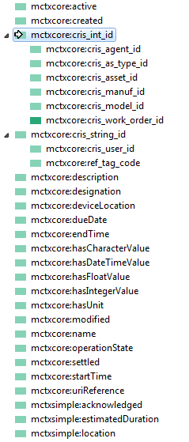
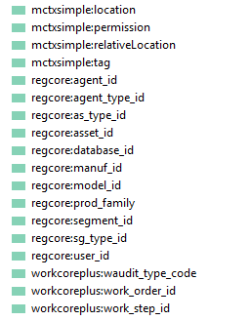
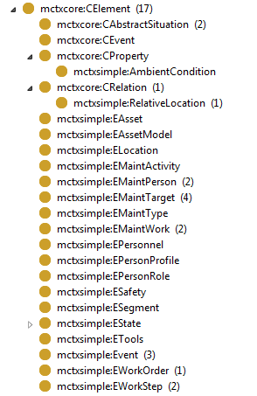
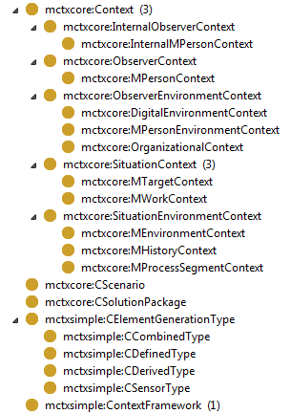

Context-Mimosa.ttl
NOTE: These mctxcore:cris_xxx_id dataTypeProperties are references to the actual regcore:yyy_id mimosa ID’s
NOTE: mctxcore:mimosaRef is an ObjectProperty for referencing objects in mimosa model.

Slide 17
ISA-95
Personnel Model
Process Segment Model

Slide 18
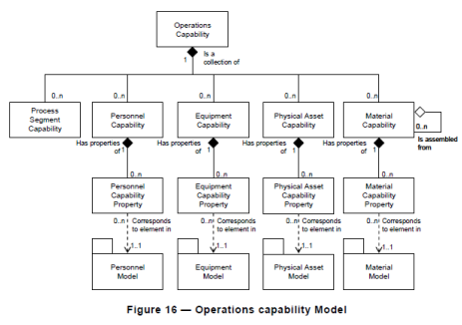
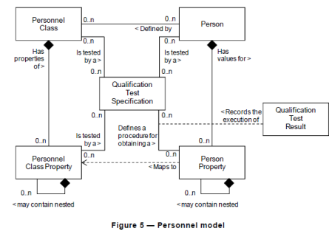
ISA-95
VPA
ISA-95
Person
(ISA-95)
Person Capability Property
“Maintenance
Experience”
(VPA)
Notes:
Saatu Davidiltä
From: C:\Users\paarnio\Documents\S-STEP_Fimecc\Standards_ISA-88-95\DIN EN 62264 (ISA-95)
Changes in ISA-95 2010 version (van de Kerkhof ISA95new).pdf

Slide 19
Personnel - Person
TBC-project: maintenance.tut.fi
mc1:Person_3 type maintcont:MaintenanceTeamLeader
maintcont:hasSubordinate
mc1:Person_1 type maintcont:Maintenanceman
mc1:Person_2 type maintcont:Maintenanceman
Notes:
KS. TBC-project: maintenance.tut.fi
mc1: <http://ase.tut.fi/ase-inf/ontologies/examples/BreweryMC01#>
maintcont:
MOT: harjoittelija = trainee, intern, apprentice
MOT: käskynalainen, jnk alainen = Subordinate

Slide 20
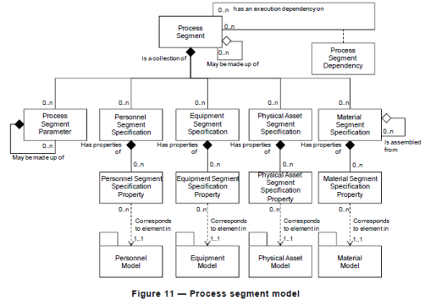
ISA-95: Process Segment Model
Isa-95:EquipSegSpecification
Notes:
Isa-95:EquipSegSpecification

Slide 21
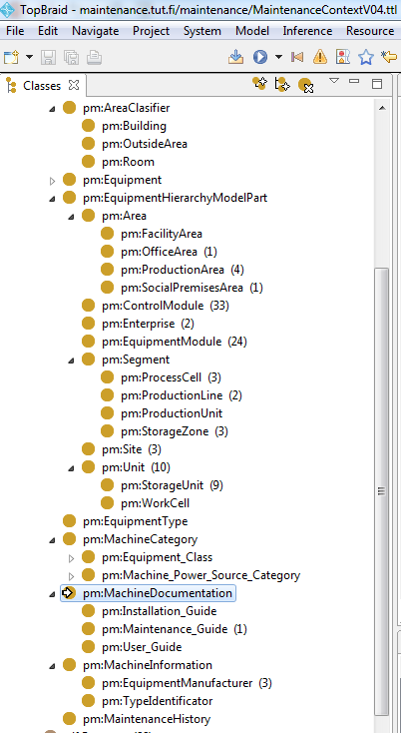
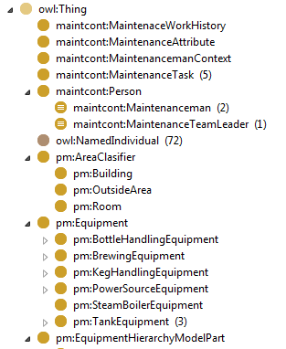
. TBC-project: maintenance.tut.fi
Pm:MachineDocumentation
http://ase.tut.fi/ase-inf/ontologies/2015/PlantModel#MachineDocumentation
Pm:MachineInformation
http://ase.tut.fi/ase-inf/ontologies/2015/PlantModel#MachineInformation
Notes:
http://ase.tut.fi/ase-inf/ontologies/2015/PlantModel#MachineDocumentation

Slide 22
Workflow JSON

Slide 23
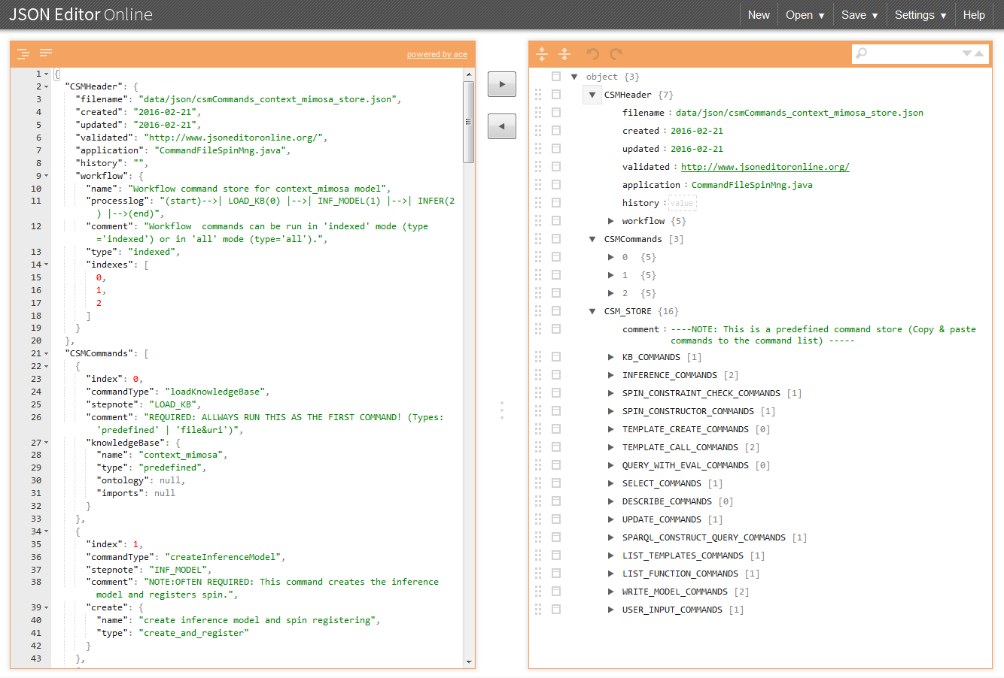
csmCommands_context_mimosa_store.json
Notes:
http://www.jsoneditoronline.org/#

Slide 24
(Building Context Model – Templates and Constructors 2)
SPIN_CONSTRUCTORS
Situation Context
hasElement
SPIN_CONSTRUCTORS
EMaintWork
EMaintTarget
EMaintPerson
FOCUS NOW
cris_work_order_id = 201
ref_tag_code = SEG-101
cris_agent_id = 1
hasElement
EWorkOrder
EAsset
EPersonProfile
cris_work_order_id = 201
ref_tag_code = SEG-101
cris_agent_id = 1
ESegment
ref_tag_code = SEG-101
Isa-95:
EquipSegSpecification
pm:
MachineDocumentation
Isa-95:
Person Capability Property
ctxisa:
Maintenance
Experience
Notes:
Note: The sub-classes of mctxcore:CELement beginning with letter E are defined in mctxsimple: namespace.
http://ase.tut.fi/ase-inf/ontologies/2015/PlantModel#MachineDocumentation
mctxcore:cris_agent_id ?agentid
mctxcore:cris_work_order_id
mctxcore:ref_tag_code
mctxsimple:tag

