Slide 1
ThreadBack
A handoff to your future self
Snapdragon AI Lab Build & Present Challenge
Notes:
ThreadBack is a Windows prototype for deliberate task handoffs. This deck describes current local implementation and the planned Snapdragon optimization path. Do not present it as hardware-validated until target-device results have been added.

Slide 2
The unfinished thought
“Why did I reject that approach?”
Reopening a file does not recover every decision behind it.
ThreadBack preserves the decision, the unresolved test, and the next action with their source evidence.
Notes:
The use case is a student interrupted during a technical project. This is a problem hypothesis grounded in the example, not a quantified productivity study.

Slide 3
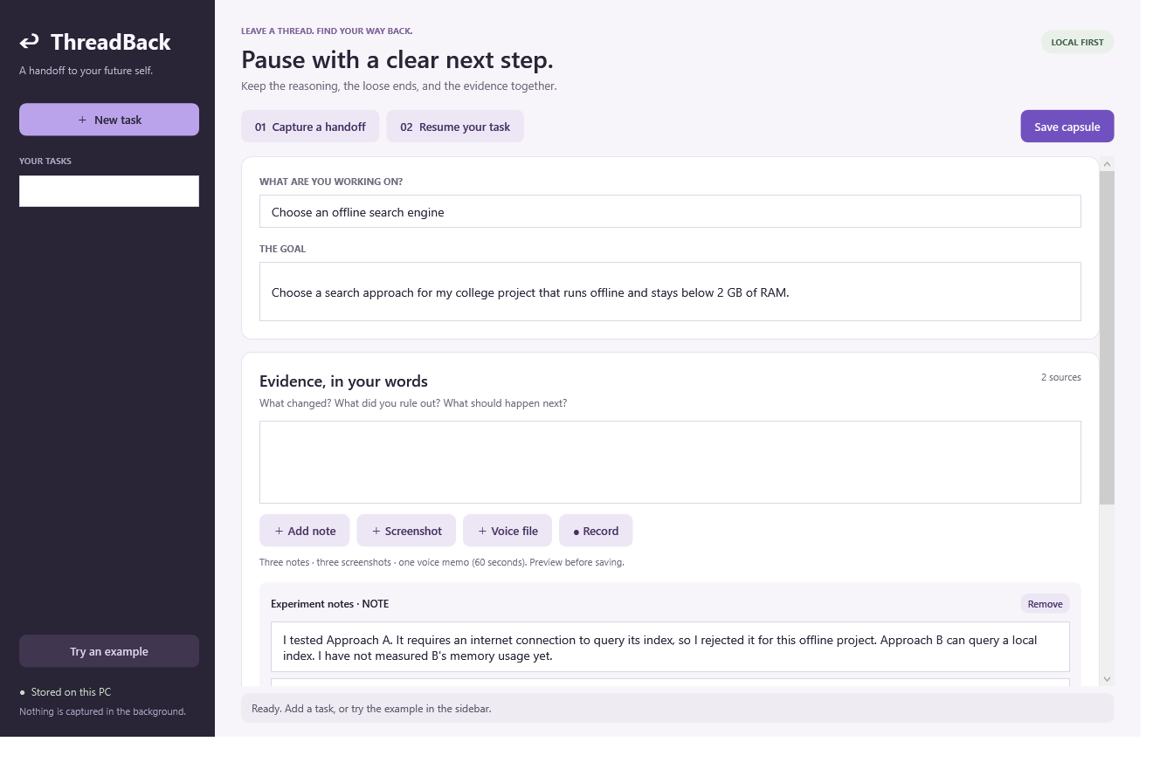
A deliberate pause
A goal and a short handoff
Notes, screenshots, or a voice memo.
Notes:
Show the goal and two source notes. The example rejects Approach A because it needs internet and leaves Approach B’s memory use unresolved. Inputs are user selected. No background screen capture occurs. Screenshot is from the actual local prototype.

Slide 4
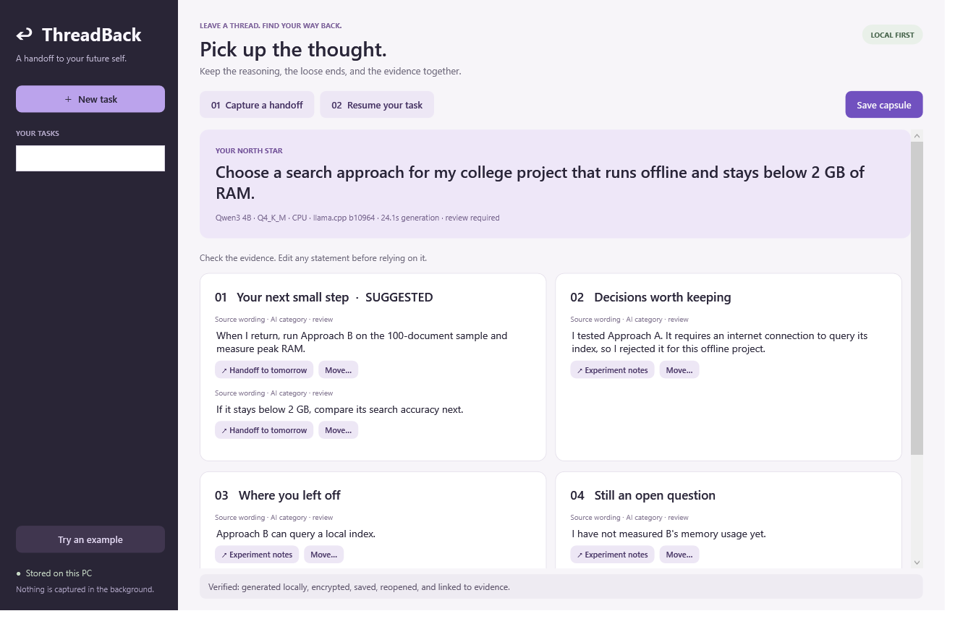
A checkable next step
Decisions stay beside their evidence
Unknowns stay visible. Suggested actions remain editable.
Notes:
Show actual generated content. Every AI statement has an exact source quote and an inspectable evidence link. Exact-quote validation checks provenance, not semantic correctness. Users can edit the interpretation. Screenshot is a real local generation and save/reopen run.

Slide 5
Local processing
01 Selected evidence
02 Structured handoff
OCR and speech transcription produce text the user reviews.
AI organizes source passages. Their original wording stays intact.
Capsules persist in protected storage for the current Windows account.
Notes:
Implementation: WPF/.NET desktop, Windows OCR, Whisper Base English, quantized Qwen through llama.cpp, and Windows DPAPI storage. Workers are separate processes. The language model binds to loopback and uses a per-launch token. First-time downloads need internet. Independent network-isolation testing remains pending. Windows OCR passed a local unpackaged smoke test but Microsoft documents package identity for supported desktop deployment. Source: https://learn.microsoft.com/en-us/uwp/api/windows.media.ocr

Slide 6
What the prototype has demonstrated
10
23 s
storage and validation checks passed
one synthetic voice handoff transcribed locally
Intel development laptop · CPU. Snapdragon performance remains unmeasured.
Notes:
These are Intel development-laptop results, not Snapdragon measurements. Storage checks verify encrypted roundtrip, attachment preservation, overwrites, citation rejection, null sections, user edits, input limits, duplicate IDs, corruption reporting and deletion as grouped into the current test runner. Speech timing is one synthetic WAV smoke test including the worker/model load, not a statistical benchmark or word-error-rate evaluation. Source: local artifacts/verification/capabilities.json and tests/ThreadBack.Checks.

Slide 7
The Snapdragon validation path
First target: NPU speech transcription
AI Hub
Device Cloud
HP validation
Compile and profile the speech model.
Run the app on an available Windows Snapdragon device.
Verify the complete workflow on the intended PC.
Pending access and measurements
Notes:
Target: Snapdragon-powered HP PCs. First NPU target: Whisper transcription using Qualcomm’s Windows ONNX/QNN example. AI Hub supports model compile/profile/inference jobs. Device Cloud provides remote device sessions. Record the exact available device and do not equate reference-device results with HP-specific validation. Sources: https://aihub.qualcomm.com/apps/whisper_windows_py ; https://aihub.qualcomm.com/ ; https://qdc.qualcomm.com/support/faq

Slide 8
Technical appendix
Reproducible evaluation
12 synthetic scenarios cover study, debugging, research, incomplete work, and untrusted input.
Pinned models and runtimes. Exact source quotes. Editable interpretations. No automatic commands.
Remaining: broader quality evaluation, installed-package validation, Snapdragon NPU measurements, and a user study.
Notes:
Adjacent product: Microsoft Recall already supports retrieval of previous activity and reopening content. ThreadBack’s proposed distinction is explicit, evidence-linked task handoff with decisions and uncertainty. No world-first or productivity-percentage claim is made. Source: https://learn.microsoft.com/en-us/windows/apps/develop/windows-integration/recall/ . Model and runtime sources: https://huggingface.co/Qwen/Qwen3-4B-GGUF ; https://huggingface.co/Qwen/Qwen2.5-1.5B-Instruct-GGUF ; https://github.com/ggml-org/llama.cpp ; https://github.com/ggml-org/whisper.cpp .

