Slide 1
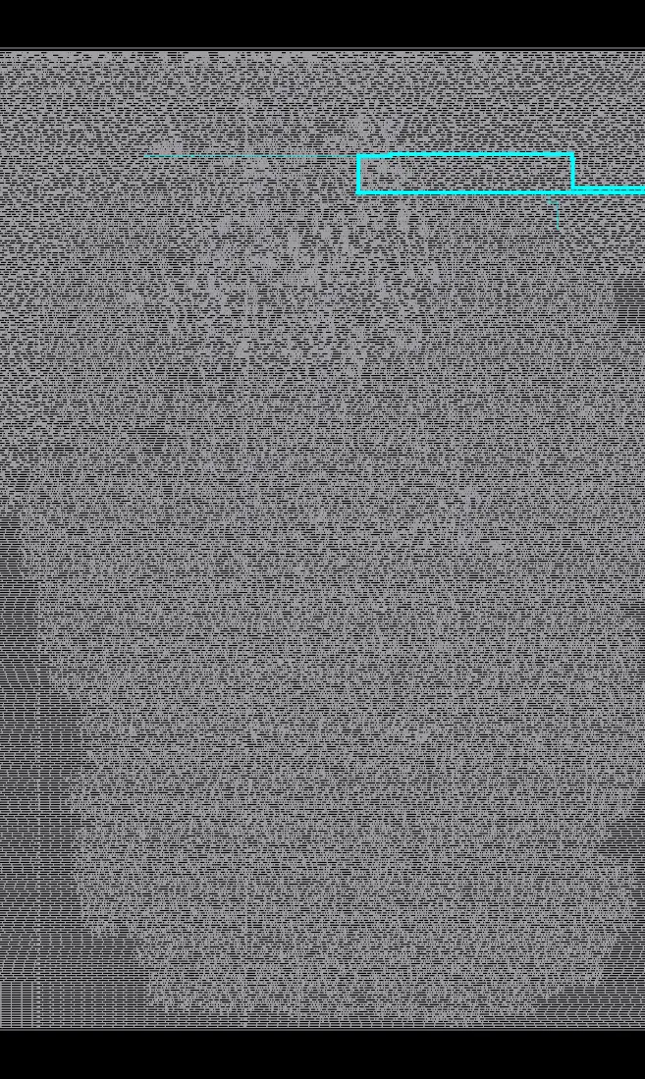
NEBULA
Constraint optimization through RTL enhancement using Generative AI
+0.094790 ns routed WNS
Whole-design EQY PASS | 57,608-cell baseline
FINAL PRESENTATION | 14 SEPTEMBER 2026
Notes:
Source: packaged candidate worst-path image from OpenROAD-flow-scripts run 20260913T164418Z_optimize. Introduce Nebula as a verification-gated RTL optimizer.

Slide 2
PROBLEM
AI proposals need deterministic proof
A plausible RTL rewrite can silently change reset behavior, latency, CDC semantics, or physical QoR.
Model role
Generate a bounded, structured RTL patch around a mapped critical module.
Tool role
Reject out-of-scope edits, synthesis failures, timing regressions, and unproven behavior.
Acceptance
Require cycle-exact whole-design proof and a matched post-route improvement.
The model proposes. Measurements decide.
NEBULA | FINAL PRESENTATION | 14 SEPTEMBER 2026
02
Notes:
Source: repository orchestrator policy, state machine and pipeline implementation at commit 040eb0d.

Slide 3
BENCHMARK QUALIFICATION
Five asynchronous domains at the requested scale
Requirement | Measured evidence
Master clocks | WB, TX, RX, AUX0, AUX1
Generated clocks | Five divide-by-two generated clocks
CDC | Protected two-flop toggle synchronizers
Clock division | Fixed divide-by-two plus programmable MDC
Design scale | 51,359 synthesis cells; 57,608 routed stdcells
0
0
final route DRC
antenna violations
10
57,608
declared clock names
routed standard cells
Locally constructed wrapper around unchanged OpenCores Ethernet MAC RTL.
NEBULA | FINAL PRESENTATION | 14 SEPTEMBER 2026
03
Notes:
Sources: benchmarks/ethmac5 README, frozen SDC, baseline metadata.json, and synthesis statistics packaged under 03_RTL_AND_CONSTRAINTS and 04_PROOFS.

Slide 4
METHOD
Verification-gated optimization pipeline
01
Analyze
Yosys + OpenSTA parse timing and map critical endpoints to RTL
02
Propose
The model returns a structured patch within editable boundaries
03
Screen
Full-design synthesis and STA reject invalid or worse candidates
04
Prove
EQY checks cycle-exact equivalence across the complete hierarchy
05
Measure
Matched OpenROAD runs decide timing and PPA acceptance
NEBULA | FINAL PRESENTATION | 14 SEPTEMBER 2026
04
Notes:
Source: orchestrator pipeline.py, policy.py, statemachine.py, patcher.py, parsers, adapters, and schemas at commit 040eb0d.

Slide 5
ACCEPTED AI CHANGE
A balanced XOR tree shortens logic depth
Baseline
Candidate
((((((s0 ^ s1) ^ s2) ^ s3) ^ s4) ^ s5) ^ s6) ^ s7
((s0 ^ s1) ^ (s2 ^ s3)) ^
((s4 ^ s5) ^ (s6 ^ s7))
Only rtl/nebula_aux_domain.v changed
Preserved
Ports, clocks, reset behavior, CDC logic, state, and cycle latency.
Retained evidence
One physical QoR regression was rejected; the accepted result reproduced independently.
NEBULA | FINAL PRESENTATION | 14 SEPTEMBER 2026
05
Notes:
Source: accepted.patch, original and optimized nebula_aux_domain.v, model recommendations, and loop_report.json in the submission package.

Slide 6
FORMAL EQUIVALENCE
Whole-design cycle-exact proof passed
EQY compared the complete nebula_ethmac5_top hierarchy under the same reset sequence.
Successfully proved designs equivalent
DONE (PASS, rc=0)
Elapsed clock time: 0:02:20 (140 seconds)
The state machine blocks UNKNOWN and FAIL results from acceptance.
Full 4,780-line proof log included in 04_PROOFS/formal/
06
Notes:
Source: 04_PROOFS/formal/eqy_full_log.txt, equiv.eqy, PASS marker, and verification_result.json. The final log line records DONE (PASS, rc=0). Runtime is 140 seconds.

Slide 7
MATCHED POST-ROUTE RESULT
Timing improved while area and power decreased
+0.094790 ns
setup WNS
+3.4968 ns
setup TNS
-100 cells
-142 um^2 area
-0.88% power
matched vectorless estimate
NEBULA | FINAL PRESENTATION | 14 SEPTEMBER 2026
07
Notes:
Source: 04_PROOFS/comparison/ppa_comparison.json and baseline/candidate OpenROAD metadata.json. Relative timing improvement uses absolute slack improvement divided by baseline slack magnitude. Power is vectorless.

Slide 8
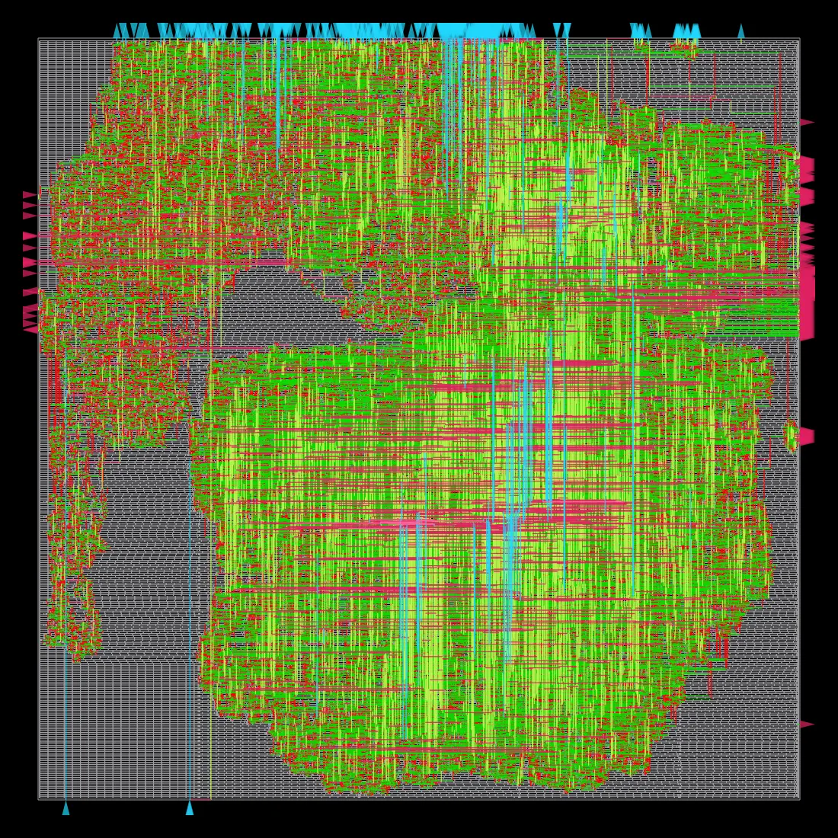
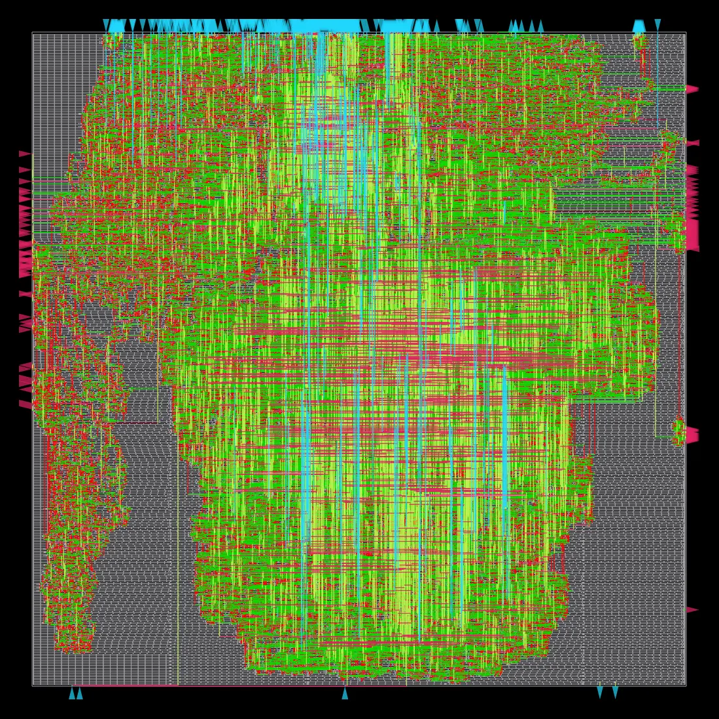
PHYSICAL EVIDENCE
Both designs completed detailed routing cleanly
BASELINE | 57,608 standard cells
CANDIDATE | 57,508 standard cells
Final route DRC: 0 | Antenna violations: 0
NEBULA | FINAL PRESENTATION | 14 SEPTEMBER 2026
08
Notes:
Sources: packaged baseline and candidate final_routing.webp images and metadata.json from OpenROAD-flow-scripts. Images show actual final routed databases, not conceptual artwork.

Slide 9
CONCLUSION
Verified optimization with explicit signoff limits
What is proved
What remains
Equivalence
Complete design, cycle-exact EQY PASS.
Setup WNS remains -0.335711 ns. Hold WNS remains -0.00689157 ns.
Physical QoR
Matched routed WNS, TNS, area, cell count, and power improved.
Power uses default vectorless activity. The frequency figure is an estimate, not a sweep.
Clean routing
Zero final route DRC and zero antenna violations.
Timing closure, activity-based power, and a frequency sweep remain future work.
Submission package: report + deck + RTL + exact patch + raw proofs + source archive + checksums
NEBULA | FINAL PRESENTATION | 14 SEPTEMBER 2026
09
Notes:
Source: final timing metadata and limitations documented in the technical report. Do not claim timing closure or activity-annotated signoff power during Q&A.

