Slide 1

Mini Project Presentation
AI Agent for Missing Person Information Management
Paarth Maheshwari (24070521050)
Sem: V
Under the guidance of
Dr. Parag Naik
Symbiosis Institute of Technology, Nagpur Campus

Slide 2


<Relevant heading of the slide>
01
1. Presentation Flow
Problem Statements
Compare & contrast alternative solution
02
04
Research Initiatives / Objectives
Existing processes/Solutions
03

Slide 3
<Relevant heading of the slide>
2. Presentation Flow
05
Problem Modeling and Algorithm
Development
06
Analysis of Developed Solution (Strengths & Weaknesses)
08
Implementation of Project Features
Results and Outcomes
07

Slide 4
Problem Statement
Missing-person investigations require information to be collected from multiple sources.
Manual searching of case records and web information can be time-consuming and inefficient.
Conventional search systems often require users to know specific keywords or search parameters.
There is a need for an AI-based system that can understand natural-language investigation queries.
The proposed system uses a local LLM, structured case database, and web search to retrieve and organize relevant information.
The system aims to provide AI-assisted investigation summaries while using synthetic data for safe and controlled experimentation.

Slide 5
Research Initiatives / Objectives
Develop an AI-powered investigation assistant using a local LLM.
Integrate Qwen3 14B with Ollama for local AI reasoning.
Create a structured synthetic missing-person database for controlled testing.
Enable natural-language search based on age, gender, location, and case ID.
Integrate Tavily Web Search for retrieving relevant external information.
Implement LLM tool calling for automatic selection of appropriate tools.
Develop a Gradio-based interactive interface for user interaction.
Generate structured investigation reports from retrieved information.
Display agent activity and tool usage for better transparency.
Demonstrate a modular architecture combining LLM, database, web search, and AI-agent technologies.

Slide 6
Existing processes/Solutions
Manual investigation: Officers or volunteers collect and cross-check information from different sources.
Missing-person databases: Centralized databases store case details such as name, age, location, and physical description.
Web search engines: Public information is searched manually using keywords and case details.
Facial recognition systems: Existing AI solutions use computer vision and deep learning to identify potential matches from images.
Tracking systems: Some solutions use GPS, geofencing, notifications, and surveillance data to assist with tracking.
Limitations: These approaches can involve multiple separate systems and often require manual searching, filtering, and interpretation of information.

Slide 7
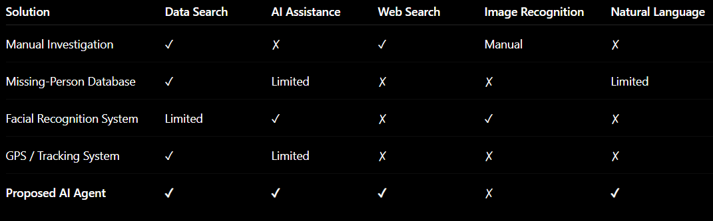
Compare & contrast alternative solution

Slide 8
Problem Modeling and Algorithm Development
Problem Modeling & Algorithm
Input: Natural-language investigation query
Process: Query analysis → Tool selection → Data/Web search → LLM analysis
Tools: search_cases • get_case • web_search
Output: Structured investigation report
Development
Python + Gradio — Application & UI
Qwen3 14B + Ollama — Local LLM
JSON — Synthetic case database
Tavily API — Web search
Tool Calling — Agent-based workflow

Slide 9
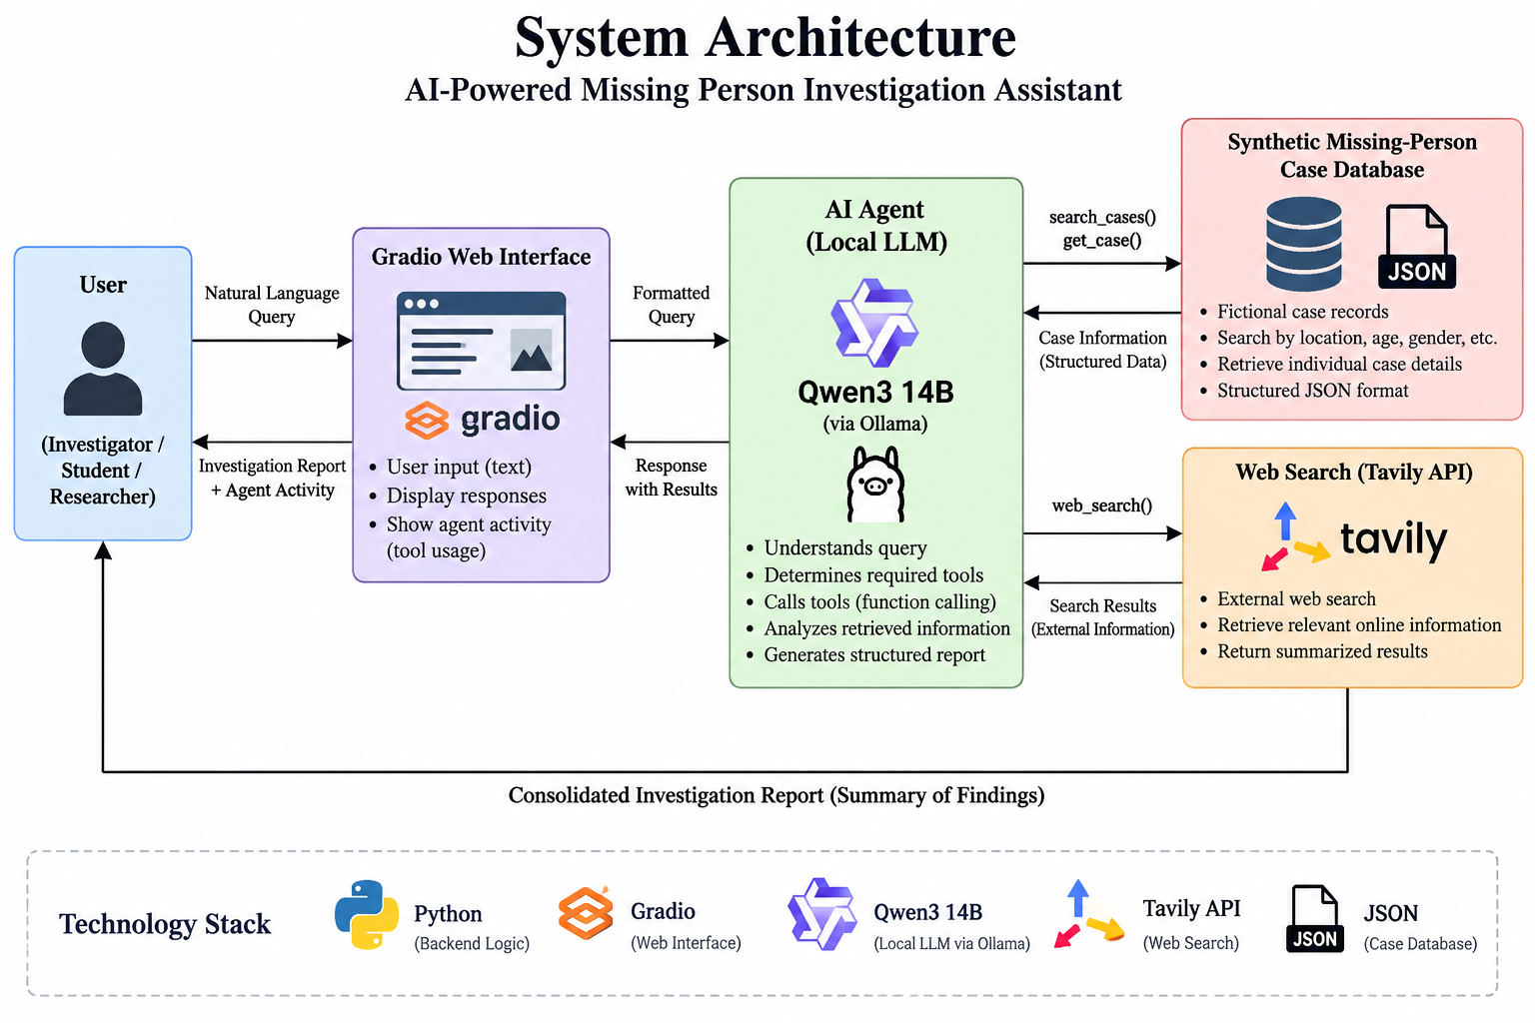
System Architecture

Slide 10
Implementation of Project Features
Natural Language Query: Users enter investigation queries in plain English.
Case Search: Filters synthetic records by age, gender, location, etc.
Case Retrieval: Fetches complete details using a case ID.
Web Search: Tavily retrieves relevant external information.
AI Agent: Qwen3 14B automatically selects and uses required tools.
Investigation Report: Combines retrieved information into a structured response.
Activity Log: Displays the tools and actions performed by the agent.
Interactive UI: Gradio provides a simple interface for investigation queries and results.

Slide 11
Implementation of Project Features
Natural Language Query: Users enter investigation queries in plain English.
Case Search: Filters synthetic records by age, gender, location, etc.
Case Retrieval: Fetches complete details using a case ID.
Web Search: Tavily retrieves relevant external information.
AI Agent: Qwen3 14B automatically selects and uses required tools.
Investigation Report: Combines retrieved information into a structured response.
Activity Log: Displays the tools and actions performed by the agent.
Interactive UI: Gradio provides a simple interface for investigation queries and results.

Slide 12
Results and Outcomes
Working AI Agent: Successfully integrates Qwen3 14B with Ollama.
Case Retrieval: Successfully searches and retrieves records from the synthetic database.
Web Search: Tavily successfully retrieves external web information.
Tool Calling: Agent selects appropriate tools based on the user query.
Report Generation: Produces structured investigation summaries.
Interactive Interface: Gradio provides real-time query and result display.
Activity Tracking: Tool usage and agent actions are displayed to the user.
Successful Prototype: Demonstrates an end-to-end AI-assisted investigation workflow.

Slide 13
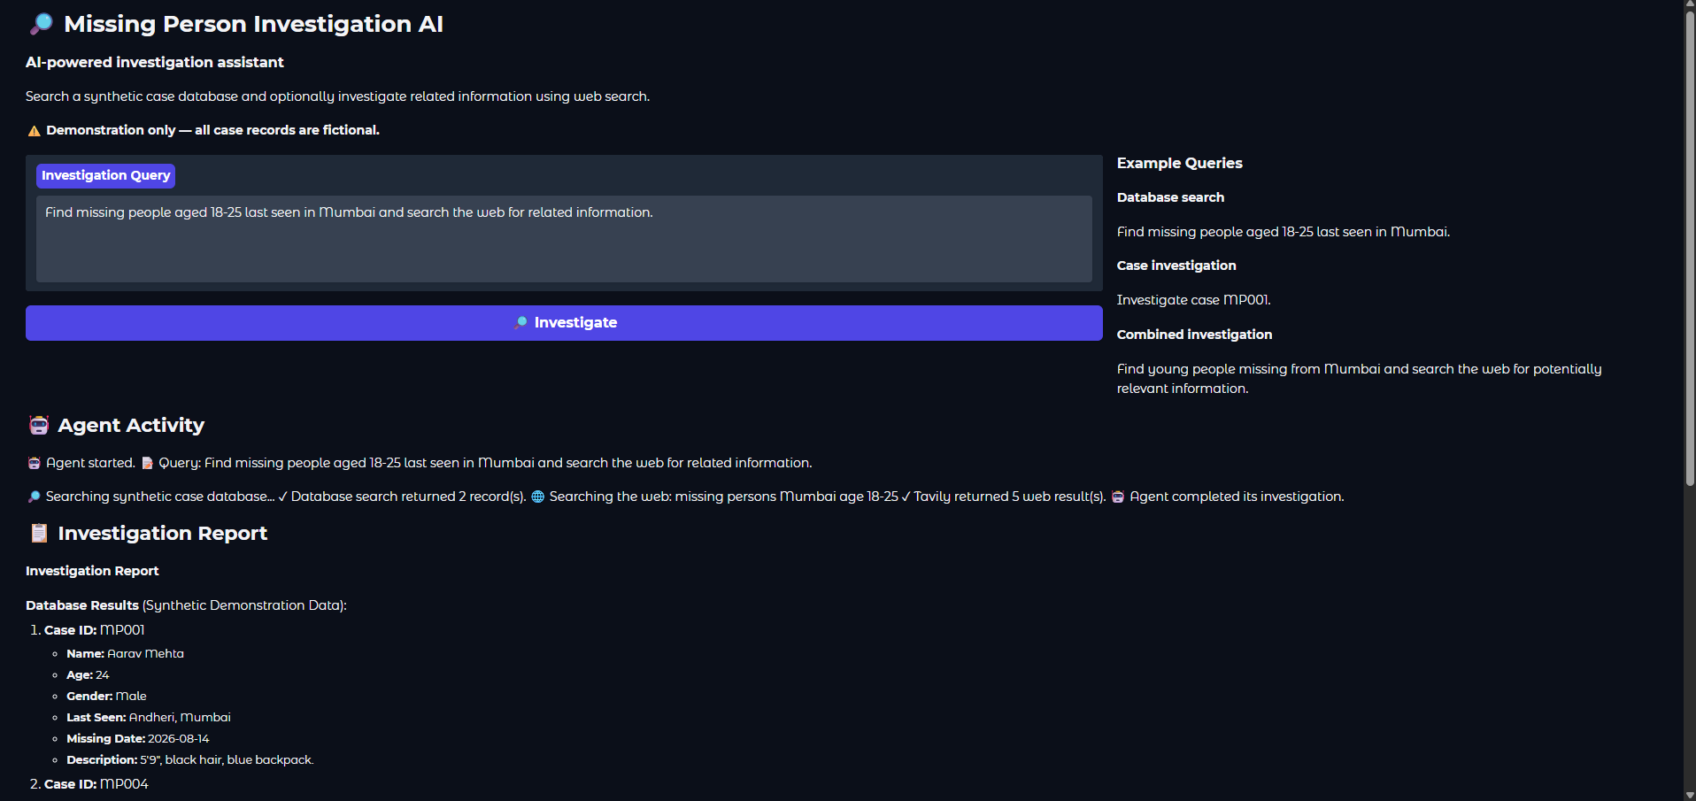
Outcome Screenshot

Slide 14
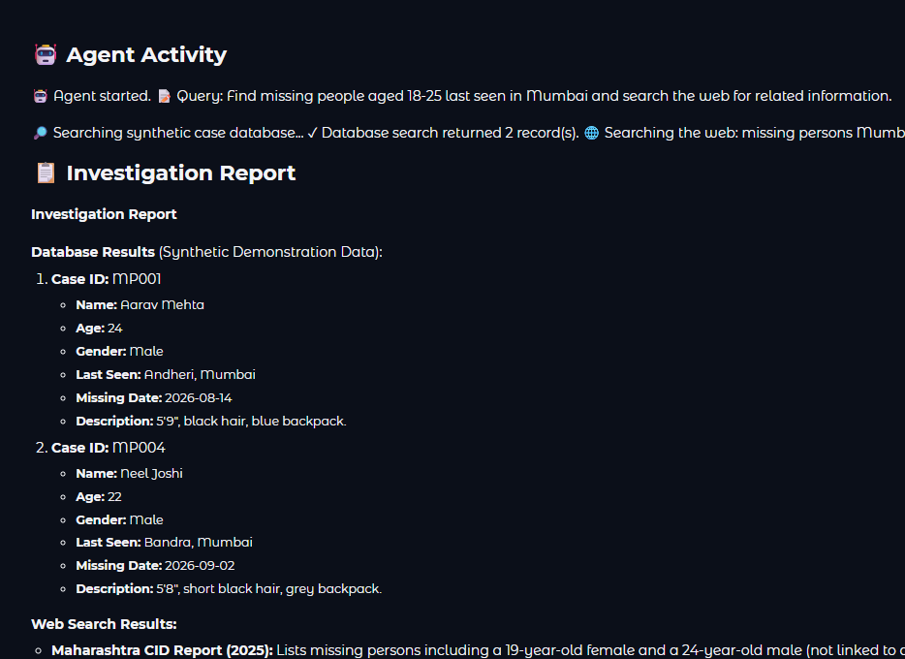
Outcome Screenshot

Slide 15
Analysis of Developed Solution (Strengths & Weaknesses
Strengths
Local LLM processing
Natural-language interaction
Automatic tool selection
Database + web search integration
Transparent activity log
Modular architecture
Weaknesses
Requires good computing resources
Uses synthetic data
Web results may be unverified
No image/facial recognition
No real-world authentication
Cannot confirm identity automatically

Slide 16
THANK YOU

