Slide 1
Topological Analysis on Drug Abuse Scenario
Paarth Gupta
Kishalay Das
Swyam Prakash Singh

Slide 2
Introduction
Hyper-Graph Based Approach
Graph Auto Encoder Based Approach
Random-Walk based Approach
Analysis
Overview

Slide 3
Introduction
Drug Abuse Warning Network (DAWN) : Data-set that records drug use contributing to hospital emergency department visits throughout the United States.
High risk of combining drugs which may impact hazardously in human health.
Our work will be an attempt to understand the nature of illicit drug abuse by analysing the pairwise relationship between drugs.
Analysing co-impact relationships among drugs and studying the topological features and modified features qualitatively on DAWN data-set.
We present three approaches to learn the network representation and perform link prediction task.
And finally we analyse the effectiveness of different approaches using a small dataset of DAWN.

Slide 4
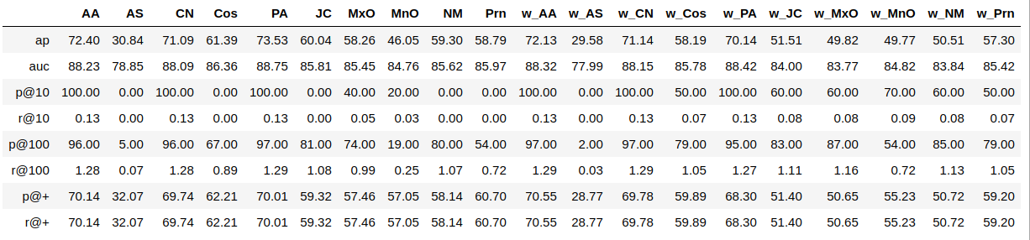
Graph Based Similarity Measures

Slide 5
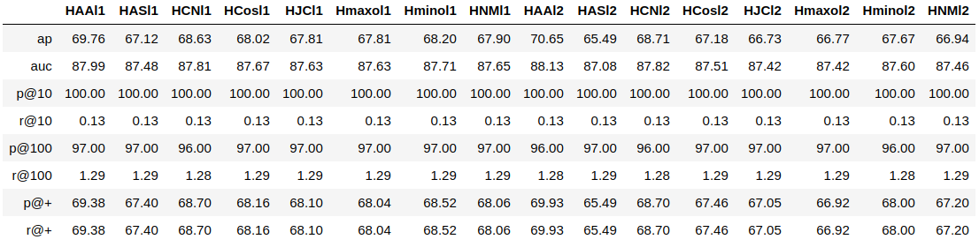
Features Extracted using Hyperedges

Slide 6
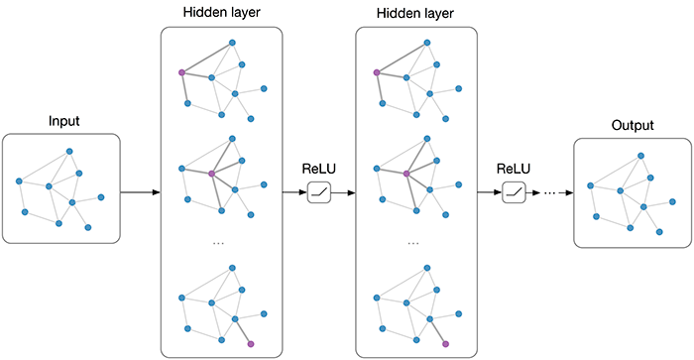

Approach-2 : Graph Auto-Encoder
GCN Model
Semi-Supervised Classification with Graph Convolutional Networks by Thomas Kipf et al., 2016

Slide 7
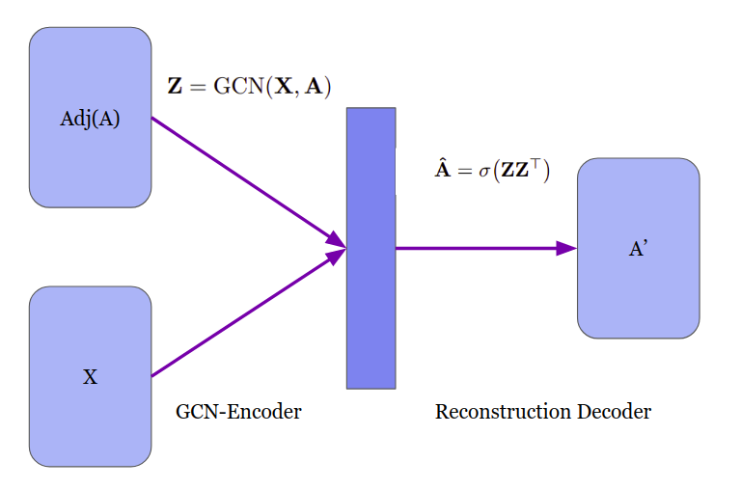
Approach-2 : Graph Auto-Encoder
Variational Graph Auto-Encoders by Thomas Kipf et al., NIPS Workshop on Bayesian Deep Learning (2016)

Slide 8
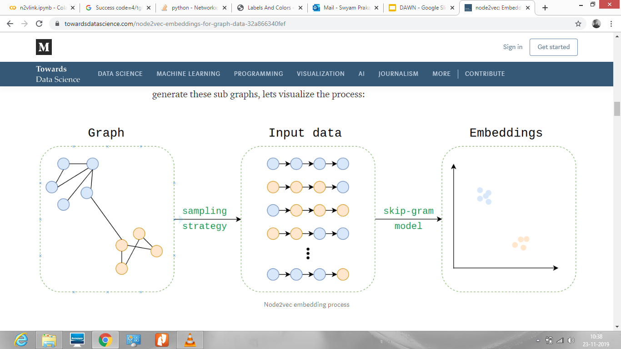
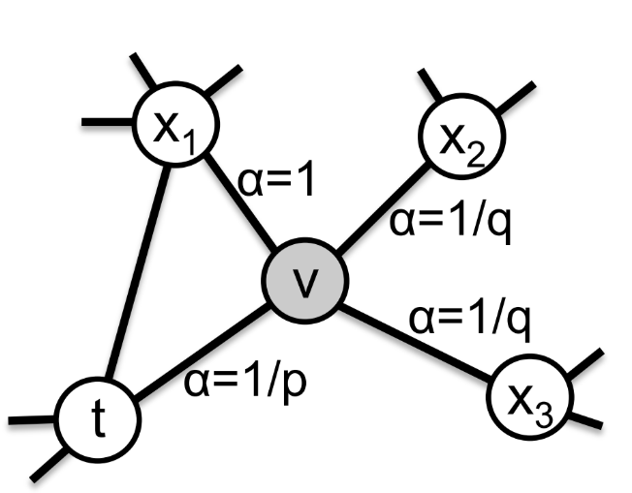
Approach-3 : Random Walk Based
NODE2VEC Model
Sampling Strategy
Deepwalk: Online learning of social representations, Bryan Perozzi, Rami Al-Rfou, and Steven Skiena. CoRR , abs/1403.6652, 2014
node2vec: Scalable Feature Learning for Networks. A. Grover, J. Leskovec. KDD, 2016

Slide 9
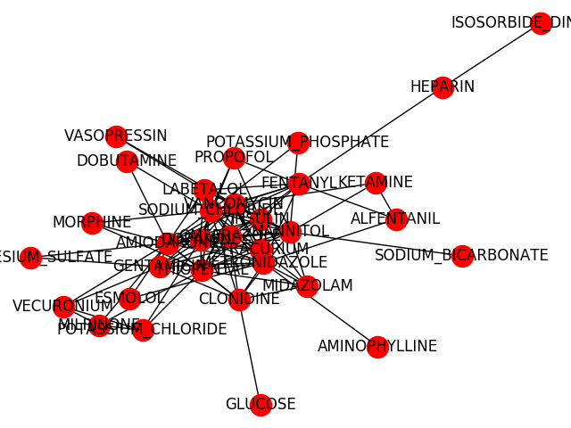
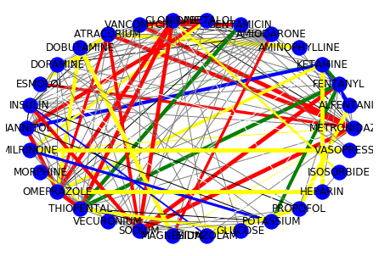
Analysis (Small DAWN Network)
# of vertices : 32
# of edges : 111
True positive edges
True Negative edges
False negative edges
False positive edges

Slide 10
Analysis / Conclusion
Pairs and Reasons in favour of Approach 1 (Negative Pairs)
Pair1: (DOBUTAMINE, CLONIDINE)
Pair2: (AMINOPHYLLINE, FENTANYL)
Intuitive Analysis:
Second hop of these chemicals are very dense, predicting it as false positive in Approach 2.

Slide 11
Analysis Contd.
Pairs and Reasons in favour of Approach 2 (Positive Pairs)
Pair1: (METRONIDAZOLE, FENTANYL)
Pair2: (VANCOMYCIN, OMEPRAZOLE)
Intuitive Analysis:
Considered weights in approach 1 which lead to bias with the chemicals that were reported multiple times.
Second hop of these chemicals are very dense, predicting it as True positives in Approach 2.

Slide 12
Analysis Contd.
Pairs and Reasons in favour of Approach 1 (Positive Pairs)
Pair1: (DOPAMINE, MANNITOL)
Pair2: (AMIODARONE, GENTAMICIN )
Intuitive Analysis:
These pairs have high number of neighbours (e.g 14 and 9 in pair2) but still not able to predict a link in deep learning approach.
Simple graph structure approach was able to predict it properly using the same argument.

Slide 13
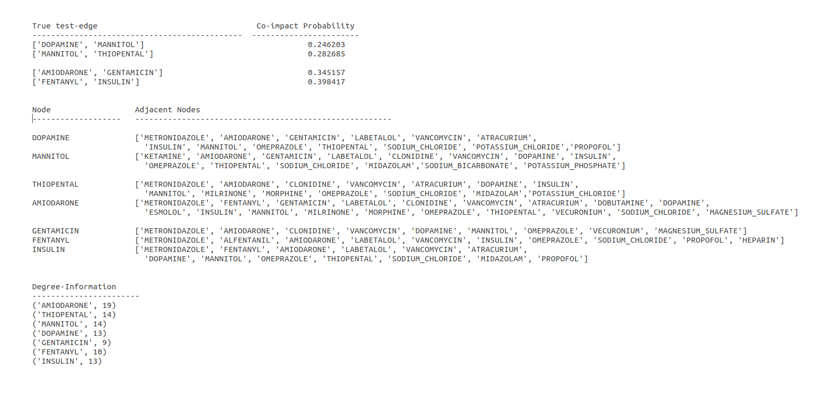
True-Edge Results by GAE

Slide 14
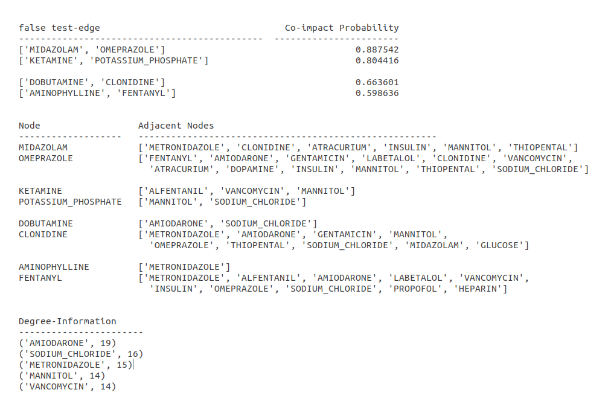
False-Edge Results by GAE

Slide 15
Final Interesting Analysis
Actually Unlinked Pairs in Graphs
Pair1: (MIDAZOLAM, OMEPRAZOLE)
Pair2: (KETAMINE, POTASSIUM_PHOSPHATE)
Approach 2 predicts it as harmful. So why interesting ?

Slide 16


