Slide 1
NyAI-Lens
A legal judgement processing with AI

Slide 2
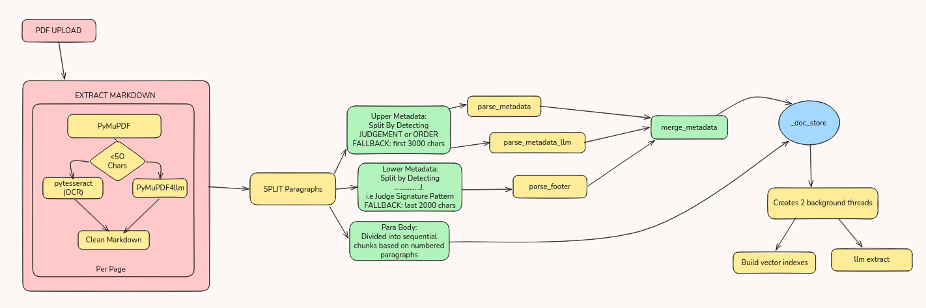
PDF processing (/extract)

Slide 3
Explanation /extract
Dividing the Judgement into 3 parts: 1. UpperMetadata (Judgement Information) 2. ParaBody (Contains the numbered paragraphs) 3. LowerMetadata ( Judge Signatures)
Using Upper and Lower Metadata for extracting and storing metadata dict in _doc_store .
Chunks are divided based on numbered paragraphs.(This was done considering the legal convivence.

Slide 4
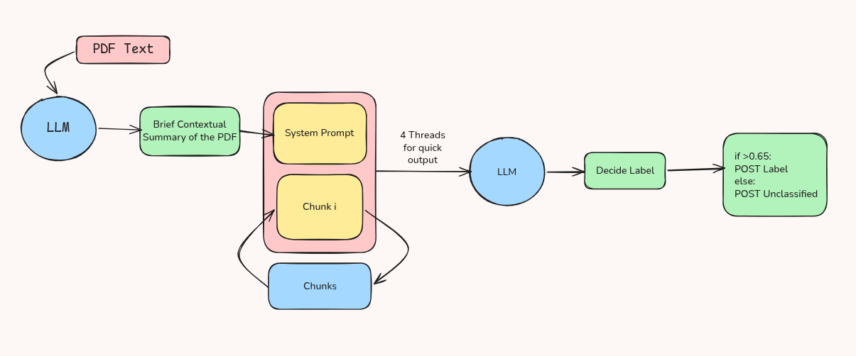
Previous Architecture /classify

Slide 5
Previous Architecture /classify
Pros:
Adding context for classification improved accuracy significantly.
Summary can be displayed to users.
Cons:
For judgements with higher paragraphs input context cost is high as summary is sent to the LLM every time.
Threading makes the hardware utilization is higher especially for local GPU as there is higher number of paragraphs

Slide 6
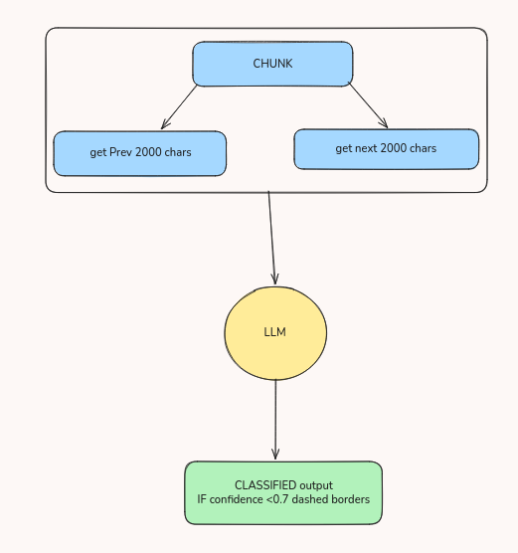
Upgraded /classify
Legal Judgements are procedural therefore context and understanding is captured by prev and next chunks start and end
Less latency per call and better accuracy

Slide 7
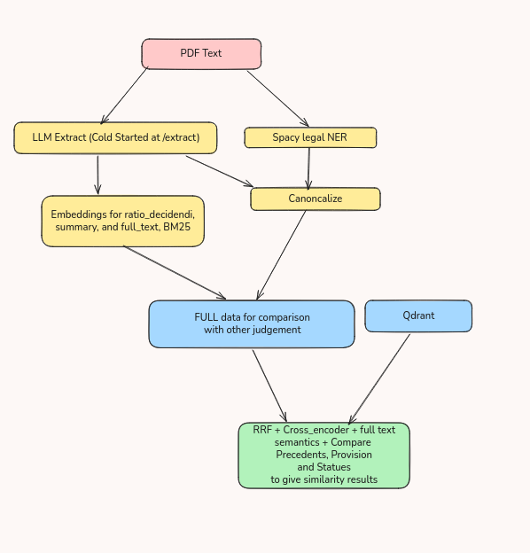
Judgement Similarity (/similar)
Similarity by comparing judgment facts, reasonings, precedents, provisions and statues.
3 Embedding vectors + 1 BM25 used to rank top 10 and then the rank list is fused using RRF which then evaluated using Cross-Encoder for re ranking.
Similarity, Ratio decidendi, Precedents, Provisions and Statues are computed for display too.

Slide 8
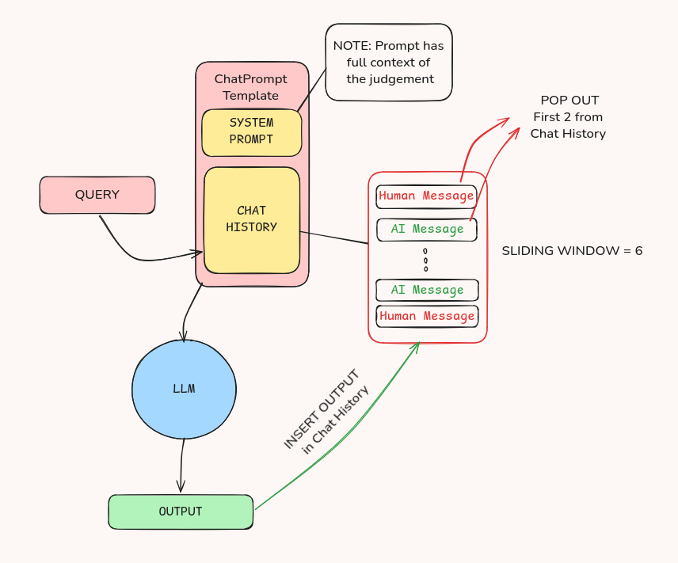
Previous Architecture /chat
Pros:
Good output in a simple architecture
NO contextual gap
Cons:
High token consumption
Hallucinations
Detailing (LLM dependent)

Slide 9
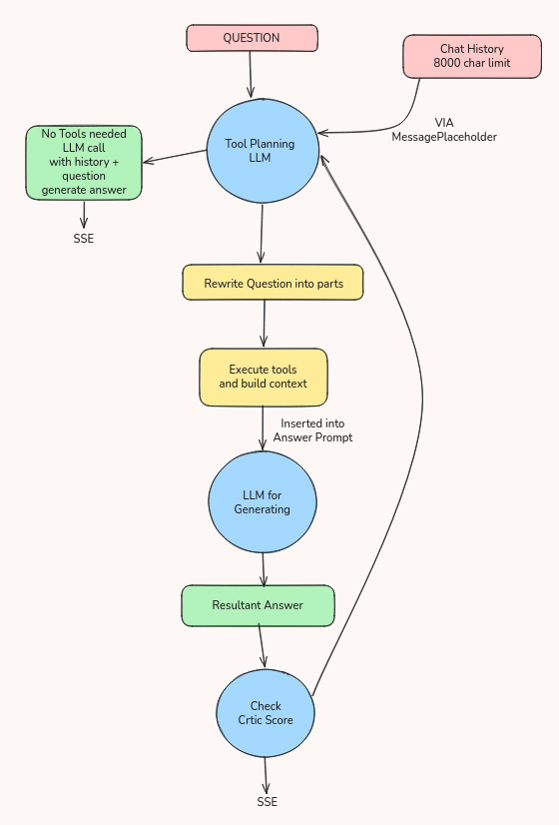
Agentic Chatbot /chat
3 Layered Agent Tool Planning and Rewriting -> Generating -> Verify
Tools used are: 1. Get_metadata (/extract) 2. Get_summary (/similar) 3. Retrive_paragraphs 4. Get_precedents

