Slide 1
Project Presentation of Industry Oriented Hands on Experience (22CS422)
On
Machine Learning Based Drug-Drug Interaction Prediction:
A TWOSIDES Dataset and Ensemble Classifier Approach
Paarth Sharma
2210990630
Supervised By
Dr. Monika Aggarwal
Department of Computer Science and Engineering,
Chitkara University, Punjab

Slide 2
Introduction
Drug-Drug Interactions (DDIs) occur when the effect of one drug is altered by another drug taken simultaneously.
DDIs can cause harmful side effects, reduced drug effectiveness, and serious health complications.
Traditional methods for detecting drug interactions are expensive, time-consuming, and difficult to scale for the large number of possible drug combinations.
Machine learning provides a faster and scalable approach for predicting potential drug interactions using real-world data and molecular information.
This project uses the TWOSIDES dataset along with molecular fingerprints generated using RDKit.
Multiple machine learning models including Logistic Regression, Random Forest, XGBoost, and a neural network using PyTorch were trained and evaluated.
The objective of this project is to develop an efficient and scalable system for predicting potential drug-drug interactions.

Slide 3
Problem Statement
Drug-drug interactions (DDIs) are a major challenge in healthcare because combining multiple medications can lead to harmful side effects, reduced drug effectiveness, or serious medical complications. Traditional methods used for identifying drug interactions, such as laboratory testing and clinical trials, are expensive, time-consuming, and difficult to scale for the large number of possible drug combinations.
With the increasing use of multiple medications by patients, there is a need for an efficient and scalable system that can predict potential drug-drug interactions using computational methods. The objective of this project is to develop a machine learning-based DDI prediction system using molecular structure information and pharmacovigilance data to accurately identify potential interactions between drug pairs.

Slide 4
Objectives
To develop a machine learning-based system for predicting potential drug-drug interactions (DDIs).
To use the TWOSIDES dataset for generating interaction labels using pharmacovigilance data.
To retrieve molecular structure information of drugs using PubChem and process it using RDKit.
To generate Morgan fingerprint representations for converting molecular structures into machine-learning-ready numerical vectors.
To perform feature engineering using cosine similarity, shared molecular features, and structural difference vectors.
To train and compare multiple machine learning models including Logistic Regression, Random Forest, XGBoost, and neural networks.
To evaluate model performance using metrics such as accuracy, precision, recall, F1-score, and AUROC.
To develop a simple prediction interface using Gradio for testing drug interaction predictions.

Slide 5
Dataset
TWOSIDES dataset was used for drug interaction prediction.
Dataset is based on FDA adverse event reports and contains drug pair interaction information.
Includes statistical measures such as:
Proportional Reporting Ratio (PRR)
Reporting Frequency
Initial dataset size: ~42.9 million records.
Molecular structures were retrieved using PubChem and RxNorm.
Balanced dataset used:
79,980 positive samples
79,980 negative samples
Drug molecules were represented using Morgan fingerprint vectors.

Slide 6
Machine Learning Models
The following machine learning models were trained and evaluated for Drug-Drug Interaction (DDI) prediction:
Logistic Regression
Used as the baseline linear classification model.
Random Forest
Used for ensemble-based classification using multiple decision trees.
XGBoost
Used for high-performance gradient boosting and structured feature learning.
Neural Network using PyTorch
Used for learning complex non-linear relationships between molecular features.
The models were evaluated using:
Accuracy
Precision
Recall
F1-Score
AUROC
Among all models, the Neural Network achieved the best overall performance.

Slide 7
Results
The machine learning models were evaluated using Accuracy, Precision, Recall, F1-Score, and AUROC metrics.
Model Performance Comparison
Model Accuracy AUROC
Logistic Regression 0.681 0.750
Random Forest 0.623 0.686
XGBoost 0.672 0.737
Neural Network 0.684 0.753
Key Outcomes
Neural Network achieved the best overall performance.
Feature engineering improved prediction quality.
Molecular fingerprints and cosine similarity helped capture structural relationships between drugs.
The system successfully predicted potential drug-drug interactions using molecular and pharmacovigilance data.

Slide 8
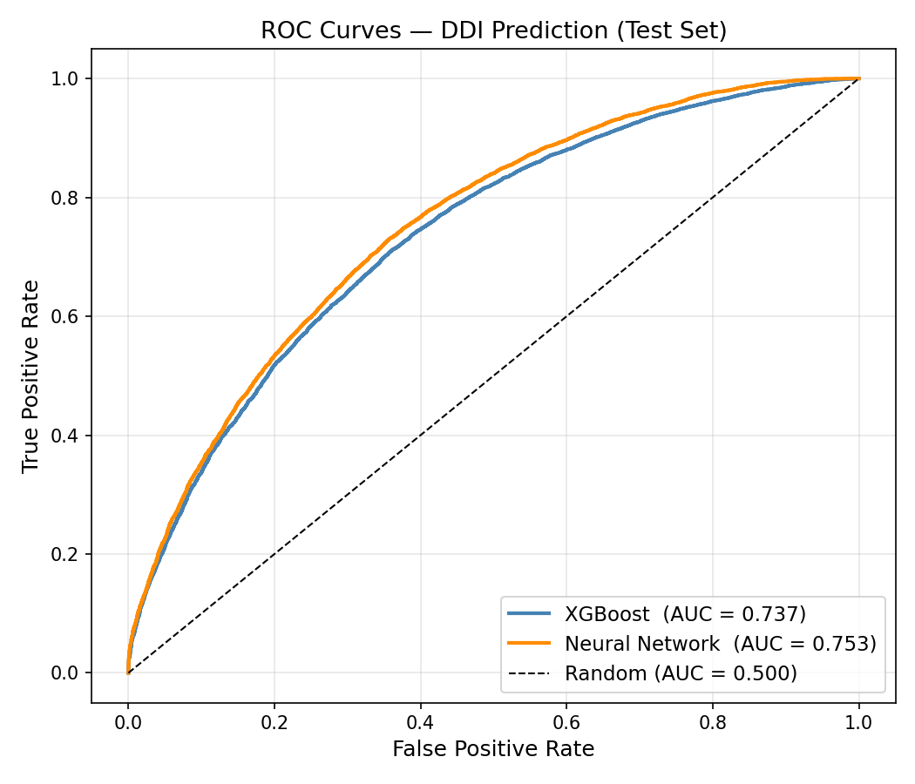
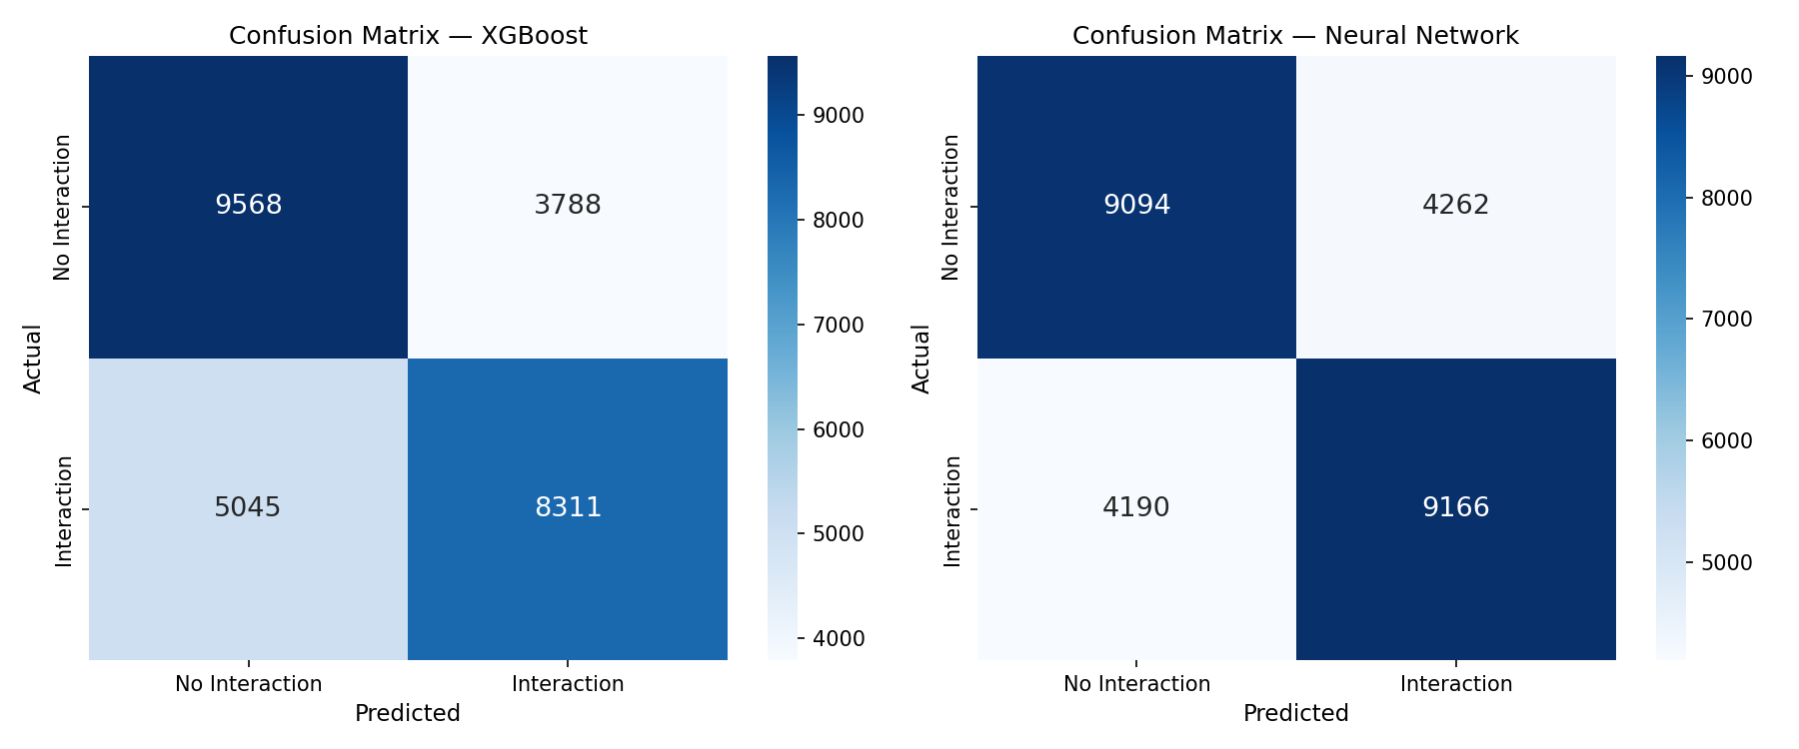
Graphs
ROC Curve
Confusion Matrices

Slide 9
Conclusion
The proposed system successfully predicted potential Drug-Drug Interactions (DDIs) using machine learning and molecular feature engineering techniques.
The TWOSIDES dataset and molecular structure information were effectively used for model training and evaluation.
Morgan fingerprint vectors, cosine similarity, and structural comparison techniques helped improve prediction performance.
Multiple machine learning models were trained and compared, including Logistic Regression, Random Forest, XGBoost, and Neural Networks.
The Neural Network model achieved the best overall performance with the highest AUROC score.
A prediction interface was also developed using Gradio for user-friendly testing of drug interactions.
The project demonstrates that machine learning can provide an efficient and scalable approach for drug-drug interaction prediction.

Slide 10
Future Scope
Implement advanced deep learning techniques such as Graph Neural Networks (GNNs) and transformer-based molecular models.
Integrate biological information such as protein targets, metabolic pathways, and gene interaction data for improved prediction accuracy.
Extend the system to predict interaction severity levels such as mild, moderate, and severe interactions.
Incorporate dosage information and patient-specific medical data for personalized predictions.
Develop real-time drug interaction monitoring systems for hospitals and pharmacies.
Improve scalability through cloud-based deployment and larger pharmacovigilance datasets.
Apply Explainable AI techniques to improve model interpretability and reliability.
Extend the system for multi-drug interaction prediction instead of only pairwise drug interactions.

Slide 11
Thank You

