Slide 1

Using a Raspberry Pi 2 and Elixir to Frankenstein a Game Machine
Notes:
Thanks for coming…hololens spillover…blend old and new to make a game.

Slide 2
Intro
Web Developer
No Electronic Skills
Breaks Things

Slide 3
Demo
Get out pocket computers
Wifi Network: Rawkets
http://rawkets:4000
pew! pew!

Slide 4
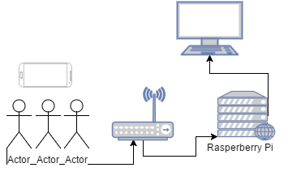
Outline
(websockets)

Slide 5
Controller(s)
Any Device supporting Websockets
Using JavaScript socket client within Phoenix framework

Slide 6
Router
Access to Admin interface
Captive Portal (not functioning)

Slide 7
Raspberry Pi 2
Raspbian Jessie (not lite want GUI)
Erlang 18 (build from source)
Elixir 1.2 from precompile zip
Notes:
Resize drive + monitor stuff

Slide 8
Run Frankencade code
Copy files to PI 2
Get dependencies (Hex)
Compile & Run
Notes:
Resize drive + monitor stuff

Slide 9
Why Erlang/Elixir
Fast (mirosecond response)
CPU ease
Telecom
Phoenix Web Framework
Build/Test local machine
Notes:
No Pymame?

Slide 10
System Info
Inspect remote system
Demo observer
Notes:
Resize drive + monitor stuff

Slide 11
Code?
Notes:
Resize drive + monitor stuff

Slide 12
Todo
Captive Portal on Router
Better Controller Touch
Improve game programming
Better OTP
Notes:
Resize drive + monitor stuff

