Slide 1
from session import title
Building APIs with the ServiceStack ‘Stack’

Slide 2
[s for s in spkrs if s == ‘Pat Paasch’]
s.Name = ‘Pat Paasch’
s.CollegeGraduation = [‘2000’
‘Degree Business Admin/Marketing’]
s.Titles = ‘.NET Developer, Data Analyst, Web Developer’
s.Liar = True if words == sense else False
Notes:
Of little significance, one contribution to Dapper Orm…like a 3 character change wrong name in anonymous function

Slide 3
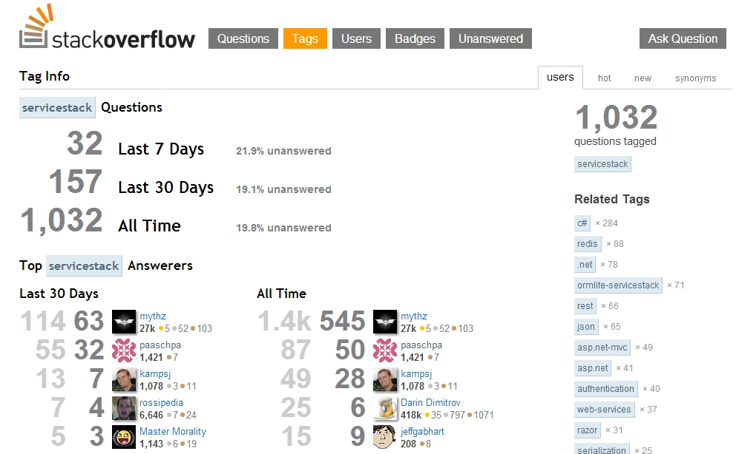
Image.open(‘credentials.jpg’)
Me
Notes:
Of little significance, one contribution to Dapper Orm…like a 3 character change wrong name in anonymous function

Slide 4
from ServiceStack import this
Simple
Fast
Lightweight
Testable
Clean
POCO
Speed & Quality – Quality we care about is speed

Slide 5
ServiceStack.__doc__
After witnessing WCF/Soap murder his parents @demisbellot swears revenge…
Thoughfully architected, obscenely fast, thoroughly enjoyable web services for all
Concept in 2007 at BBC & mflow - Project is 5 years old
- Mainly Web Services but has many ‘Sub Components’

Slide 6
dir(ServiceStack)
[ ‘REST, SOAP & MQ Services’,
‘JSON, XML, CSV, JSV, SOAP, HTML,
‘Typed Clients (C#, JavaScript, Silverlight’),
‘Plugins_Features: OrmLite, Swagger, Authentication, Validation, Caching, Mini-Profiler, Redis Client, Razor’ ]
Notes:
Man I wish ServiceStack did X and then I look and it already does X

Slide 7
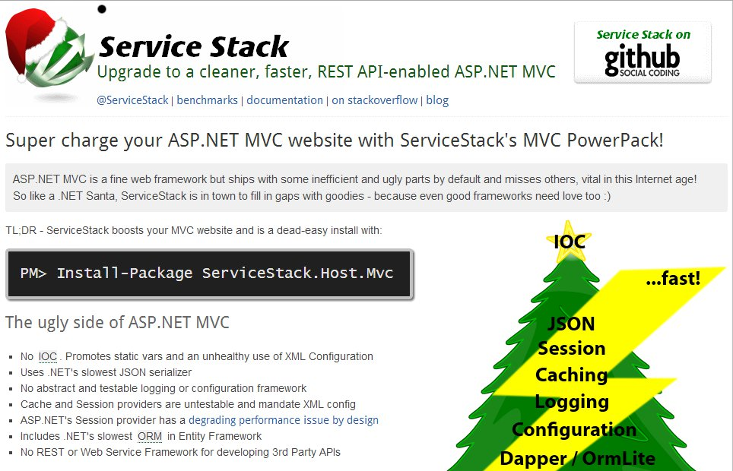
Wish for a Pony

Slide 8
unittest.main()
Services only need to inherit Service class
HttpListener for in-memory integration test
Easy to mock HttpRequest
  MyService service = new MyService()
  {
  RequestContext = Mock<IRequestContext>
  };
  var result = service.Get(myRequest);

Slide 9
os.path, sys.platform
IIS 5/6/7 (uses IHttpHandler)
Windows Service
Console App
Linux/OSX with Mono
Apache + mod_mono
Nginx + MonoFastCGI

Slide 10
pip install ServiceStack
Use NuGet
ServiceStack
ServiceStack.Razor
ServiceStack.Host.Mvc (/api)
ServiceStack.Host

Slide 11
AppHost.__init__()
Create an AppHost by inheriting from AppHostBase or AppHostHttpListenerBase
Override Configure method in AppHost
Add HttpHandler in Web.Config
Call AppHost.Init()

Slide 12
MyService(Service):
[Route(“/Hello”, “GET”)]
public class Hello
{
public string Name {get; set;}
}
public class HelloService : Service
{
public string Get(Hello request)
{
return “Hello “ + request.Name;
}
}

Slide 13
CODE

Slide 14
resources
Web Api vs. ServiceStack
http://stackoverflow.com/questions/9699083
Docs/Wiki
https://github.com/ServiceStack/ServiceStack/wiki
Pluralsight
pluralsight.com/training/Courses/Description/service-stack
http://tech.pro/cyberzed/blog
http://www.infoq.com/articles/interview-servicestack
@servicestack, @demisbellot

