Slide 1
from session import title
What I Played With in 2013

Slide 2
[s for s in spkrs if s == ‘Pat Paasch’]
s.Name = ‘Pat Paasch’,
s.CollegeGraduation = [‘2000’,
‘Degree Business Admin/Marketing’,
‘.NET Developer, Data Analyst, Web Developer’],
s.Liar = True if words == sense else False
Notes:
Of little significance, one contribution to Dapper Orm…like a 3 character change wrong name in anonymous function

Slide 3
import this
try:
MyWay()
except BetterWayError:
raise BetterWay(“For All”)
Notes:
Just some of the tools and code I’ve played with…not shared or reviewed…or even in production. Simple and Flexible…not a lot of code

Slide 4
Demo???

Slide 5
Always Be source Controlling
git clone https://github.com/paaschpa/ordersDemo.git
git checkout –b YourNewBranch
git add . (add all your code changes)
git commit –m “my code changes”
git push origin YourNewBranch
git fetch origin (are there changes from other developers)
git rebase origin/YourNewBranch
git checkout master
git merge YourNewBranch
Notes:
Git is confusing…any git power users??...these are the 9 most common commands and would allow you to get code from a master branch checkout a new branch…commit and merge code into master branch

Slide 6
Git.__doc__
- Merge conflicts are tricky (find a good ‘mergetool’)
- Use gitk –all& or other history browser
- Copy single file from different branch??
- Git extension for Visual Studio
- www.gitimmersion.com
- http://reinh.com/blog/2009/03/02/a-git-workflow-for-agile-teams.html
Notes:
In my experience…just very different from SVN or TFS…but I was never a power user in either. Separate folder for every branch…git overwrittes folder contents…and very painful if you have VS open and switch branches.

Slide 7
@more_than_save
- Not just for storing saving code
- Social and Open Source projects
- bitbucket.org, codeplex.com, github.com
- Publish code/app to the ‘Cloud’
Notes:
Haven’t really said anything great about Git so why use it…Not just for saving code. It’s a social thing, becoming part of the deploy process.

Slide 8
Hosting
- Windows Azure
- I want some control over my servers
- AppHarbor.com
- What is a server?
Notes:
Transition…Now that we have a place to keep our code let’s ship it. Using Azure or AppHarbor (appengine or heroku?) Show azure and appharbor interfaces.

Slide 9
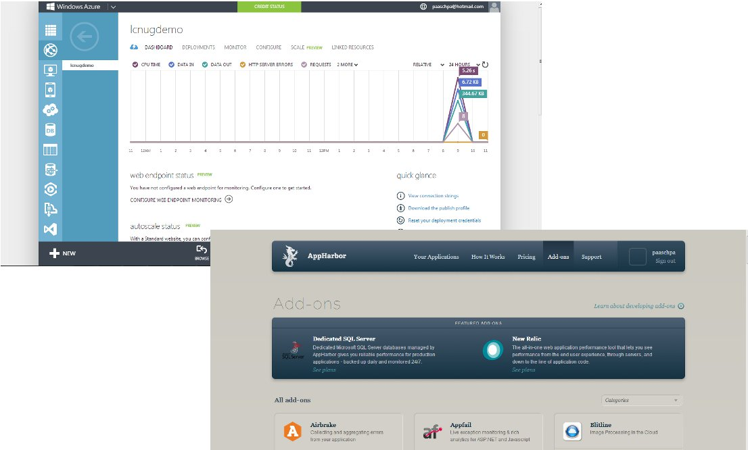
Hosting
Notes:
Comparison

Slide 10
Bootstrap
For the developer that knows a little about design
Avoid writing JavaScript
Common UI elements
Responsive Design
Simple documentation
GetBootstrap.com
Notes:
_layout, Customize at http://getbootstrap.com/customize/, Style Guide
Common UI Elements (buttons, alerts, progress bars, labels, pagination, popover, tooltip, modal, collapse)

Slide 11
AngularJS
Keep HTML as template language
2 way databinding
Tools to build CRUD app in cohesive set
Use simple objects
$scope
ng-app, ng-controller, ng-model
Directives, Services, Providers
Notes:
Key Concepts :> 1- Enhanced DOM, 2-Dependency Injection, 3-use simple objects
factory -> no configuration values
provider -> pass configuration values

Slide 12
.NET MVC + ServiceStack
ServiceStack for simple, fast, flexible API
ServiceStack 4 is commercial
- MVC flexible web frontend to get stuff on page and consume ServiceStack API

Slide 13
ServiceStack
[Route(“/Hello”, “GET”)]
public class Hello
{
public string Name {get; set;}
}
public class HelloService : Service
{
public string Get(Hello request)
{
return “Hello “ + request.Name;
}
}
Notes:
Request is Hello class -> Service is the computering -> Response is a string (serialized)

Slide 14
ServiceStack
OrmLite
Redis Client
Swagger Api Documentation Framework
Authentication (Google, OpenId, Facebook, and more)
Validation using Fluent Validation library
Caching
Support for MsgPack, Protocol Buffers

Slide 15
SignalR
Server Broadcast - low-rate, message to all
Server Push - low-rate, message to unique clients
- User Event Driven - broadcast depends on clients (chat system)
- High Frequency - gaming (< 25/sec)
Notes:
GridHub.cs -> FulFillment/Index -> fulfillmentSubscribers
connection.logging = true;

Slide 16
Redis
Data Structure server
Strings (json), Hashes, Lists, Sets, Sorted Sets
Pub/Sub – does not persist messages
RDB – snapshots, backups
AOF – append only, fsync intervals (1 second default)

Slide 17
Redis Commands
INFO
KEYS *
DEL key
String (GET key, SET key val, APPEND key val)
Hashes (HGET key fld, HSET key fld val, HVALS key, HDEL key field

