Slide 1
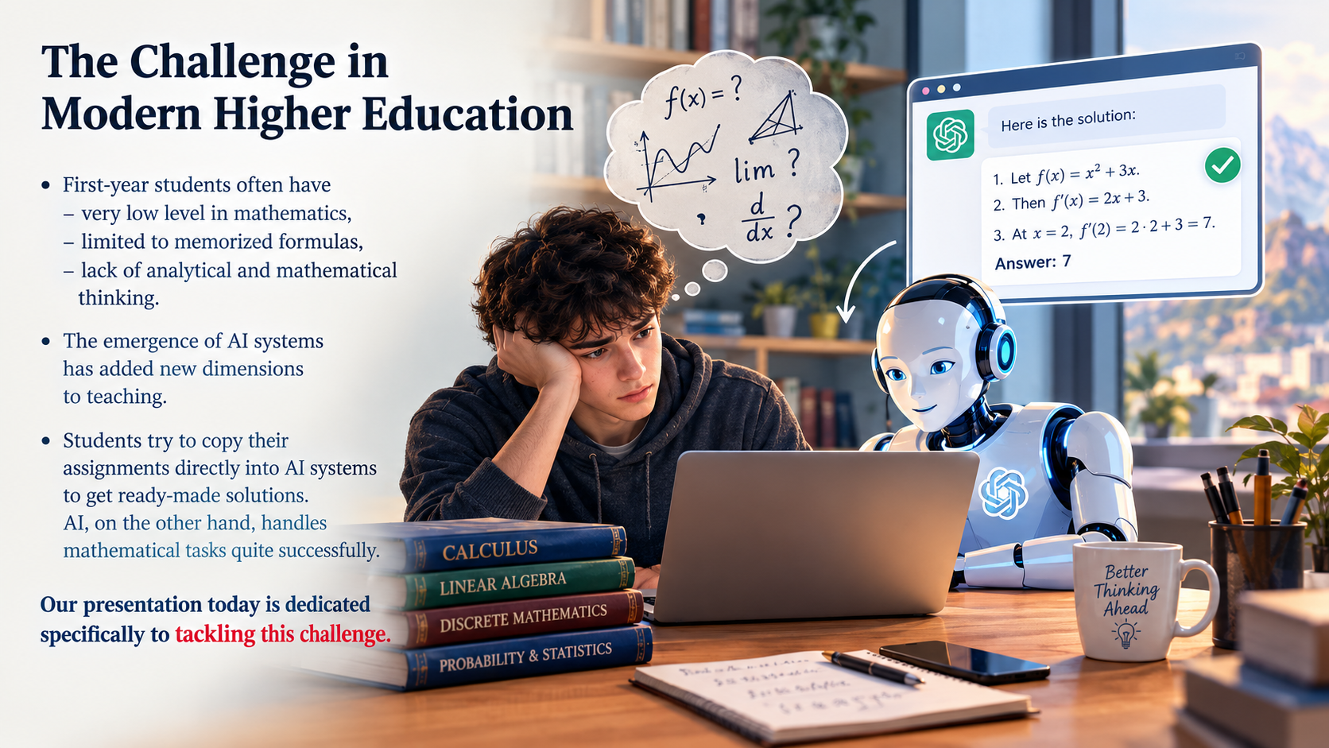

Slide 2
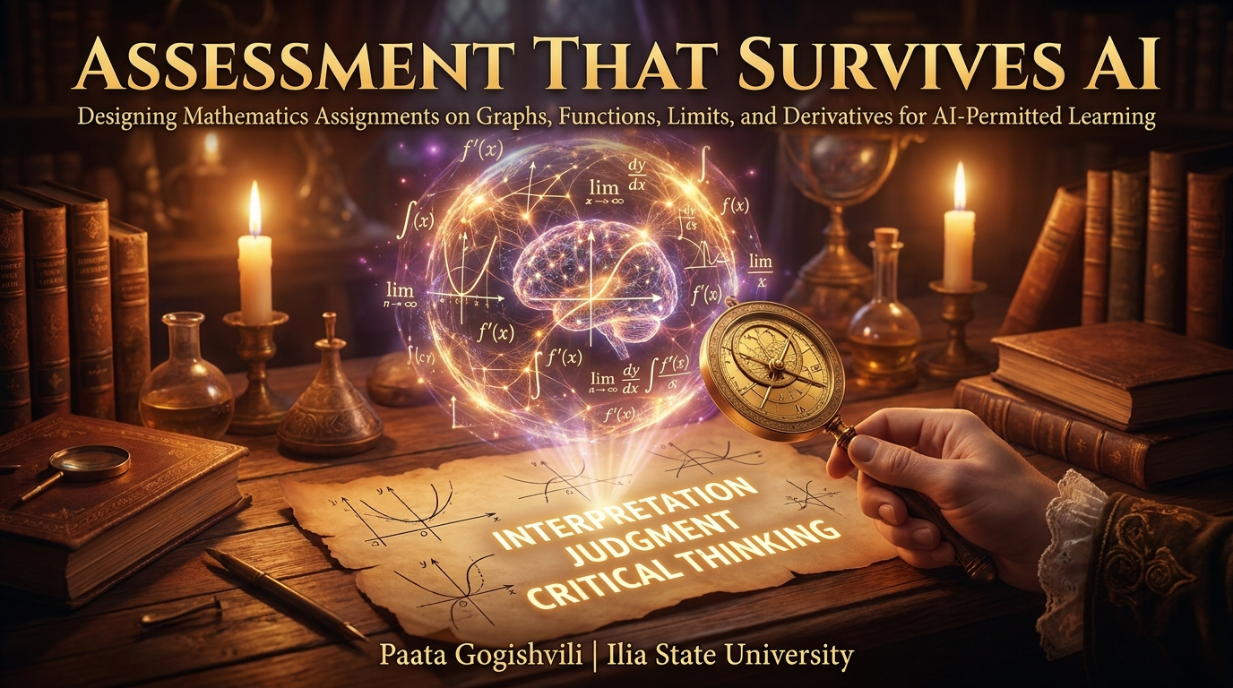

Slide 3
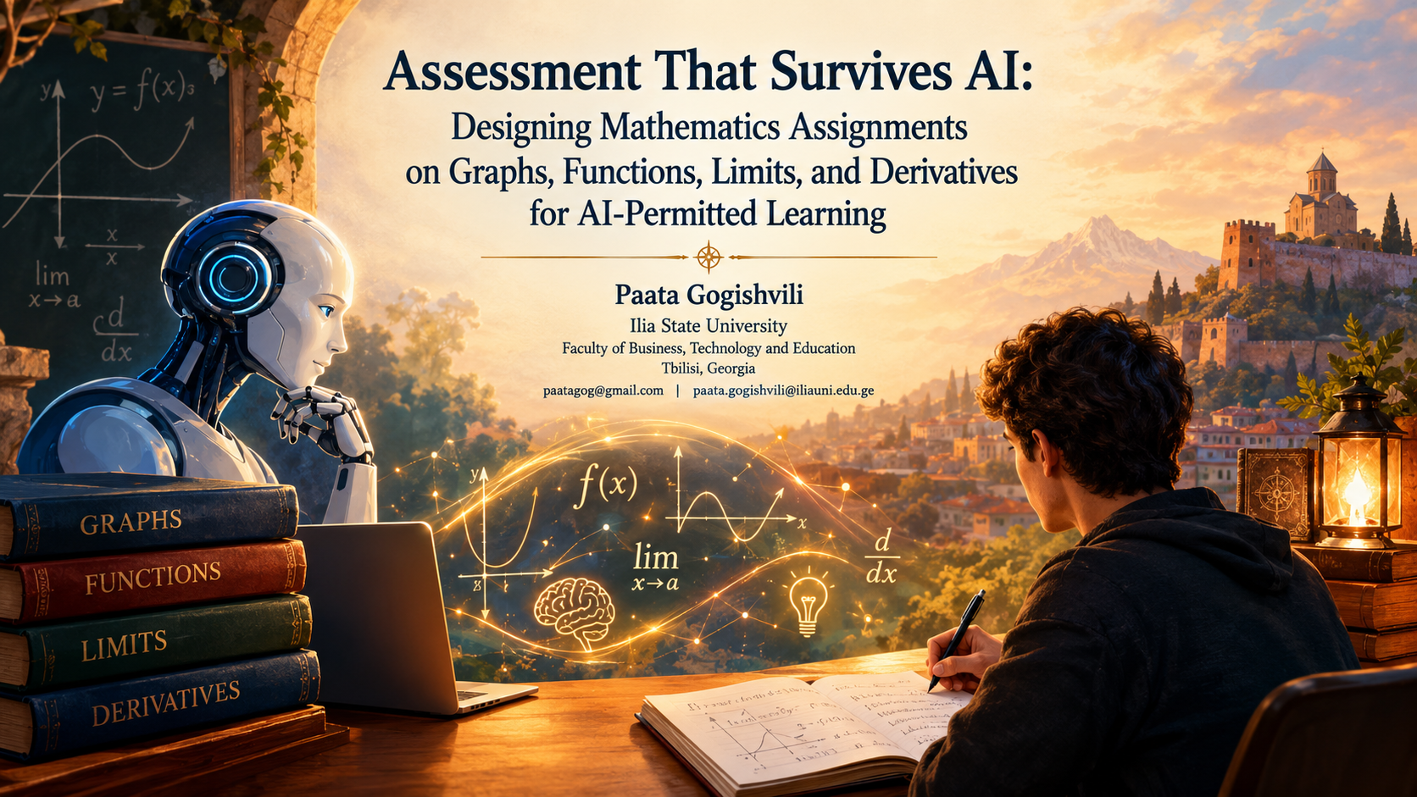

Slide 4
XVI Annual International Conference of the Georgian Mathematical Union
Assessment That Survives AI
Designing Mathematics Assignments on Graphs, Functions, Limits, and Derivatives for AI-Permitted Learning
Paata Gogishvili
Ilia State University, Associate Professor,
Head of The School of Technology,
Head of The Computing Center.
Batumi Shota Rustaveli State University
31/08/2026 - 05/09/2026

Slide 5
OVERVIEW
Teaching mathematics is one of the biggest challenges in modern higher education.
Typically, the level of first-year students in mathematics is very low. Sometimes, their knowledge is limited to memorized formulas, and there is a noticeable lack of analytical and mathematical thinking.
The emergence of artificial intelligence systems has added new dimensions to teaching.
Students try to copy their assignments directly into artificial intelligence systems to get ready-made solutions. Artificial intelligence, on the other hand, handles mathematical tasks quite successfully.
Our presentation today is dedicated specifically to tackling this challenge.

Slide 6
SOLUTION
Excluding the artificial intelligence factor is one approach. For example, during exams, we could bring the student into an examination hall where supervision is established, thus eliminating the use of AI systems.
The goal of our report is to propose a different approach.
We have developed a method that takes into account the fact that a student might use artificial intelligence, yet we are still able to adequately assess their knowledge.

Slide 7
ALREADY USED SUCCESSFULLY
I teach several courses at the university where I actively use mathematical tools, which is precisely why I started working on this issue. Furthermore, my father teaches mathematics at the university, and he was also interested in working on these matters.
Last year, he presented the results of our joint work to you. Since then, our approach has developed further, and today I am presenting these updated results.
Our approach is already implemented and successfully used for three years.

Slide 8
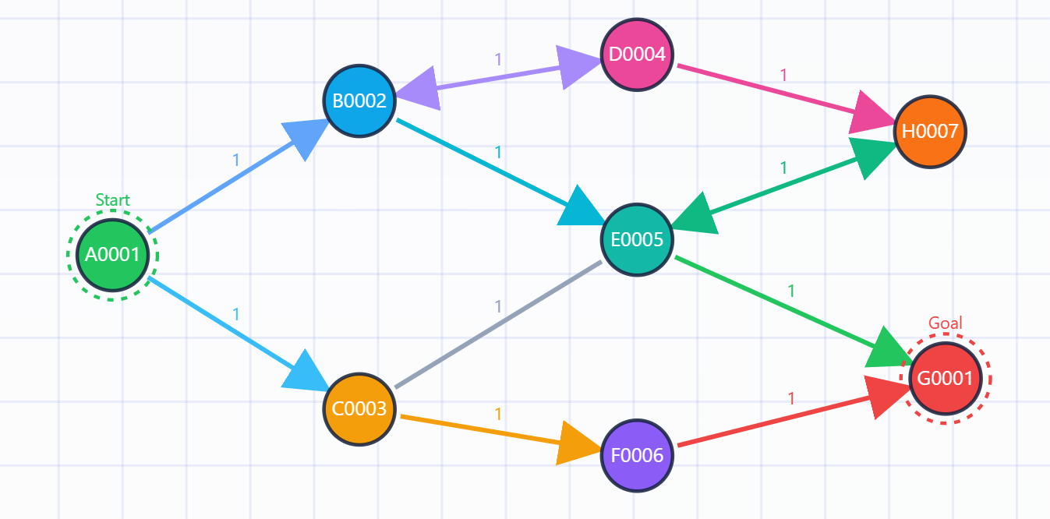
GRAPHS
First of all, let us consider the technique for working with graphs.
A standard problem formulation might look like this:
Given a graph:
Find a path from the starting vertex to the goal vertex using the DFS algorithm.

Slide 9
GRAPHS
Formulated this way, a student will simply take a picture of the problem, submit it to the artificial intelligence, and copy-paste the provided solution directly into the answer without even realizing what was asked or how it was solved.
Given a graph:
Old and Wrong Way!
AI
Find a path from the starting vertex to the goal vertex using the DFS algorithm.
Perfect Solution to Copy!

Slide 10
GRAPHS
To achieve our goal, we must obviously leverage AI's weakness.
One such weakness (for now) is its limitation in interacting with dynamic websites. At this stage, AI systems are quite poor at opening websites and interacting with them independently.
Therefore, we propose the following solution: let's build a website where the graph is never fully displayed at once. Only a single vertex or connecting edge of the graph might be visible at any given moment.
In this case, the student will have to "extract" the graph, or at least understand the problem and provide the correct input to the AI. This in itself is a step forward compared to blind copy-pasting.

Slide 11
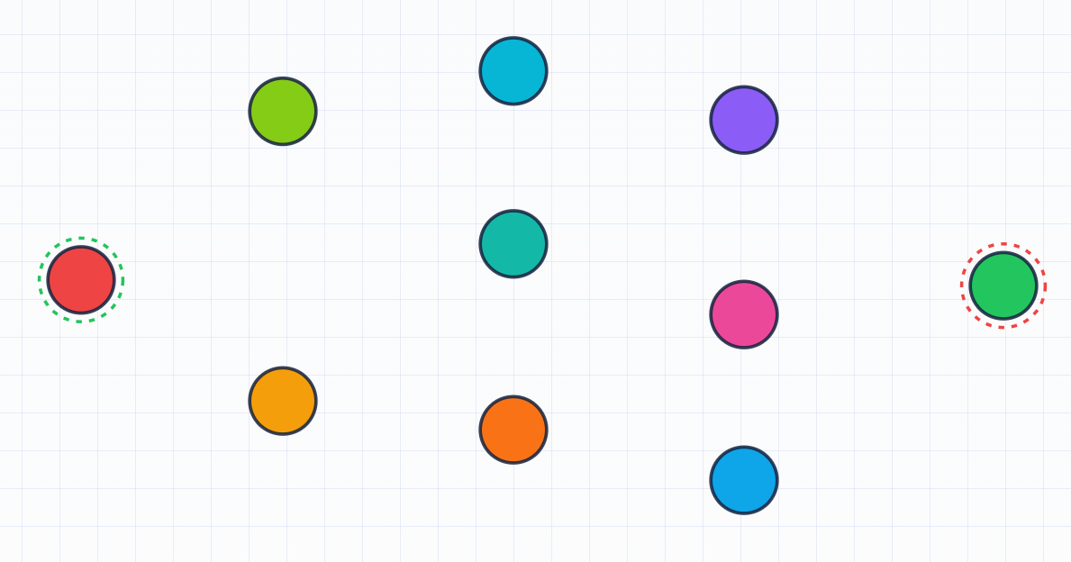
GRAPHS
Method #1 Assignment: https://max.ge/batumi2026/graph/graph_482731905.html
Tool for lecturers: https://max.ge/batumi2026/graph/graph-creator.html

Slide 12
GRAPHS
We also offer a second approach for graph-related problems.
This approach involves an automated bot through which the student must determine the topology of the graph themselves.

Slide 13
GRAPHS
Method #2 Assignment: https://max.ge/batumi2026/graph/graph_bot_915204887.html
Tool for lecturers: https://max.ge/batumi2026/graph/graph-bot.html

Slide 14
FUNCTIONS (Limits, Derivatives, Integrals)
When teaching mathematics, there are numerous problems related to functions and their properties.
In the process of teaching, a specific pattern is observed: students memorize formulas relatively easily (for example, differentiation rules), but have a poorer understanding of their geometric meaning.
These aspects require additional effort, alongside the integration of artificial intelligence.
We propose presenting functions in a format that requires students to apply specific effort, even when they have access to an artificial intelligence assistant.

Slide 15

FUNCTIONS (Limits, Derivatives, Integrals)
Formulated this way, a student will simply copy-paste the provided solution directly into the answer without even realizing what was asked or how it was solved. The memorize formulas are another problem in this case.
Find the derivative of the function in $x=2.5$, given that the function is $sin(x) \frac{x}{3}$
Old and Wrong Way!
AI
Perfect Solution to Copy!

Slide 16
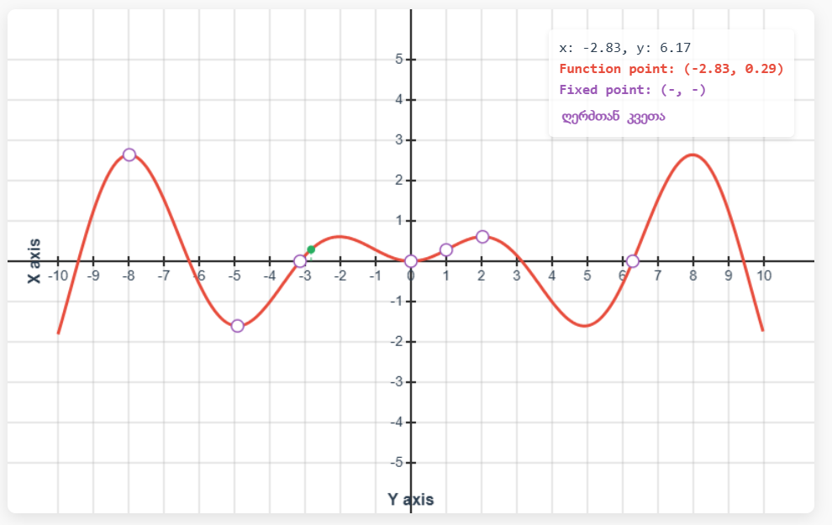

FUNCTIONS (Limits, Derivatives, Integrals)
Assignment https://max.ge/batumi2026/function/target_function1.html
Find the derivative of the function given below at $x=2.5$, given that the function is of the form $a sin(x) \frac{x}{2}$, where $a∈\{0, \frac{2}{3}, 1, 5, 10\}$

Slide 17
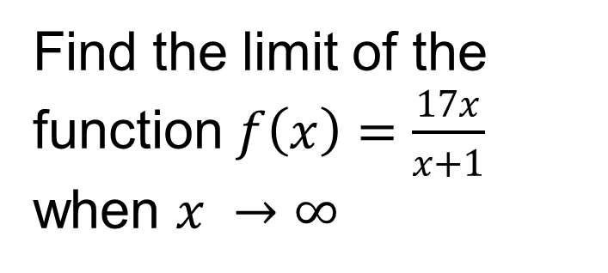
FUNCTIONS (Limits, Derivatives, Integrals)
Formulated this way, a student will simply copy-paste the provided solution directly into the answer without even realizing what was asked or how it was solved. The memorize formulas are another problem in this case as well.
Find the limit of the function $f\left(x\right)=\frac{17x}{x+1}$ when $x →∞$
Old and Wrong Way!
AI
Perfect Solution to Copy!

Slide 18
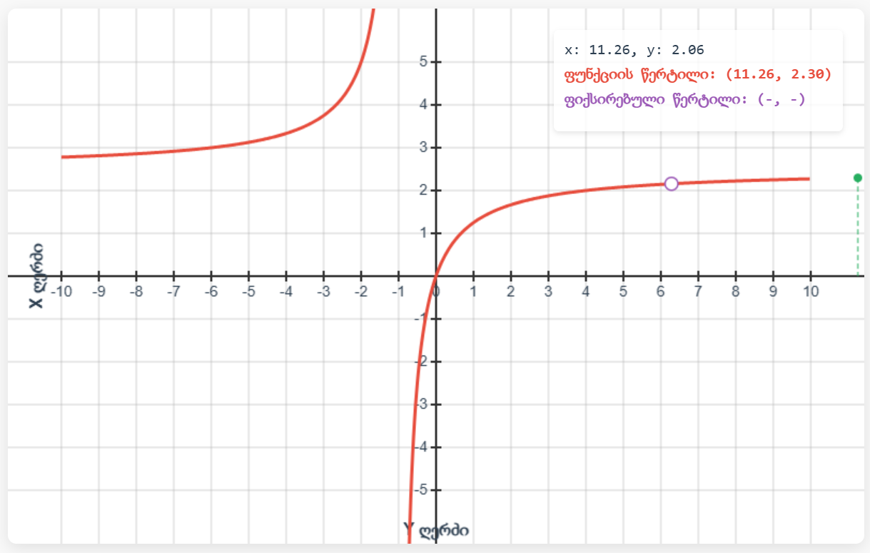
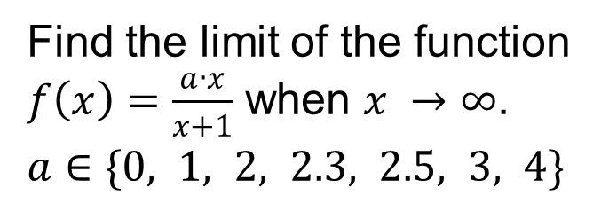
FUNCTIONS (Limits, Derivatives, Integrals)
Assignment https://max.ge/batumi2026/function/target_function2.html
Find the limit of the function $f\left(x\right)=\frac{a∙x}{x+1}$ when $x →∞$. $a∈\{0, 1, 2, 2.3, 2.5, 3, 4\}$

Slide 19
LAST YEAR TOPICS
Last year, at this very conference, I presented general findings, including several topics that can be successfully taught in mathematics under the conditions of allowing artificial intelligence.
These topics include calculating the area bounded by the intersection of functions, computing correlation, and other elementary issues, which I will show you again today as a quick reminder.

Slide 20
CONCLUSION
In conclusion, I can tell you that I have been using these methods effectively for several years, although there are also challenges.
1. Artificial intelligence is getting smarter and is gradually approaching human-level performance even in interactive tasks.
2. Students try to feed an entire web page to the AI, since LLMs are currently best at handling code. There is a solution to this as well: using not just pure HTML code, but a simple web application with its own back-end. Such an application is no longer directly accessible to the student through the web browser.

Slide 21
OPEN QUESTION
What should we do if AI outperforms humans across all domains?

Slide 22
