Slide 1
Ocean Lighting
Paavan kumar Sirigiri

Slide 2
Overview
Paper chosen is “Realistic Ocean Lighting using Seamless Transitions from Geometry to BRDF” by Eric Bruneton.
The algorithm is based on a hierarchical representation, combining geometry, normals and BRDF(Bi-directional Reflectance Distribution Functions).
This paper is based on the deep water waves model of Pierson and Moskowitz , and shares the limitations of this model
Their geometric model is a finite sum of wave trains of all wavelengths
The transition from geometry to normal to BRDF depends on the wavelength, for each wave train

Slide 3
Implementation
Model the ocean surface with a sum of n trochoid wave trains of amplitude h , wavenumber k and angular frequency ω sampled from the Pierson-Moskowitz and Hasselman.
A regular grid in screen space is projected on the horizontal plane, displaced by waves and
projected back to screen
Per pixel normals are computed and attenuated independently . They are eventually replaced
with a distribution of normal, i.e BRDF
Gaussian distribution of slope variances is used to form the ocean waves.

Slide 4
Implementation
Ocean waves and BRDF lighting has been done
Grid Based Mesh is generated based on the work of Hinsinger.
Vertex and Fragment Shaders attached to the program.
The vertex shader projects the screen space regular grid, displaces it according to average position of vertices and projects it back.
The fragment shader computes the per pixel normals and then the Sun, sky and refracted light.
Frame buffers are formed based on the output of these shaders as per the normal OpenGL Rendering Pipeline.

Slide 5
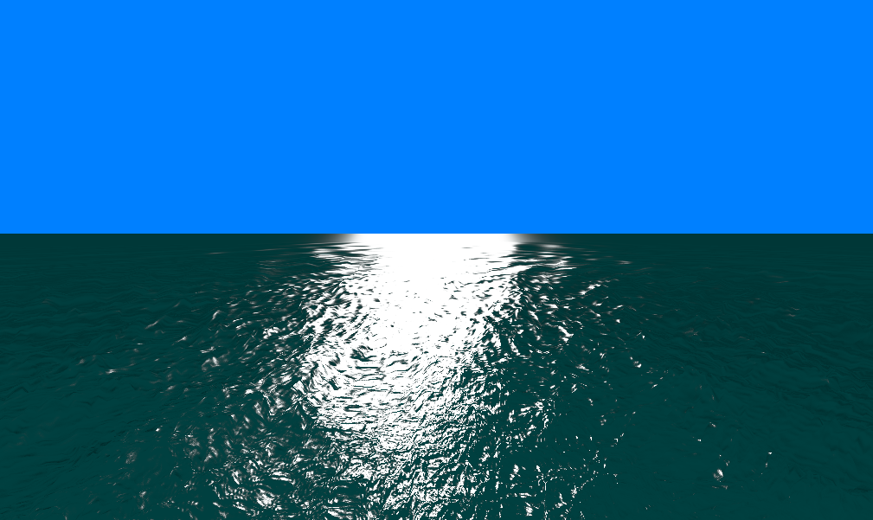
Results

Slide 6
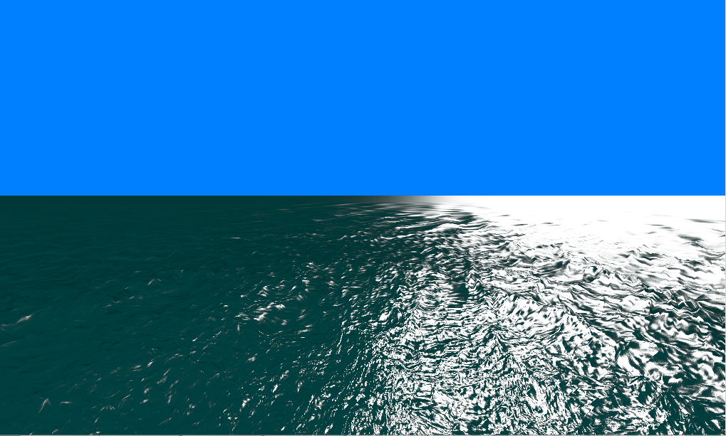
Results

Slide 7
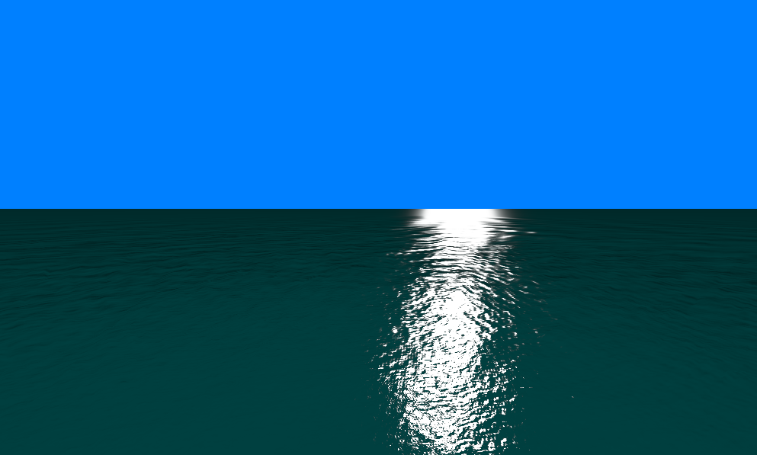
Results

Slide 8
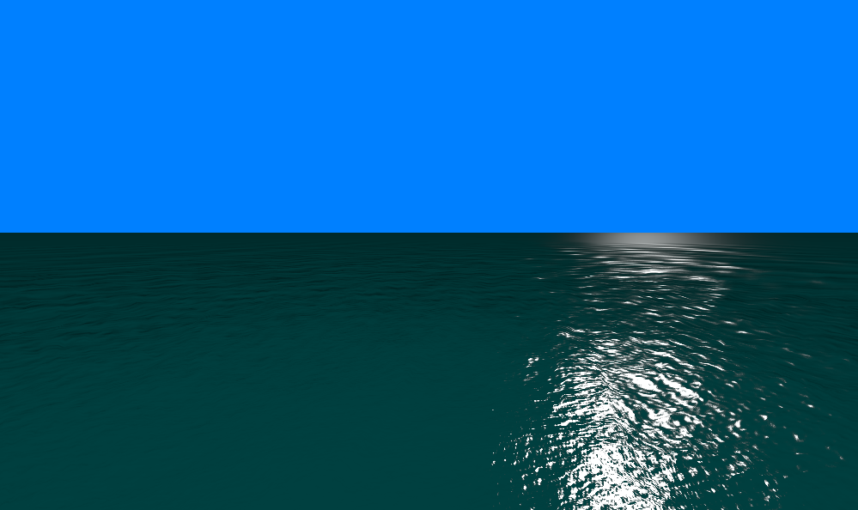
Results

Slide 9
THANK YOU

