Slide 1

Network Architecture
Production
Sandbox
DB
API
Web
Web
API
DB
External Partners
Mobile
External APIs
Internet
Developers
Development
Web
API
DB
Dotted lines represent environments and solid lines represent separate servers hosted on Rackspace
All databases are firewalled to allow access from the API of that environment only
All communication from the web layer to the API layer goes through the public internet

Slide 2
Component Architecture
Add-Ons*
Hydrogen Platform⁺
Modular RESTful APIs – Partners can access the Hydrogen platform through RESTful APIs and build on top of the functionality already provided
Add-Ons – Partners can leverage pre-built, configurable, add-ons provided by Hedgeable for an additional cost
Extendible – The Hydrogen platform is extendible – partners can write their own connectors to 3rd party integrations, interfaces for which are already provided as part of the platform
Node.js middleware
SSL (Symantec)
Redis DB (caching)
HTML/CSS/Javascript
AngularJS, Jquery, Bootstrap, D3.js
Tomcat, Java, Spring (Digital API)
Django, Python (Investing API)*
Relational database (MySQL)
SSL (Symantec)
Caching, Paging, Sorting
Data management
Investment algorithms
Automated scripts
Configurable 3rd party integrations*
Data
Custodian/Brokerage
Compliance
Communication
CRM
Account aggregation
Analytics
Support
External Partners
API exposed to external partners
* Optional and extra cost
+ Deep dive in following slides

Slide 3
Hydrogen Platform Extendibility
Hydrogen Platform
Data Access Layer with Persistence*
Interfaces
Services
Business Logic
Encryption
Interfaces
3rd party integrations Interface
Customized Connector
3rd party API (e.g., custodian, brokerage, data, email)
Controllers
For each 3rd Party integration, Hedgeable has an interface defined
To customize a new vendor for a particular type of integration, Hedgeable customizes a connector to connect to the 3rd party API
Model – Business Objects, Helper Objects
* Under development

Slide 4
Major Data Components
Client
Main entity signed up by the Partner
Login
2 factor authentication
Custom attributes
Benchmarks
Documents
Support
Account
Legal entity that the client is signing up for
Custom attributes
Account types
Account levels to track progress
Sync to allocation
Allocations
Virtual entity assigned to the account, holding the ideal allocation of the account
Custom attributes
Algorithm
Partner
Main entity to authorize the API
IP Whitelist
Benchmarks
Support
Widgets
Defines attributes for all the entities
Goal
Goal the client is signing up for
This can be a dummy value if no goal present
Custom attributes
Sub-goals
Models
Virtual entity composing the allocation and holding the ideal weights of the securities in a portfolio
Custom portfolio
Historical holdings, balances, and transactions
Portfolios
Virtual entity composing the Account and holding the actual client securities
Each account must have a “cash” portfolio to facilitate funding
Maps uniquely to a model
Historical holdings, balances and transactions
Sync to model
Securities
Financial instrument to invest in
Custom attributes
Prices
Geographical breakdown
Composition
Answers
Type and allowed answer for each question
Questions
Sign up questions under each goal
Custom Attributes

Slide 5
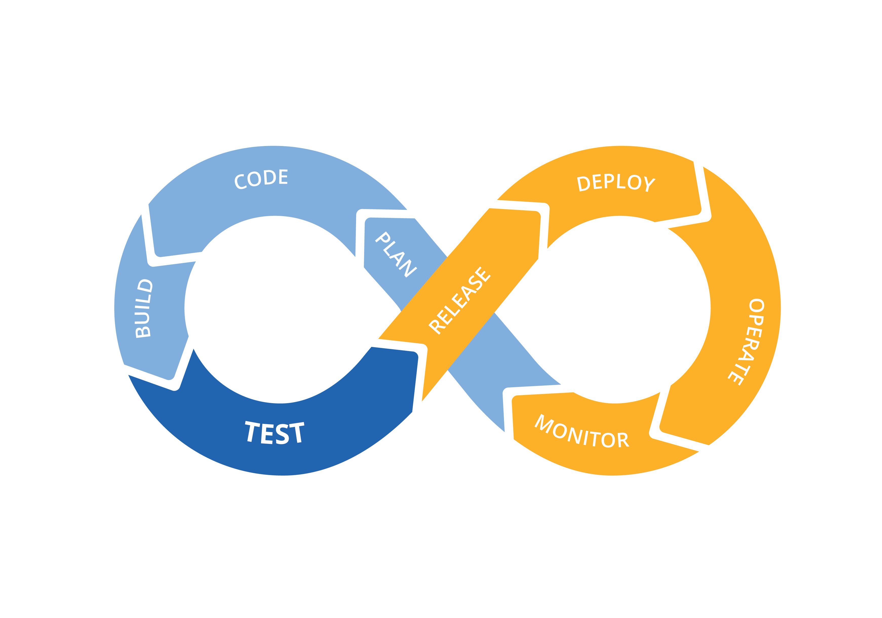












Development Process
In development

