Slide 1
Personalized financial advisor- using LLM
Group 5
D. Paavan Sundar
Manikandan NP
Shah Imran Alam
Allan Abraham
Ish Preet Singh Modi
Git: https://github.com/paavansundar/personnel_financial_advisor

Slide 2
ABOUT US
We are a team of software professionals ; business analysts and academicians came together to pursue our interest in learning AI/ML and MLOps at IISc through talent sprint. We chose Personalized Financial Advisor as our capstone project to expand our knowledge in AI/ML and NLP/LLM in specific. Apart from expanding our knowledge we want to try something which is challenging and gives us an opportunity to experiment with new ideas and features.

Slide 3
PROBLEM
Complexity
Data
The field of finance is complex and overwhelming for individuals seeking financial advice.
Paucity of fundamental data and other financial metrics makes it tough to derive insights.
Training
USABILITY
Training and finetuning on large financial datasets is complex and time consuming.
Customers want something easy to use that helps make their life easier
Deployment
As the solution is complex involving huge data and model development the deployment choice should be carefully considered perused.

Slide 4
SOLUTION
Chat GPT
Jinja templates & Fast API
Out of box chat gpt was trained on intelligent investor book to respond to generic queries. The language of choice is python.
Jinja templates were chosen instead of gradio for better navigation between pages. Fast API will act as API for multiple endpoints using API lead approach.
AlPHA VANTAGE & FB Prophet
EASY TO USE
HTML customers the targeted information they need using HTML and CSS. Three radio button that provides three navigational choices to users to act upon.
Alphavantage was used to retrieve live quotes on weekly time frame to calculate tolerance and provide stock/etf specific query. FB Prophet was used find trend of shares/etf and provide a portfolio of stocks

Slide 5
PRODUCT OVERVIEW
UNIQUE
TESTED
Only product specifically dedicated to this niche area with this kind of features.
Conducted testing multiple times to ensure proper navigation and responses.
Containerized
AUTHENTIC
The entire solution is containerized and hence can be deployed or used across platforms.
Tried to be as authentic as we can using very less artifacts from internet.

Slide 6
PRODUCT BENEFITS
Personal buy/sell advice regarding shares/ETF
Generic finanal advice.
Portfolio building advice as well as list of stock picks.

Slide 7
Functional Architecture OVERVIEW

Slide 8



Architecture SELECTION PARAMETERS
RESEARCH
ABSTRACT
DESIGN
Web based our research on internet and other platforms to find out regarding similar products.
We believe people need more products specifically dedicated to this niche segmet
Minimalist and easy to use

Slide 9
Data
Two types of data are considered for this project
Text based for providing generic advice using chat GPT
The intelligent investor book has been considered for this.
Realtime time series data for providing stock/share/ETF advice and financial modelling.
The data source for real time is AlphaVantage an API based financial data provider. The provider provides following data
Realtime & historical stock market data APIs
Forex, commodity & crypto data feeds
60+ technical & economic indicators
Market news API & sentiments
Global coverage

Slide 10
Data consideration
The API provides data for 3 timeframes, 1. Daily 2. Weekly and 3. Monthly
For this project we have considered weekly adjusted data i.e., weekly timeframe, for 3 years due to memory constraints. This API returns weekly adjusted time series (last trading day of each week, weekly open, weekly high, weekly low, weekly close, weekly adjusted close, weekly volume, weekly dividend) of the global equity specified, covering 20+ years of historical data. After carefully observing the features, it is understood 90 percent data provided is based on price volume and a limited data from fundamentals.

Slide 11
Data Type
All the data is of type either numeric/float or date. Further the data is continuous i.e. time series in tabular form. Apart from this data should be retrieved on real time bases using API calls and every time real time data is returned as JSON string. The data received should be parsed and needed to be converted it into data frames.

Slide 12
Data Model
As the data from AlphaVantage is of time series it was decided that we should use FBProphet a time series forecasting model to predict price trends of a stock/ETF for a year.

Slide 13
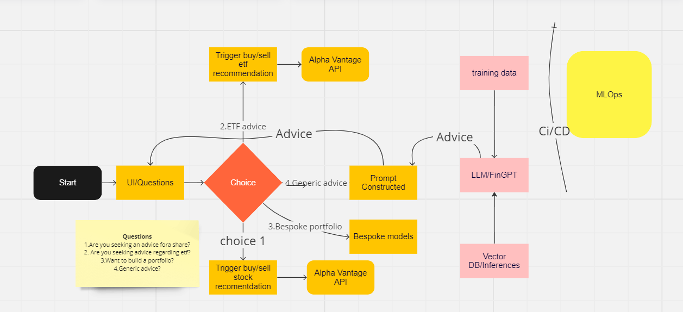
OVERVIEW

Slide 14
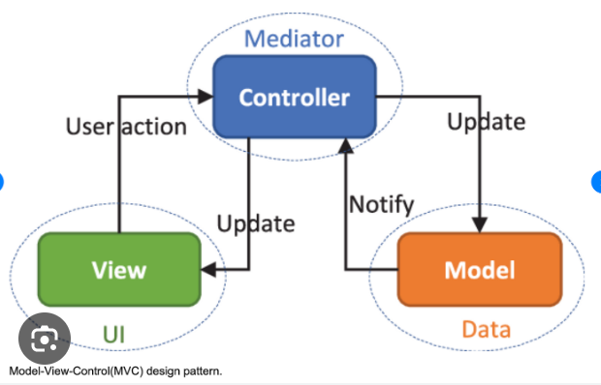
Technical Architecture

Slide 15
Tools and Technologies
VIEW
HTML, CSS, JINJA Templates
Controller
Fast API
Model
Chat GPT, AlphaVantage API, FB Prophet, Python

Slide 16
Deployment Architecture
GIT
CI
DOCKER
CD
Self hosted Agent

Slide 17
CI/CD
CI
CD
Pull code from git repository.
Create a docker container.
Push the container to Docker hub.
Pull the container from Dockerhub.
Deploy the container on any host machine using git self hosted agent

Slide 18

MEET THE TEAM
D. Paavan Sundar
Manikandan NP
Allan Abraham
Ishpreet Singh Modi
Co-Ordinator

Slide 19
MEET THE TEAM
Shah Imran Alam

Slide 20
SUMMARY
A financial advisor quiz chatbot works by asking its users a series of questions. The questions can be generic or bespoke if the questions is generic the user will get a generic response or if the question is bespoke questions are designed to ask common queries from potential clients. For example, the chatbot may ask "how much money do you earn?", "what type of investments do you currently hold?", and "what kind of retirement savings plan do you have?". Once the user provides an answer to each question, the chatbot analyzes the responses and gives personalized recommendations at the end.

Slide 21
THANK YOU
D. Paavan Sundar
paavan.sundar@gmail.com

