Slide 1
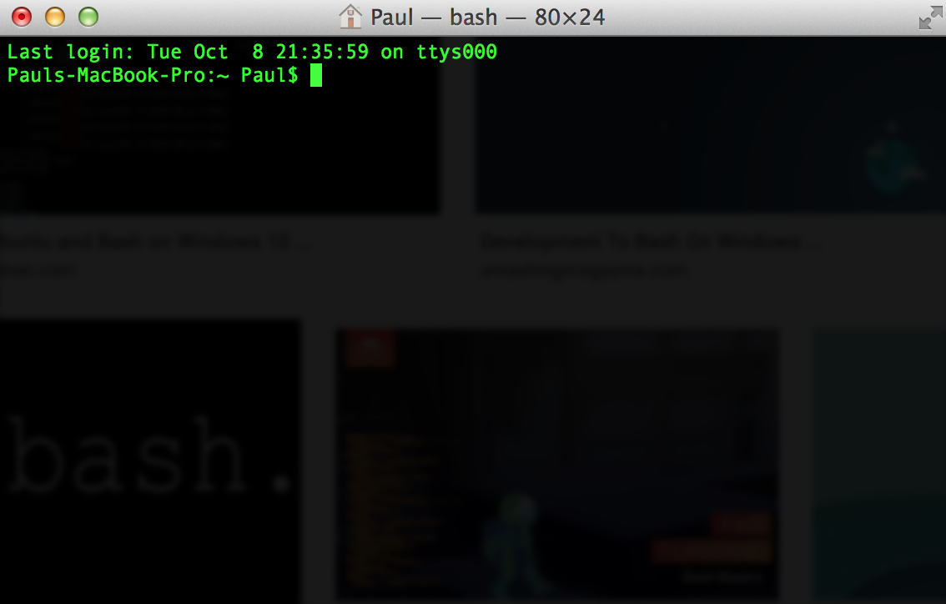
Bash/Unix Shell

Slide 2
Why use bash?
Automate repetitive tasks
Save time and energy
Reduce untraceable errors
Easily communicable & reproducible across computers
Scripts!

Slide 3
Scenarios where bash/unix can help
You have thousands of files, each representing different measurements for a study. You want to just pull 1 piece of information out of each file for your analysis
You want to create an analysis ‘pipeline’ linking together your data cleaning, preprocessing, analysis, and graphing steps

Slide 4
You want to efficiently transfer a large amount of data from one server to another (or between a local computer and a server)
You get access to a folder with thousands of files, but it badly organized and you want to systematically move or delete many of them
Much much more!

