Slide 1
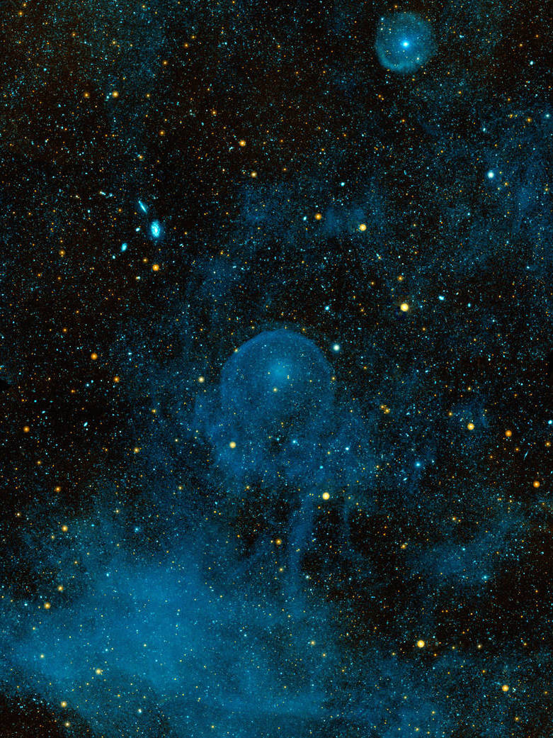
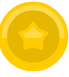


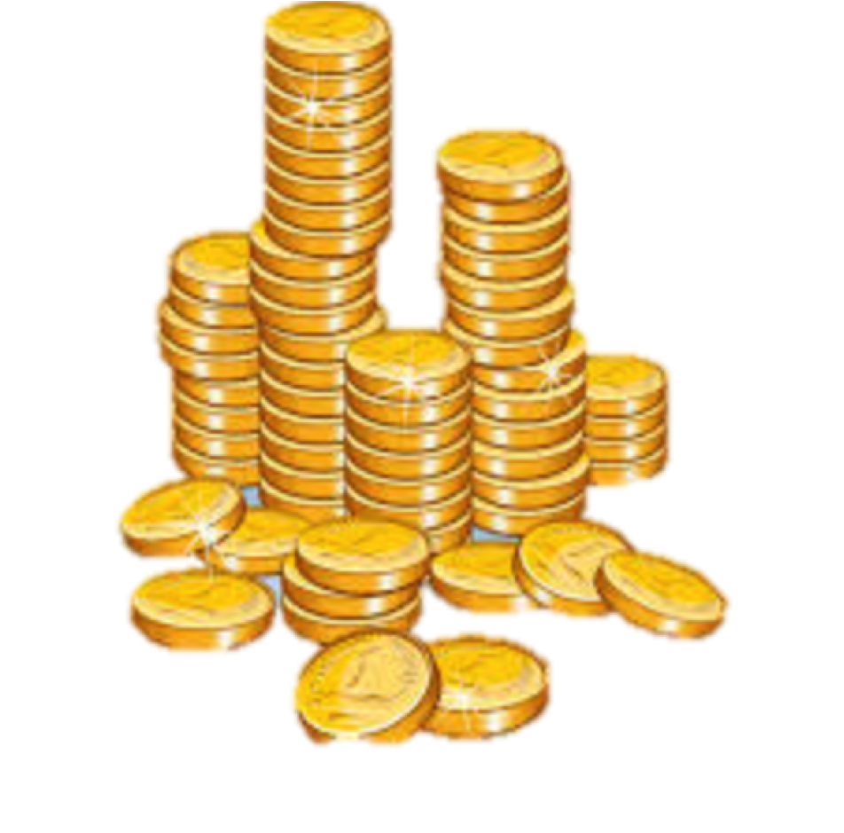





SPACE
TREASURE

Slide 2
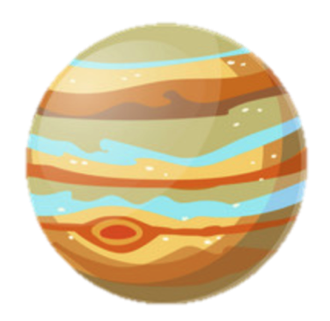
The goal of this game is to visit two planets to earn as many space coins as possible!
Try to get as many coins as you can to get the highest score!

Slide 3

How can you get coins?
By visiting these aliens!
They help you find coins!
When you’re at a planet, you choose an alien with the left/right arrows to try to get a coin.

Slide 4
?
?
?
?
Sometimes the alien will find you a coin, sometimes not.
Remember to pay attention! The aliens that are best at finding coins will change over time!

Slide 5

But first, you’ll need to get from earth to the planets! You can choose portals with the left/right keys to help you get to the planets

Slide 6
Pay special attention to the color of the portals! The yellow portal usually goes to one planet, and the green portal usually goes to the other planet.

Slide 7
Try and figure out which portal is most likely to take you to which planet!
That way you can reach the alien of your choice!

Slide 8
Are yOU
READY?

Slide 10
Which planet does the yellow portal usually go to?

Slide 11
Which planet does the green portal usually go to?

Slide 12
If you wanted to go to this planet, which portal would you choose?

Slide 13
If you wanted to go to this planet, which portal would you choose?

Slide 14



When you picked a portal, which type of ladder did you see more often?
(Choose with arrow keys)
STRAIGHT
SLANTED

Slide 15
Mission
Complete!

