Slide 1

Introduction to Circuits

Slide 2
What does Codasign do?

Slide 3
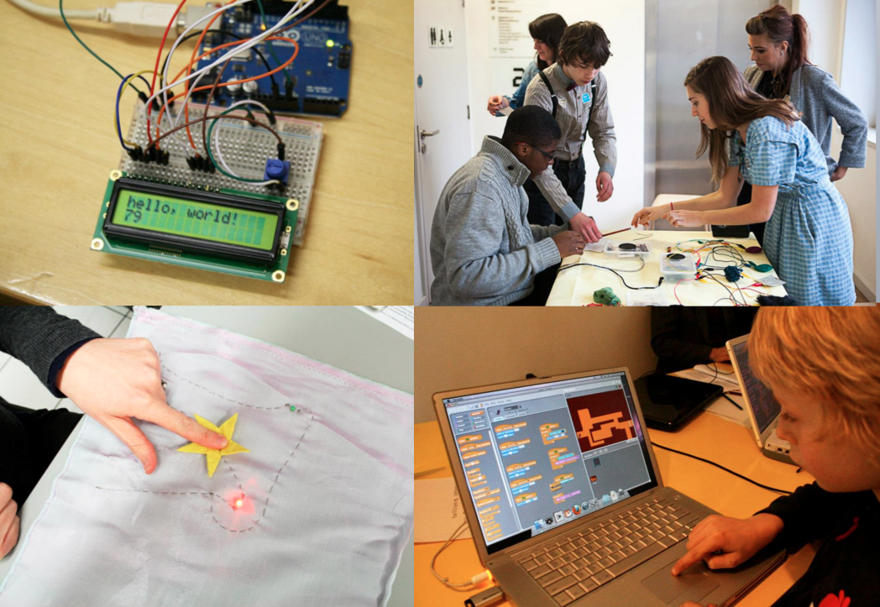

Slide 4
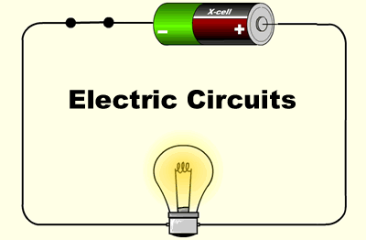
Arduino diagram1

Slide 5

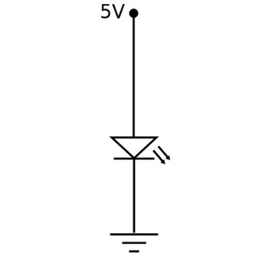
Arduino diagram1

Slide 6
Let’s make pencil and paper circuits
Arduino diagram1

Slide 7
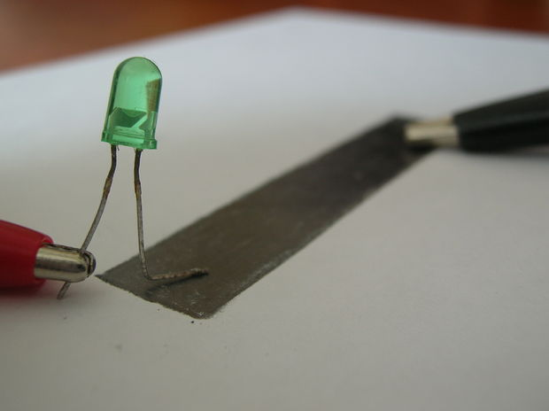
Arduino diagram1
Variable Resistor
Notes:
Pencil variable resistor

Slide 8
Let’s make pencil and paper circuits
Arduino diagram1

Slide 9
Arduino diagram1
How does it work?
Notes:
Pencil variable resistor

Slide 10
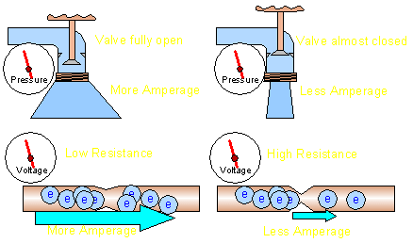
Arduino diagram1
Change Resistance
Notes:
Pencil variable resistor

Slide 11
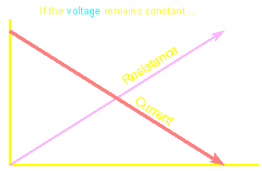
Arduino diagram1
More Resistance =
Less Current
Notes:
Pencil variable resistor

Slide 12
Arduino diagram1
Change Voltage
Notes:
Pencil variable resistor

Slide 13
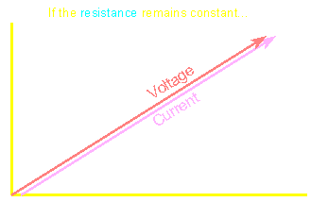
Arduino diagram1
More Voltage =
More Current
Notes:
Pencil variable resistor

Slide 14
Let’s make pencil and paper Flashlight
Arduino diagram1

Slide 15
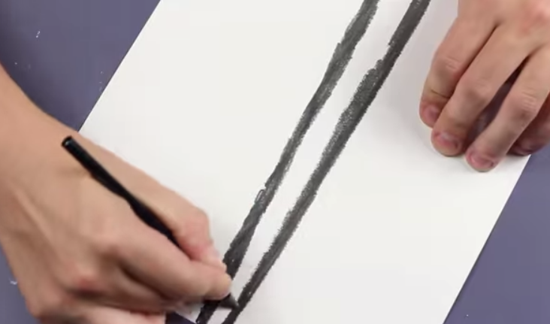
Arduino diagram1

Slide 16
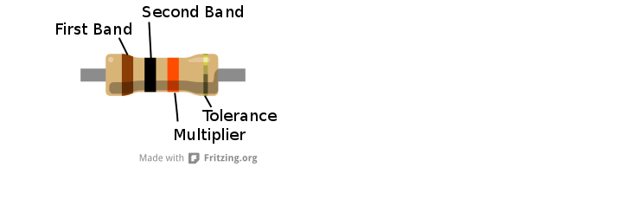
Resistor
They reduce the current that flows across them and are
useful for making sure other components aren't overloaded
with too much current.

Slide 17
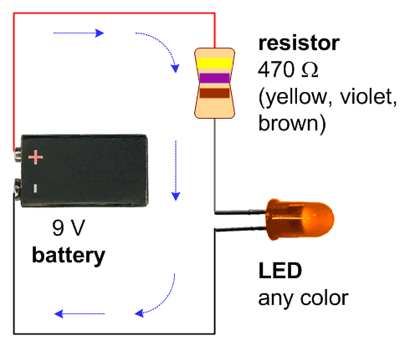
Arduino diagram1

Slide 18
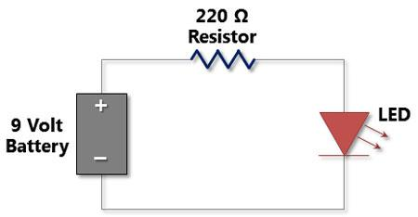
Arduino diagram1

Slide 19
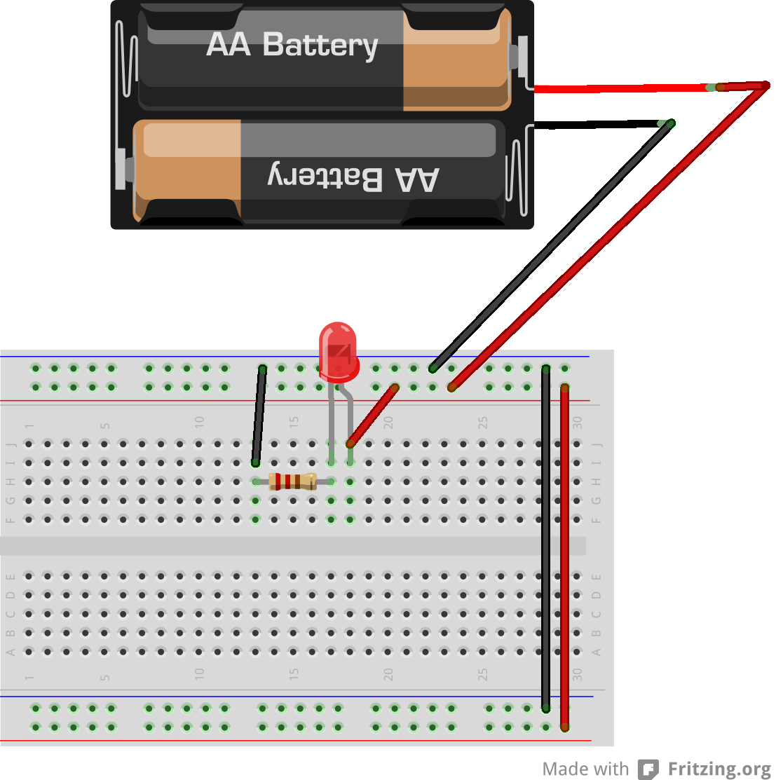
Arduino diagram1

Slide 20
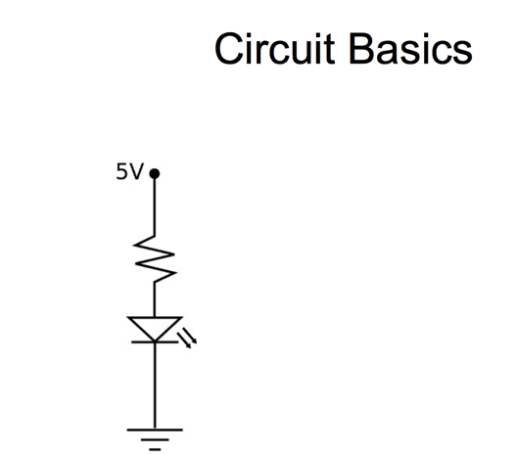

Slide 21
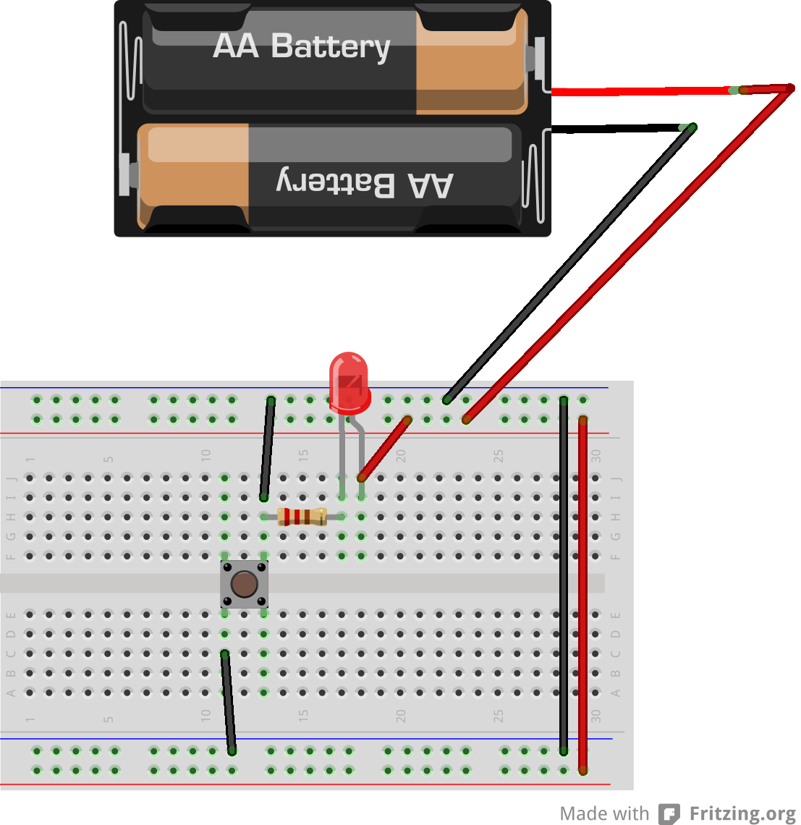
Arduino diagram1

Slide 22
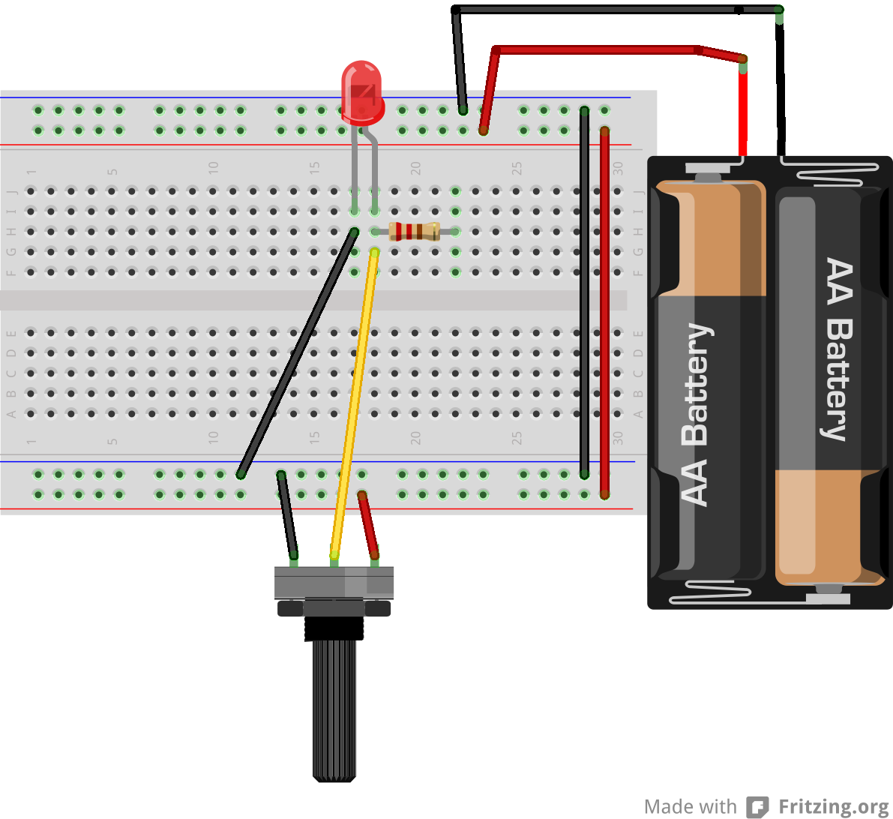
Arduino diagram1

Slide 23
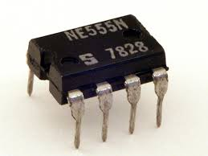
Arduino diagram1
555 Timer Chip

Slide 24
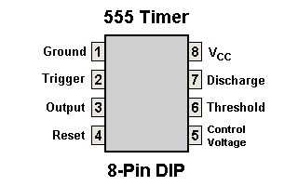
Arduino diagram1
555 Timer Chip

Slide 25
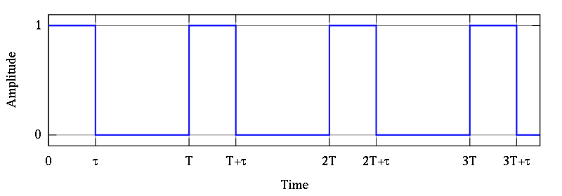
Arduino diagram1
Pulse waveform
The 555 timer is a chip that can be used to create pulses of various durations

Slide 26
Arduino diagram1
What is it good for?
The 555 timer is a chip that can be used to create pulses of various durations
a steady clock to keep time in a circuit (astable mode)
a very basic noise maker
time delay for an incoming signal (monostable mode)

Slide 27
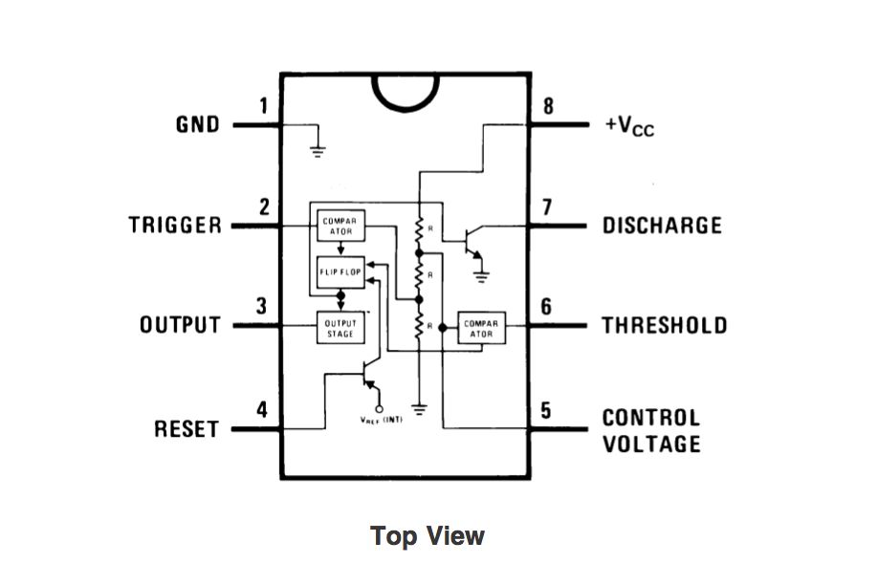
Arduino diagram1
555 Timer Chip
Flip Flop

Slide 28

Monostable Mode Circuit
Monostable Mode is great for creating time delays.

Slide 29
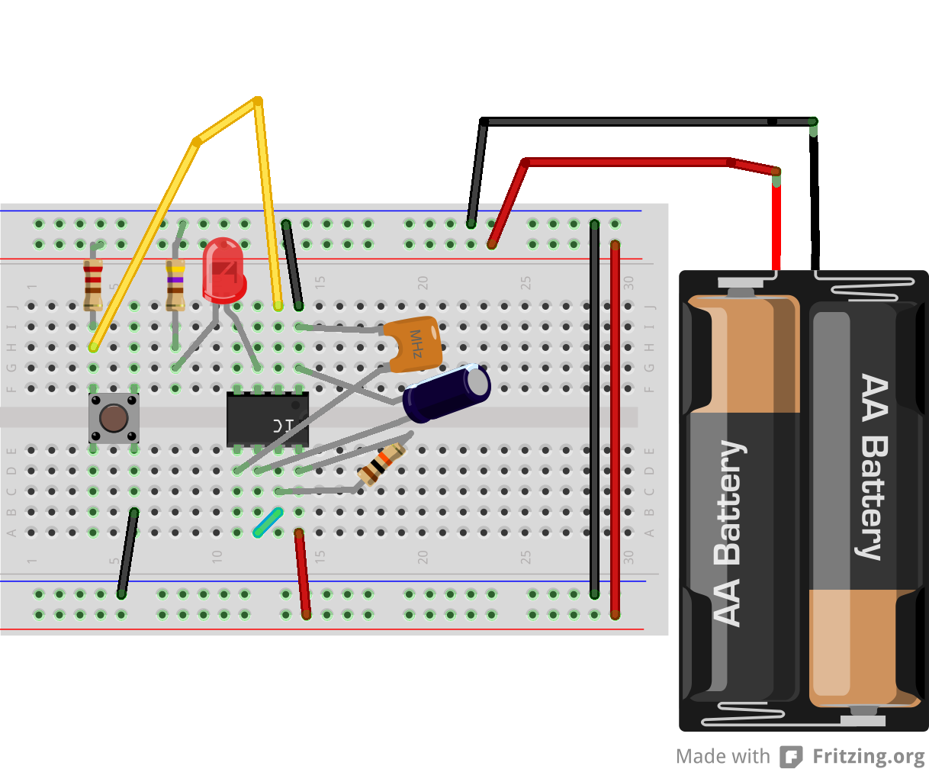
Monostable Mode Circuit

Slide 30
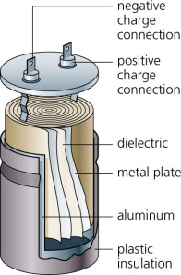
Capacitor
Notes:
How it works

Slide 31
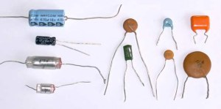
Capacitors

Slide 32
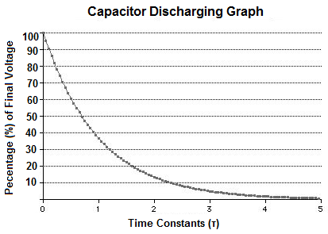
Capacitor Discharge

Slide 33
Arduino diagram1
Astable Mode Circuit
Astable Mode outputs an oscillating pulse signal/waveform.

Slide 34
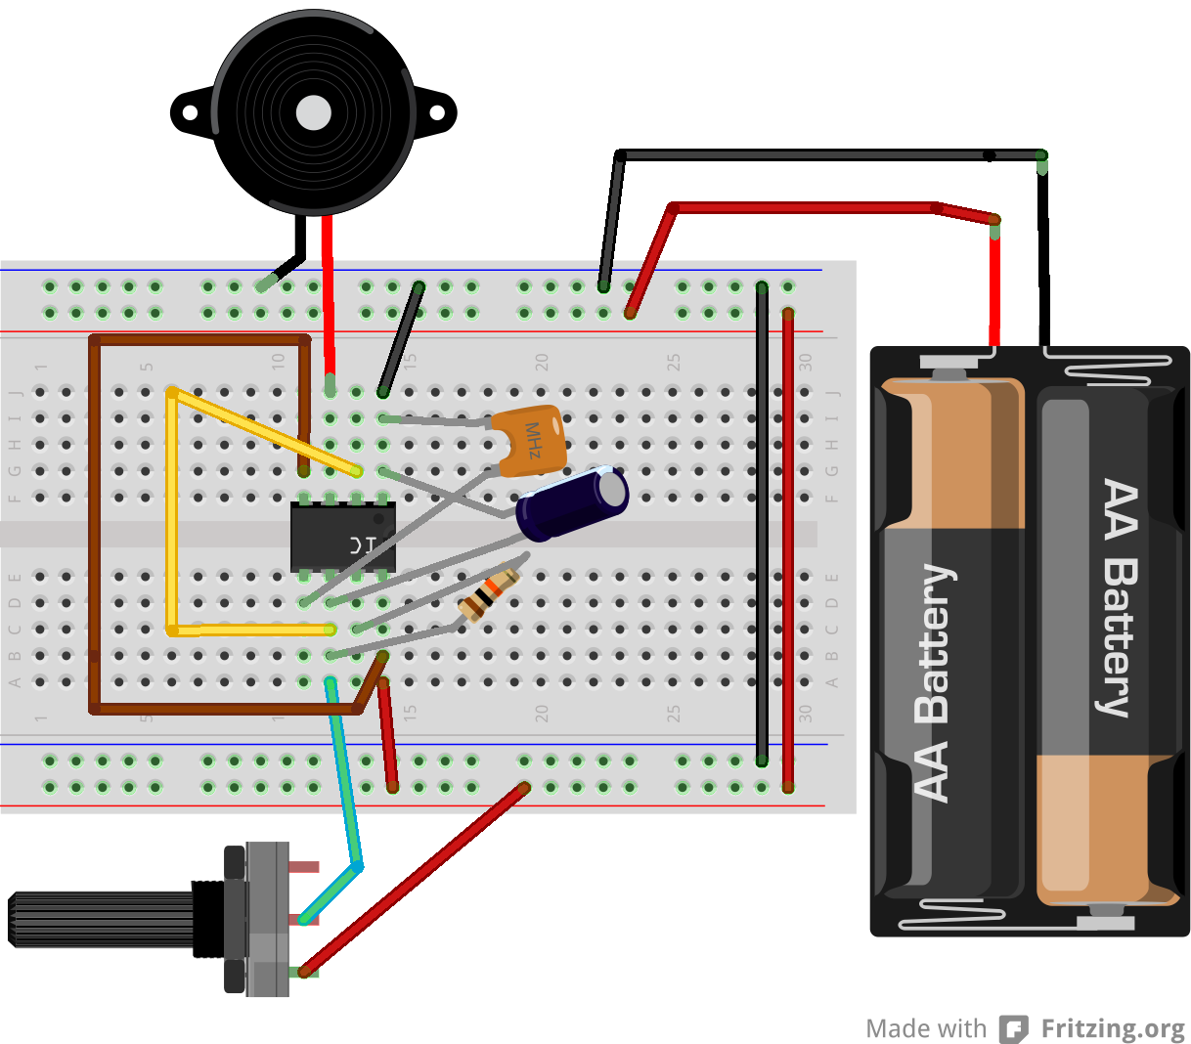
Arduino diagram1
Astable Mode Circuit

Slide 35
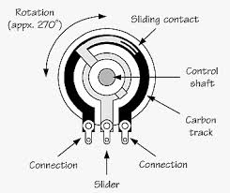
Potentiometer as variable resistor

Slide 36
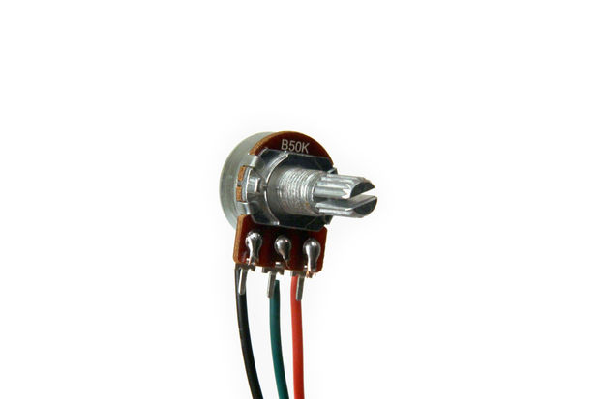
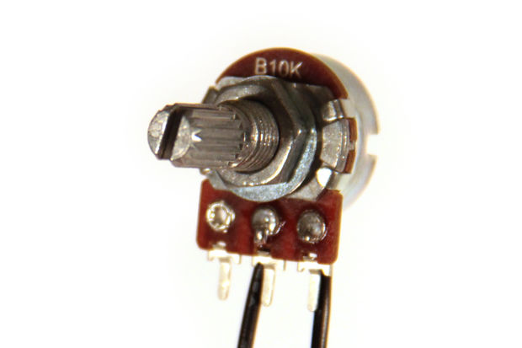
Potentiometer as variable resistor
Voltage Divider
Variable Resistor
Notes:
Normally, potentiometers are wired as variable voltage dividers: connect +V to one side, connect the other side to ground, and the middle pin will output a voltage between 0 and +V (fig 2).
by only connecting two pins (one outside pin and one center pin) of a potentiometer to your circuit, you can turn a pot into a variable resistor.
a B label means it is a linear taper pot. This means the resistance of the material inside the pot is uniform for all positions of the knob.
A label on it it has a logarithmic taper: the resistive material inside the pot is not uniform.

Slide 37
Arduino diagram1
Variable Resistor
Notes:
Pencil variable resistor

Slide 38
Arduino diagram1
Pulse waveform
The 555 timer is a chip that can be used to create pulses of various durations

