Slide 1
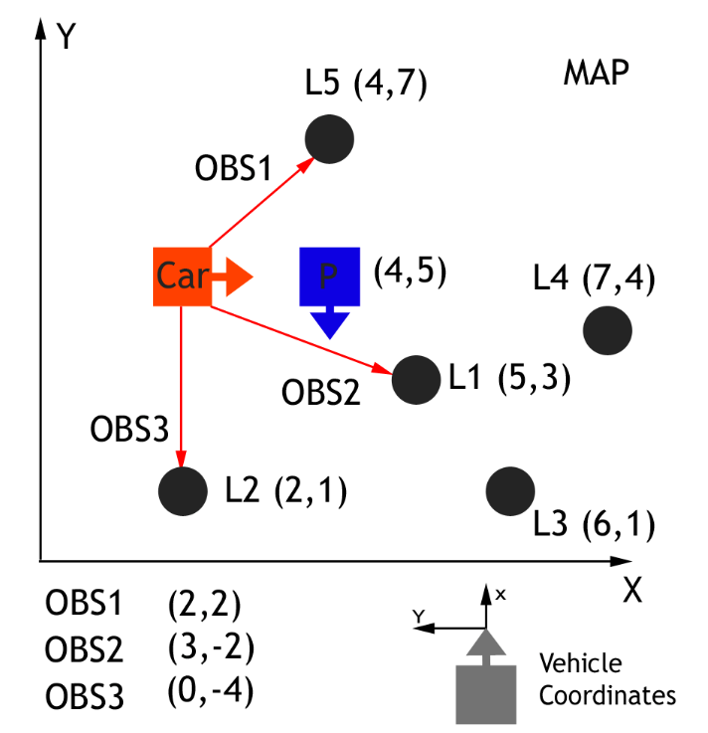
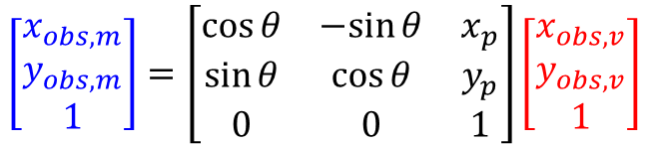
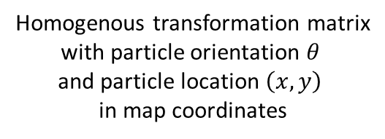
Homogenous transformation matrix
with particle orientation $θ$
and particle location $\left(x,y\right)$
in map coordinates
OBS1
OBS3
$$\left[\begin{matrix}x_{obs, m} \\ y_{obs,m} \\ 1\end{matrix}\right]=\left[\begin{matrix}\cos{θ} & −sin{θ} & x_{p} \\ \sin{θ} & \cos{θ} & y_{p} \\ 0 & 0 & 1\end{matrix}\right]\left[\begin{matrix}x_{obs,v} \\ y_{obs, v} \\ 1\end{matrix}\right]$$
OBS1
OBS3
OBS2
observation in
map coordinates
observation in
vehicle coordinates
OBS2

