Slide 1

NERVE
An AI conversation gym
Helping young adults speak with confidence in dating and job interviews.
Pabath Wedamuhandirama
hellonerve.com
Notes:
Company and founder details from the OpenVC dashboard screenshot supplied by the user. The one-sentence description reflects docs/PRODUCT.md and the current product code.

Slide 2
NERVE
02
The problem
The conversations that matter most are the hardest to rehearse.
A first date or job interview changes with every answer. Practice alone cannot reproduce hesitation, interruption, or rejection.
NERVE STARTS WITH REALISTIC VOICE PRACTICE
Notes:
Nerve positioning and product hypothesis from docs/NERVE-SPEC.md and app/page.tsx. This is a customer problem statement, not a quantified prevalence claim.

Slide 3
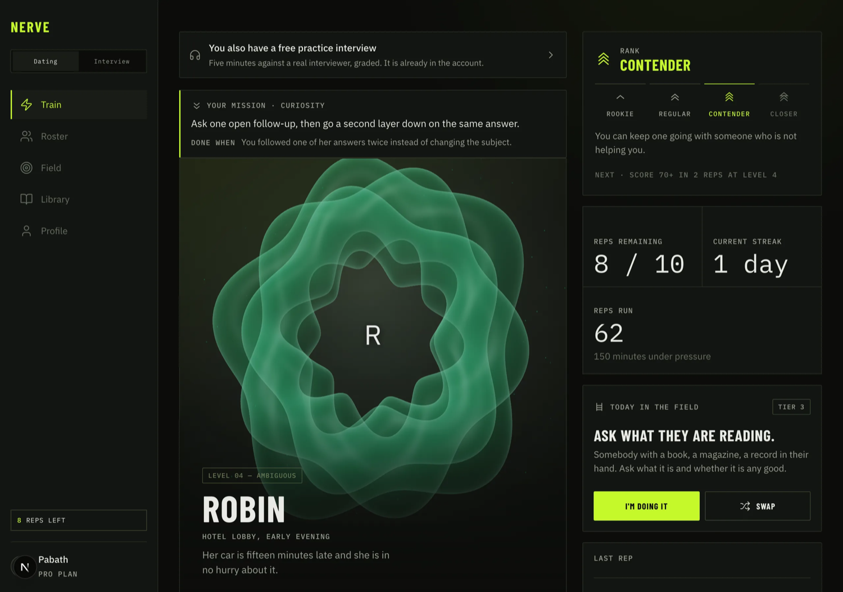
NERVE
03
A conversation gym
VOICE REPS
Speak out loud with an AI character who responds in the moment.
The dating rep lasts three minutes. The character can lose interest, get distracted, or say no.
Notes:
Product behavior from docs/PRODUCT.md. Screenshot: public/shots/train.webp, a product UI image in the repository. UI values shown in the screenshot are demonstration content and are not traction.

Slide 4
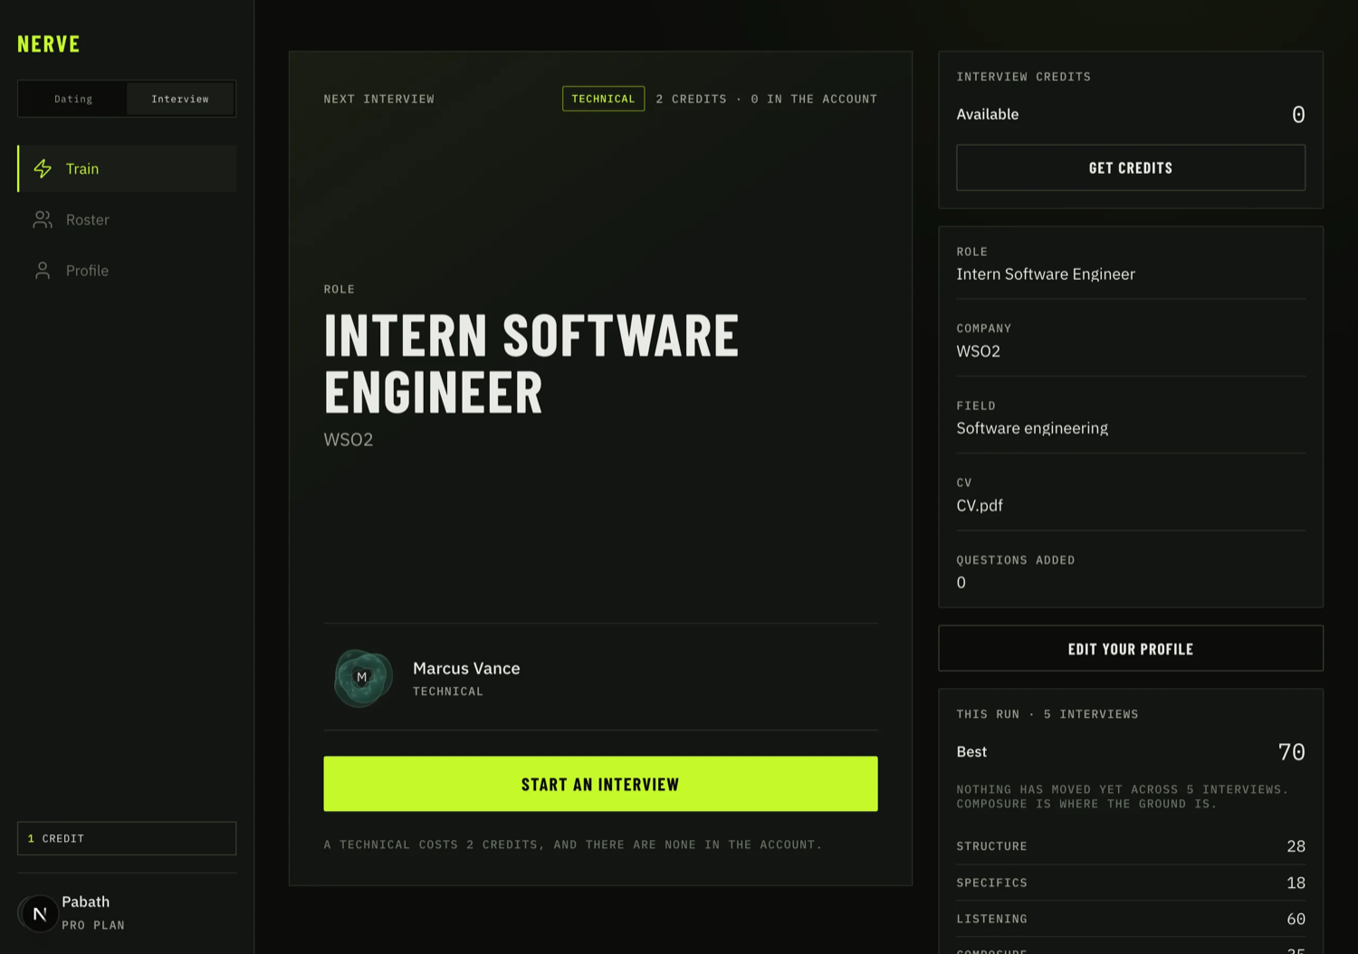
NERVE
04
Interview practice
SECOND USE CASE
Candidates practice with an interviewer who has read their CV and role.
Rounds run 5 to 25 minutes. Technical rounds can assess answer accuracy as well as delivery.
Notes:
Interview features and pricing from docs/PRODUCT.md and app/interviews/page.tsx. Screenshot: public/shots/interview-home.webp, a product UI image in the repository. Screenshot fields are illustrative product content, not customer data.

Slide 5
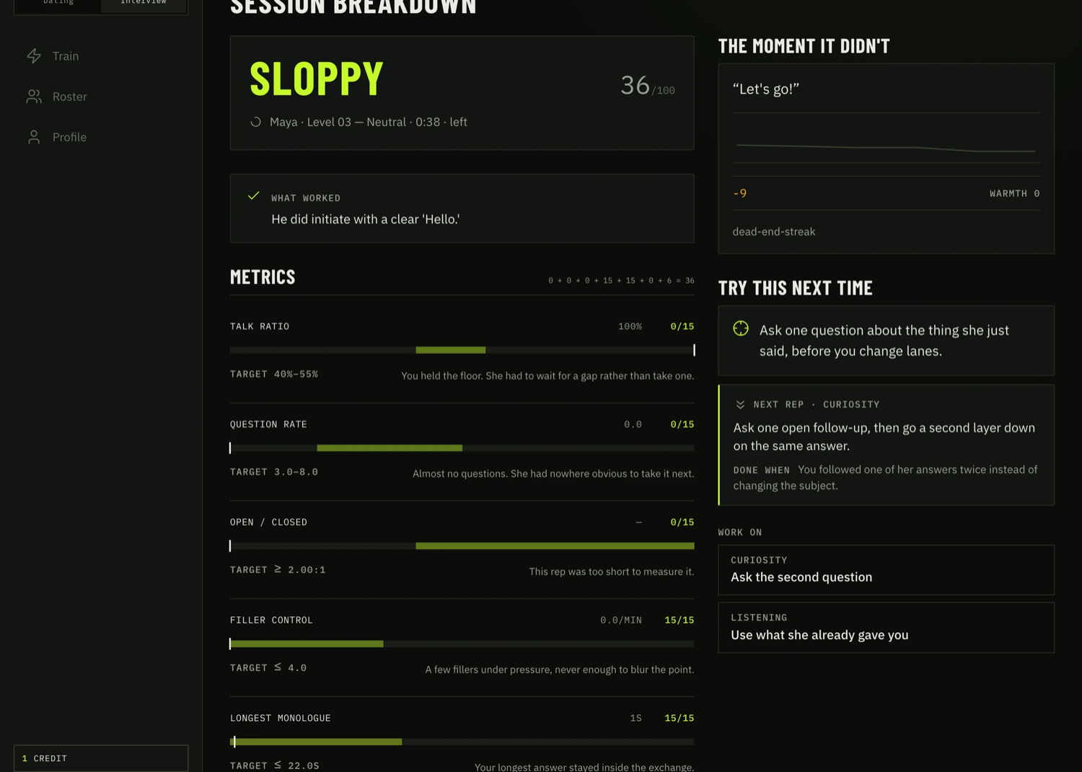
NERVE
05
Feedback on what users can improve
AFTER EACH REP
A scorecard identifies the moment the conversation changed.
Nerve grades how the user spoke, including questions, listening, and composure. A rejection can still be a strong rep.
Notes:
Scoring behavior from docs/PRODUCT.md, sections on dating and interview tracks. Screenshot: public/shots/scorecard.webp, a product UI image in the repository. Screenshot score is illustrative UI content.

Slide 6
NERVE
06
The practice loop
01
Voice rep
A timed conversation creates a real attempt.
02
Scorecard
The user sees one concrete behavior to improve.
03
Next mission
The next rep targets that behavior.
04
Real-world challenge
The user tries the skill outside the app and logs what happened.
Notes:
Current product loop synthesized from docs/PRODUCT.md and docs/RETENTION-AUDIT.md. No outcome or retention rate is claimed.

Slide 7
NERVE
07
Business model
SUBSCRIPTION VOICE PRACTICE
INTERVIEW PACKS
$19
Pro / month
$6 / $20 / $45
3 dating voice reps per day
2, 8, or 20 one-time credits
$49
Elite / month
Every account starts with one free dating rep and a five-minute interview screener.
6 dating voice reps per day
Notes:
Pricing from docs/PRODUCT.md and docs/LAUNCH-GAP.md D18-D19, checked against app/pricing/page.tsx and lib/billing/plans.ts. Prices are current repository configuration as inspected 12 Sep 2026, not a claim about revenue.

Slide 8
NERVE
08
Early evidence
89
0 / 42
dating sessions
visit-to-account conversions
Across 17 user accounts in an internal product audit.
TikTok and Meta visits, 4–10 Sep. The sign-up flow was then instrumented and changed.
These are learning signals, not proof of repeat paid demand.
Notes:
Internal product snapshot: docs/INTERVIEW-PLAN.md §15 and docs/LAUNCH-GAP.md D21. 89 sessions across 17 users at the 7 Sep 2026 track-filter audit; 42 visits from TikTok and Meta from 4–10 Sep with 0 new accounts. These figures are dated, include possible tests, and do not establish retention, paying conversion, or product-market fit.

Slide 9
NERVE
09
Customer focus
ENTRY SEGMENT
ADJACENT SEGMENT
Young adults who avoid starting conversations
Candidates preparing for early career interviews
The dating track offers short, repeatable practice and a real-world challenge.
The interview track adds rounds tailored to a CV and a one-time credit purchase.
Notes:
Customer segments are Nerve’s current product positioning in docs/PRODUCT.md and docs/MARKETING-PLAN.md. This slide intentionally makes no quantified TAM claim because no defensible bottom-up market estimate was available in the supplied materials.

Slide 10
NERVE
10
Go-to-market test
US LAUNCH EXPERIMENT
Short-form content
Creator referrals
Show one recognizable conversation mistake and the rep that corrects it.
Test small paid creators while measuring each step from visit to first rep and purchase.
The planned 60-day budget is $340. The decision metric is paid, repeat use.
Notes:
Proposed 60-day US launch plan and $340 budget from docs/MARKETING-PLAN.md. The /start funnel instrumentation shipped 11 Sep 2026 per docs/LAUNCH-GAP.md D21. The plan is a test, not achieved traction.

Slide 11
NERVE
11
Founder
Pabath
Wedamuhandirama
Solo founder based in Sri Lanka
Nerve is live with voice reps, scorecards, billing, and an interview track.
Notes:
Founder name, team size and Sri Lanka location from the supplied OpenVC dashboard screenshot. Product status from docs/PRODUCT.md. No education, work history, or unsupported personal credentials are claimed.

Slide 12
NERVE
12
The ask
Raising $100k
Capital to test whether voice practice becomes repeat paid behavior.
MILESTONES FOR THIS ROUND
Validate the acquisition funnel. Prove paid conversion and retention. Improve voice quality and reliability with real users.
Notes:
Raise target of $100k from the user-supplied OpenVC dashboard screenshot. Milestones are a proposed use-of-funds framework, not a representation of an approved budget or guaranteed outcome.

