Slide 1
IBM COURSE: APPLIED DATA SCIENCE CAPSTONE
Peer-graded Assignment: Capstone Project - The Battle of Neighborhoods (Week 5)

Slide 2
I. INTRODUCTION
Question: Introduction where you discuss the business problem and who would be interested in this project.
The problem that want to be addressed with such work is to measure the attractiveness of the City of Melbourn, Australia in terms of facilities (parks, cafes,…), in particular in the Northern part of the city.
Such work could be in the interest of those who are looking for an apartment in such area, to understand whether it satisfy their needs.

Slide 3
II. DATA DESCRIPTION
Question: Data where you describe the data that will be used to solve the problem and the source of the data.
The data that are going to be used are mainly the postcodes and the median house sales price in the state of Victoria (VIC), Australia. Such data are already well structured and clean, this is the reason why I have choosen to perform this work on such area.
https://www.matthewproctor.com/full_australian_postcodes_vic
https://www.data.vic.gov.au

Slide 4
III. METHODOLOGY
Question: Methodology section which represents the main component of the report where you discuss and describe any exploratory data analysis that you did, any inferential statistical testing that you performed, if any, and what machine learnings were used and why.
To measure the attractiveness of the Northern part of Melbourne have been analysed different attribute of the Suburb: number of cafes, parks, avg price, distance.
In order to do this the following step have been done:
1. Serach of the abovementioned data from which start the analysis
2. Ensure that data where enough and consistent to allow the analysis
3. Clean the data and structure (fliter and sort) in order to allow to be used for the analysis on the basis of the abovementioned attribute (cafes and parks)
4. Scrape the data in order to analyse the location. This has been done thanks to Foursquare API
5. Group the data. This has been done thanks to k-means
6. Analysis of the identified groups in terms of house price and distance.
7. Identify the best group

Slide 5
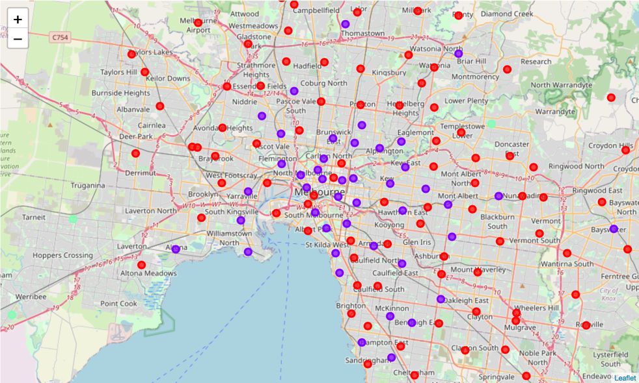
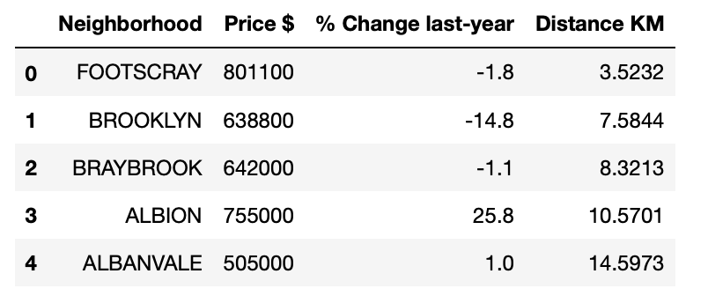
RESULTS
Question: Results section where you discuss the results.

