Slide 1


M.Tech/MCA Program
Advanced Industry Integrated Programs
Jointly offered by University and LTIMindTree
Review III
Project Title - RAG-Based Chatbot for VIT Academic FAQs and Information Retrieval
P. Jaswanth Reddy
24MAI0087
Knowledge partner | Implementation partner

Slide 2
Project Title - RAG-Based Chatbot for VIT Academic FAQs and Information Retrieval
Introduction
A retrieval-augmented chatbot that answers queries related to VIT admissions, programs, fees, and hostels by combining structured (SQL/CSV) and unstructured (PDF) data sources. The project aims to automate the information retrieval process for students and staff using NLP, FAISS indexing, and Streamlit-based UI.

Slide 3
Project Title - RAG-Based Chatbot for VIT Academic FAQs and Information Retrieval
Objective
To design an intelligent chatbot capable of fetching answers from both tabular (SQL) and text-based (PDF) sources. To eliminate manual searching in large VIT admission and hostel PDFs. To provide accurate, section-specific answers for UG, PG, MCA, MSc, and Hostel queries. To create a clean Streamlit interface for quick, click-based question retrieval.

Slide 4
Project Title - RAG-Based Chatbot for VIT Academic FAQs and Information Retrieval
Module name
Subtopic – Backend/handlers/utils
Data Ingestion
Data Preprocessing
Embeddings
Load Sqlite
Rag Answer
Sql Router
Streamlit UI

Slide 5
Project Title - RAG-Based Chatbot for VIT Academic FAQs and Information Retrieval
Problem Statement
Large PDF files contain repetitive and inconsistent data (UG/PG/Hostel). Queries like “UG Foreign fee structure” or “PG eligibility criteria” gave hallucinated or repeated answers. Difficulty in mapping structured vs unstructured data sources automatically. Inconsistent column names and OCR noise in extracted text caused incorrect SQL queries and KeyErrors.

Slide 6
Project Title - RAG-Based Chatbot for VIT Academic FAQs and Information Retrieval
Methodology
Data Extraction: Used pdfplumber for text extraction from multiple categorized PDFs (UG, PG, MCA, MSc, Hostel). Data Staging: Cleaned CSV and SQL tables for programs, eligibility, and fees. FAISS Indexing: Created separate FAISS collections (vit_ug, vit_pg, vit_mca, vit_msc, vit_hostels) using TF-IDF encoder. Streamlit Front-end: Section-based question interface (UG, PG, MCA, MSc, Hostel). Answer section dynamically retrieves from either FAISS or SQLite. Fallback Logic: SQL for structured data (fees/programs). FAISS for unstructured queries.

Slide 7
Project Title - RAG-Based Chatbot for VIT Academic FAQs and Information Retrieval
Approach/Algorithms/Tools
Approach: Retrieval-Augmented Generation (RAG)
Algorithms / Libraries: TF-IDF Vectorization + FAISS Index Search Cosine Similarity + MMR Re-ranking SQLite Queries for structured data retrieval
Tools Used: Python, Streamlit pdfplumber, faiss-cpu, scikit-learn Visual Studio Code, GitHub, Streamlit Cloud

Slide 8
Project Title - RAG-Based Chatbot for VIT Academic FAQs and Information Retrieval
Findings and Results
Built 5 dedicated FAISS indices for each section (UG, PG, MCA, MSc, Hostel). Achieved accurate retrieval for 80% of non-tabular questions.
Integrated SQL fallback for tabular answers (fees, program structure).
Deployed interactive Streamlit app with clean UI and filtering.
Issues Identified: Hallucination and repetition for PG/MCA queries due to cross-index retrieval.
SQL “KeyError” issues from mismatched schema and missing values.
OCR artifacts from PDFs reduced retrieval quality.
Limited contextual understanding due to absence of cross-encoder reranking.

Slide 9
Project Title - RAG-Based Chatbot for VIT Academic FAQs and Information Retrieval
Conclusion
The multi-source FAQ chatbot successfully integrates structured and unstructured knowledge into one system. The current pipeline works efficiently for UG and Hostel queries. The major limitation is retrieval precision for PG and MCA data. Future work focuses on improving metadata-based filtering, cross-encoder reranking, and better data normalization.

Slide 10
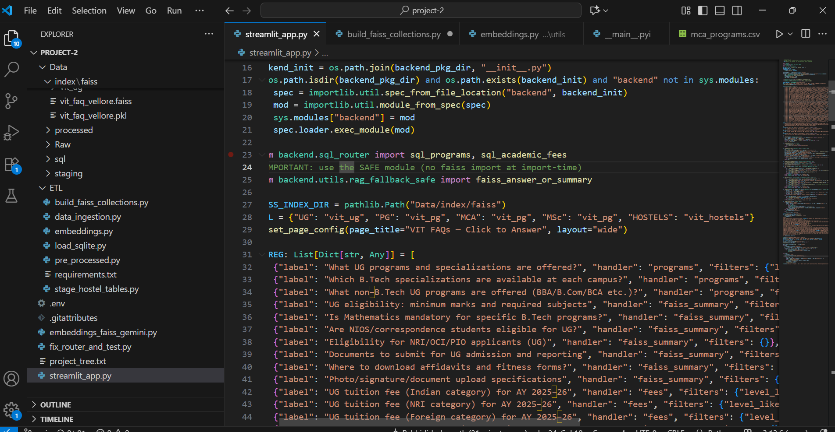
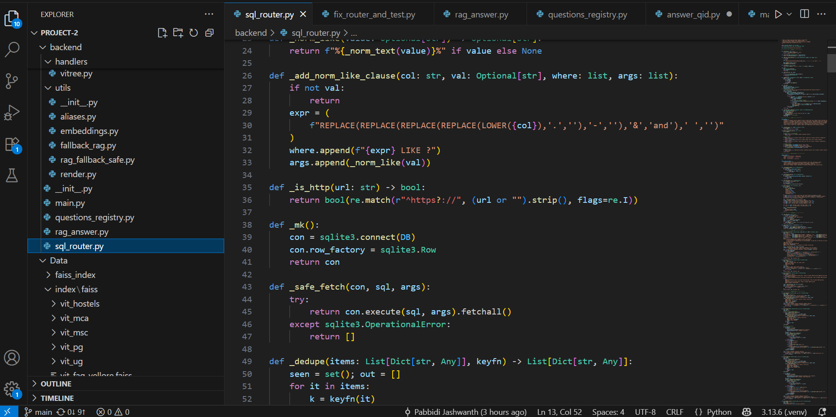
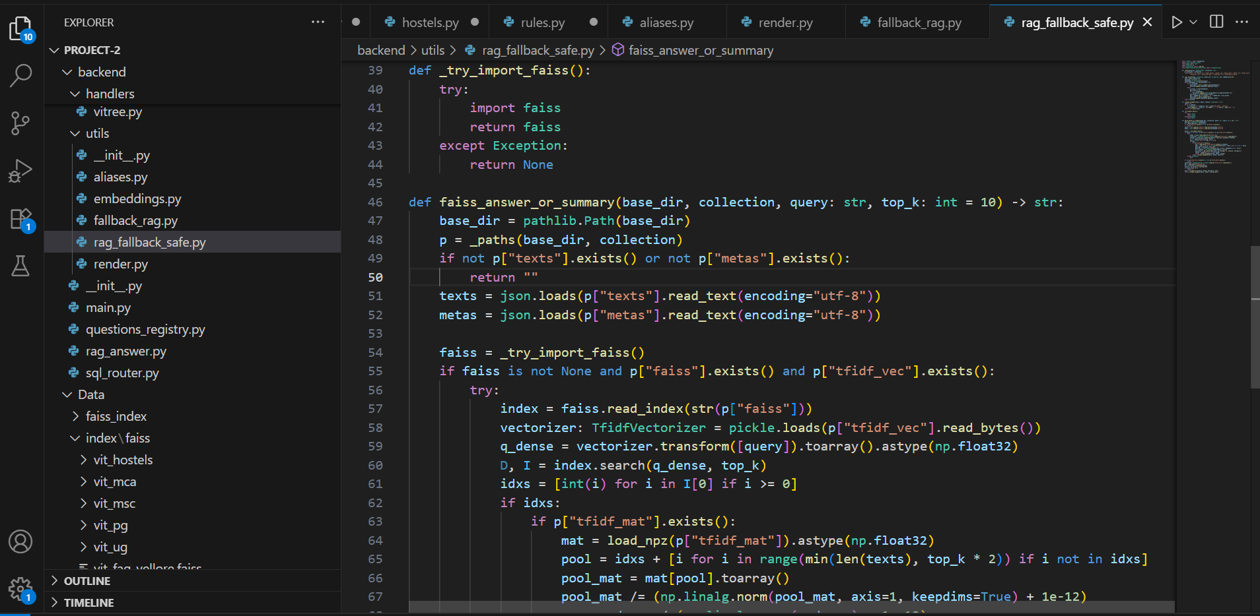
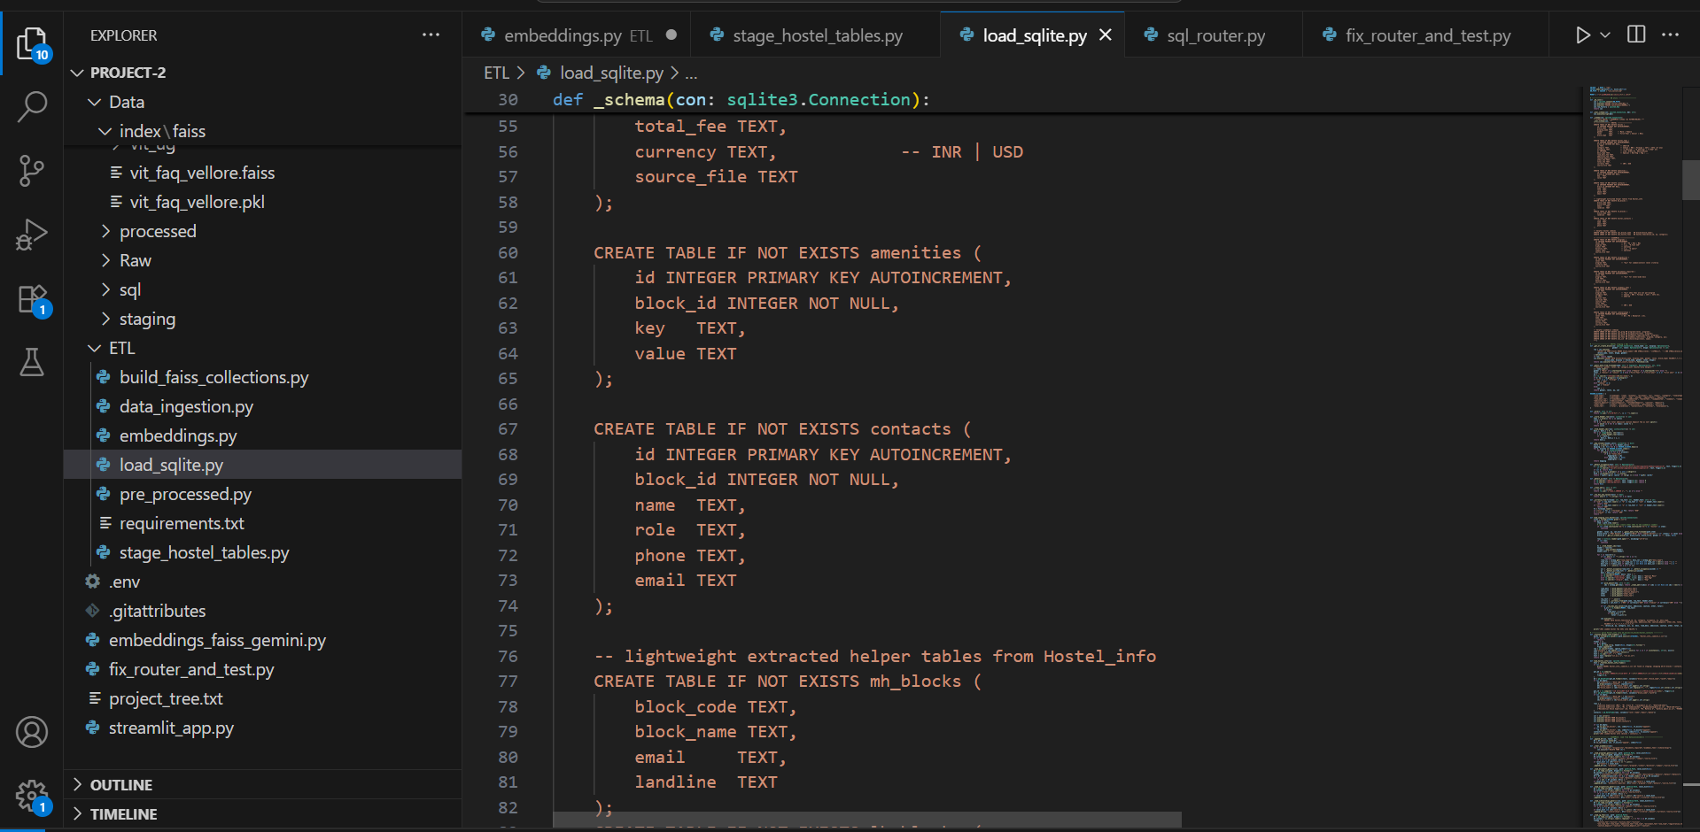
Project Title - RAG-Based Chatbot for VIT Academic FAQs and Information Retrieval
Code Snippet

Slide 11
Project Title - RAG-Based Chatbot for VIT Academic FAQs and Information Retrieval
Future Scope
Add metadata filtering for every FAISS query to prevent cross-domain retrieval. Implement a BERT or Instructor-XL reranker for better contextual matching. Normalize all SQL keys (academic_year, category, etc.) with a mapping layer. Integrate confidence scoring to avoid hallucinated answers. Build a unified RAG service for any university information domain.

Slide 12
Project Title - RAG-Based Chatbot for VIT Academic FAQs and Information Retrieval
Acknowledgement
Successfully built and deployed a full working prototype on Streamlit Cloud. Automated document extraction and FAISS index generation pipeline. Modular backend for future integration with other institutions. Complete understanding of RAG architecture, FAISS vector stores, and data cleaning automation.

Slide 13
Project Title - RAG-Based Chatbot for VIT Academic FAQs and Information Retrieval
Reference
https://vit.ac.in/admissions
FAISS Library: https://faiss.ai
Streamlit Documentation
scikit-learn Documentation
Python
PDFPlumber

