Slide 1
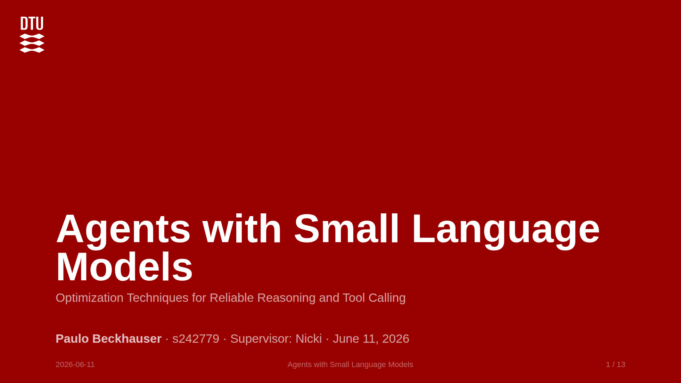
Notes:
20-25 min, roughly one minute per slide. Opening: "Thank you all for being here. My thesis asks whether a small language model, the kind that runs on a single consumer GPU, can call tools reliably enough to replace an expensive frontier API for most requests. I tested seven optimization techniques across four model sizes to find out. The model size is not a footnote in this talk, it is the axis I will keep returning to." Keep background short. Spend the time on results and discussion.

Slide 2
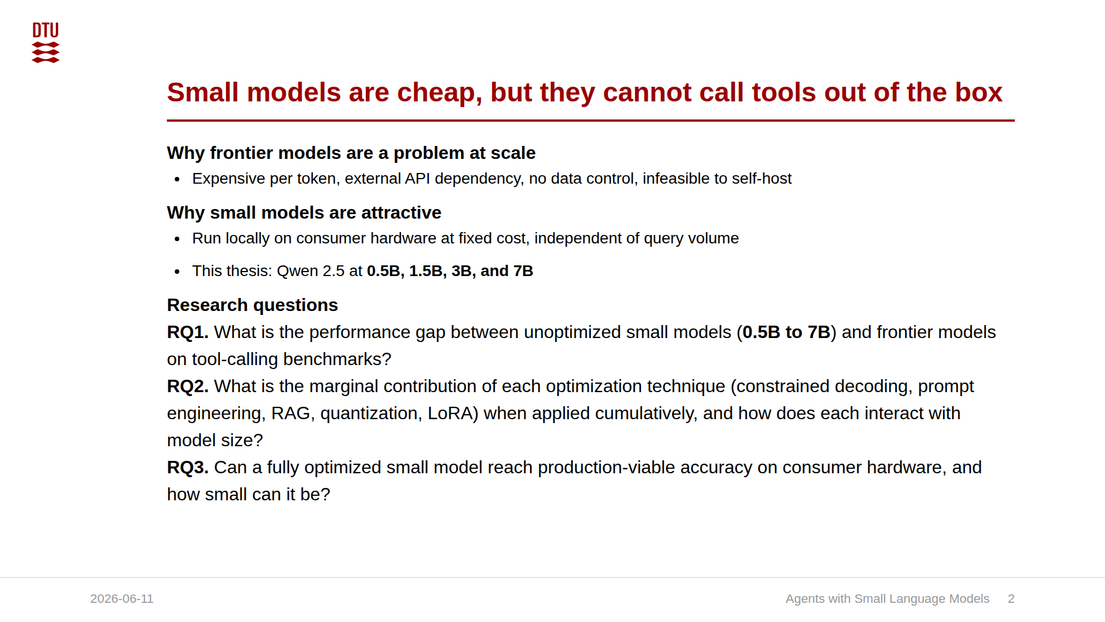
Notes:
The only motivation slide, deliberately. The advisor said not to dwell on motivation and background. Frame the size axis up front: the interesting question for a thesis titled "Small Language Models" is not just "can a 7B do it" but "how small can you go before it breaks." Every results slide answers that for one technique. Honest scoping to state: I evaluate the SLM tier in isolation. I do not build the router or the escalation logic. BFCL accuracy is my proxy for the fraction of requests the small model could handle.

Slide 3
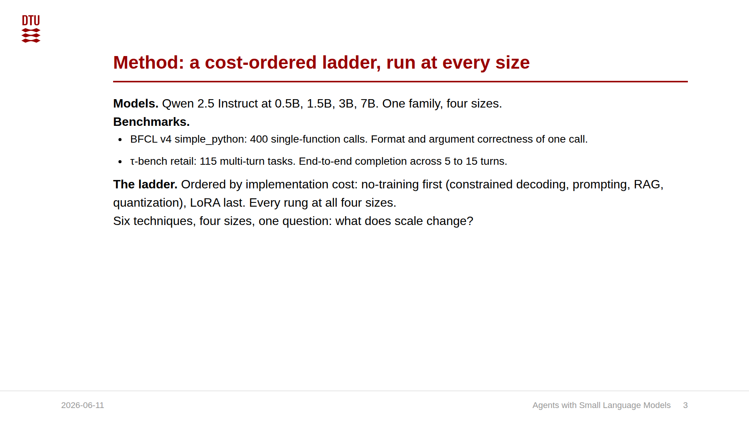
Notes:
Transition: "I will walk each technique across all four sizes. For every one, the interesting question is the same: does it help the small models, the large ones, all of them, or none?"

Slide 4
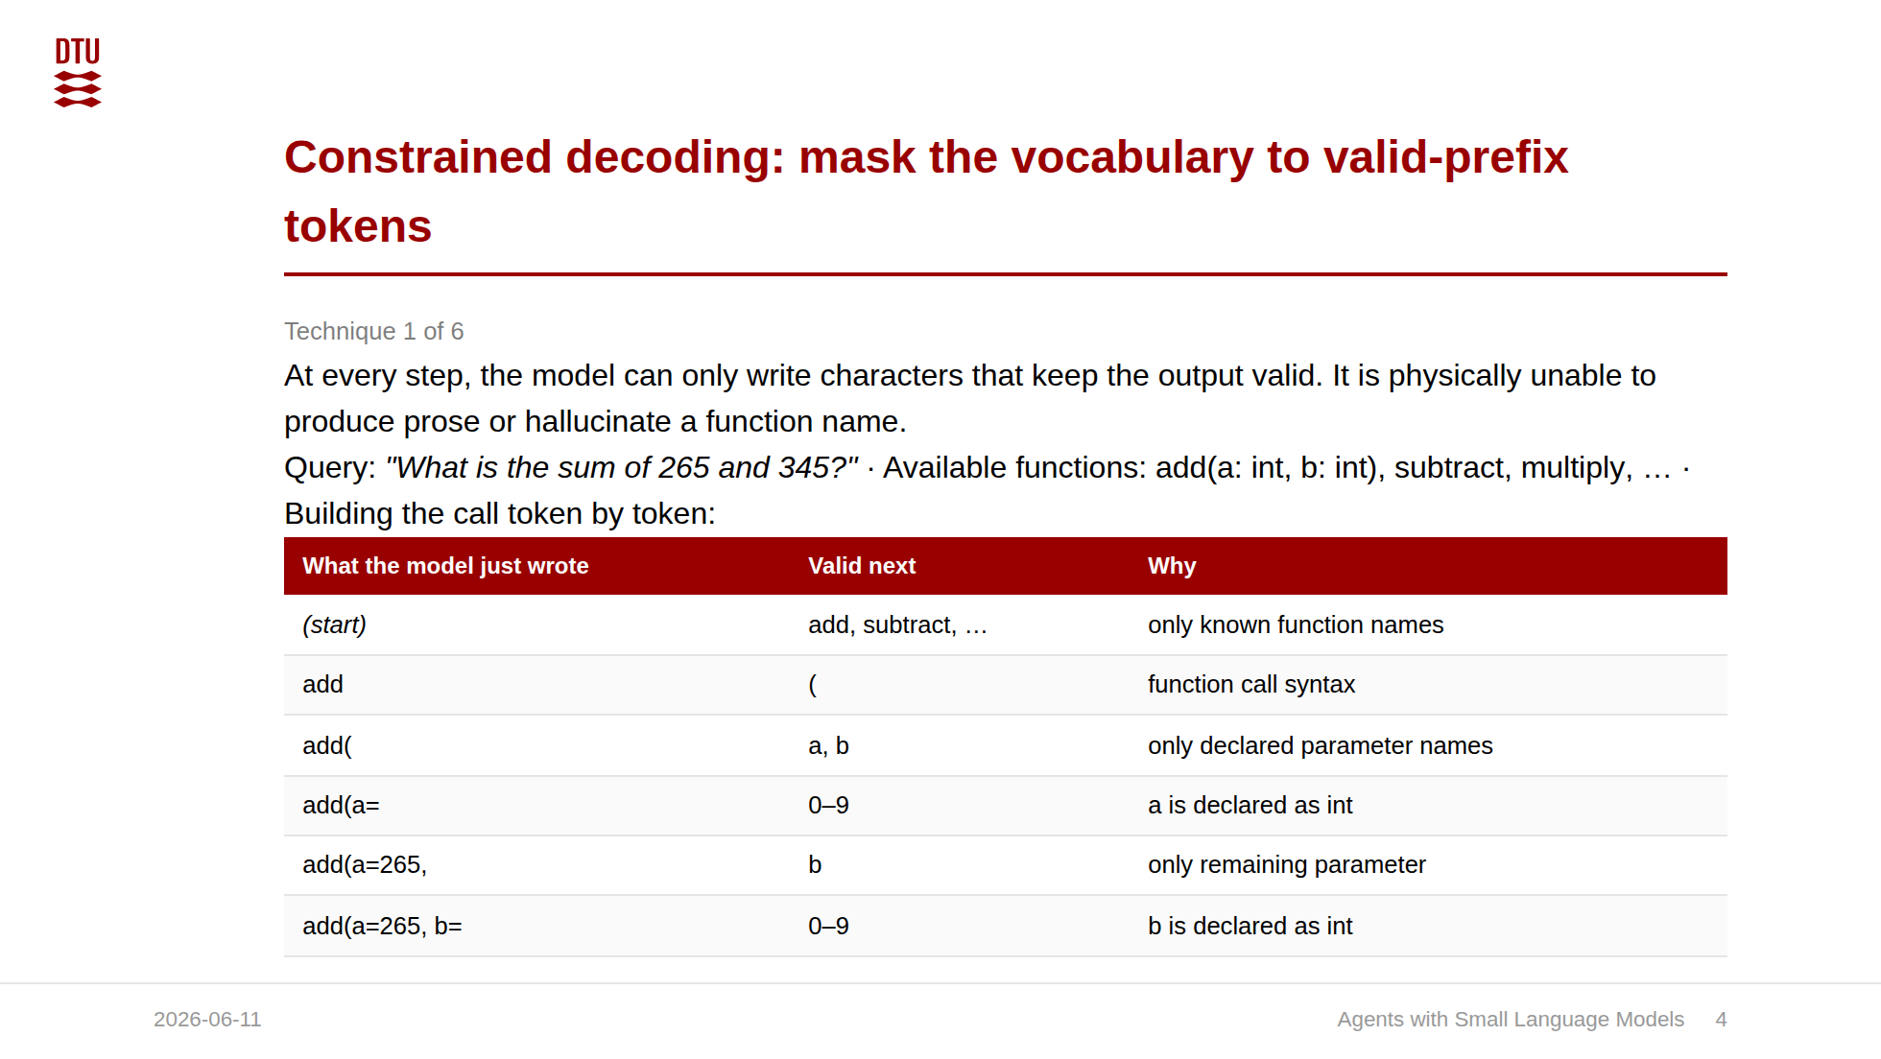
Notes:
Be precise here, because the thesis says the BFCL results are produced via vLLM's guided_choice and guided_json (Willard and Louf's FSM approach). I implemented my own decoder for the local llm_sdk backend, which is real engineering work and fine to mention, but the reported numbers come from the vLLM pipeline. Do not say the results come from a from-scratch decoder. Five steps if asked: run the model, get logits; set everything to minus infinity; unmask only valid-prefix tokens; argmax over survivors; append and repeat. The conceptual punchline, repeated next slide: structural errors become impossible, semantic errors remain possible. That is the heart of the thesis, and it is what makes the size story legible: CD removes the size-independent failure (format) and exposes the size-dependent one (values).

Slide 5
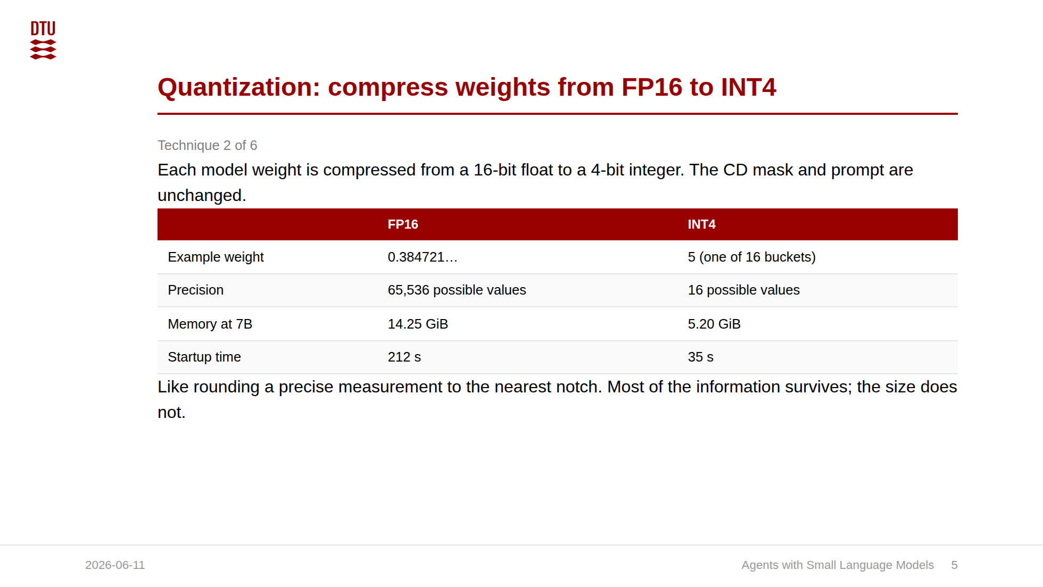
Notes:
The size story here is clean: quantization is free where you have parameters to spare and costs a few points where you do not. So the safe operating point is 3B and up. This makes the RQ3 "consumer hardware" claim concrete: the 7B at INT4 is 5.20 GiB, fits an RTX 4090 with room for the KV cache. Even the 0.5B and 1.5B quantized models run on far weaker hardware. The tradeoff: at 0.5B you pay 3.75 pp for 4x memory savings, still acceptable if memory is the binding constraint.

Slide 6
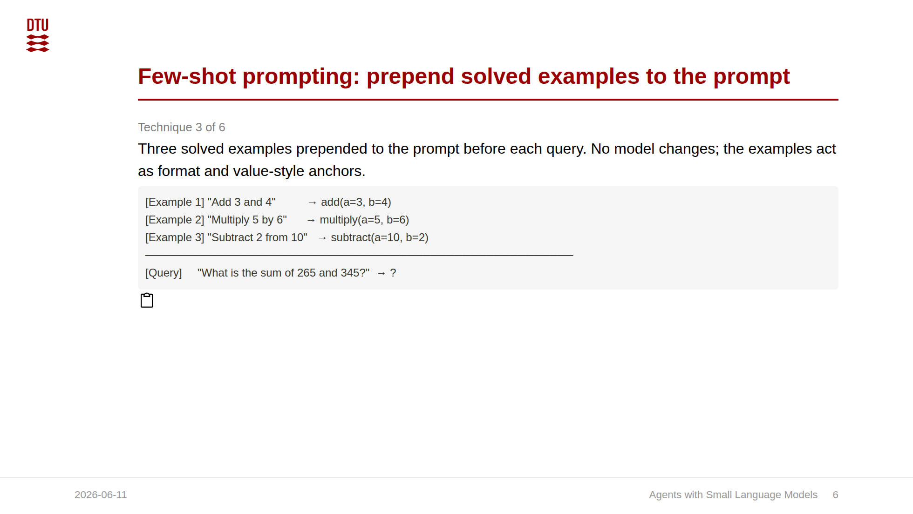
Notes:
This is the cleanest size-interaction result in the thesis, and it is exactly the kind of finding you only see by sweeping sizes. If I had tested 7B alone I would have concluded "few-shot hurts." If I had tested 0.5B alone I would have concluded "few-shot helps." Both are wrong as general statements. The truth is it reverses. Mechanism: few-shot teaches format and value style. Small models still need that hint. The 7B does not, so the examples are pure context noise.

Slide 7
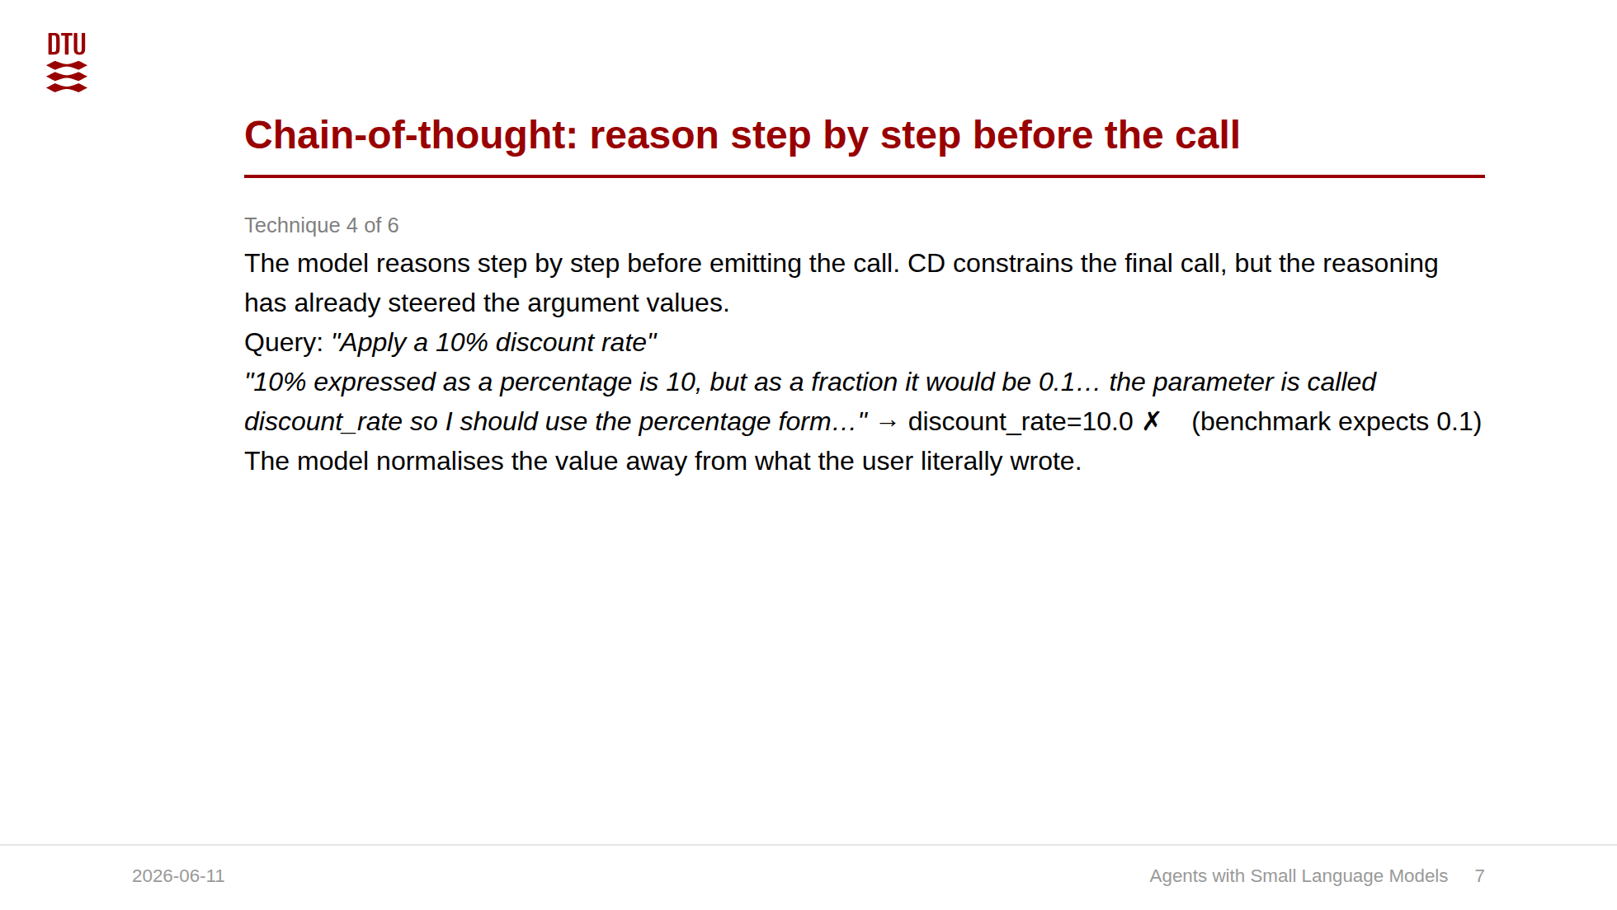
Notes:
The size story: unlike few-shot, CoT hurts uniformly. The penalty is flat across the range. So this is not "small models are too weak to reason," it is "explicit reasoning points compute at the wrong subproblem regardless of size." The flips are intuitive: when the model thinks, it normalizes. It knows discount rates are percentages, dates should be ISO, gas is short for gasoline. So it converts. The benchmark wants the literal query value. Connects to Wei et al: CoT helps multi-step arithmetic and symbolic decomposition. Argument extraction is value recall, not that kind of reasoning.

Slide 8
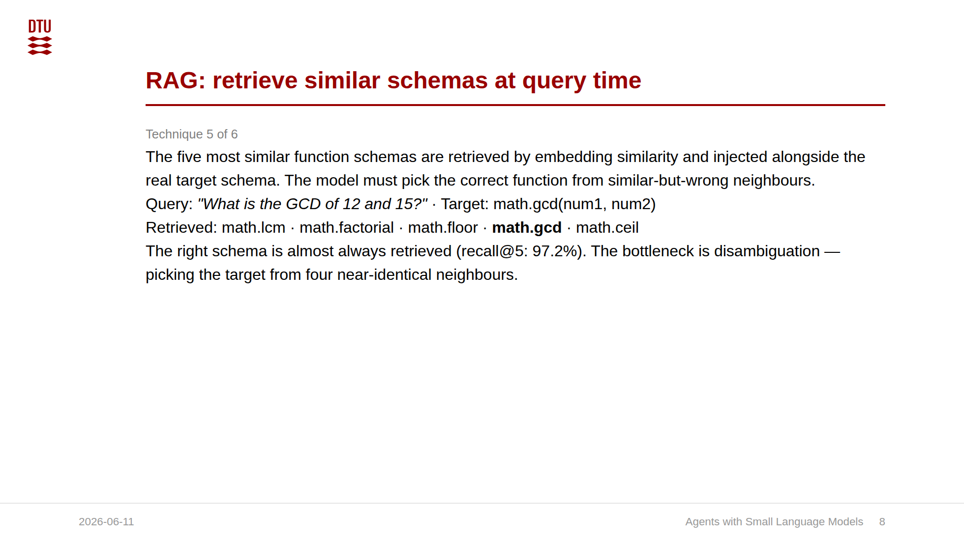
Notes:
The counterintuitive result: retrieval works (97.2% recall), but feeding the model near-miss schemas confuses it. "Similar" and "correct" are nearly identical here, so the distractors are maximally adversarial. The size message is the important one for the scaling thesis: disambiguation is a capability that does NOT come with parameters. A bigger model does not rescue you. That is why the fix is architectural (re-ranking, or training-time retrieval like Gorilla), not "use a larger model." 66% of RAG failures produce the identical answer as the non-RAG run, so retrieval mostly adds overhead.

Slide 9
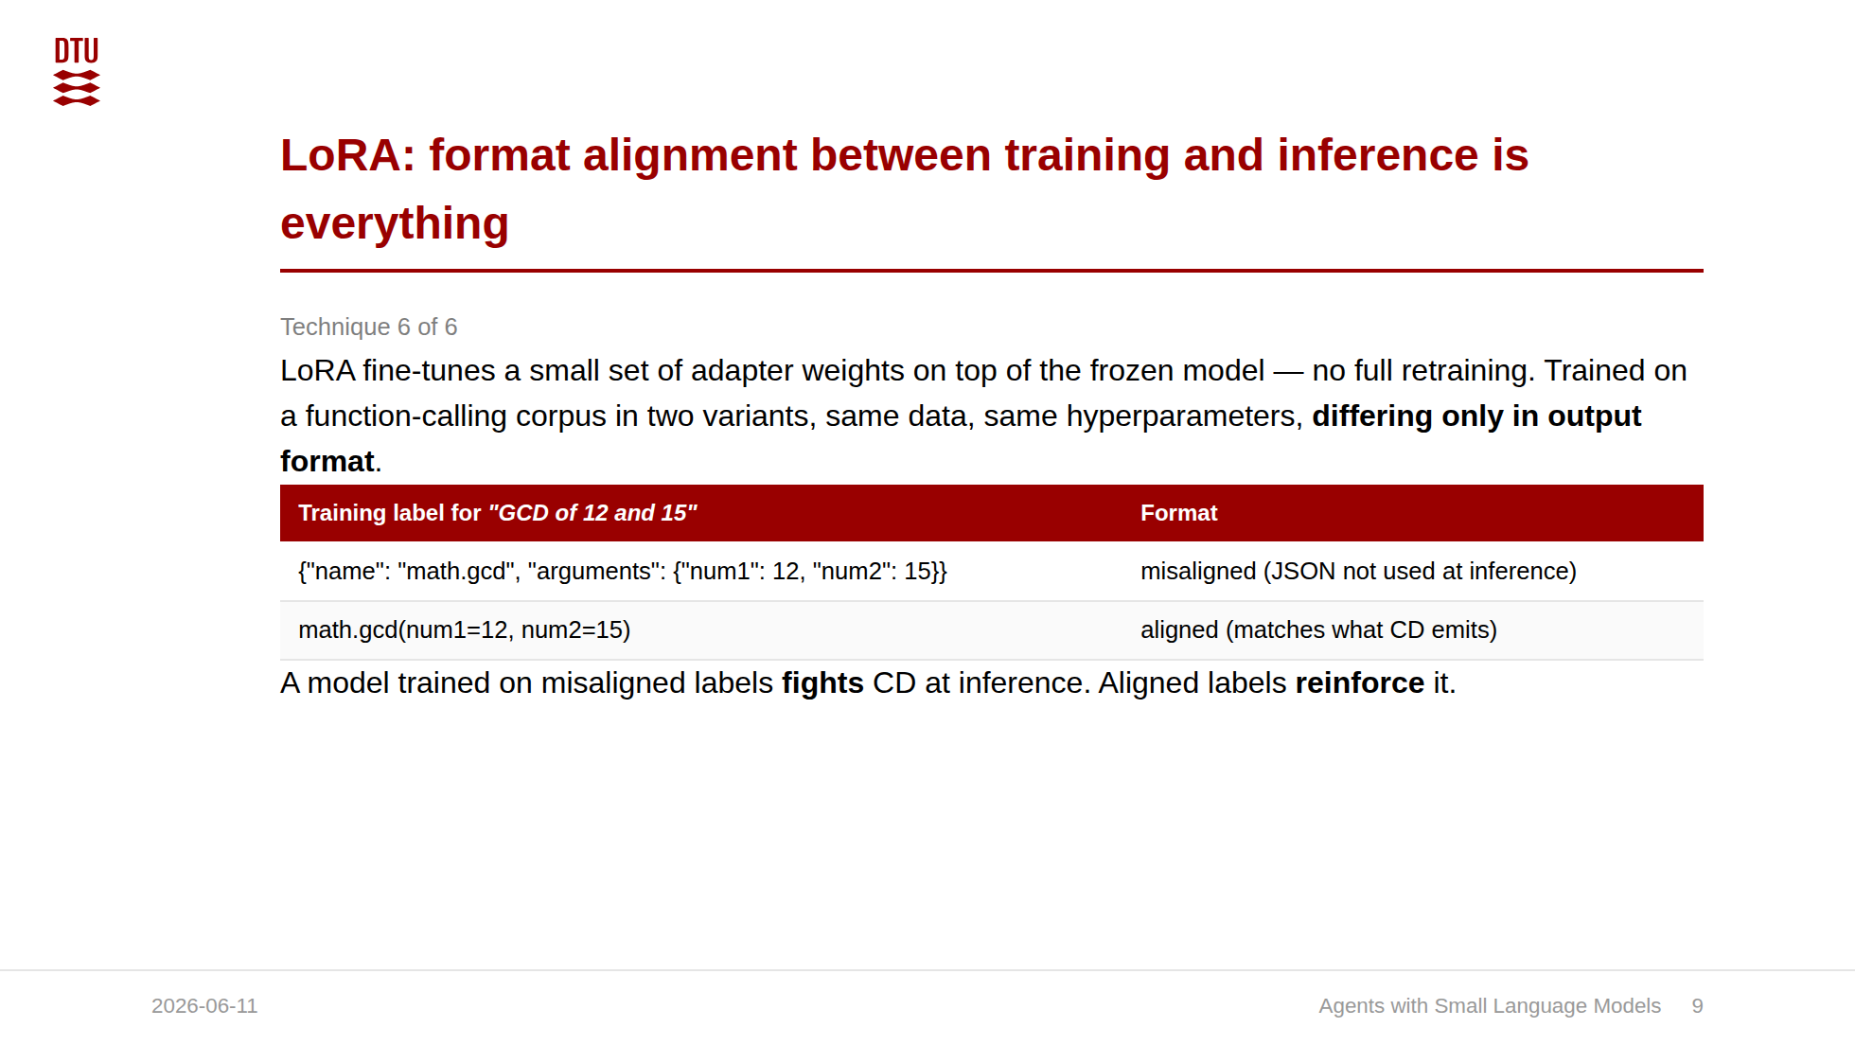
Notes:
The finding I am proudest of, because it turned a failure into a confirmed hypothesis. The first LoRA run regressed 3 pp under CD. Rather than concluding "fine-tuning does not help," I diagnosed it: the xlam training data encodes calls as Python syntax, my pipeline expects a JSON argument object. Format mismatch. I reformatted the labels to match inference exactly and re-ran. That one change moved the result 7 pp. Generalizes Gorilla: they showed content relevance matters in training data. I show output-format compatibility matters just as much.

Slide 10
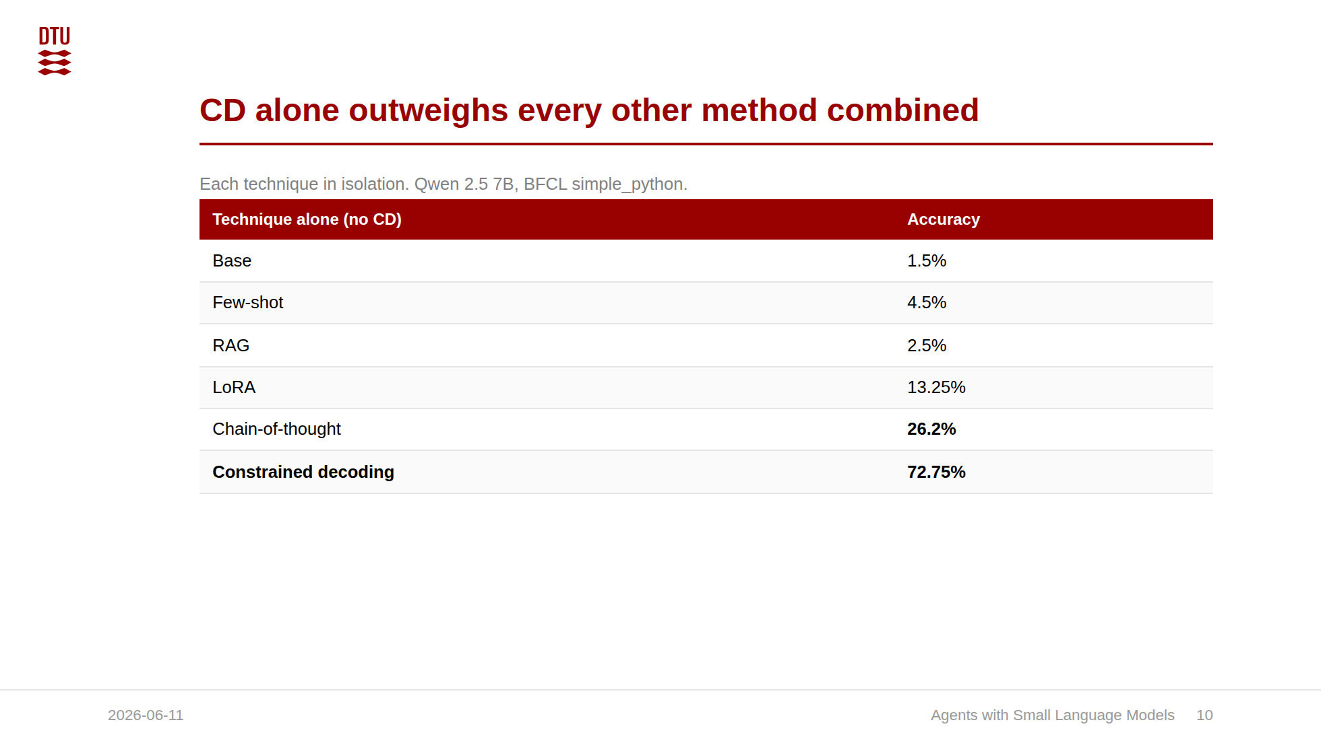
Notes:
This slide is the direct answer to "what is each technique worth on its own," which is the heart of RQ2 and exactly the isolation a censor wants to see. The story: format compliance dominates so completely that running a method alone barely moves the needle. Few-shot (+3) and RAG (+1) are essentially noise. The one surprise is CoT at 26.2%: thinking step by step before answering accidentally produces more consistently formatted JSON, a self-scaffolding effect. But even that is 46 pp below CD alone. This reframes the whole ablation: it is not that the other techniques are bad, it is that CD solves the problem that dominates, and once you measure each one alone you see just how much of the accuracy is pure format compliance. Decomposition I can offer verbally if pushed: adding CD on top of each technique recovers +65.75 pp (few-shot), +45.25 pp (RAG), +39.3 pp (CoT). CD's marginal contribution is smallest on top of CoT, because CoT already supplied partial format scaffolding. This is in the thesis: Section 4.2.5 (Technique Isolation Without Constrained Decoding), Table 4.3 (isolation accuracies) and Table 4.4 (CD contribution decomposition). The three prompt-level no-CD runs are framed there as supplementary controls, separate from the eleven-config ladder, run to isolate CD's marginal contribution.

Slide 11
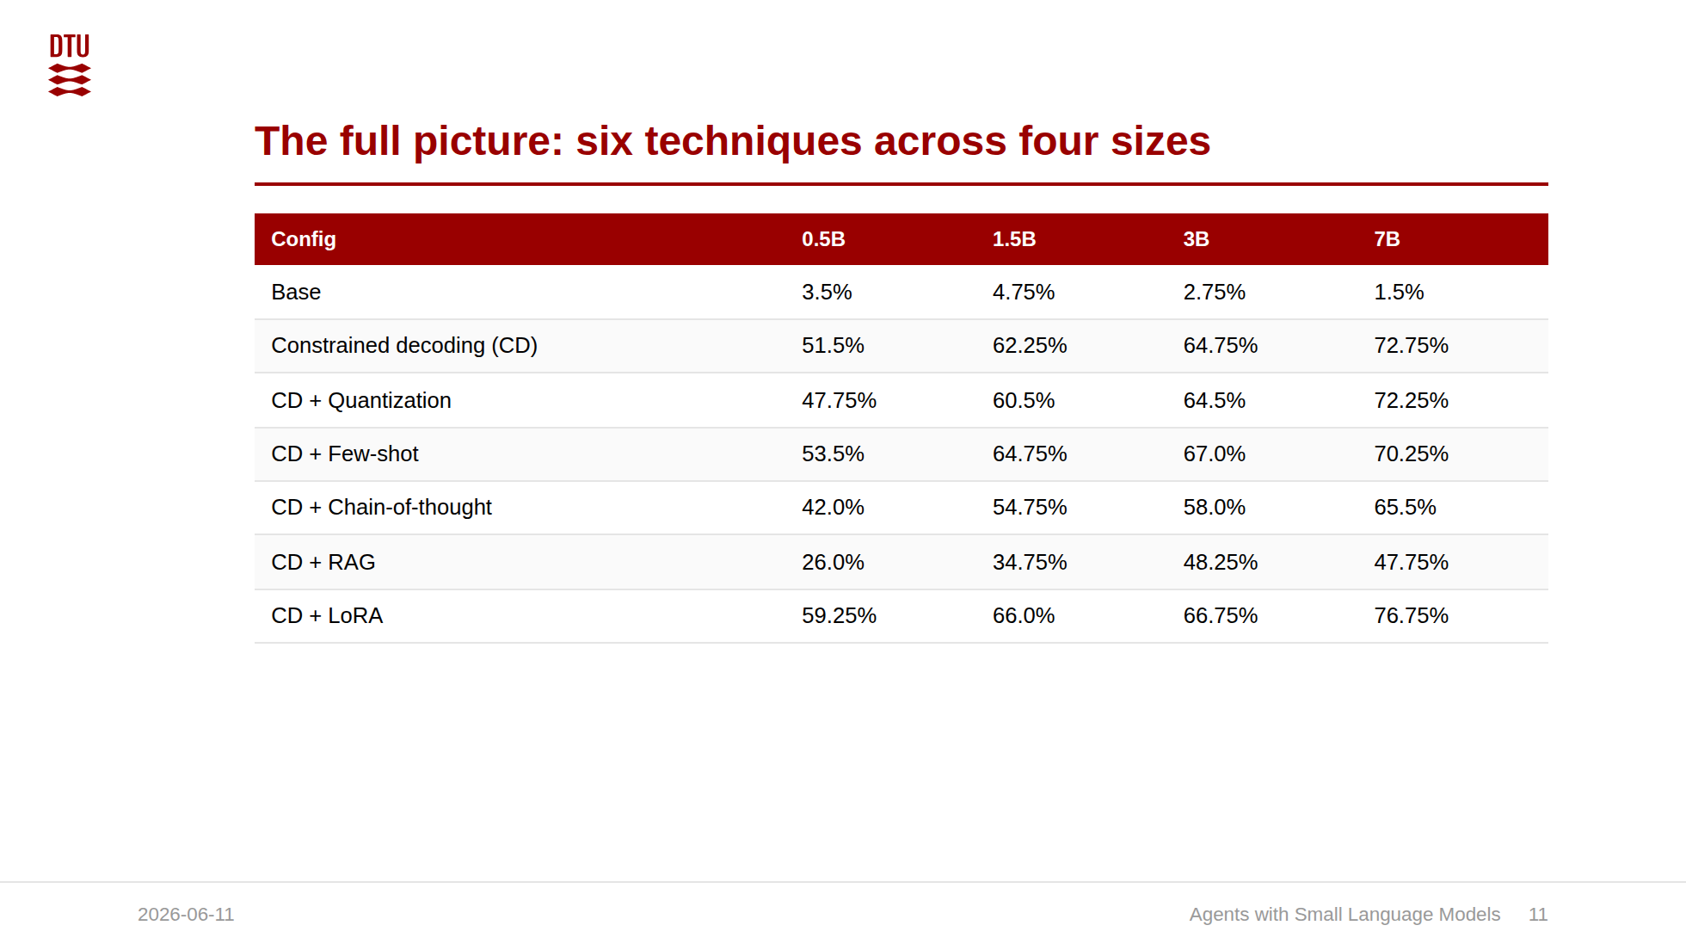
Notes:
The synthesis slide. Pause here and let them read the matrix. The story in one breath: constrained decoding does almost everything at every size; quantization is free where parameters are plentiful; few-shot helps the small and hurts the large; CoT and RAG hurt across the board; only fine-tuning on correctly-formatted examples pushes past CD, and it does so everywhere. This matrix IS the size-sweep contribution. It is the densest slide; do not read every cell, point at the bold bottom row and the columns. The matrix shows every technique on top of CD. The next slide shows the complement: each technique run alone without CD, at 7B, which is how I isolated each one's own contribution. Together they answer RQ2 from both directions.

Slide 12
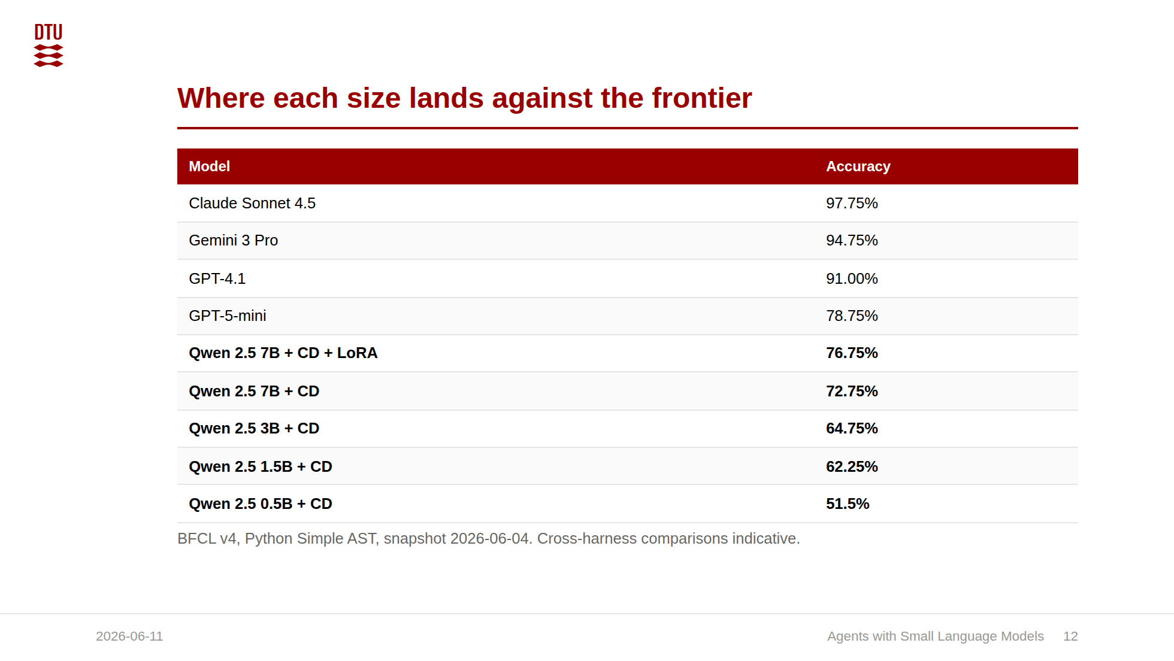
Notes:
Schema enrichment reaches 89.0%: above GPT-5-mini, 2 pp below GPT-4.1. The B-template control (96.00%) confirms the gap is integration quality, not model capability. This is the answer to RQ1 and RQ3, and the size axis makes it far more interesting than a single 7B number. I am placing every SLM size in the frontier ranking, so the audience sees the whole spectrum: 0.5B far below frontier, 7B with CD+schema entering the frontier range above GPT-5-mini and just below GPT-4.1. Honest framing: frontier models use native function-calling APIs that enforce structure the same way CD does, so the fair comparison is at the CD level. The raw 78 pp unoptimized gap at 7B collapses to about 6 pp with CD, to near-parity with GPT-5-mini after LoRA, and to above GPT-5-mini with CD+schema. The comparability caveat is load-bearing now: my own B-template control scores 96.00% locally, inside the flagship band (Gemini 3 Pro 94.75%, Claude Sonnet 4.5 97.75%). That confirms the local evaluation and leaderboard are commensurable on this category. I present these as indicative placement; the internally valid comparisons are between my own configurations under one harness. Threats to validity if pressed: frontier scores are from the public leaderboard, not re-run under my harness, so I claim indicative placement, not a definitive ranking.

Slide 13
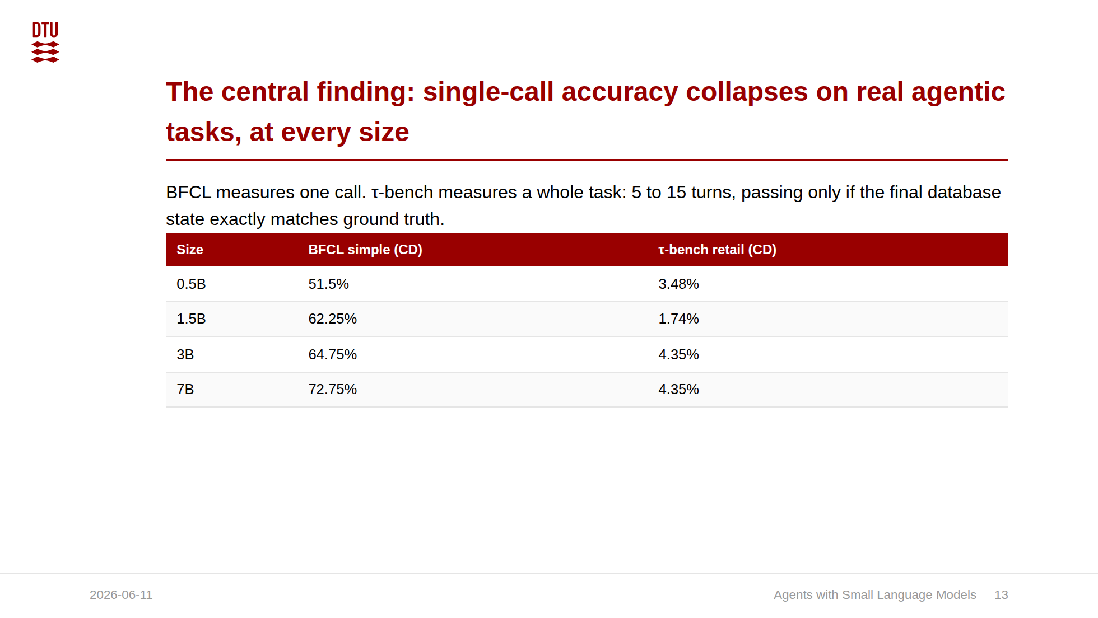
Notes:
The most important honest result in the thesis. Do not bury it. State the simulator confound before anyone asks: the user simulator is the same 7B model, where the reference tau-bench setup uses a frontier model. A weak simulator deflates pass rates independently of agent capability, so the absolute floor is conservative and comparisons to published frontier pass rates are not like-for-like. The qualitative finding (single-call gains do not transfer to multi-turn) survives because trajectory inspection attributes the failures to agent-side planning errors. It would be easy to stop at "small models match frontier on single calls" and tell a triumphant story. The truth is more interesting: parity on single calls, collapse on multi-step agency. The size column is the key addition here: the agentic floor is flat across 0.5B to 7B. So this is a capability boundary, not a tuning or scale problem within the small range. It is the single best argument for the cascade: the SLM handles the simple bulk, the frontier model handles genuine multi-step agency. This is the slide an examiner will probe. Lean into it.

