Slide 1
Research Questions — Summary
Planning for ASE special issue
Data: Perf<Cycles>, 4 target programs, 5-fold CV, budgets {100,250,500,750,1000}

Slide 2
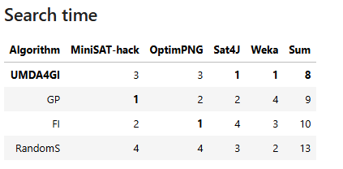
RQ1 — Is UMDA4GI competitive with state-of-the-art GI?
Answer: YES. FI leads globally, but UMDA4GI is 2nd, the most consistent, and the fastest algorithm.
Algorithm | MiniSAT-hack | OptimPNG | Sat4J | Weka | Sum | Top-2
FI | 4 | 1 | 1 | 1 | 7 | 3
UMDA4GI | 2 | 3 | 2 | 2 | 9 | 3
RandomSearch | 1 | 2 | 3 | 3 | 9 | 2
GP | 3 | 4 | 4 | 4 | 15 | 0
Reading the table
• Ranking = sum of per-software ranks (1 = best); lower is better
• UMDA4GI: best trade-off — never worse than rank 3, wins/ties in 3/4 programs
• Also best in search time.
Justyna, please note that here I am only displaying rankings, in the journal I would insert the tables with all the tabbed results.

Slide 3
RQ1 details
UMDA4GI achieves competitive results against state-of-the-art GI algorithms. Using median aggregation (robust to outlier folds)
UMDA4GI and RandomSearch tie on Sum (9) and worst rank (3). The tiebreak is resolved by the number of software subjects with rank ≤ 2: UMDA4GI reaches rank ≤ 2 in 3 subjects (MiniSAT-hack, Sat4J, Weka) versus 2 for RandomSearch (MiniSAT-hack, OptimPNG), placing UMDA4GI 2nd overall.
Also, RandomSearch is the slowest
11 runs did not find a better variant (never happened with UMDA4GI).

Slide 4
RQ2 — Which algorithm has the highest generalization?
Answer: UMDA4GI. Higher generalization overall
Algorithm | MiniSAT-hack | OptimPNG | Sat4J | Weka | Sum | Top-2
UMDA4GI | 1 | 1 | 2 | 2 | 6 | 4
RandomSearch | 2 | 2 | 4 | 3 | 11 | 2
GP | 3 | 3 | 1 | 4 | 11 | 1
FI | 4 | 4 | 3 | 1 | 12 | 1
• FI best on improvement (RQ1) but worst on generalization here — a clear trade-off to discuss

Slide 5
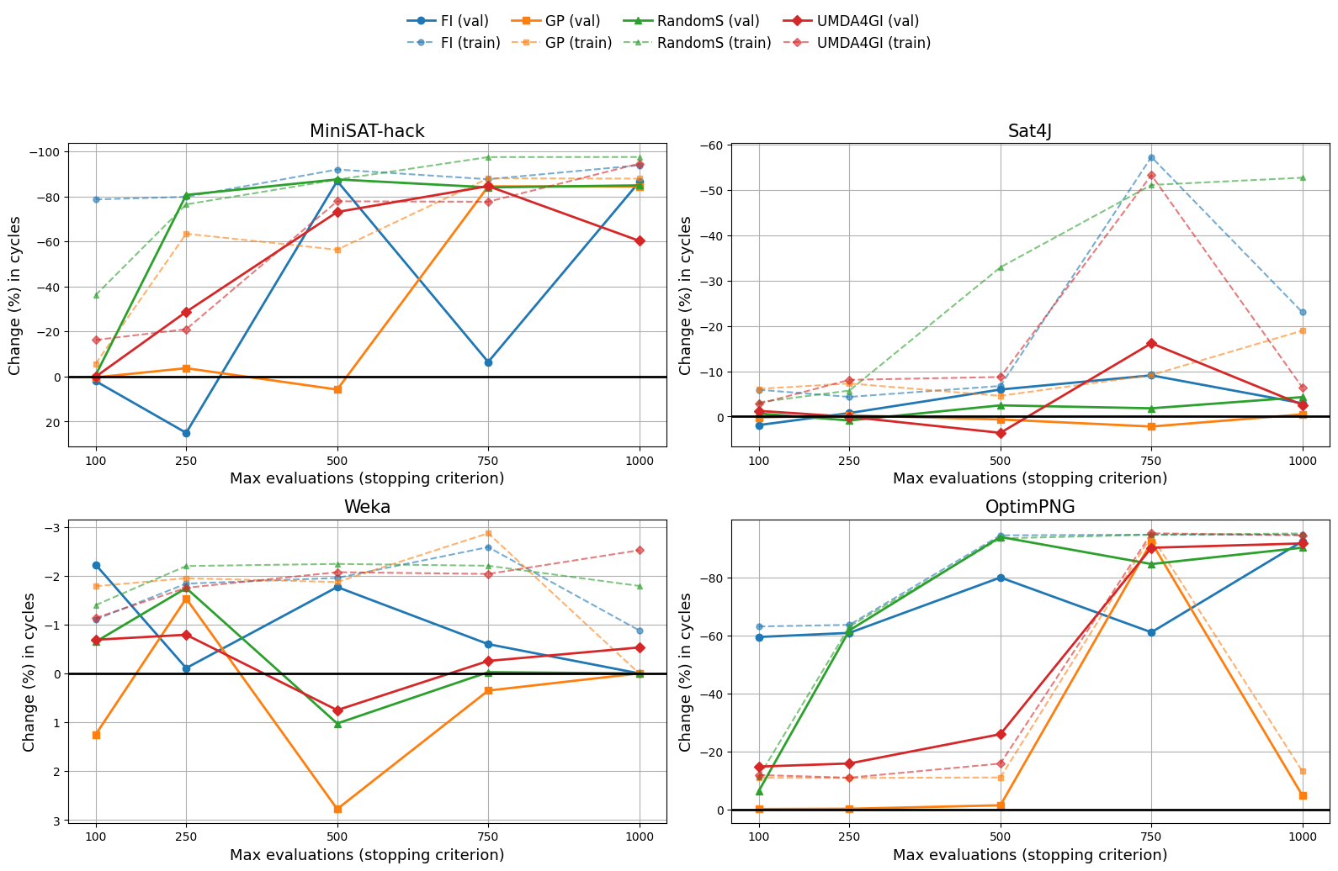
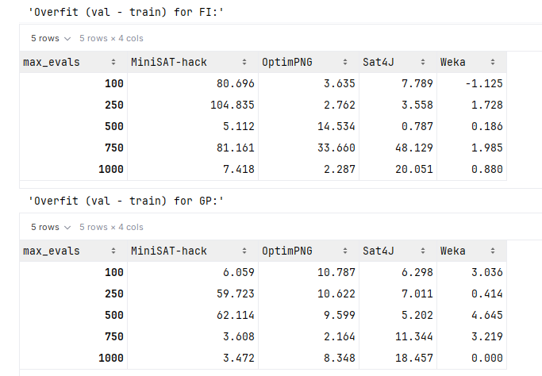
RQ2 example of plots and tabbed data

Slide 6
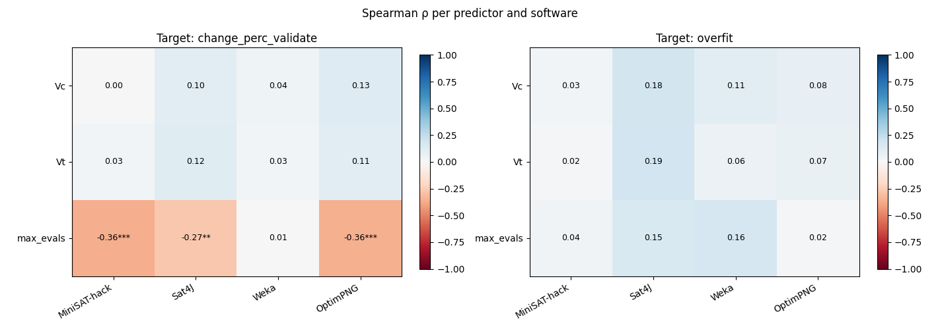
RQ3 — Do Vt, Vc, max_evals correlate with generalization or improvement?
Answer: max_evals correlates with validation improvement.
Answer: Vt and Vc do not correlate with generalization nor improvement.
Shall we skip this RQ?

Slide 7
RQ4 — Does feeding UMDA's distribution to an LLM help?
LLM used to create population (qwen2.5-coder:7b and llama3.1:8b)
LLM prompt:
Block 1 — Task description + full source code
Block 2 — Best patches found so far
Block 3 — UMDA distribution (used in UMDA+LLM, absent in LLM only)
Block 4 — Output format specification
Since the only difference between LLM only and UMDA+LLM is the UMDA distribution (block 3), RQ4 can be answered by comparing the results.

Slide 8
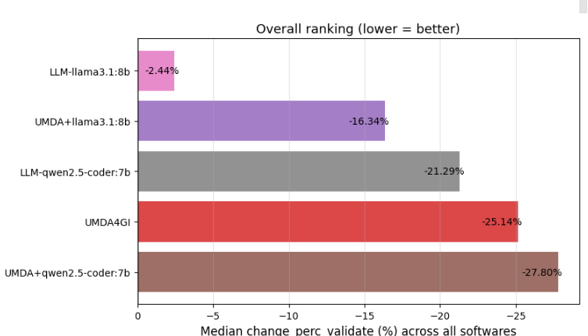
RQ4 — Does feeding UMDA's distribution to an LLM help?
Answer: Yes, UMDA+LLM beats LLM-only in every ranking (and, by Little, original single UMDAGI).
Rank | By improvement (sum) | By generaliz. (sum)
1 | UMDA+qwen2.5-coder (7) | LLM-qwen2.5-coder (8)
2 | UMDA4GI (8) | UMDA+llama3.1 (11)
3 | UMDA+llama3.1 (11) | LLM-llama3.1 (13)
4 | LLM-qwen2.5-coder (15) | UMDA4GI (14)
5 | LLM-llama3.1 (19) | UMDA+qwen2.5-coder (14)
• UMDA distribution clearly helps the LLM: +8 rank positions for both models (qwen: 7 vs 15, llama: 11 vs 19)
• LLM-only, llama: worst on all 4 programs, worst generalization
• All 3 UMDA-based groups dominate the normalized-score ranking (0.659–0.792) vs LLM-only (−0.039–0.271)

Slide 9
RQ4 — Patch-finding rate: why LLM-only underperforms
Group | Runs | Patch found | No patch | % no patch
UMDA4GI | 100 | 100 | 0 | 0%
UMDA+llama3.1:8b | 100 | 96 | 4 | 4%
UMDA+qwen2.5-coder:7b | 100 | 97 | 3 | 3%
LLM-llama3.1:8b | 100 | 58 | 42 | 42%
LLM-qwen2.5-coder:7b | 100 | 79 | 21 | 21%
Key takeaway
• LLM-only fails to produce a working patch in 21–42% of runs (empty validate_log → patch_length=0)
• Feeding it the UMDA distribution cuts failure to 3–4%, matching the no-LLM baselines
• This explains why LLM-only's median change is 0% on several programs — a large share of runs contribute nothing
• LLM-qwen has the lowest overfitting overall (rank 8) despite ranking 4th on improvement — when it does find a patch, it generalizes well
RQ4 · 2/2 · Writing note: this table is the strongest argument for the 'distribution-guided LLM' contribution

Slide 10
Paper Writing Plan
Draft structure based on RQ1–RQ4 results
• 1. Introduction & Motivation
• 2. Background — UMDA4GI, GI baselines (FI, GP, RandomSearch), LLM-assisted patching
• 3. Experimental Setup — 4 target programs, 5-fold CV, budgets, Perf<Cycles>
• 4. Results
- RQ1 — Competitiveness (ranking table + per-program discussion)
- RQ2 — Overfitting (ranking table + improvement/overfitting trade-off)
- RQ3 — Predictors of performance (max_evals as global signal + notable exceptions)
- RQ4 — UMDA distribution feeding the LLM (ranking + patch-finding-rate argument)
• 5. Discussion — limitations (7–8B models only, Weka/OptimPNG ceiling hypotheses, GP outlier)
• 6. Conclusion
Next: turn each RQ slide's bullets into Results prose; confirm limitations wording with co-author

