Slide 1
FORMAL MODELLING AND VERIFICATION OF NAND FLASH MEMORY
Supervisor : P.Abhinav Kumar
Dr.Srinivas Pinisetty 16CS01028

Slide 2
PROBLEM STATEMENT
Globally, NAND Flash consumption has increased, and new products, such as NAND solid-state drives, are now making significant inroads into enterprise computing devices
Develop new model for the Ransom Blocker of NAND flash-based SSDs and verify the correctness of the model
UPPAAL Tool is used for Formal Modelling and verification of NAND Flash Memory

Slide 3
MOTIVATION
Flash Guard and SSD Insider provides protection from Ransomware attacks
Flash Guard suffers from very high space overhead of maintaining backup data
Early detection in SSD Insider not to maintain backup data for long time but ransomware variants can modify ransomware detection algorithms
How long suspicion pages should be kept as valid in an SSD is an important factor in designing SSD Level techniques?

Slide 4
Block Diagram of Ransom Blocker
Encrypted Write Tracker
Timeout based Invalidator
jasbc
Mapping Table contains L2P ,Page status info,Read Tracker Table(RTT)
Garbage Collector

Slide 5
LITERATURE REVIEW
Timed Automata which contains Formal Syntax,Operational Semantics,Timed Language,Query Language
Garbage Collection Policy In NAND Flash Memory
Ransom Blocker In NAND Flash Memory
Overview of Uppaal Tool Kit
Temporal Logics used for defining the observed properties
Understanding the UPPAAL Tool with Car Parking Scenario and Implement it in UPPAAL

Slide 6
Properties Observed
After observing Encrypted writes,the pages which have encrypted writes should be made invalid and make them available for Garbage collection
Update Physical Location of victim pages in the Time out invalidator queues when their location has changed
EWT provides information of potential victims to TOI,
If read TOI puts a pair of physical location and timestamp into queue(page in the queue is still valid).
Notes:
List of properties to be observed when Ransom blocker is installed in NAND Flash SSD

Slide 7
Properties Observed(Contd …)
When the page is trimmed,it should be seen whether It goes to TP Short,TP Long or Overwritten Queue
LTL : G~(OPQueue ^ TPShort ^ TPLong)
TOI receives information of potential victim pages
If page is overwritten it goes to OP Queue
If page is trimmed and bitmap is 0 it goes to TP Queue Short
If page is trimmed and bitmap is not 0 it goes to TP Queue Long

Slide 8
Properties Observed(Contd …)
When a page reaches overwritten state,it always goes to overwritten queue
LTL : F(Overwrite → G(OPQueue))
When a page reaches trim state,it should always goes to either TP Short Queue or TP Long Queue
LTL : F(Trim → G(TPShort v TPLong)
When the bitmap is zero,it should go to TP Short Queue ,if any encrypted writes occur then page should be sent to TP Long Queue
If there are no encrypted writes in the monitoring period the items in the queue should be made available for garbage collection

Slide 9
RESULTS
TOI MODEL(Time Out Based Invalidator)
1.The aim of this model is to insert the page into one of the three TOI Queues
2.After inserting we will be monitoring the page in the given state with time constraints and check whether the page is safe to erase or it should be monitored for some more time
3.If encrypted writes are observed during monitoring period ,we will be backing that page for some more time
4.Otherwise we will make that page safe to erase state and make available for reclamation.

Slide 10
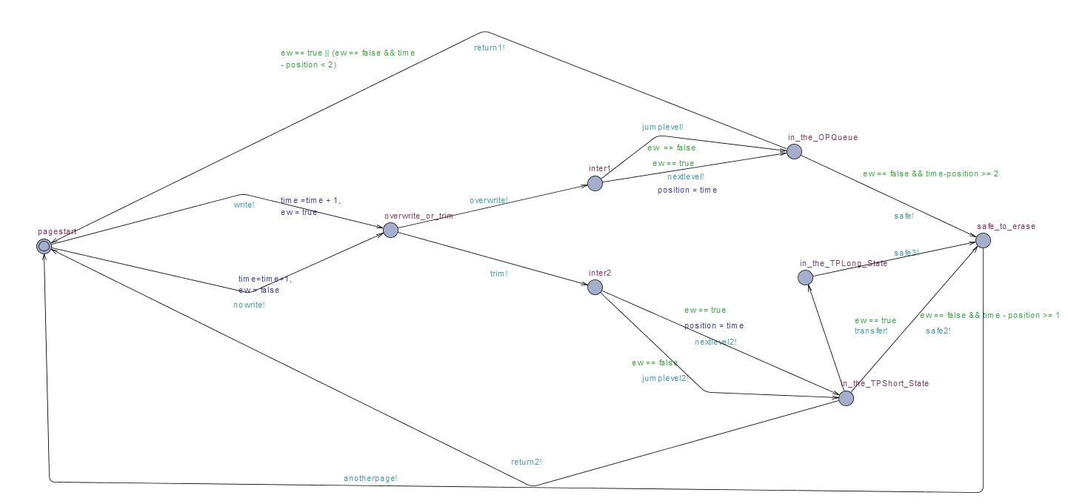
UPPAAL MODEL FOR TIMEOUT BASED INVALIDATOR

Slide 11
States | Edges
Pagestart | overwrite,trim
overwrite_or_trim | nextlevel, nextlevel 2
inter 1 and inter 2 | return1,return2
in_the_OPQueue | write,no write
In_the_TPLong_Queue | jumplevel, jumplevel 2
In_the_TPShort_Queue | safe,safe2,safe3
safe_to_erase | anotherpage
 | transfer

Slide 12
Guards and Updates on Edges of TOI Model
1.Write !
Update : time = time + 1 // time incremented
ew = true // as write is encrypted
2.Nowrite !
Update : time = time + 1 // time incremented
ew = false // as write is non encrypted
3.Jumplevel !
Guard : ew == false // Restricting the update of timestamp
4.Nextlevel !
Guard : ew == true // we have to update the position of page
Update : position = time (update for monitoring)

Slide 13
Guards and Updates on Edges of TOI Model(Contd.)
5.Return1! and Return2!
Guard : ew == true || ew == false && time - position < k (need to be monitored for some more time )
6.Transfer !
Guard : ew == true // transfer to TPLong if and only if encrypt write is true
7.Safe! & safe 2!
Guard : ew == false && time - position >= k(depends on whether overwrite or trim,sample values of 1 and 2 are taken in the above model)

Slide 14
Example Execution Path for TOI
Path1 (for overwrite)
Step1)For the page to be inserted(p1)
Write → overwrite → inter1 →(nextlevel) OPQueue→ return1
Here return1 is used so that we can monitor this page in the following steps
Step2)We can use this page or we can try to insert another page into one of the three queues
2a) for monitoring the inserted page(p1)
nowrite→ overwrite → inter1→(jumplevel)OPQueue-->return1
2b) can insert the another page(p2)
Write → trim → inter2 →(nextlevel)TPQueue → return2
Step3)We can repeat the above step 2a until we get a safe to erase state

Slide 15
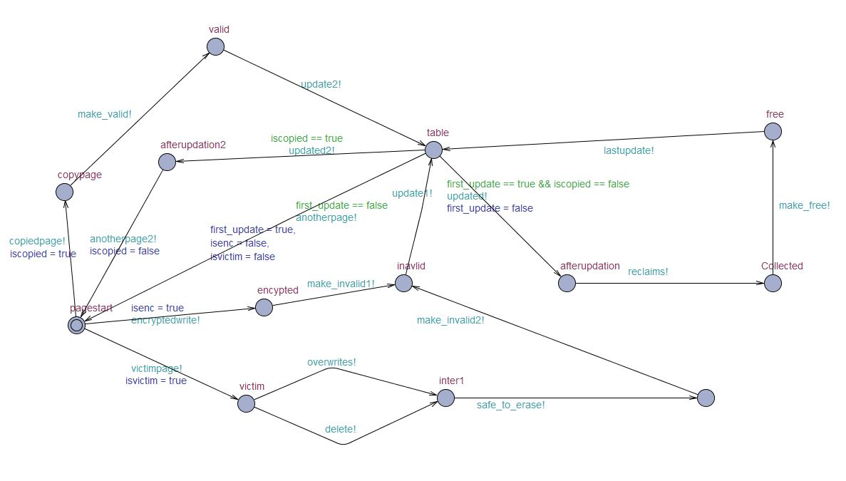
2.Page Status Model fig
MODEL FOR UPDATING THE STATUS OF PAGE IN THE TABLE

Slide 16
Page Table Status Model
1.Pagestatus model helps in changing the state of page from one form to another and updates in the table which maintains the physical locations and page status such as valid,invalid or free.
2.In copied page, while erasing ,when it copies data to other pages in other block,the status of the page changes from free to valid.
3.If the page is encrypted .then page status should be made from valid to invalid
4.If the page is the victim page ,then after some time it will be made invalid
5.After going to the invalid state those pages were reclaimed by garbage collector and made free.

Slide 17
States | Edges
Page start | copied page,encrypted write
encrypted | victim,overwrites ,trim
copypage | make_invalid1,make_invalid2
victim page | safe_to_erase,make_valid
inter1 | update1,update2
safe to erase ,collected | updated,updated2
invalid,valid,free | reclaims,last update
after updation,after updation 2 | anotherpage,anotherpage2

Slide 18
Execution Paths for Page Table Status
Path1(for encrypted)
Pagestart → encrypted → invalid → table → afterupdation → collected → free → table → another page → page start
Path2(for victim)
Pagestart → victim → overwrite/trim → inter1 → inter2 → invalid → table → after updation → collected →free → table → page start
Path3(for copied page)
Pagestart → copy → valid → table→ after updation → pagestart

Slide 19
Difficulties Encountered
Determining hidden properties of Ransom Blocker and Application of CTL to verify those properties in UPPAAL Tool
Determining Atomic Propositions and States
Dividing Ransom Blocker System into various templates and synchronise them in the design of Timed Transition system
Determine invariants and guards of the templates

Slide 20
CONCLUSION
1.We have presented Time out based Invalidator model and a model for page status updation in this module
2.RansomBlocker can selectively back up only the data which are highly likely to be attacked by ransomware
3.Integrating RBlocker with AI acceleration chips for more quick and accurate ransomware detection is one of the future scope

Slide 21
References
1. Jisung Park ,Youngdon Jung, Jonghoon Won, Minji Kang, Sungjin Lee,Jihong Kim RansomBlocker: a Low-Overhead Ransomware-Proof SSD
https://www.researchgate.net/publication/333333966_RansomBlocker_a_Low-Overhead_Ransomware-Proof_SSD
2.Johan Bengtsson and Wang Yi , Timed Automata: Semantics, Algorithms and Tools https://link.springer.com/chapter/10.1007/978-3-540-27755-2_3
3. Rajeev Alur and David L. Dill ,A theory of timed automata
https://www.sciencedirect.com/science/article/pii/0304397594900108
4. https://www.it.uu.se/research/group/darts/papers/texts/new-tutorial.pdf
5. https://www.researchgate.net/publication/282304130_Garbage_collection_and_wear_leveling_for_flash_memory_Past_and_future

Slide 22
THANK
YOU

