Slide 1
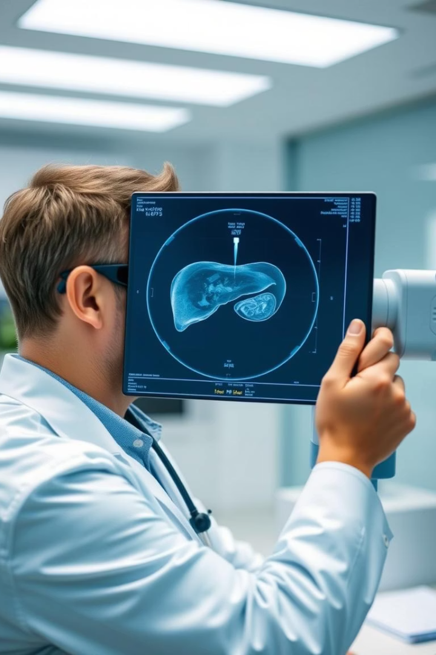
Hepatitis C Prediction
Hepatitis C prediction. Hepatitis C is a liver infection caused by the hepatitis C virus (HCV). It's crucial to detect early and prevent life-threatening complications.

Slide 2

Understanding the Problem
Hepatitis C (HCV)
CDC Statistics
A liver infection spread through contact with infected blood.
Chronic HCV leads to cirrhosis and liver cancer.
Often asymptomatic until advanced stages.
No vaccine exists; prevention is key.
Early testing and treatment can cure most people within a few months. This project focuses on predicting Hepatitis C using machine learning.

Slide 3




Key Attributes
Age & Sex
Blood Markers
Target Feature
Our analysis uses patient demographics and blood test results. We predict the target feature, which indicates the stage of liver disease. 0=Blood Donor, 0s=suspect Blood Donor, 1=Hepatitis, 2=Fibrosis, 3=Cirrhosis

Slide 4



Important Terminology
Liver Enzymes (ALT, AST, ALP, GGT)
Albumin & Total Protein
Lower levels may indicate liver disease.
Elevated levels indicate liver damage.
Bilirubin
Elevated levels (jaundice) suggest liver issues.
Understanding these markers is crucial for accurate Hepatitis C prediction. These enzymes can show damage even when the patient feels fine.

Slide 5




Dataset Balancing with SMOTE
Original Data
Imbalanced classes can bias models.
SMOTE
Synthetic Minority Oversampling Technique.
Balanced Data
Improved model performance.
SMOTE helps address class imbalance, ensuring fairer and more accurate predictions. Class imbalance is a common problem in medical datasets.

Slide 6



Data Preprocessing & Scaling
Cleaning
Handling missing values.
Transformation
Converting categorical data.
Scaling
Normalizing numerical features.
Preprocessing ensures data quality and compatibility for machine learning models. Properly scaled and cleaned data can yield greater accuracy.

Slide 7






Hyperparameter Tuning
Cross-Validation
Robust evaluation.
Grid Search
Systematic search.
Best Parameters
Optimal model configuration.
Tuning improves model performance on validation and test sets. Optimal model configuration can yield up to 97% accuracy.

Slide 8

Key Takeaways
Hepatitis C
Machine Learning
Future Work
Early prediction is crucial.
Effective prediction tool.
Further model refinement.
This project demonstrates the potential of machine learning in healthcare. It enables timely interventions and improved patient outcomes.

Slide 9
Limitations and Future Work
Data Limitations
Feature Expansion
Model Refinement
The dataset, while informative, has limitations. A larger, more diverse dataset would improve model generalization.
Additional blood markers or patient history could improve accuracy. Socioeconomic factors could also be considered.
Exploring other machine learning models, like neural networks, is an exciting avenue for development.

