Slide 1

COVID 19 DATA ANALYSIS
By- Pabitra Kumar Panda
Regd. No- 11903542

Slide 2
INTRODUCTION
The report gives us an overview on the Covid 19 pandemic of the India over a period of 2 years (2020-2021). For the country’s betterment, it is important to know where this virus spread the most and where maximum number of doses were taken. We have chosen this dataset to analyse and generate some insights on the covid. The data collected provides us with the basic information on the covid 19.

Slide 3
SCOPE
In order to have a better insight it is important to analyze the data so that we can get ready for the future for different waves to come.
It is also important to have made strategies ready on the basis of the report in order to have a better performance.

Slide 4
SOURCE OF THE DATASET
https://www.kaggle.com/sudalairajkumar/covid19-in-india

Slide 5
ETL Process ETL is the process of extracting huge volumes of data from a variety of sources and formats and converting it to a single format before putting it into a database or destination file.

Slide 6
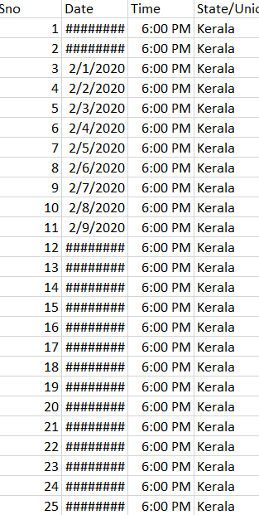
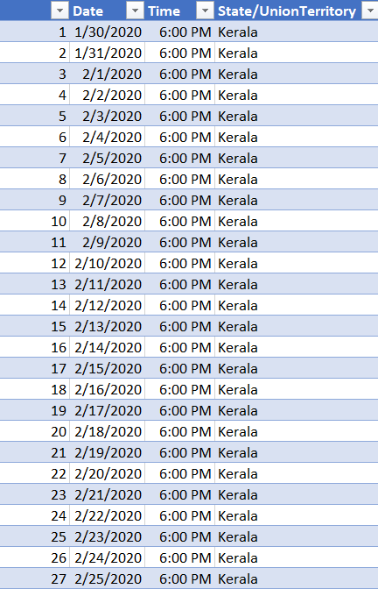
← Original CSV File (Raw Data)
Formatted Excel File
After cleaning the data and making it into readable format

Slide 7
OBJECTIVES
Objective -1
Month Wise Analysis of Covid in India.
Objective – 2
Comparison Between Confirmed, Cure & Death.
Objective -3
State Wise Analysis for Tested Sample.
Objective -4
State Wise Comparison of Vaccine.
Objective – 5
Total No. of Doses Administered.

Slide 8
ANALYSIS OF THE DATASET
Covid Based On Months
Introduction: The analysis shows state wise spread of covid.
Specific Requirements/Functions and Formulas:
Pivot table of the dataset.
GETPIVOTDATA function.
Pivot Chart.
Analysis Results: We can easily analyse with the help of this Line graph that in between Jun & Jul had the highest no. of cases.

Slide 9
Covid in year
Introduction: This analysis shows sum of confirmed, sum of cured & sum of death in both year.
Specific Requirements/Functions and Formulas:
Pivot table of the dataset.
Pivot Bar Chart.
Analysis Results: We can analyze from this chart that 2021 has maximum no.

Slide 10
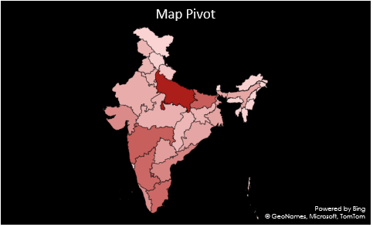
Maximum Tested State
Introduction: This analysis shows sum of samples taken in a state.
Specific Requirements/Functions and Formulas:.
Map chart.
Analysis Results: We can easily analyse through this chart that which state has tested the most.

Slide 11
Which company vaccine was used the most
Introduction: This analysis show that which state has taken the maximum of which vaccine.
Specific Requirements/Functions and Formulas:
Pivot table of the dataset.
Bar chart.
Analysis Results: We can analyze from this chart that covishield is the most preferred vaccine.

Slide 12
Which State has taken maximum of vaccine
Introduction: This analysis represents which state has taken more doses.
Specific Requirements/Functions and Formulas:
Pivot table of the dataset.
Area chart.
Analysis Results: We can easily analyze from this chart that himachal and J&K were in the top

Slide 13
LIST OF ANALYSIS WITH RESULTS
In this section we can see that we are able to answer so many questions due to this analysis.
In which month covid was the most ? Ans: Jun 2021 & Jul 2021
In which year covid was the most? Ans: 2021.
Which Region had highest covid testing? Ans:
Which vaccine was taken the most? And: Covidshield
Which was the state taken maximum vaccine? Ans: Himachal Pradesh

Slide 14
THANK YOU

