Slide 1

Deluxe Phone Hub
Premium Smartphone Shopping App
Project by: Pabitra Biswas

Slide 2
Problem Statement
❌ Premium phones are mixed with budget listings.
❌ Counterfeit products and inconsistent prices.
❌ Delivery delays and lack of trust in sellers.
❌ No direct-from-OEM app in the market.
Project by: Pabitra Biswas

Slide 3
The Solution
✅ OEM-direct flagship smartphones only.
✅ Fastest delivery: Same-day/24-hour options.
✅ Factory-sealed units at official prices.
✅ Premium UI/UX App with No third-party sellers involved.
Project by: Pabitra Biswas

Slide 4
Key Features
📱 Curated Premium Catalog (Apple, Samsung, Google)
📦 Real-time Stock Display & Delivery ETA
🔐 Secure Login & Multi-mode Payments (UPI, EMI, Cards)
🛒 Wishlist & Restock Notifications
💬 Live Customer Chat Support
🚀 Lightning-Fast Delivery Options
Project by: Pabitra Biswas

Slide 5
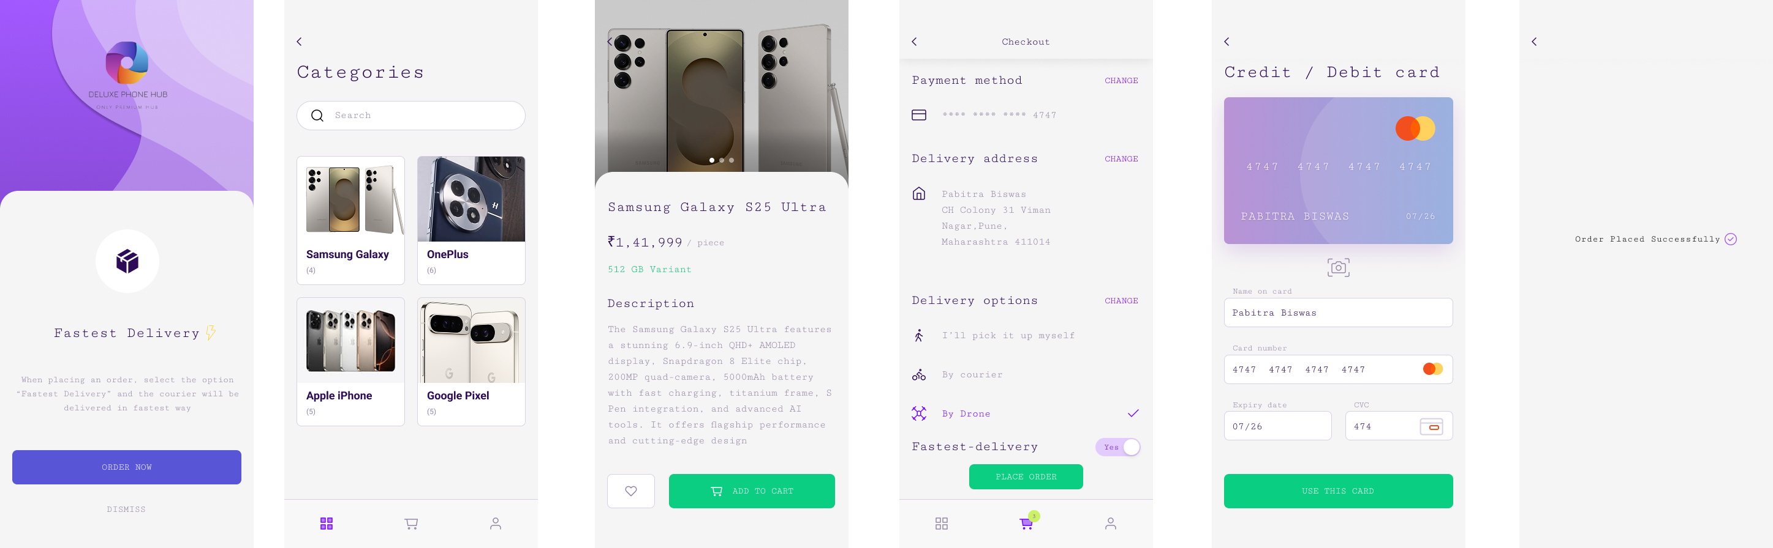
DPH-App Pages Views
Project by: Pabitra Biswas

Slide 6
DPH-App Pages Views
Project by: Pabitra Biswas

Slide 7
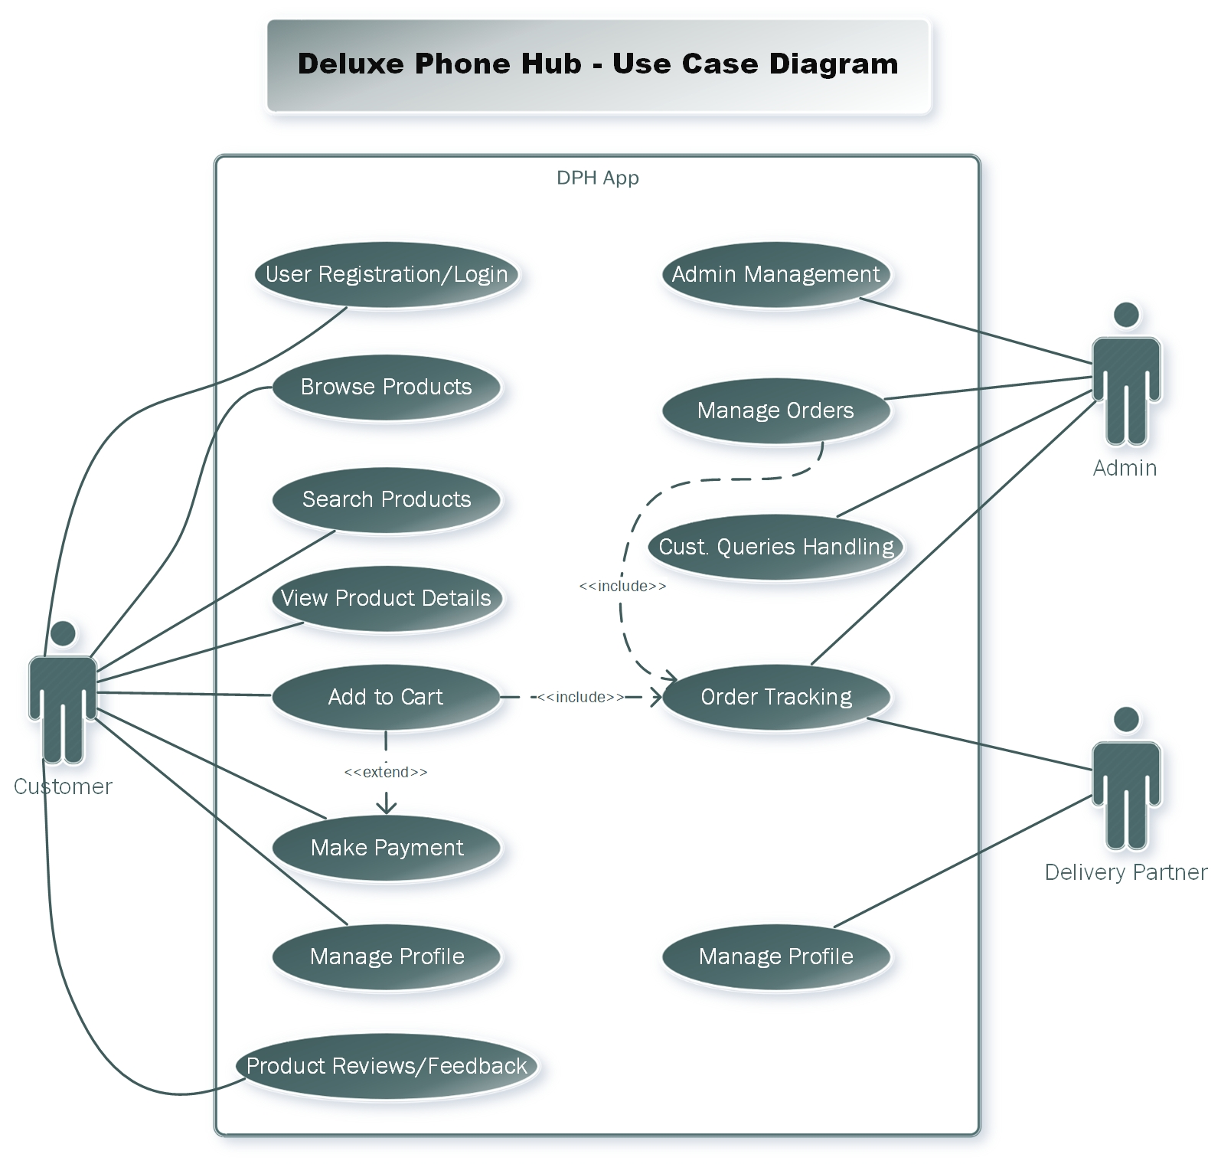
Project by: Pabitra Biswas

Slide 8
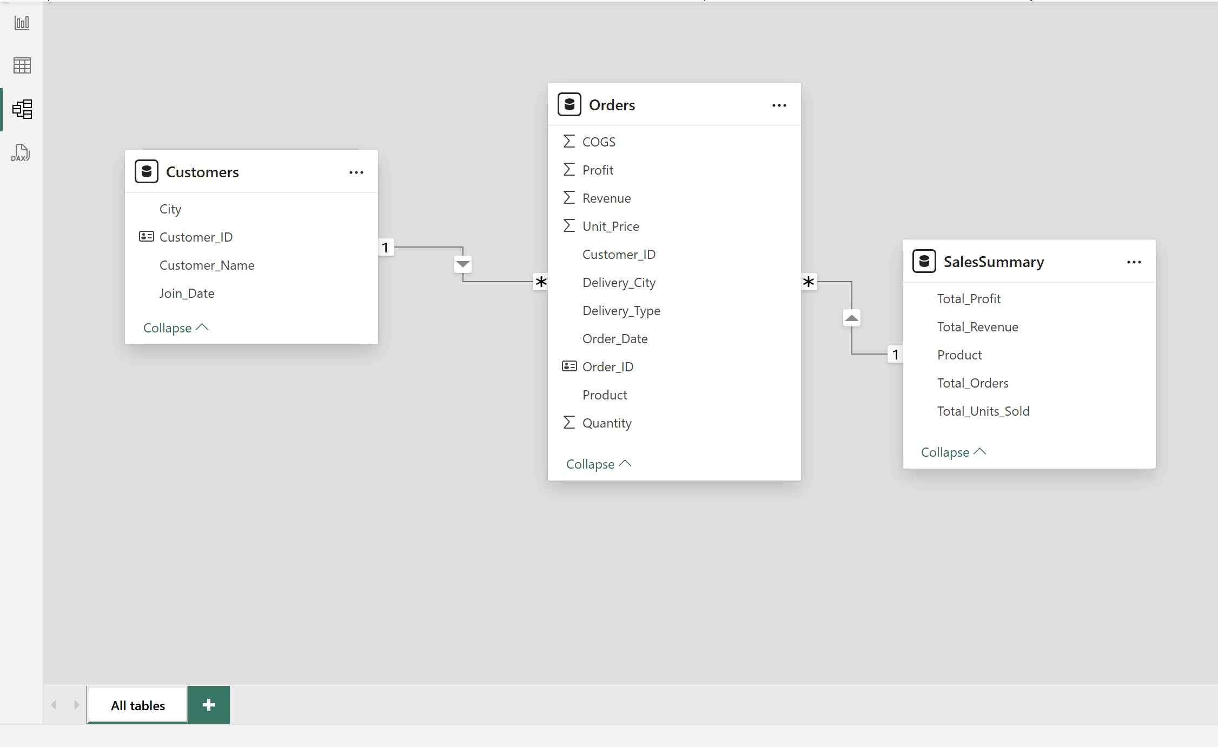
Tables Relationships Model
Project by: Pabitra Biswas

Slide 9
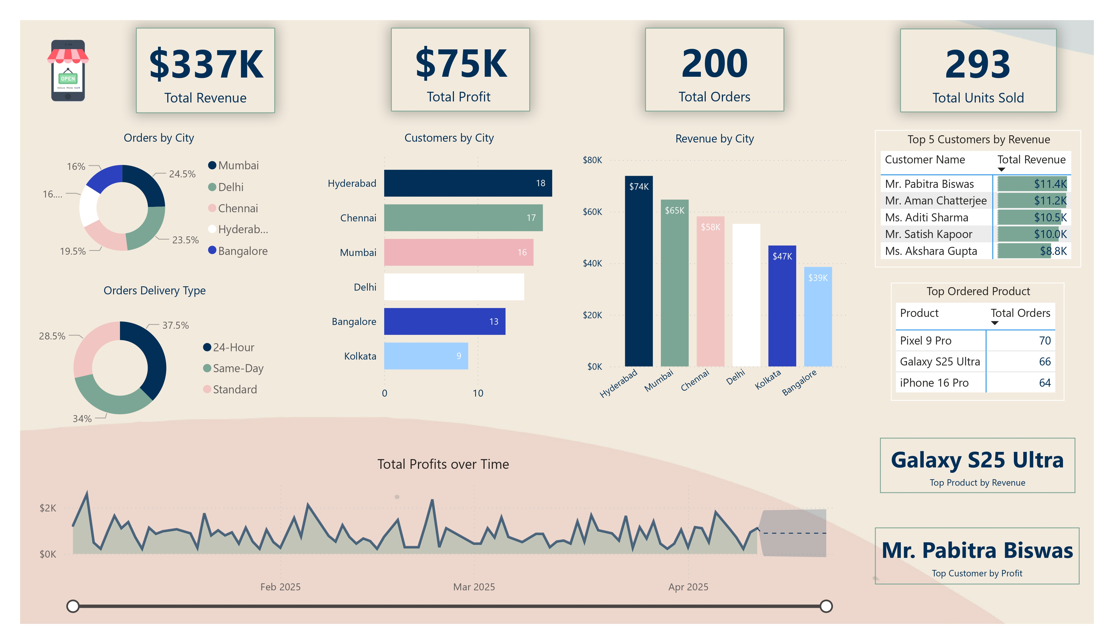
Sales Dashboard
Project by: Pabitra Biswas

Slide 10
My Contribution
📌 BRD & FRD Documentation aligned with stakeholders.
📌 Use Case Diagram (MS Visio) to visualize workflows.
📌 Figma Enhanced UI/UX principles for purposeful design.
📌 Functional & Non-functional requirement analysis.
📌 Sales Dashboard (POWER BI) with dynamic and interactive visuals.
Project by: Pabitra Biswas

Slide 11
Key Learnings
📘 Bridging business goals & technical workflows.
📘 Writing clear and structured BRD/FRD.
📘 Applying BA tools like Power BI, Visio, Figma effectively.
📘 Applied DAX for calculated columns, measures, & Dynamic visuals.
Project by: Pabitra Biswas

Slide 12
Let’s Connect!
📈 Exploring Business Analyst opportunities.
💼 Passionate about technology.
📧 Open to connect, collaborate and grow!
Project by: Pabitra Biswas

