Slide 1
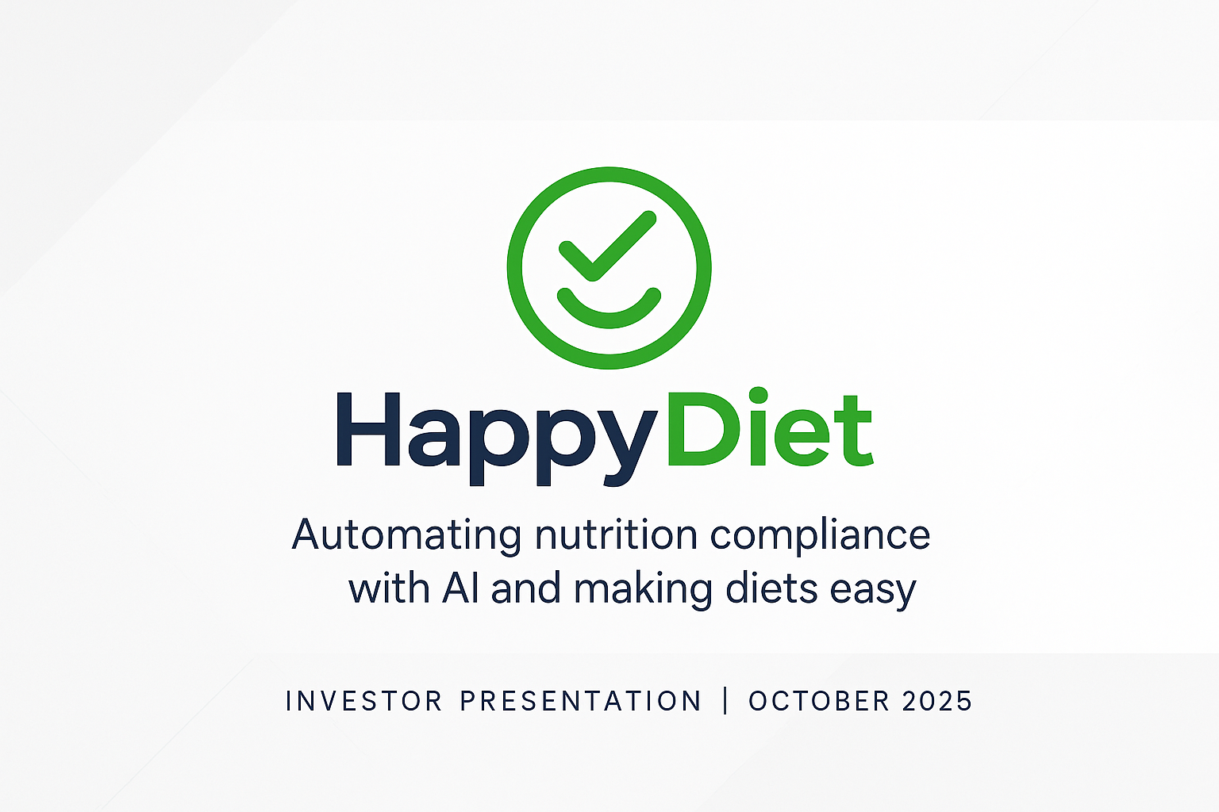

Slide 2

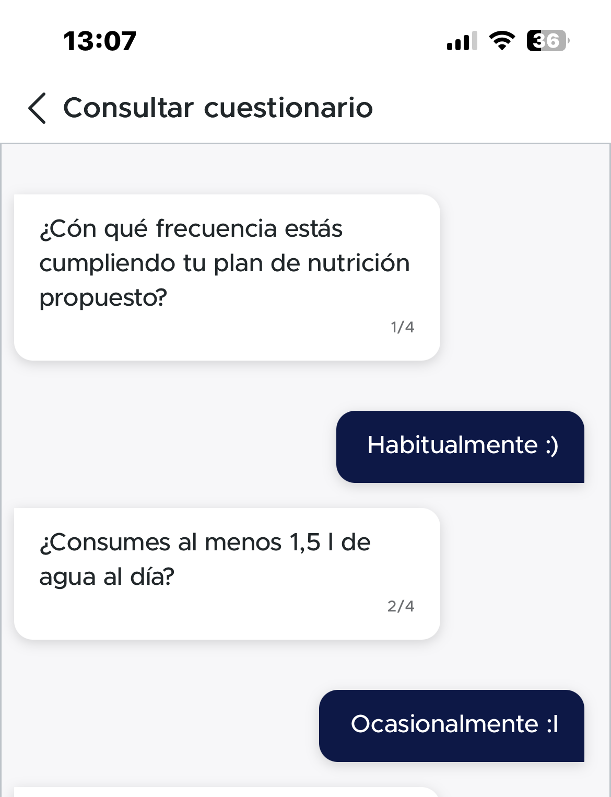

The Problem
Friction kills compliance: manual logs, unclear metrics, and subjective diet tracking.
Existing tools fail because they create friction and lack of enough support to patients

Slide 3
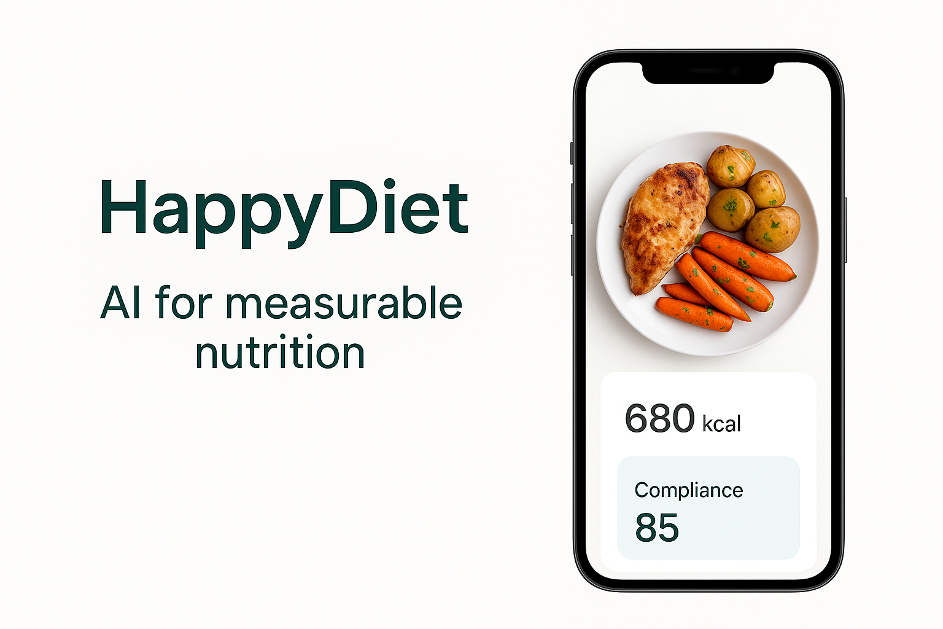
The Opportunity
Digital health market >$20B, rising demand for measurable nutrition and prevention.
Top players dominate the arena do focus strongly on kcal as key driver
Nutrition remains the only major health driver without measurable feedback.
• 80% of diet plans fail by week 8.
• Manual tracking creates friction.
• Clinics and insurers lack objective adherence data.

Slide 4
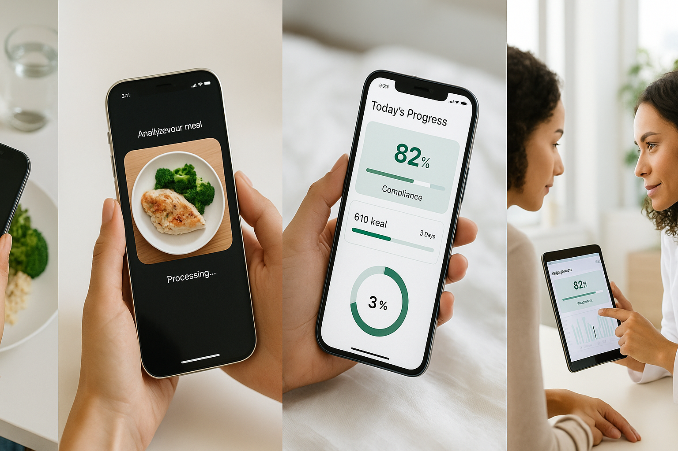
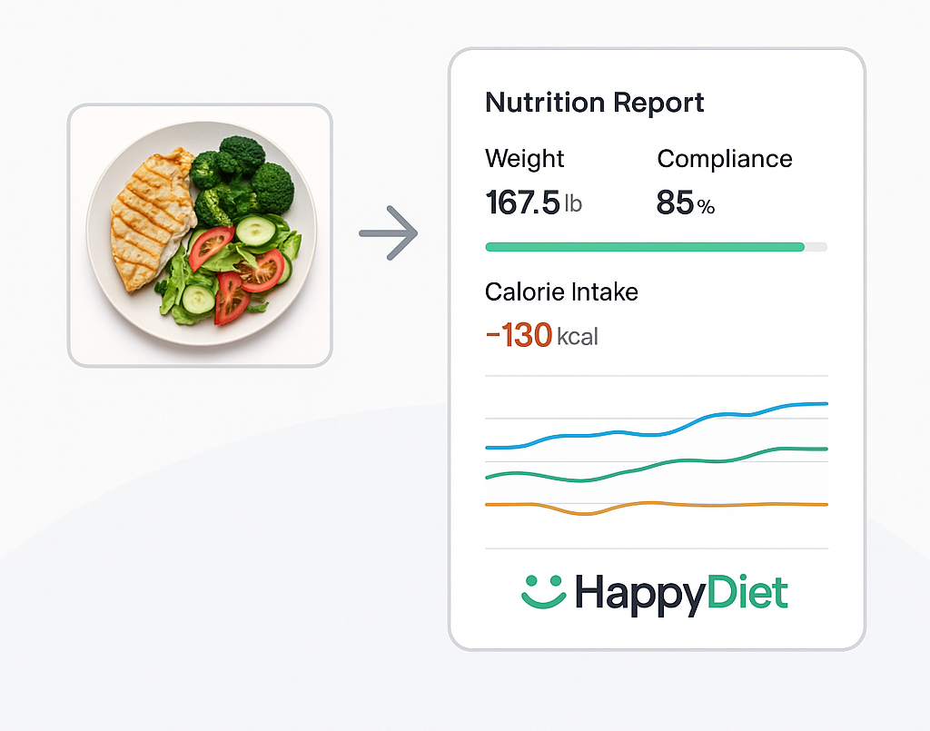
Solution Overview
HappyDiet automates nutrition tracking —
from your meal to insight & compliance.

Slide 5

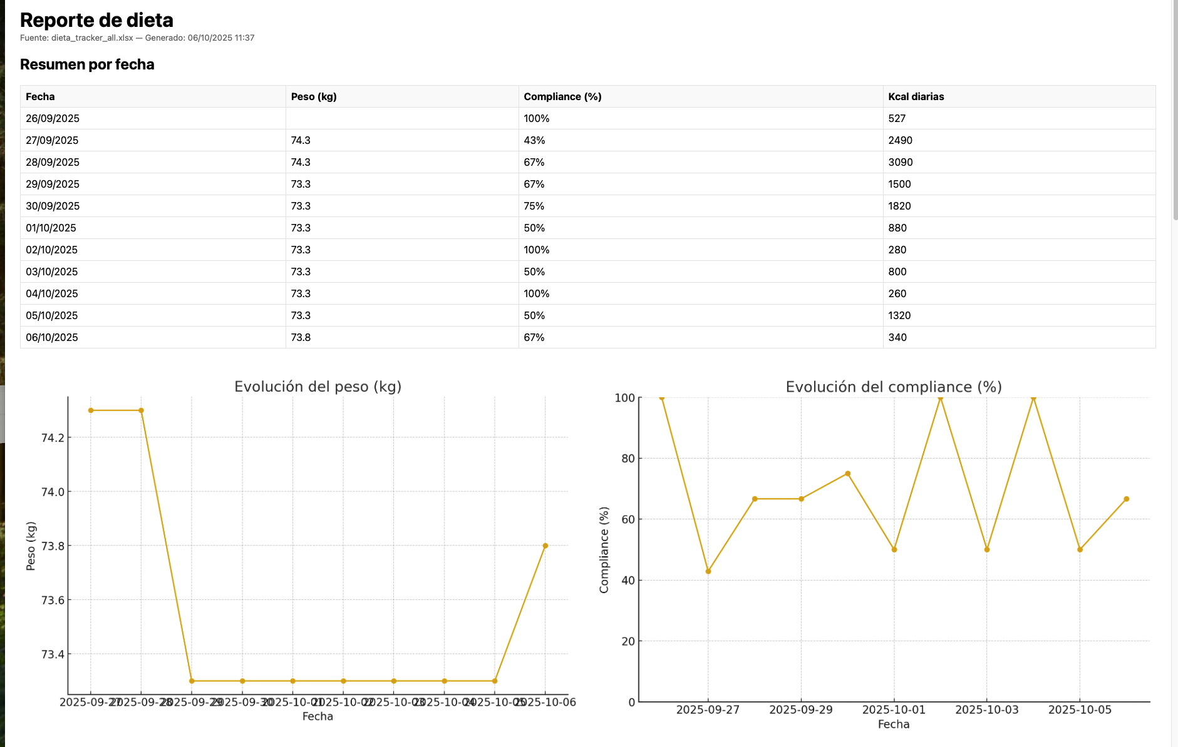
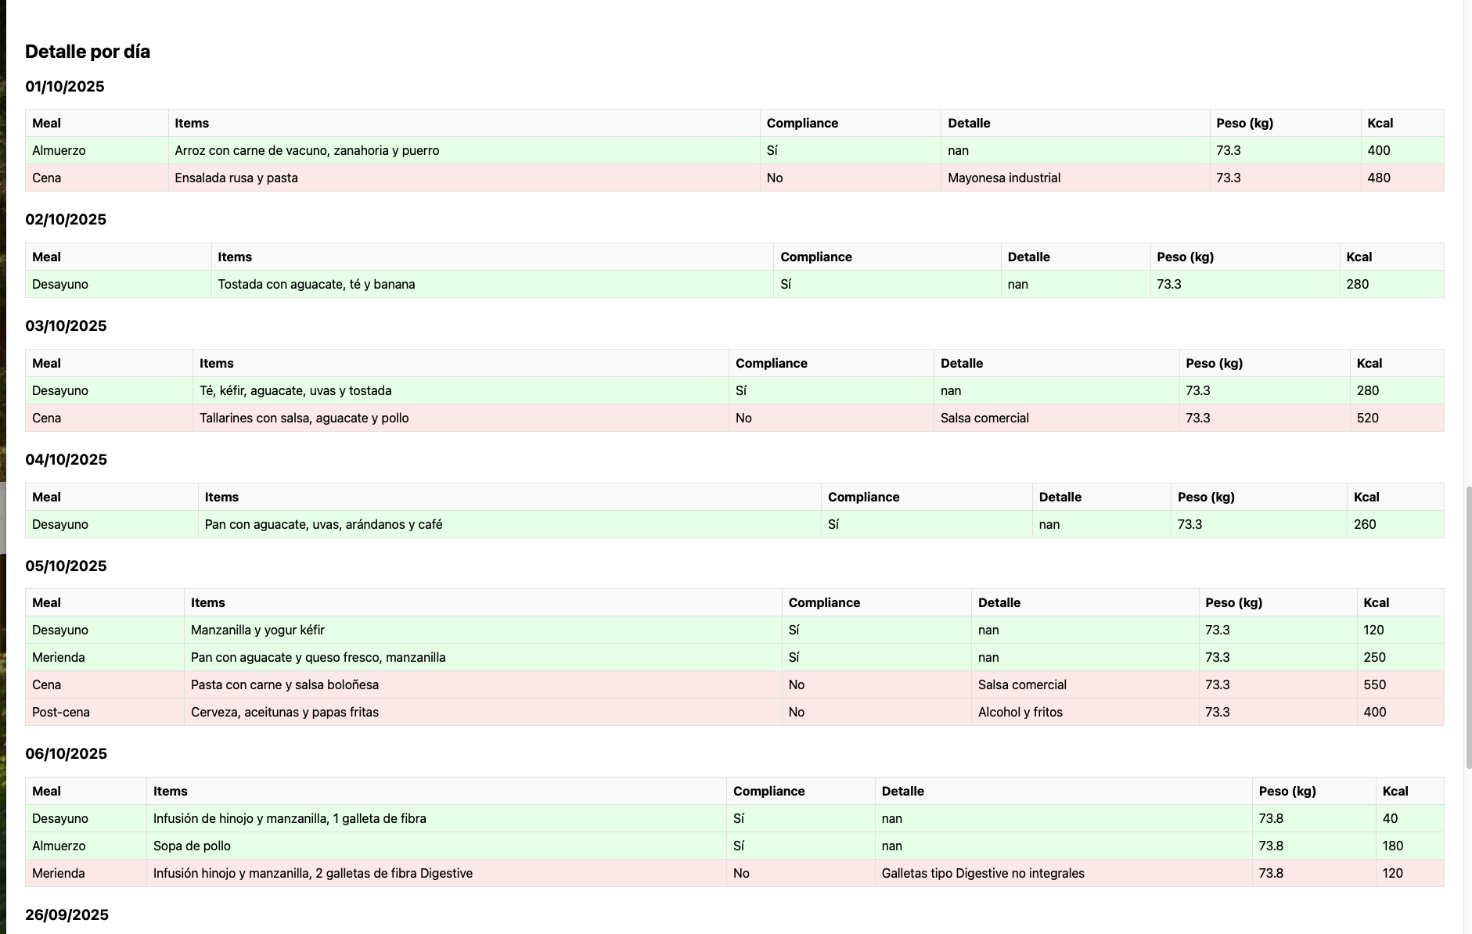
Proof of Concept & Early Validation
Need-validation : A local nutrition clinic confirmed the utility of this tracking system and suggested additional measures.
PoC tech: ChatGPT-5 multimodal with a prompt setup with main business logic built-in (rule engine, dataset, reporting)
Iterations (Patient Experience, Tool Development, data persistency, rule engine changes)
MVP to scale needs to move to a more stable architecture in a microservices App

Slide 6
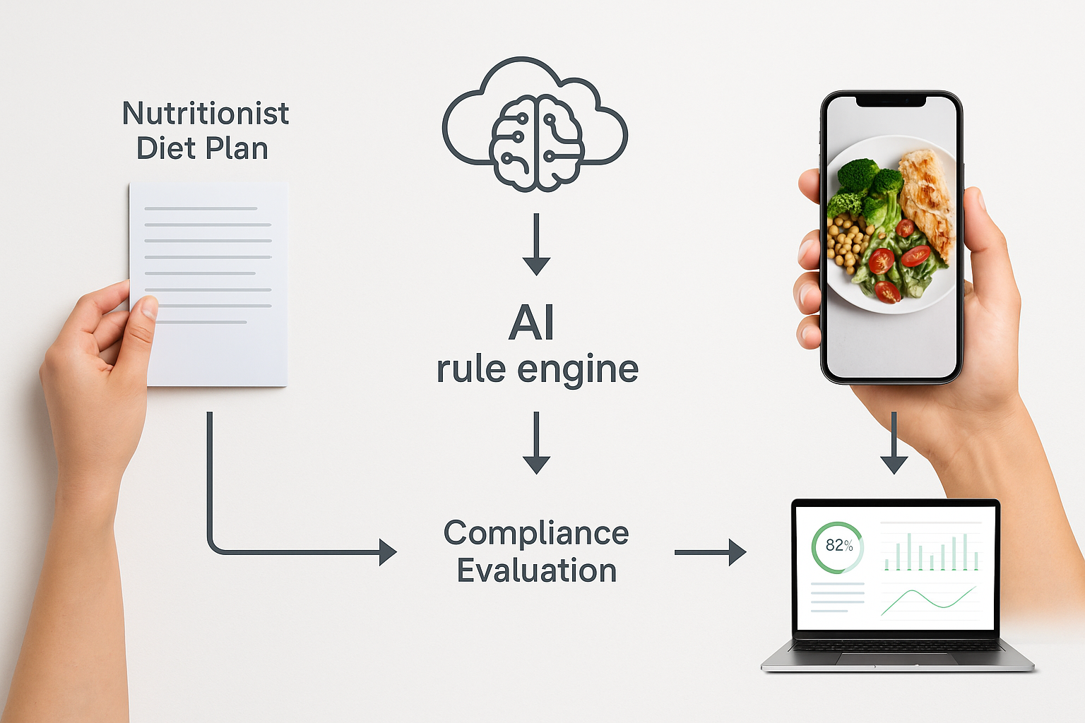
How It Works — The Intelligent Loop
1. AI reads diet plan issued by the nutritionist → 2. Rule engine defines compliance logic → 3. Vision AI matches meals → 4. Rule engine confirms level of compliance → 5. Dashboard shows adherence for patient & ready for doctor’s follow up.

Slide 7
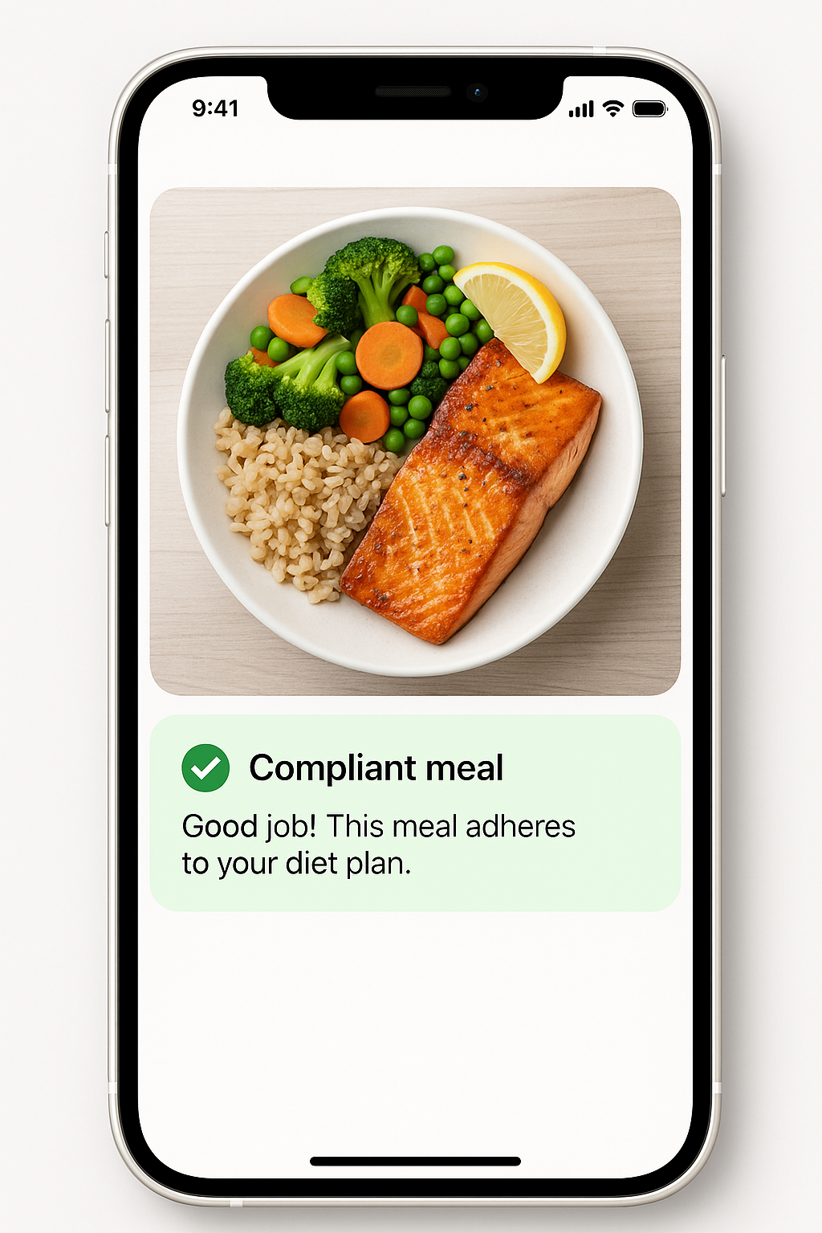
Real-time Feedback on Compliance
Transforming meal tracking from passive logging to active behavioral guidance

Slide 8
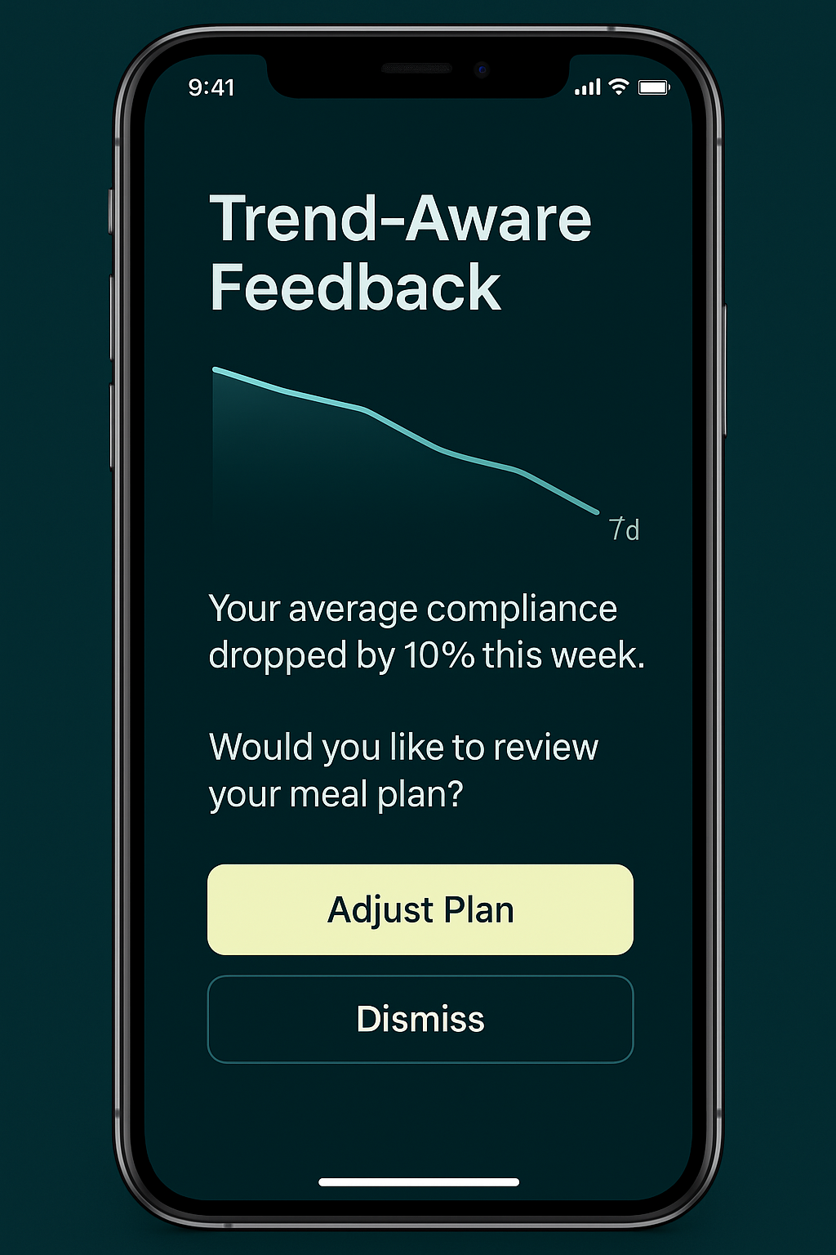
Trend-awareness & Gentle Reminders ☺
HappyDiet can identify deviations and trends and provide gentle reminders and insights on patterns

Slide 9
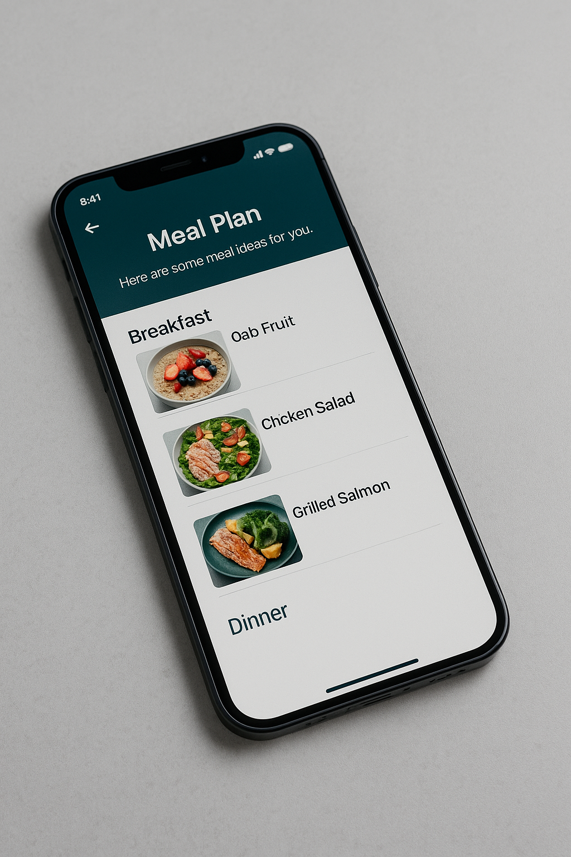
Personalized meal plan
Powered by AI-LLM, given its knowledge on the diet plan it can provide a meal plan for the day or the week

Slide 10
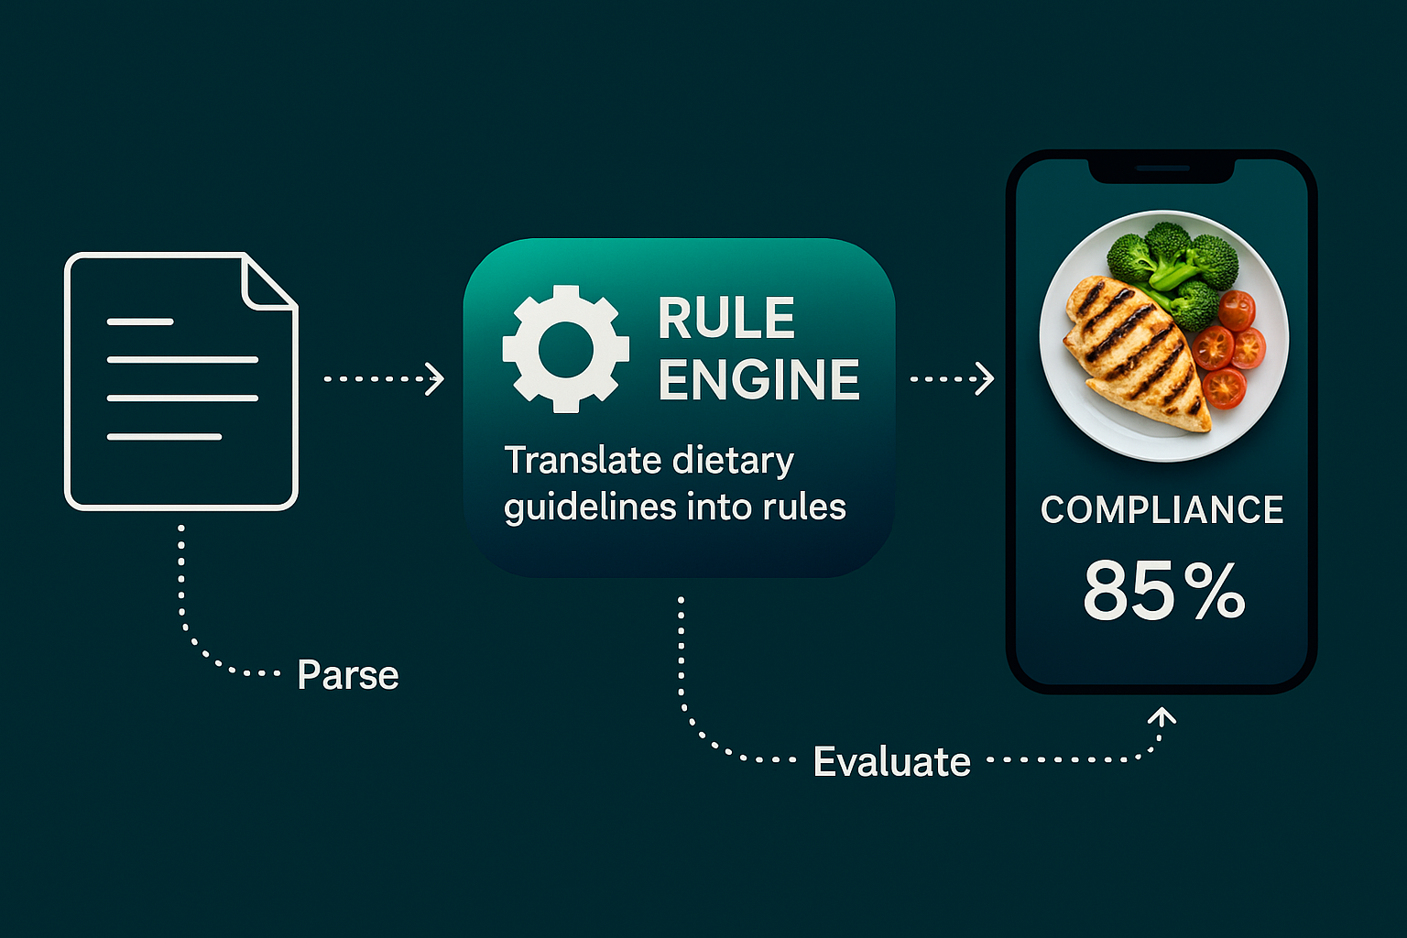
The Rule Engine — Our Superpower
Makes the diet actionable - Transforms dietary logic into executable and persistent rules enabling the system
Remains adaptive & explainable
Combined with AI/LLM - Enables assistance & coaching, eg coaching in deviations, weekly meal plan, supermarket purchase list…

Slide 11
Technical Architecture
AI Across the value chain:
LLM + AI Vision → Rule Engine → Dashboard → Insights + AI
A scalable framework that can extend beyond nutrition into broader lifestyle and chronic condition management.

Slide 12
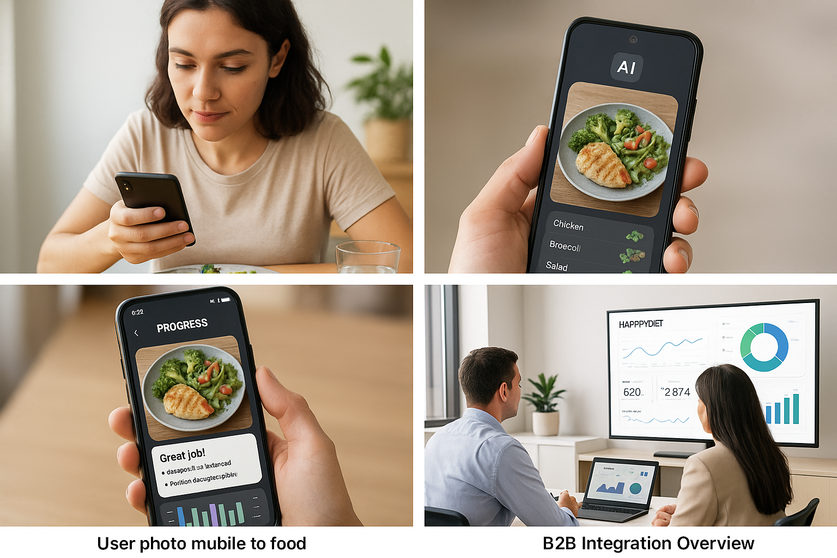
B2C & B2B Journeys
B2C: effortless daily tracking. B2B: clinics and insurers gain measurable data and insights.

Slide 13
Business Model
Phase 1: B2B SaaS/API for clinics & insurers.
Phase 2: Consumer freemium app.
Phase 3: Analytics insights and integrations.
Phase 4: Gadget for AI Wearable Devices (Smart glasses, …)

Slide 14
Go-To-Market Plan
2025 Q4: Prototype validation.
2026: Pilot with digital health clinics in Madrid & Paris.
2027: API integrations and scaling for Insurers and AI Wearables
Next steps: pilot program, pre-seed round, team expansion.

Slide 15


Founder & Next Steps
Pablo Miranda – Founder & CEO, HappyDiet
+pablo.miranda@sfr.fr
linkedin.com/in/pablomirandamba/
MSc (c) in Computer Science | MBA
BSc in Software Engineering & Political Science
12+ years in (re)insurance, business intelligence, cybersecurity & data protection (GDPR, HIPAA, DORA, AI Act) across Europe, US & Latam.
Now applying that vision to healthtech — building AI systems that automate nutritional adherence and compliance reporting.
CISSP & DPO in progress.

Slide 16
