Slide 1
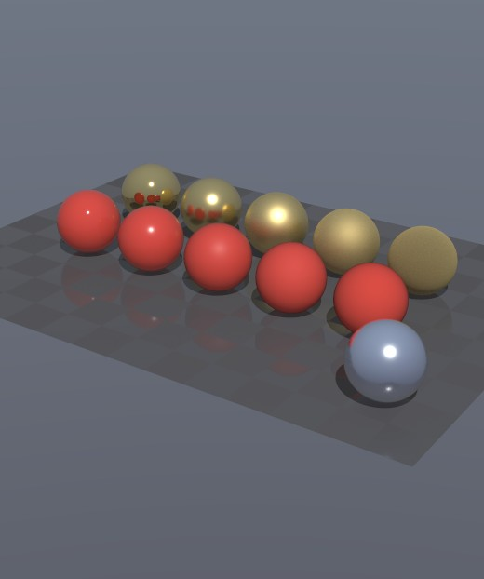
UsdOptixViewer
How the code works: from a USD stage to ray-traced pixels, and on to a headset
VizTools · ginebra · October 2026
Notes:
A walkthrough of the UsdOptixViewer source code, in the order the data flows: loading the USD stage, ray tracing it with OptiX, the desktop application, and the XR output of the cloudxr branch.

Slide 2
The program at a glance
17
4,400
5
143
source files
C++, CUDA and CMake
lines of code
plus stb_image
libraries
OpenUSD, EnTT, OptiX, SDL3 + ImGui, OpenXR
book pages
every line explained
What it does
Opens .usd/.usda/.usdc/.usdz stages, shows the prim tree and every property
Ray traces the geometry with UsdPreviewSurface materials, textures, shadows and glossy reflections
Looks through USD cameras; on the cloudxr branch, streams stereo to a headset through CloudXR
Notes:
Counts are for the cloudxr branch. main has 13 files: it lacks XrOutput and CloudXrService. The literate book in LiterateP/ contains every line of the code with prose.

Slide 3
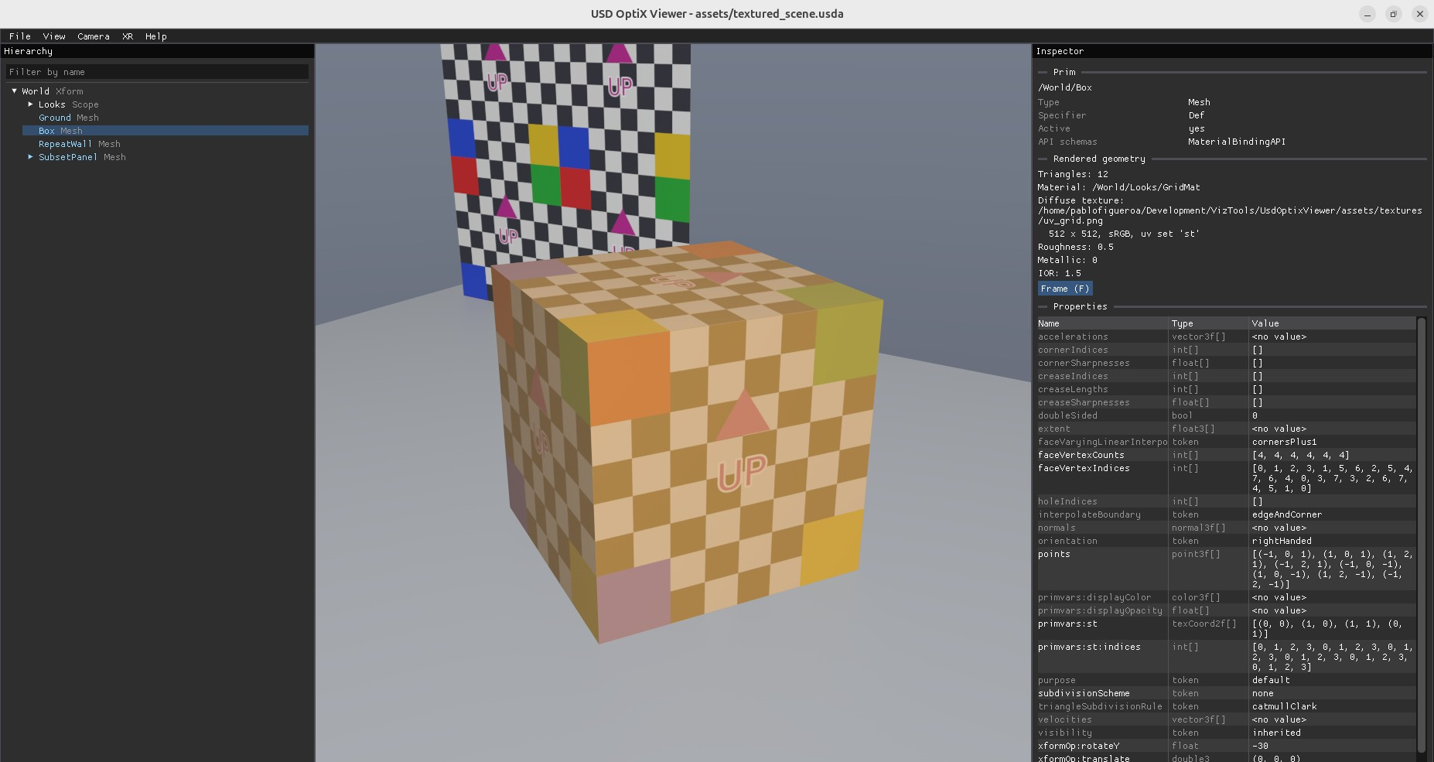
The viewer at work
1
Hierarchy
prims of the stage, filter by name
2
Viewport
OptiX image; click to pick
3
Inspector
prim, material, properties
4
Status bar
counts, camera, samples
Notes:
textured_scene.usda with --select /World/Box: the selected cube is highlighted, revealed in the tree and described in the inspector, with its texture, roughness and every USD attribute.

Slide 4
Architecture: data flows left to right
USD stage
OpenUSD
Scene
EnTT registry + FlatGeometry
OptixRenderer
GAS, SBT, launch
Device programs
devicePrograms.cu, on the GPU
App
SDL3 window, ImGui panels
pixels + mesh ids
XrOutput
OpenXR / CloudXR
LaunchParams.h is the one structure both CPU and GPU read
Notes:
Scene.* converts USD into an EnTT registry and flat world-space triangle arrays. OptixRenderer.* uploads them and launches the OptiX programs in devicePrograms.cu. App.* owns the window, the panels and the camera. XrOutput (cloudxr branch) sends eye images to an OpenXR runtime.

Slide 5
Loading the scene
1
Scene.h / Scene.cpp: USD stage → EnTT registry → world-space triangles

Slide 6
One entity per prim
PrimInfo
path, name, type name
A
Why a registry
The tree panel walks Hierarchy; the inspector reads the prim back by PrimInfo::path
Only drawn prims get MeshGeometry, so "is it rendered?" is one lookup
Picking maps a mesh id back to its entity
Instance proxies are included, so instanced models appear in full
Hierarchy
parent and children entities
B
MeshGeometry
triangle range, material, mesh id
C
CameraView
index into Scene::cameras()
D
Notes:
createEntities walks the stage with UsdTraverseInstanceProxies and creates one entity per prim. Components are added by later passes: extractGeometry adds MeshGeometry, extractCameras adds CameraView.

Slide 7
Flattening the geometry
1
Triangulate
2
Orient
3
Shade
4
Transform
Mesh faces fan-split; Cube and Sphere generated
leftHanded meshes rewound, so e1 × e2 is the outward normal
authored normals, smooth for subdivision, flat for "none"
UsdGeomXformCache to world space, bounds grown
struct FlatGeometry { // one soup, ready for one GAS
vertices, indices; // shared positions
triMesh, triMaterial; // per triangle
triUVs (6), triNormals (9); // per triangle corner
materials, textures, meshEntity, bounds;
};
Notes:
Everything the GPU needs per hit is indexed by the triangle index OptiX reports, so all the attribute arrays are per triangle. A zero shading normal means flat shading.

Slide 8
Materials and textures
M
UsdPreviewSurface subset
T
Textures
diffuseColor: constant or texture × scale + bias
normal: tangent-space map, frame from positions and st
roughness, metallic, ior: constants or any texture channel
useSpecularWorkflow with specularColor
opacity + opacityThreshold: alpha cutouts
GeomSubsets give faces their own material
Read through ArResolver, so files inside .usdz work
Decoded with stb_image, cached by path and settings
CPU-built mip chain, averaged in linear space for sRGB
Uploaded as mipmapped CUDA arrays with trilinear, 8× anisotropic filtering
Unsupported inputs become inspector warnings
Notes:
materialFor follows UsdShade connections through node graphs to the UsdPreviewSurface inputs. scalarInput handles packed maps: one texture channel per input, each with its own scale and bias.

Slide 9
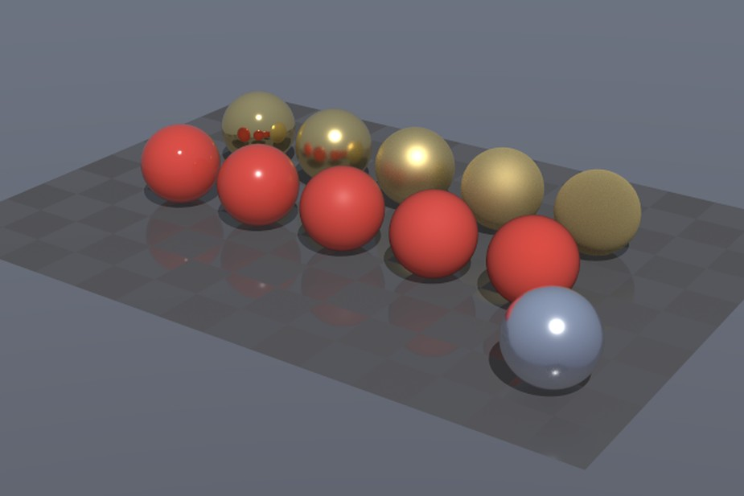
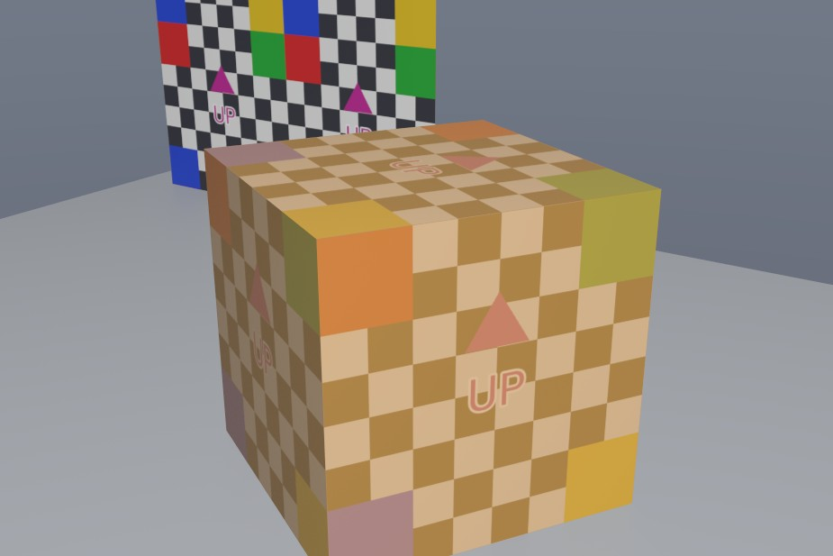
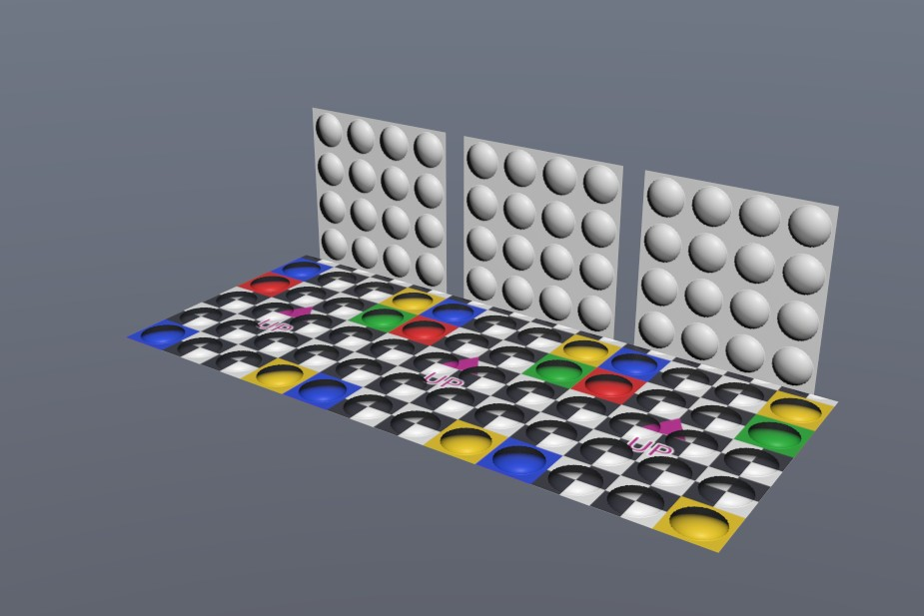
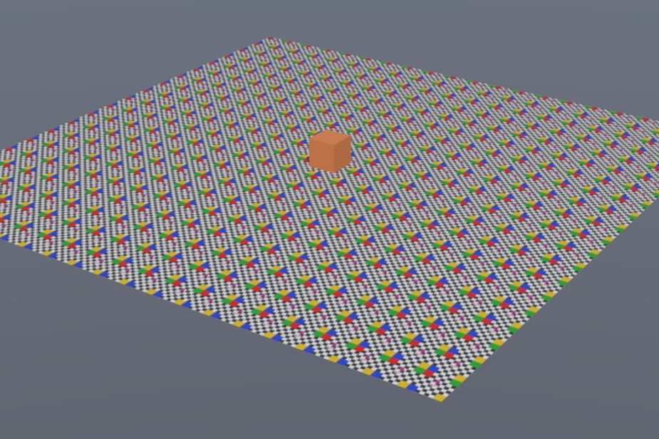
What the renderer draws
Roughness and metallic
gold and plastic chart, GGX reflections
Textures
UV grids; every "UP" arrow points up
Normal maps
every bump lit on its upper right
Mipmaps
a far floor without moiré
Notes:
The four material test scenes in UsdOptixViewer/assets, each after 256 accumulated samples.

Slide 10
Ray tracing with OptiX
2
OptixRenderer.* on the host, devicePrograms.cu on the GPU

Slide 11
The renderer on the host
1
CUDA primary context
setGeometry(FlatGeometry)
2
OptiX device context
Uploads the arrays and textures
Builds one compacted GAS over all triangles
3
Module from embedded PTX
render()
4
Program groups → pipeline
Uploads LaunchParams, calls optixLaunch
Copies colors back; mesh ids too on frame 0
frameIndex counts samples; resetAccumulation() sets it to 0
5
Shader binding table
Notes:
init runs once (or again on another GPU in the cloudxr branch, through release()). The PTX is compiled by nvcc at build time and embedded with cmake/EmbedFile.cmake, so the binary is self-contained.

Slide 12
LaunchParams: the CPU–GPU contract
struct LaunchParams {
uchar4* colorBuffer; // average
float4* accumBuffer; // running sums
unsigned* meshIdBuffer;// for picking
unsigned width, height, frameIndex;
Camera camera; // eye, u, v, w,
// ortho, clipping
float3 lightDir;
unsigned shadows, mipmaps, ...;
OptixTraversableHandle handle;
const float3* vertices; ...
};
Rules
One header, compiled by g++ and nvcc
Change both sides together
The camera has no trigonometry on the GPU: ray = w + x·u + y·v
Orthographic: shift the origin instead
Notes:
Camera::w is unit length for desktop cameras. XR eyes use an off-centre w for asymmetric frusta, which is why they use no clipping range.

Slide 13
The device programs
1
raygen
2
closest-hit
Jittered sample per pixel; accumulates; writes mesh id on frame 0
Lambert + GGX, shadow ray, one VNDF glossy bounce, firefly clamp
3
any-hit
4
miss ×2
Alpha cutout: ignore hits below opacityThreshold
Radiance: gradient sky. Shadow: light is visible
Payload: rgb, mesh id, depth, rng seed · max trace depth 3 (camera → reflection → shadow)
Notes:
sampleTexture picks the mip level from ray differentials: rays through neighbouring pixels are intersected with the triangle's plane and turned into st gradients for tex2DGrad.

Slide 14
Progressive rendering
How the app drives it
Any change sets m_needsRender
updateCamera() + resetAccumulation()
One sample per frame until 256
Frame 0 hits pixel centres, so picking is exact
Notes:
The accumulation buffer holds float sums; the displayed color is the average with an approximate sRGB (square root) encoding. Antialiasing comes for free from the jitter.

Slide 15
The application
3
App.h / App.cpp: SDL3, Dear ImGui, cameras and picking

Slide 16
One turn of the main loop
Events
SDL events, drops
Open
pending file, loaded off the dialog thread
XR
headset frame (cloudxr branch)
UI
menus and four panels
Present
SDL_Renderer, vsync
Panels
Immediate mode
Hierarchy: tree with name filter
Inspector: prim, camera, material, properties
Viewport: image, mouse, picking
Status bar: counts, camera, samples, XR
No widget objects: drawUi() describes the whole UI each frame
State lives in plain App members
Tests drive the UI from command-line flags, not the mouse
Notes:
Synthetic X input does not reach SDL on this machine, which is why --select and --camera exist: they let scripted screenshots test selection and cameras.

Slide 17
Two kinds of camera
O
Orbit camera
U
USD cameras
Target, distance, yaw, pitch
Follows the stage's up axis (Y or Z)
Left drag orbits, right/middle pans, wheel zooms
Framing: d = r / sin(φ/2) + 15%
GfCamera → GfFrustum at the start time
Perspective or orthographic, clipping range as depth along w
Film back fitted inside the viewport (usdview's "fit")
Moving the view hands off to the orbit camera without a jump
Test scene: assets/camera_test.usda has five cameras: Front, Telephoto, orthographic Top, Clipped and a scaled Rig/Side
Notes:
Camera menu, the inspector's Look through button, or --camera. orbitFromUsdCamera inverts the orbit formulas so the first drag continues from the USD camera's pose. assets/camera_test.usda has five test cameras.

Slide 18
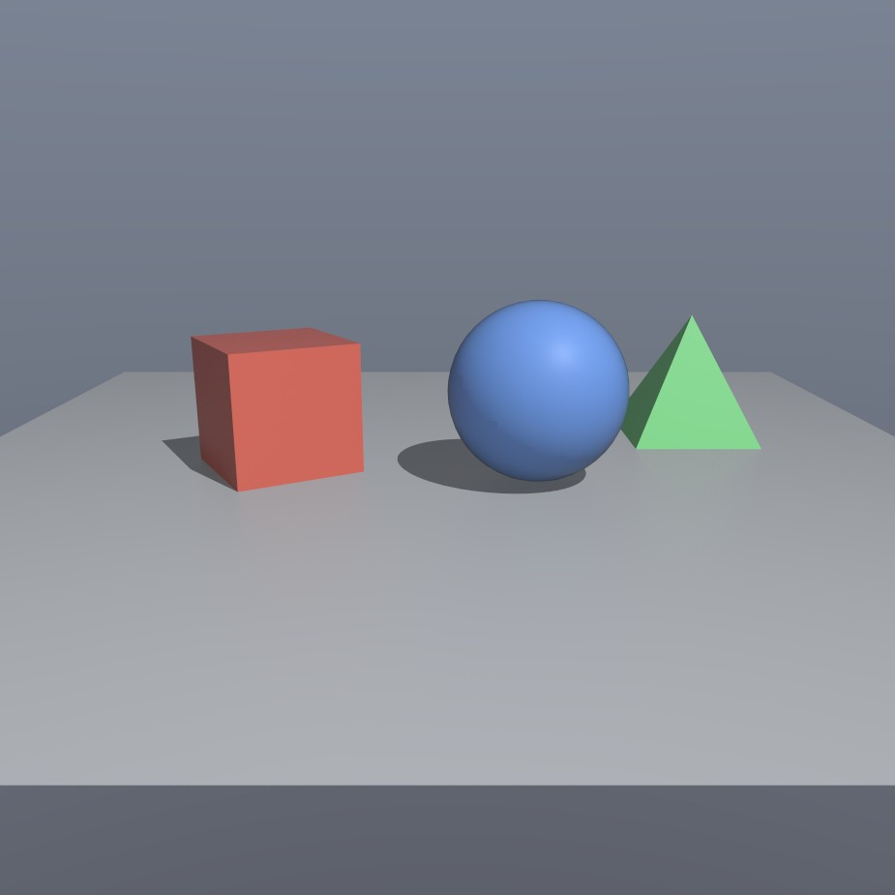
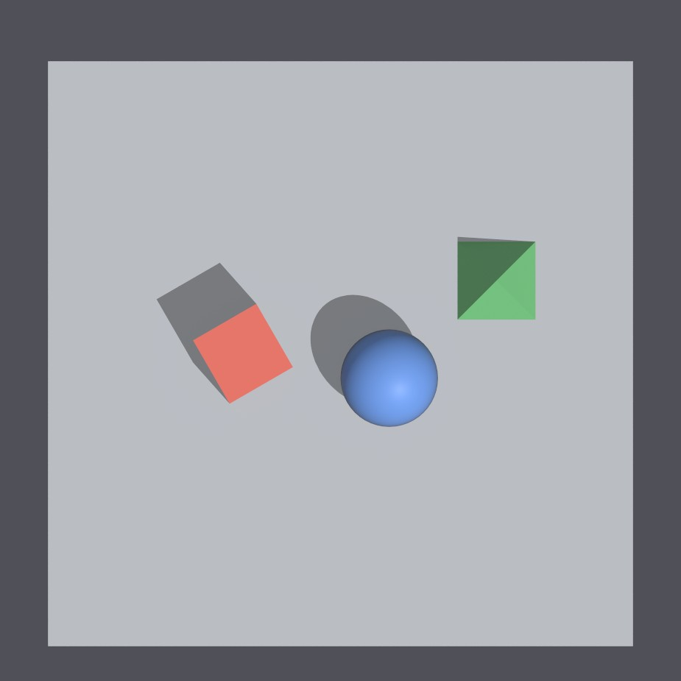
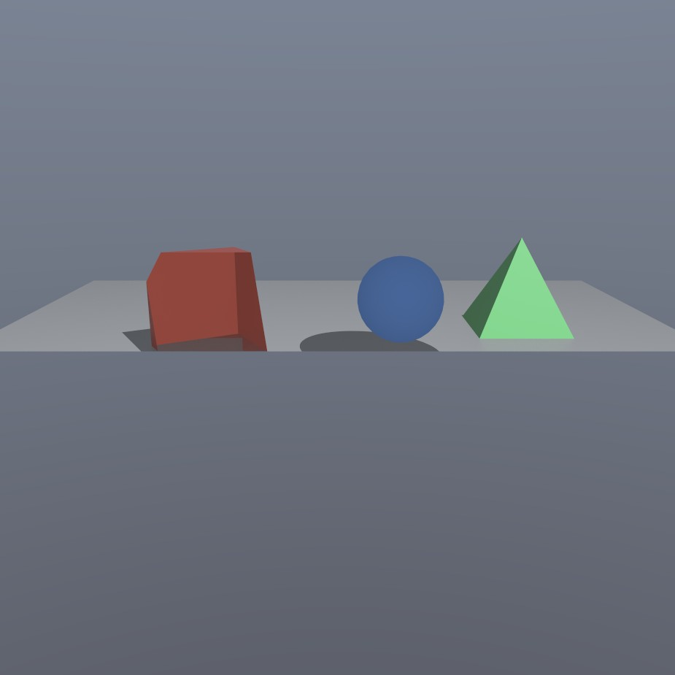
Looking through USD cameras
Front
perspective, 35 mm lens
Top
orthographic, 14 × 14 units
Clipped
near plane at 10.4 cuts the scene
Notes:
assets/camera_test.usda, started with --camera /World/Cameras/<name>. The window is fitted inside the square viewport, so the 3:2 film back shows extra scene above and below.

Slide 19
XR output
4
cloudxr branch: XrOutput.* and CloudXrService.*

Slide 20
From OptiX to the headset
OptiX
renderView()
Shared buffer
Vulkan memory, CUDA view
Swapchain
copy on Vulkan queue
CloudXR
OpenXR runtime
Headset
Vision Pro, Quest
2 × 2400×1920
2.8 ms
0
eye images (Vision Pro profile)
per frame, both eyes, 1 sample
copies through main memory
Memory is exported from Vulkan as an opaque fd and imported with cudaImportExternalMemory, so CUDA and the runtime must share one GPU (matched by UUID).
Notes:
The CloudXR runtime accepts only Vulkan apps (XR_KHR_vulkan_enable2). The runtime creates the Vulkan instance and device; Vulkan itself is dlopened, so no Vulkan SDK is needed to build.

Slide 21
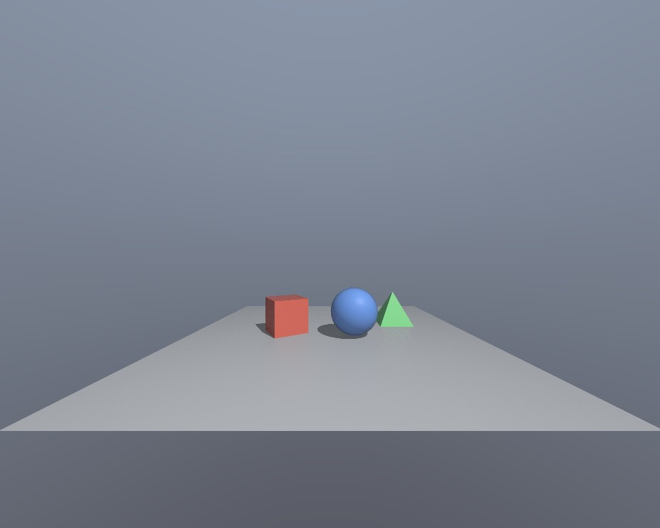
The headset view on the desktop
--xr-mirror
The left eye, copied back from the shared buffer
CloudXR 6.2.1 in-process, Vision Pro profile, no headset attached
Head placed at the Front camera's eye, (0, 3, 10)
4 samples per pixel: 4.8 ms per frame for both eyes
Notes:
The eyes have a field of view of about 112 × 100 degrees, which is why the scene looks small in the mirror: a headset shows the same image across most of the user's view.

Slide 22
The XR session, step by step
Off
Waiting
SystemReady
Idle
Running
What happens
Where the user stands
Waiting: xrGetSystem retried; auto profiles wait for a client
SystemReady: renderer moves to the runtime's GPU
Running: xrWaitFrame paces the loop; vsync off
XR origin at the desktop camera's eye, facing its horizontal direction
1 m of head motion = 1/metersPerUnit units × world scale
Asymmetric eye frusta: w aims at the window centre
Notes:
--cloudxr starts the CloudXR service in-process (CloudXrService dlopens libcloudxr.so and restores SDL's signal handlers); --xr uses a runtime already running, e.g. from Isaac Teleop. CLOUDXR.md lists every difference from main.

Slide 23
Build, test and document
B
Build
T
Test
D
Document
CMake 3.28, C++20
PTX embedded
OpenXR fetched
No warnings
Six test scenes
xwd screenshots
usdchecker
CloudXR, no headset
LiterateP/ book
lp.py check
logbook.md
CLOUDXR.md
cmake -S UsdOptixViewer -B build && cmake --build build -j
./build/UsdOptixViewer assets/textured_scene.usda --select /World/Box
python3 LiterateP/lp.py check # must print ok for every file
Notes:
CLAUDE.md has the exact build, test and book commands. Every code change must also update the matching chunk in LiterateP/src and pass lp.py check.

Slide 24
Where to start reading
LaunchParams.h → Scene.cpp → devicePrograms.cu → App.cpp
Or read LiterateP/UsdOptixViewer-literate.pdf from the start: same code, with the reasons.
Notes:
The shared header shows what the GPU needs; Scene.cpp shows how USD becomes that; the device programs show how it becomes light; App.cpp ties it together.

