Slide 1
Presentation project ontwerpen
Pablo Jenné

Slide 2
Table of contents
Introduction
Schema
PCB layout
Components
Case
website

Slide 3
Introduction
- Idea
- What programs did i use
- Status
- How about next year

Slide 4
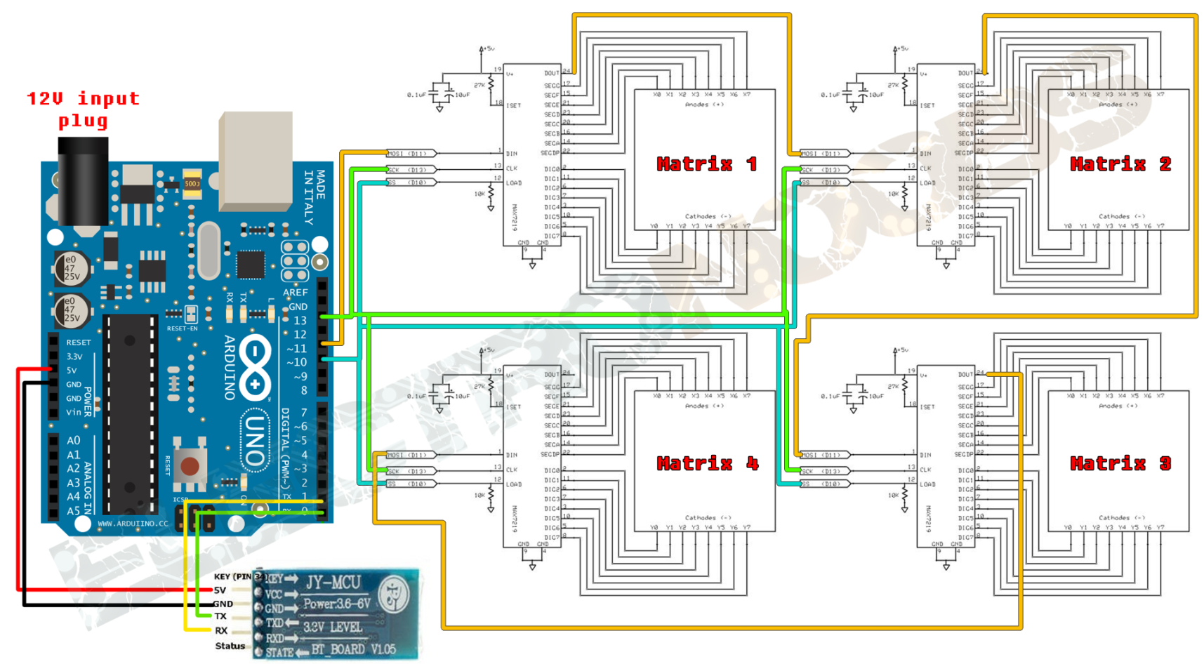
Schema
Elektor/internet

Slide 5
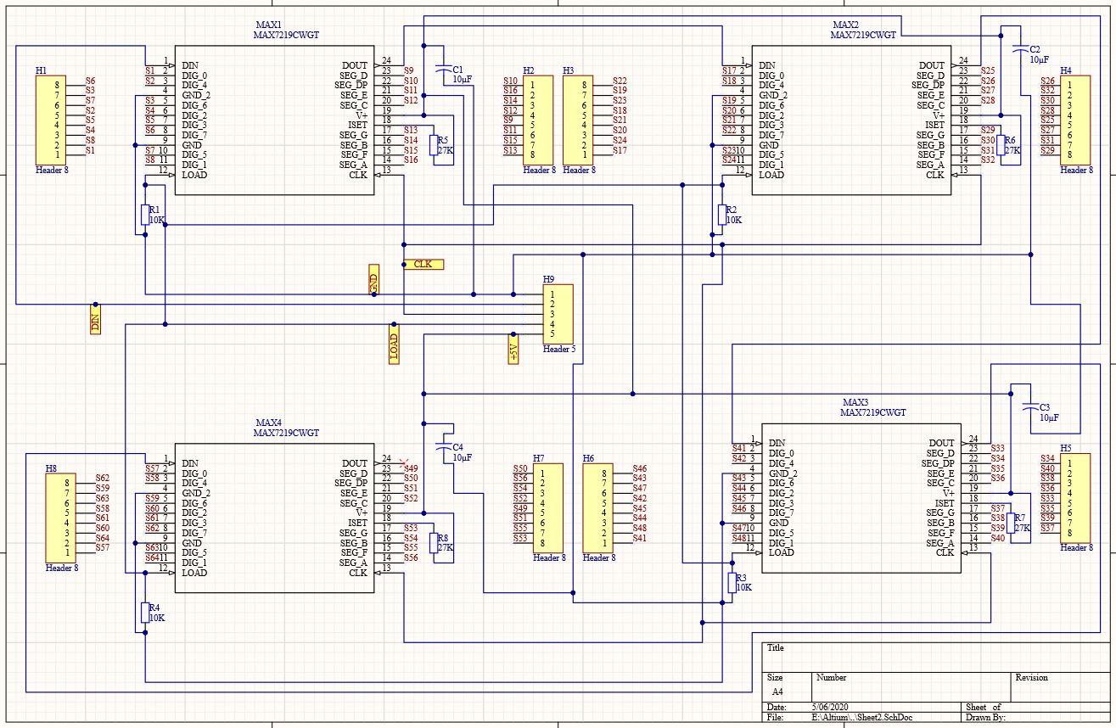
Schema
Altium designer

Slide 6
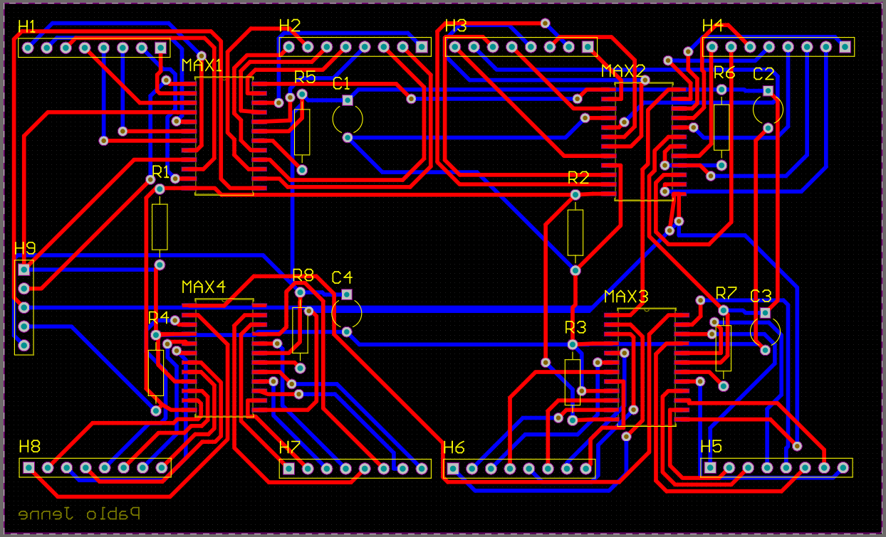
PCB layout

Slide 7
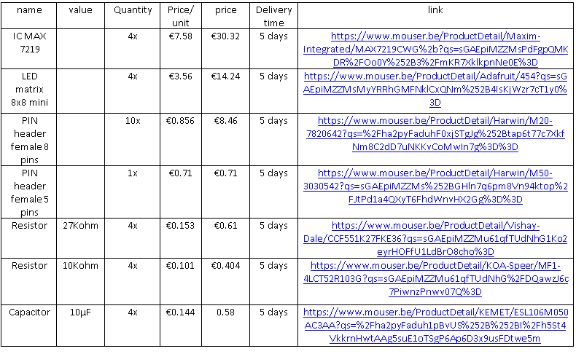
Components

Slide 8
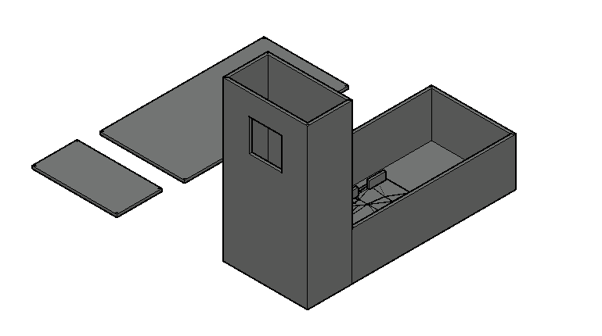
Case
L-shape
Width: 100mm
Height: 200mm
Length: 250mm
Wall: 3mm

Slide 9
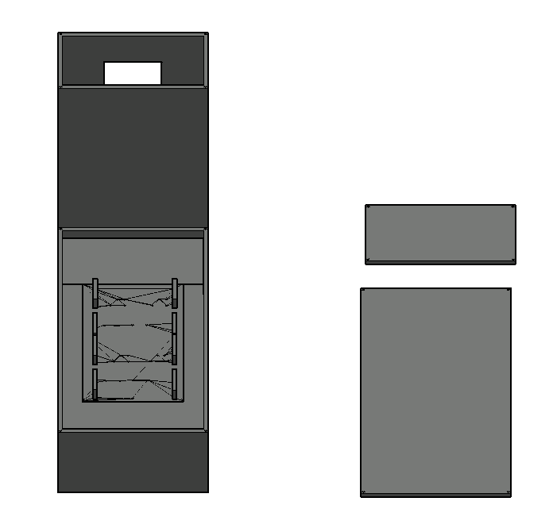
Case

Slide 10
Website
11901508.pxl-ea-ict.be
Sublime Tekst 3
HTML5 & CSS3

Slide 11
Thank you for you attention

