Slide 1
DATA-RELATED JOBS IN US
By Pablo Sánchez Mérida

Slide 2

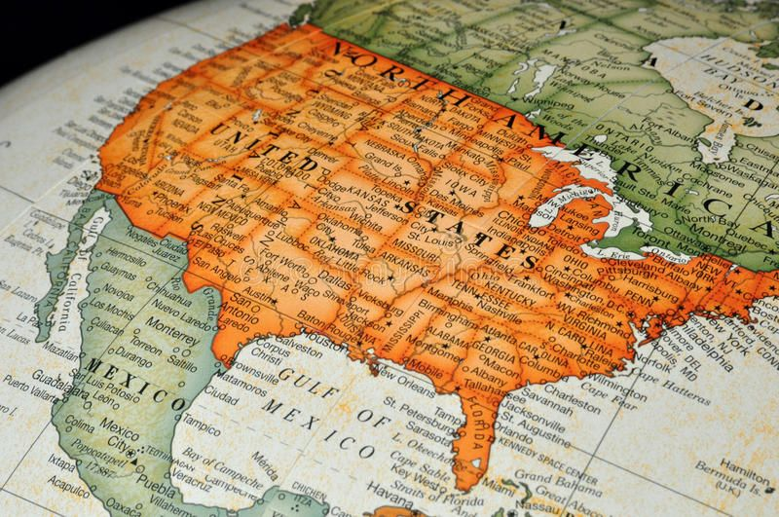
Context
Dataset on Kaggle after scraping US Glassdoor webpage.
Analysis over jobs related with data: Data Scientist, Data Analyst, Data Engineer and Machine Learning Engineer.
My goal: Improve data cleaning, some EDA, transformations and apply several models.

Slide 3
DATA CLEANING
Columns: company attributes, location, skills encoded, role and experience.
A lot of NaN values mostly cleaned manually and with KNN Imputer.
Eliminated the job positions that doesn't fit into the categories analyzed.
A lot of duplicates (from almost 2100 rows and to around 720 rows).
Cardinality reduced.

Slide 4
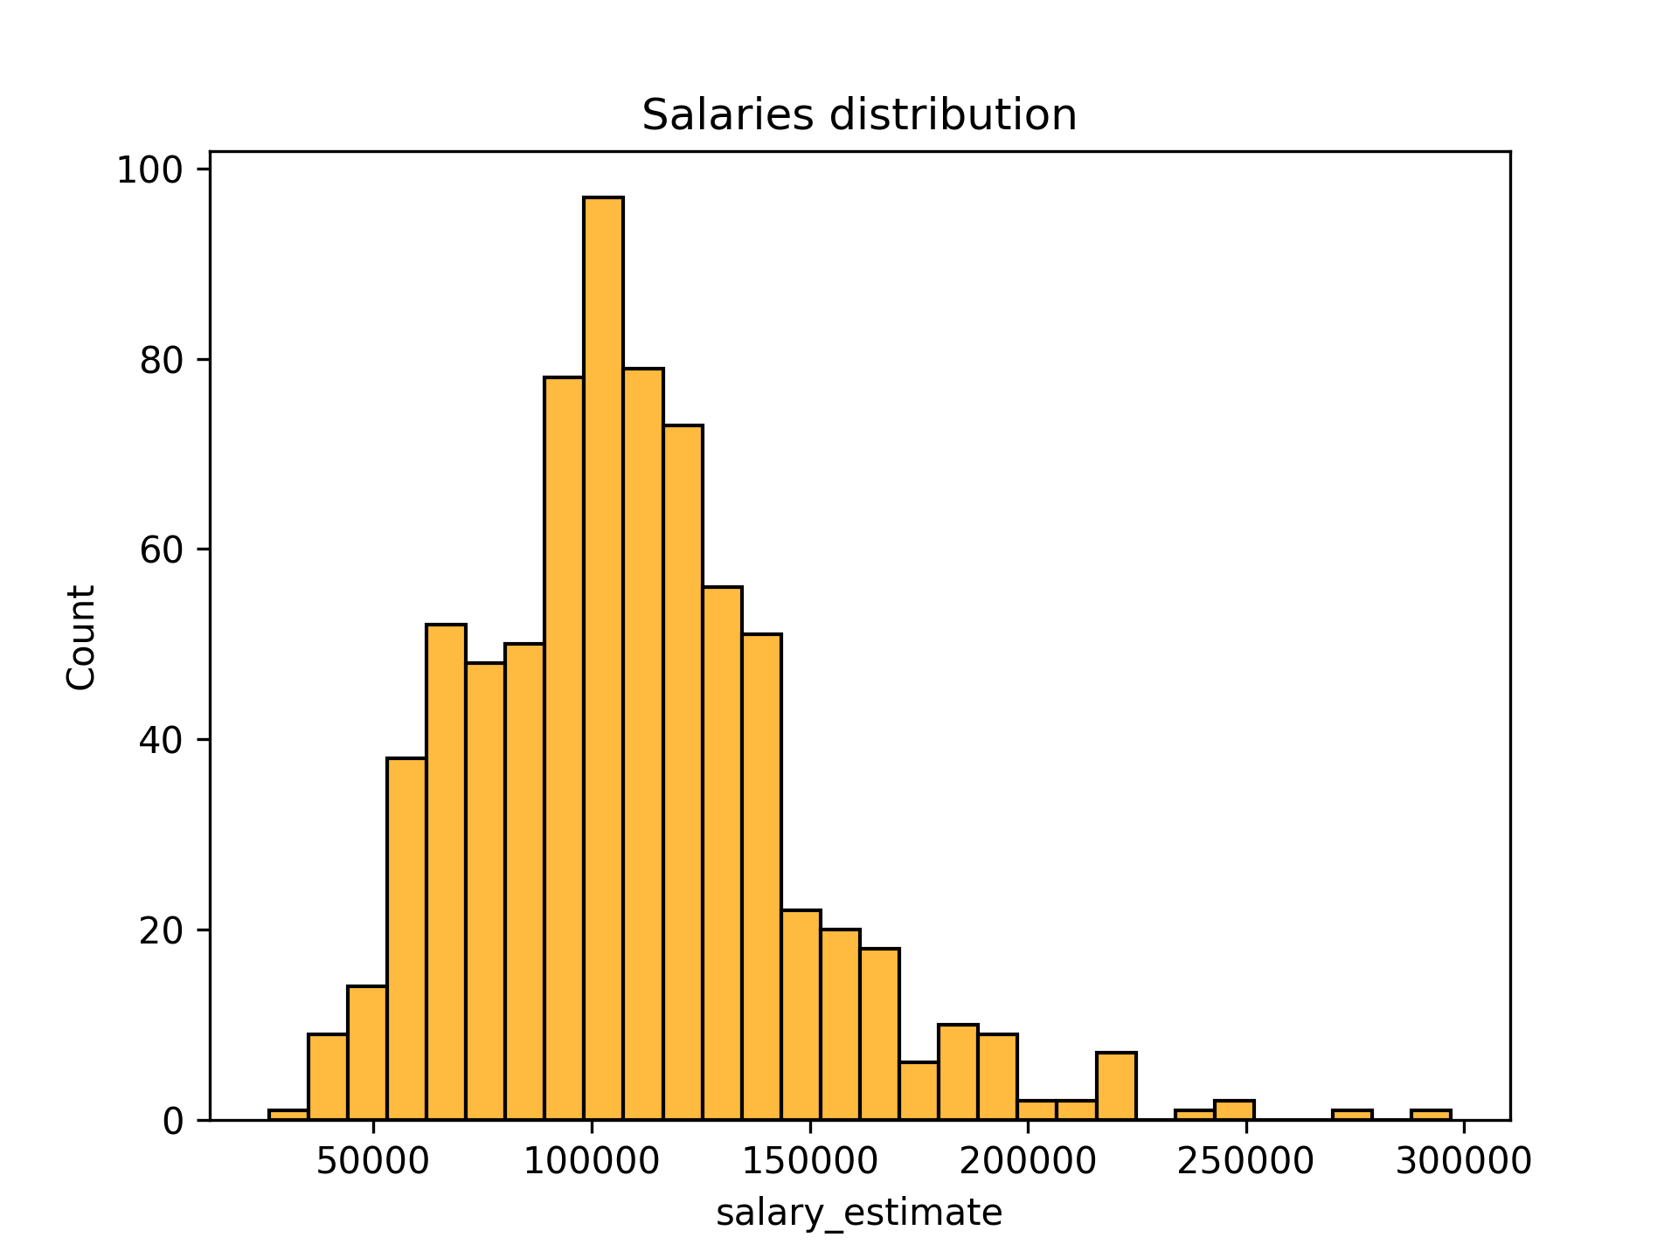
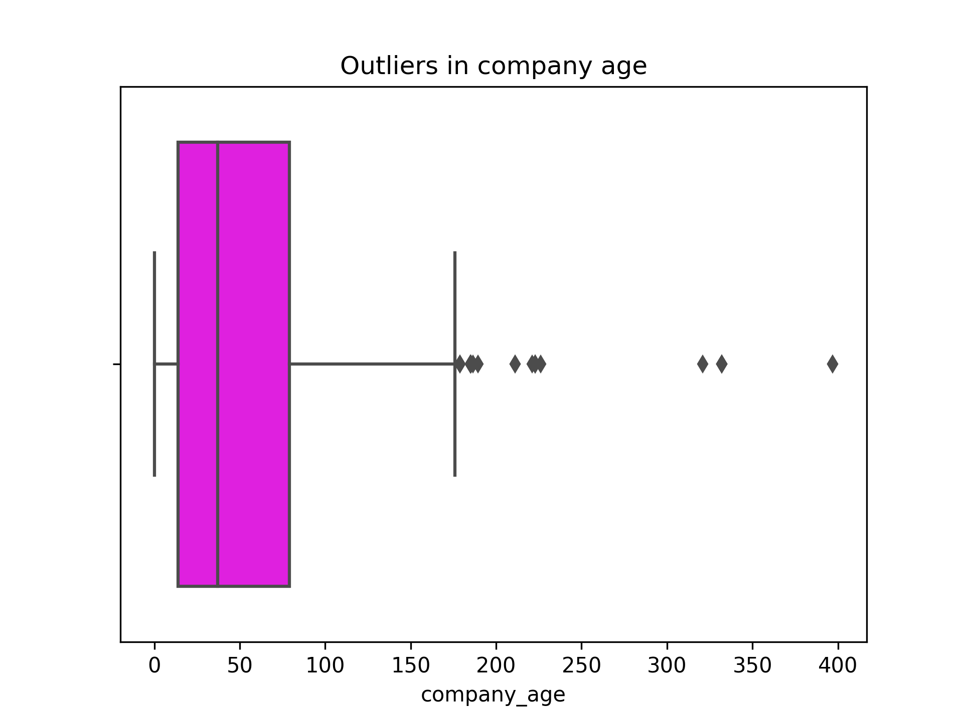
Exploratory data análisis (EDA)
Target column to predict
One of the few numerical columns

Slide 5
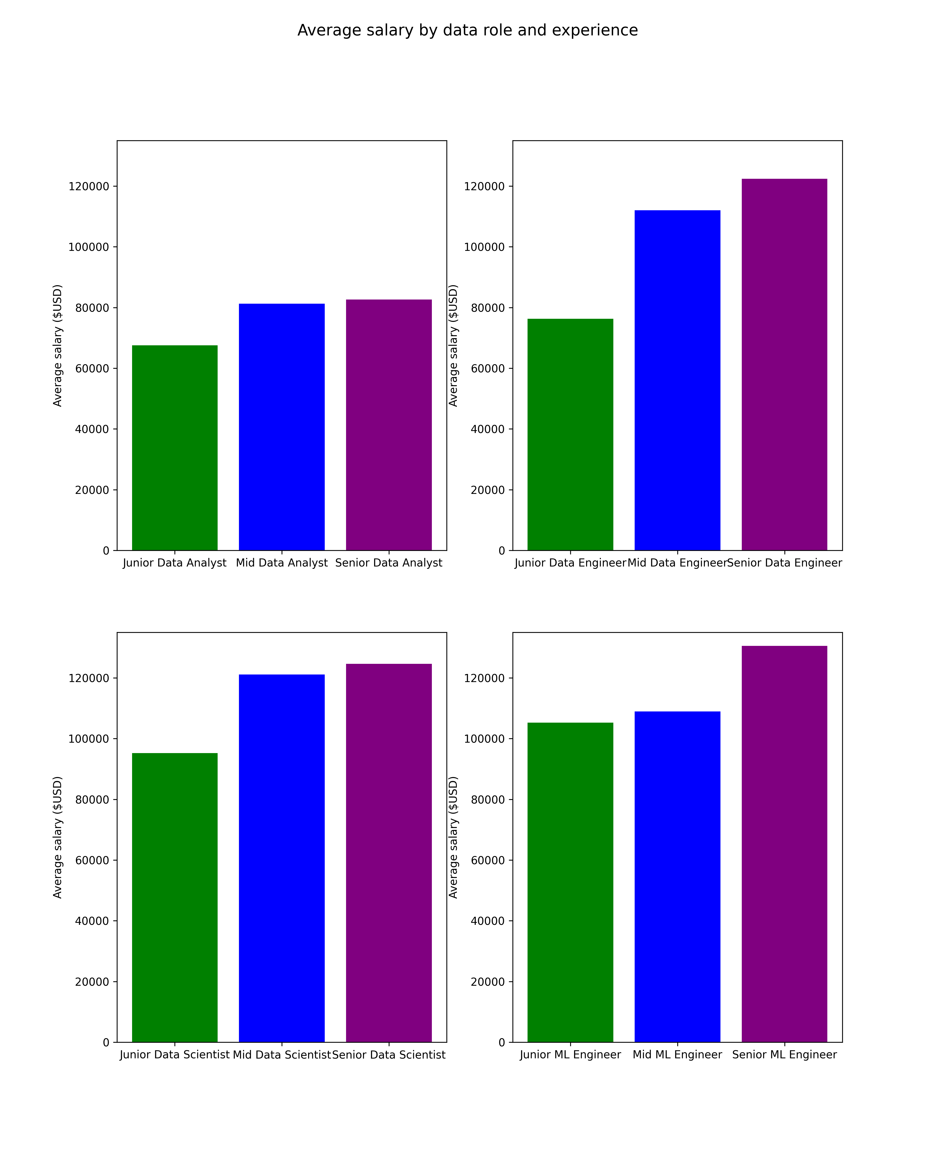

Slide 6
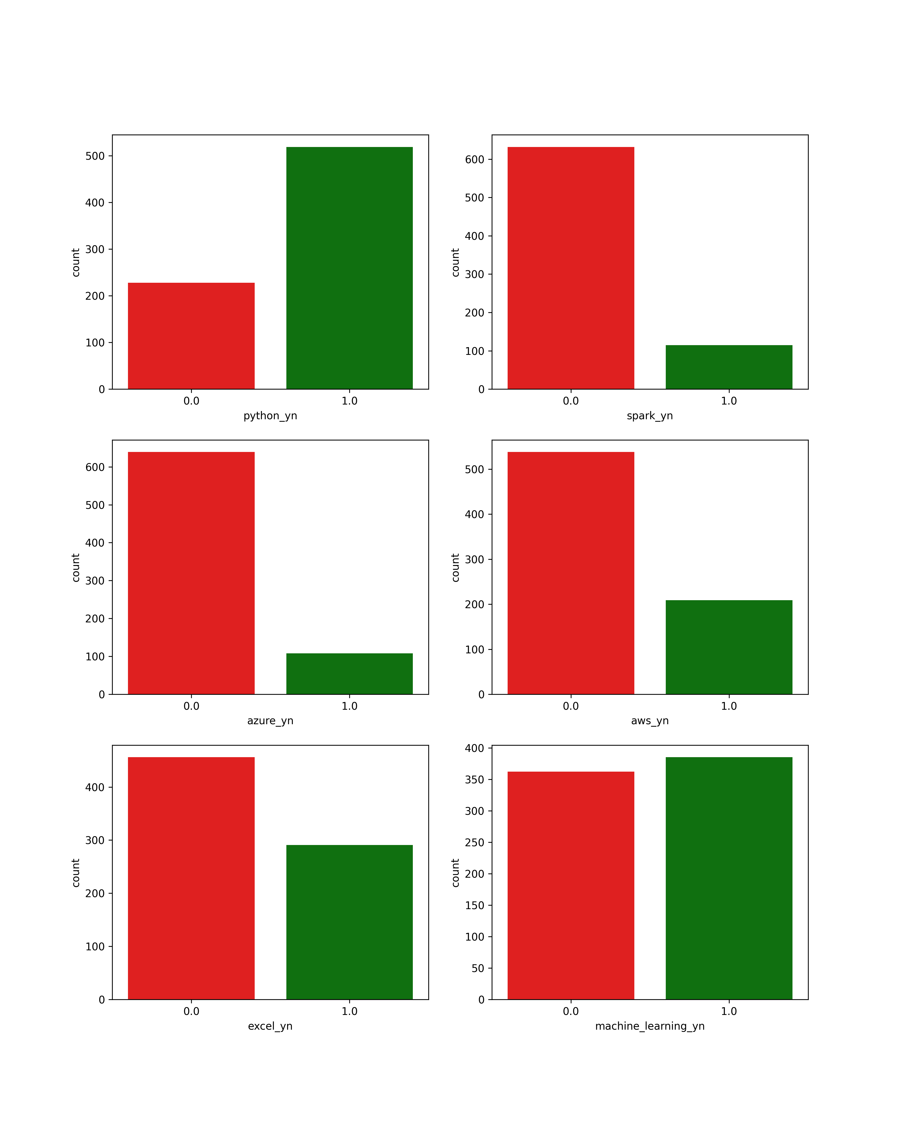
Skills encoded

Slide 7
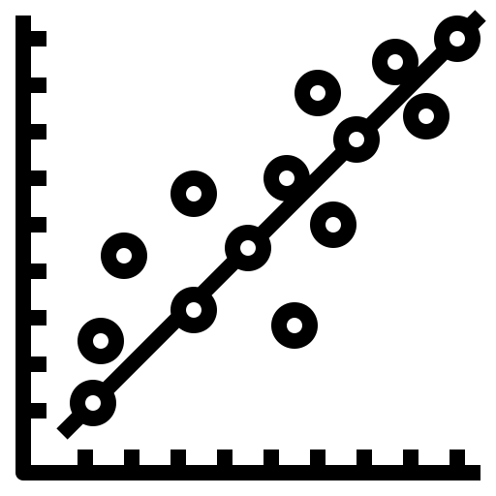



Transformations and models
Transformers: Outliers removed, power transformer, min max scaler, one hot encoder
Models:
Linear Regression
KNN with elbow method, Bayes and Grid Search
Random Forest with Bayes and Grid Search
Gradient Boosting with Bayes and Grid Search

Slide 8
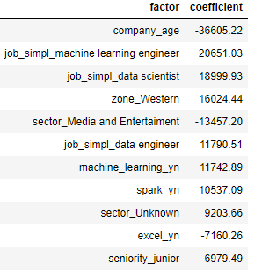
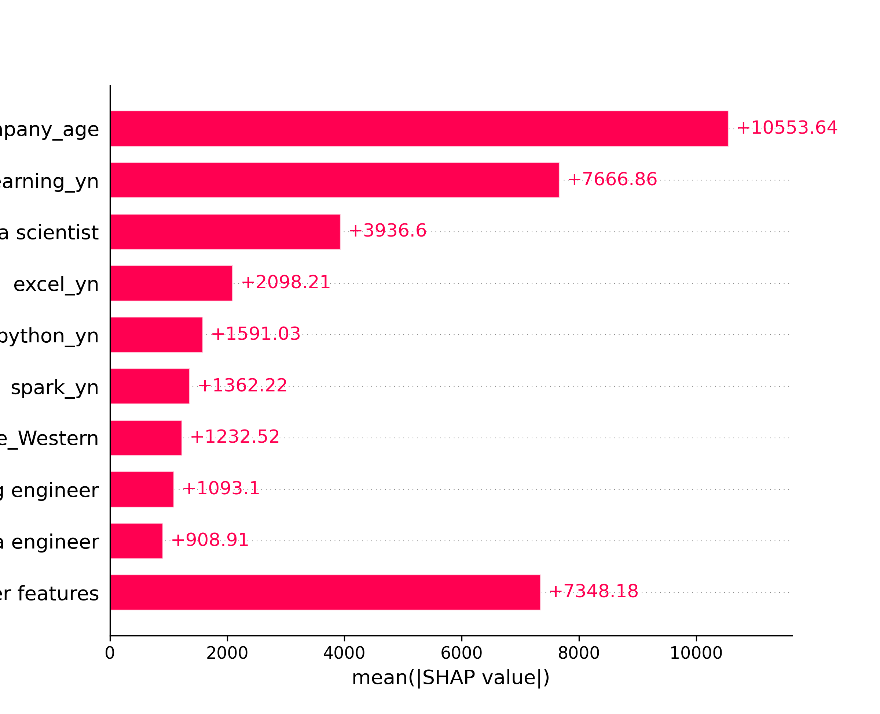
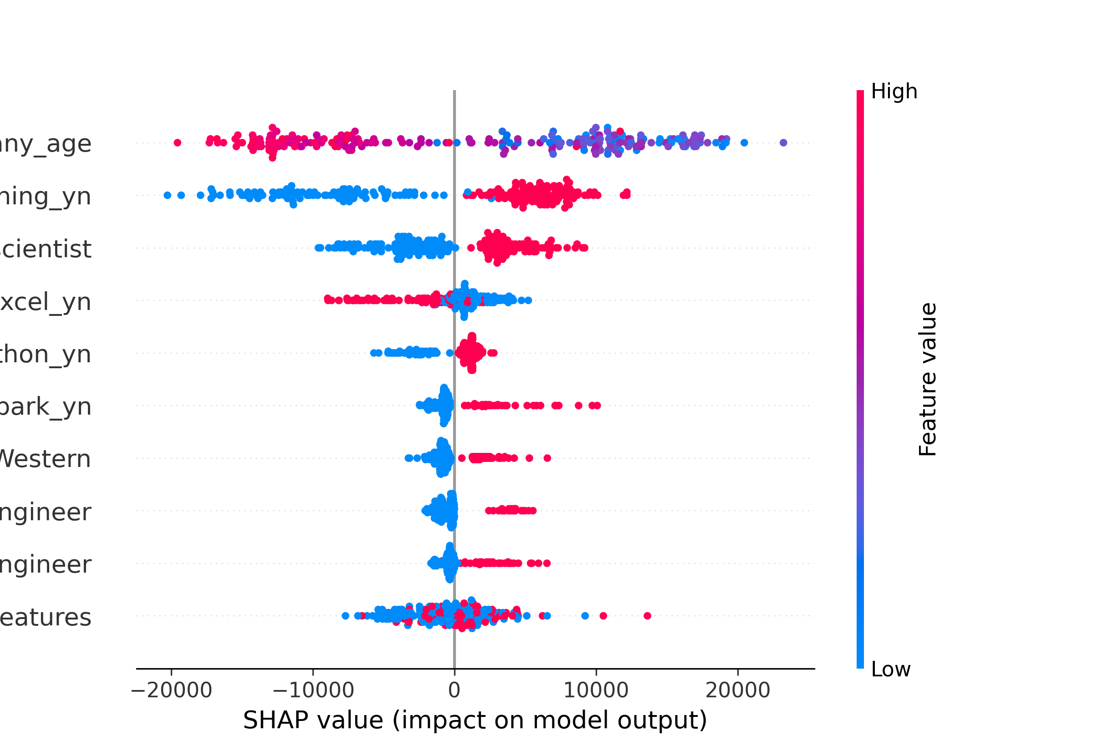
Model selected
Random Forest found with Grid Search CV:
Maximum dept = 10
Maximum features = auto
Minimun samples leaf = 2
Number of estimators = 150
R2 in the test set 0,17 and 0,80 in the train set

Slide 9
DATA CLEANING
Columns: company attributes, location, skills encoded, role and experience.
A lot of NaN values mostly cleaned manually and with KNN Imputer.
Eliminated the job positions that doesn't fit into the categories analyzed.
A lot of duplicates (from almost 2100 rows and to around 720 rows).
Cardinality reduced.

