Slide 1

Weekly recap:
17.11.2022 - 23.11.2022

Slide 2
3. Team-Meeting: Thursday 17.11.2022
Recap of supervisor meeting
Summary of all the things we worked out together

Slide 3
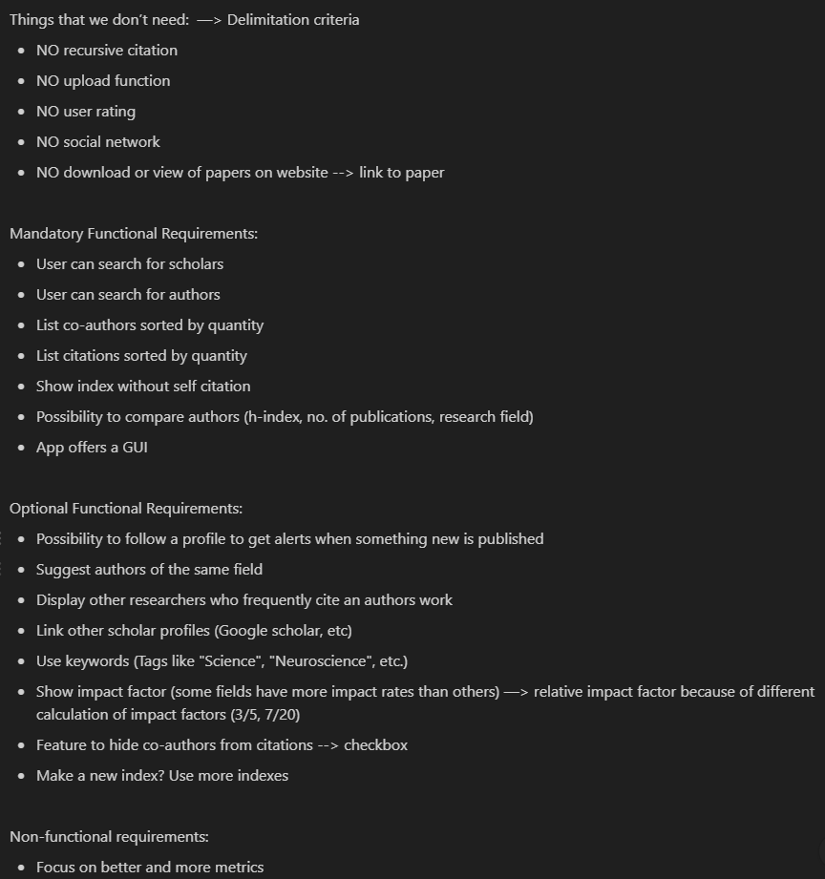

Slide 4
4. Team-Meeting: Sunday 20.11.2022
Database API → IEEE
Non-Functional requirements
Indices

Slide 5
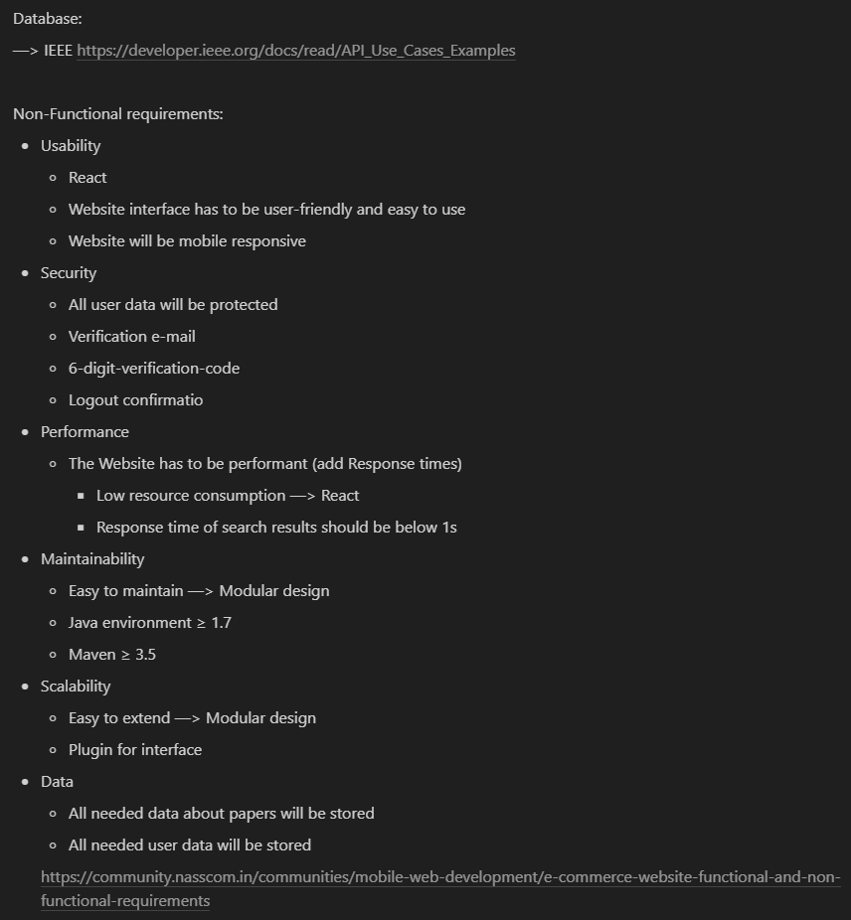

Slide 6
Questions:
One API enough? IEEEX
Cookies or accounts for suggestions/recommendations?
Server hosted locally?
Difference between General system functionalities/modules vs. functional requirements?

Slide 7
What is meant by softwaredata/structures?
Recommendations for databases?
Which browser do you use?

Slide 8
Which indices are the most important for you?
Which metrics are the most important, that you want to have in the comparison betweens authors?

